Slide 1


E-LECTRONIX.COM
PROJECT

Slide 2

OUR TEAM
Trần Vĩnh Phát
Vũ Hữu Tài
Trần Anh Tiến
Trần Ngọc Anh
Lê Viết Nguyên Sơn
Leader
Member 1
Member 2
Member 3
Member 4

Slide 3

CONTENT
01
ENTITY RELATIONSHIP DIAGRAM
02
OUR TEAM
03
STRATEGY
04
OUR SERVICES
05
EXPERIENCE
06
QUARTER
07
NEXT PROJECT

Slide 4
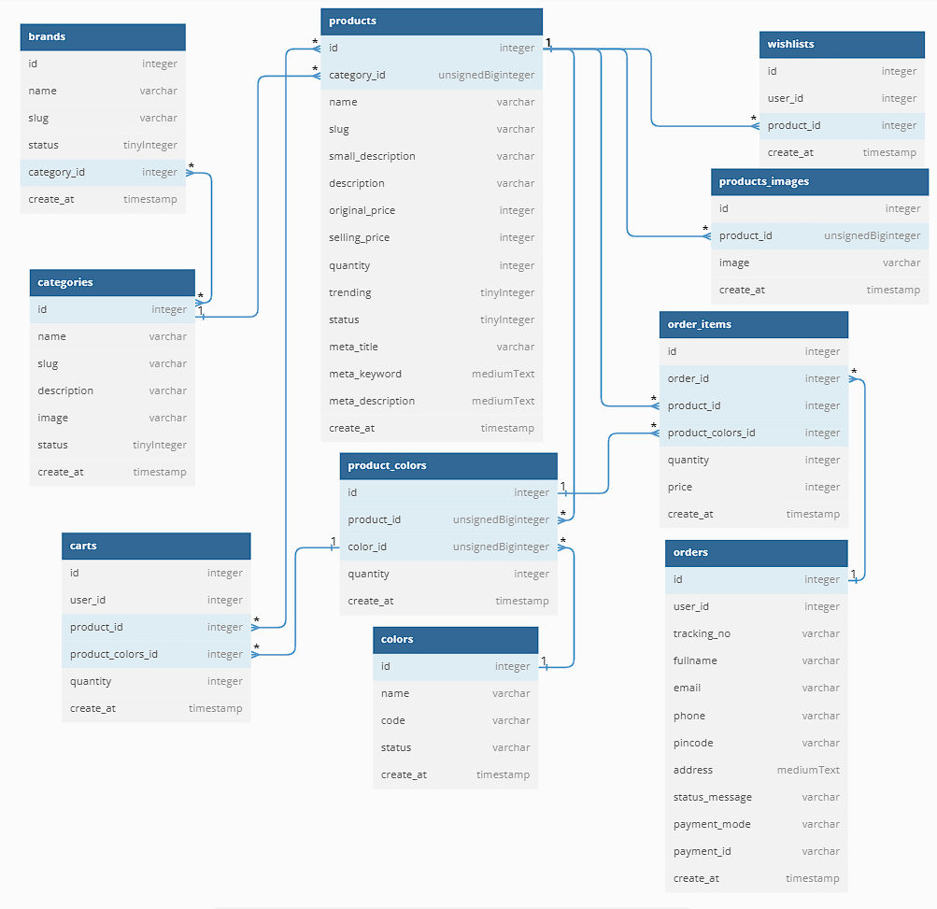
ENTITY RELATIONSHIP DIAGRAM

Slide 5

SYSTEM SPECIFICATION
Frontend
HTML,CSS,JQuerry 3.7.0, Javascript
PHP, MySQL
API Paypal + Momo(QR)
API Login Google + Twitter
Backend

Slide 6
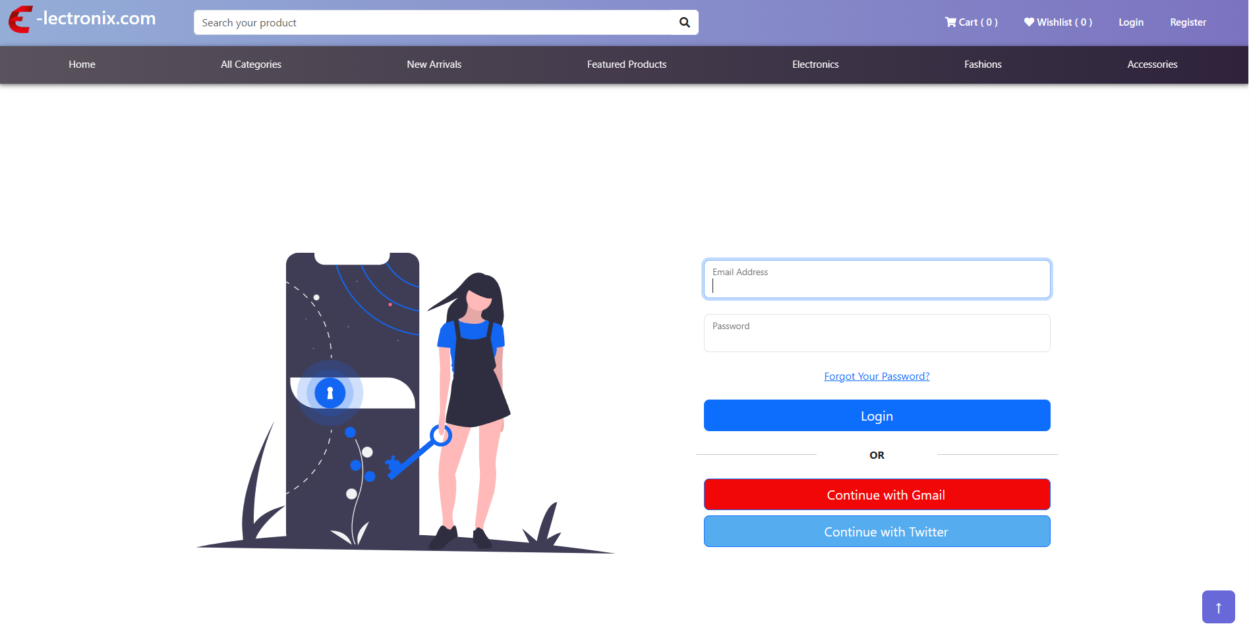
LOGIN PAGE

Slide 7
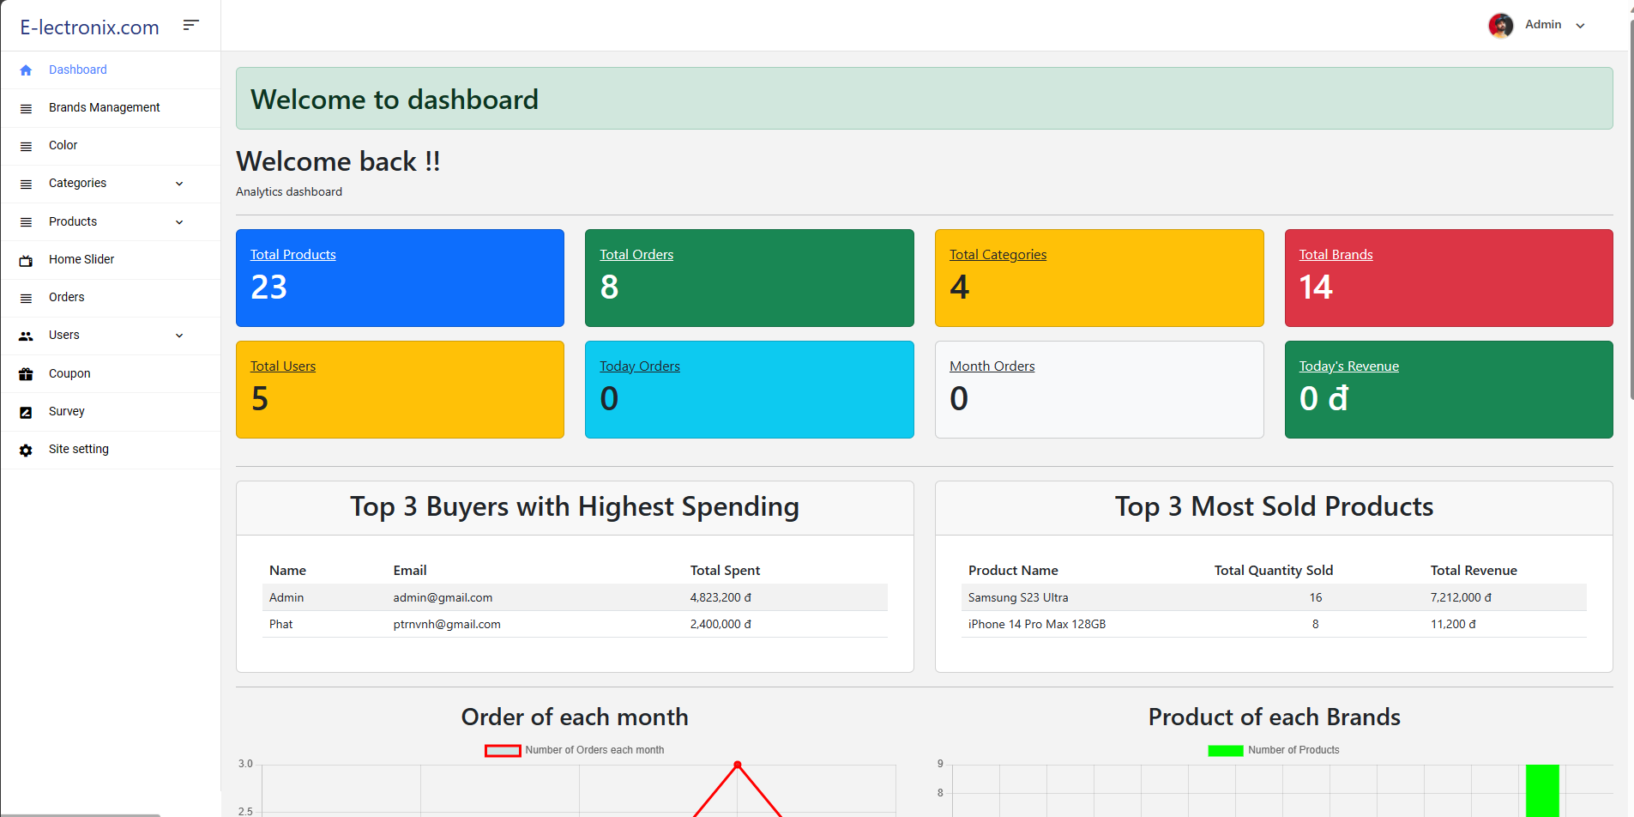


Slide 8
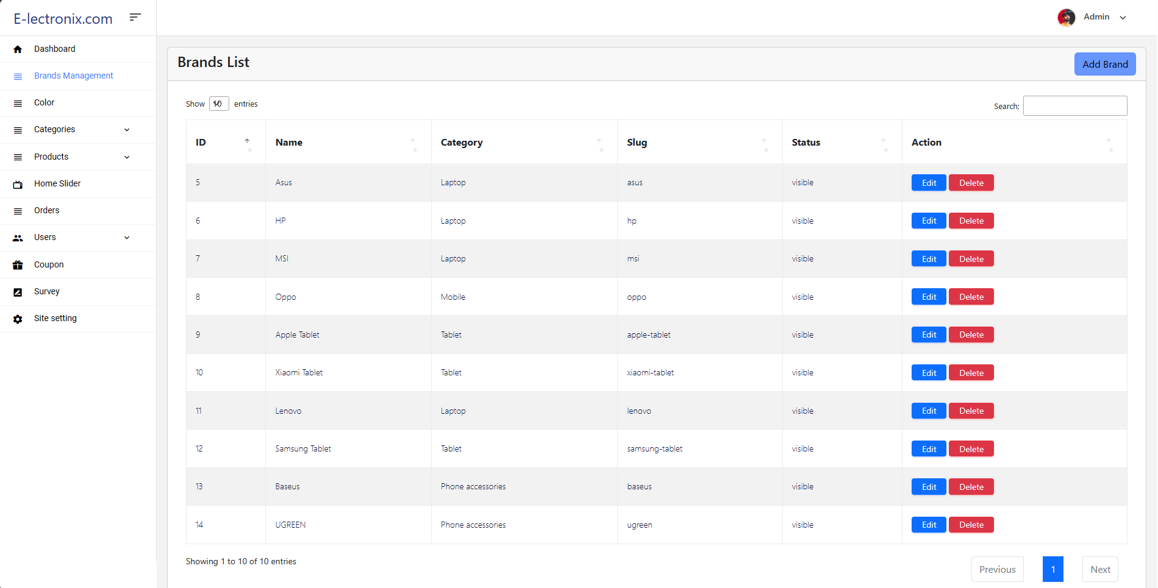
Brands Management Page
Admin can view, create, edit or delete Brands in here.
This page also has basic sort and search function.

Slide 9

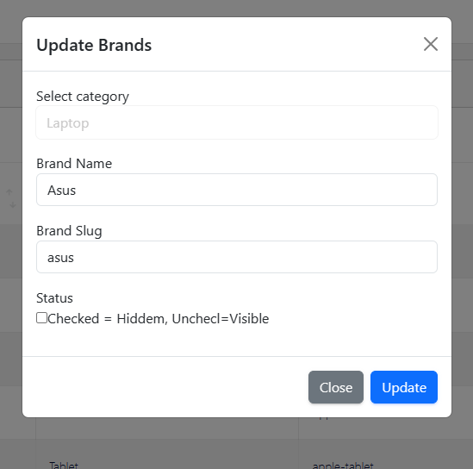
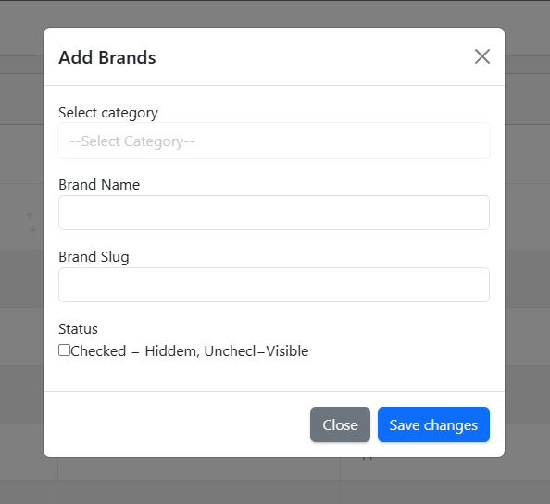
Brands Edit Page
Brands Create Page
Here is Edit Brand Modal appear when admin click Edit on Brands.
Here is Create Brand Modal appear when admin click Add Brand button.

Slide 10
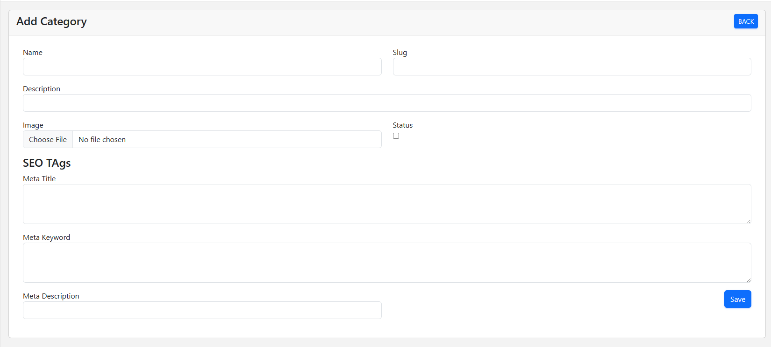
Category Create Page
Here is Create Category page appear when admin click Add Category link

Slide 11
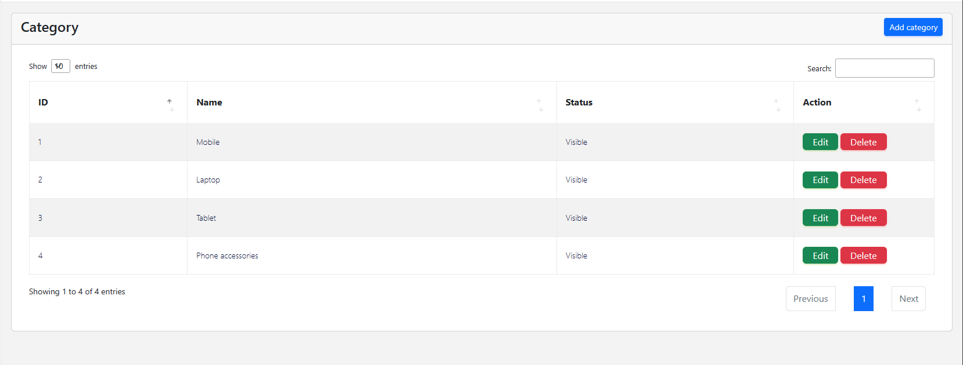
Category View Page
Here is View Category page appear when admin click Add Category link

Slide 12
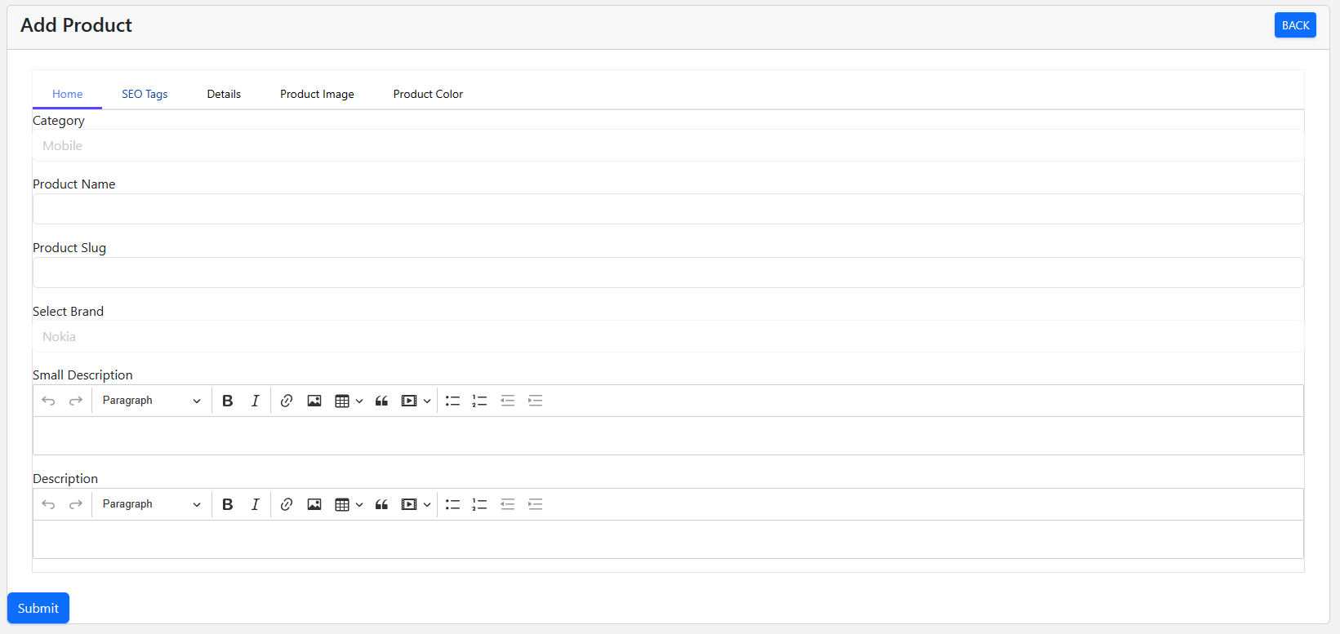
Product Create Page
Here is Create Product page appear when admin click Add Product link

Slide 13
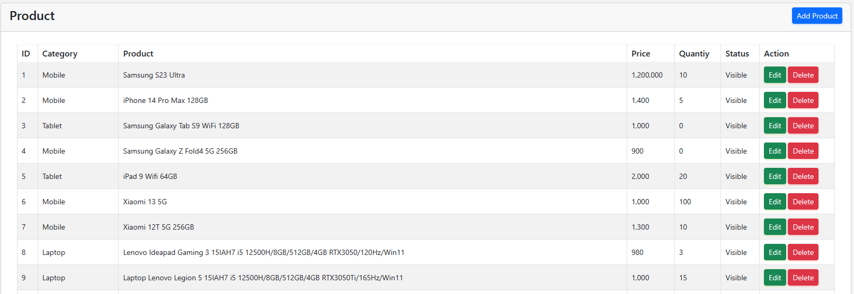
Product View Page
Here is View Product page appear when admin click View Product link

Slide 14
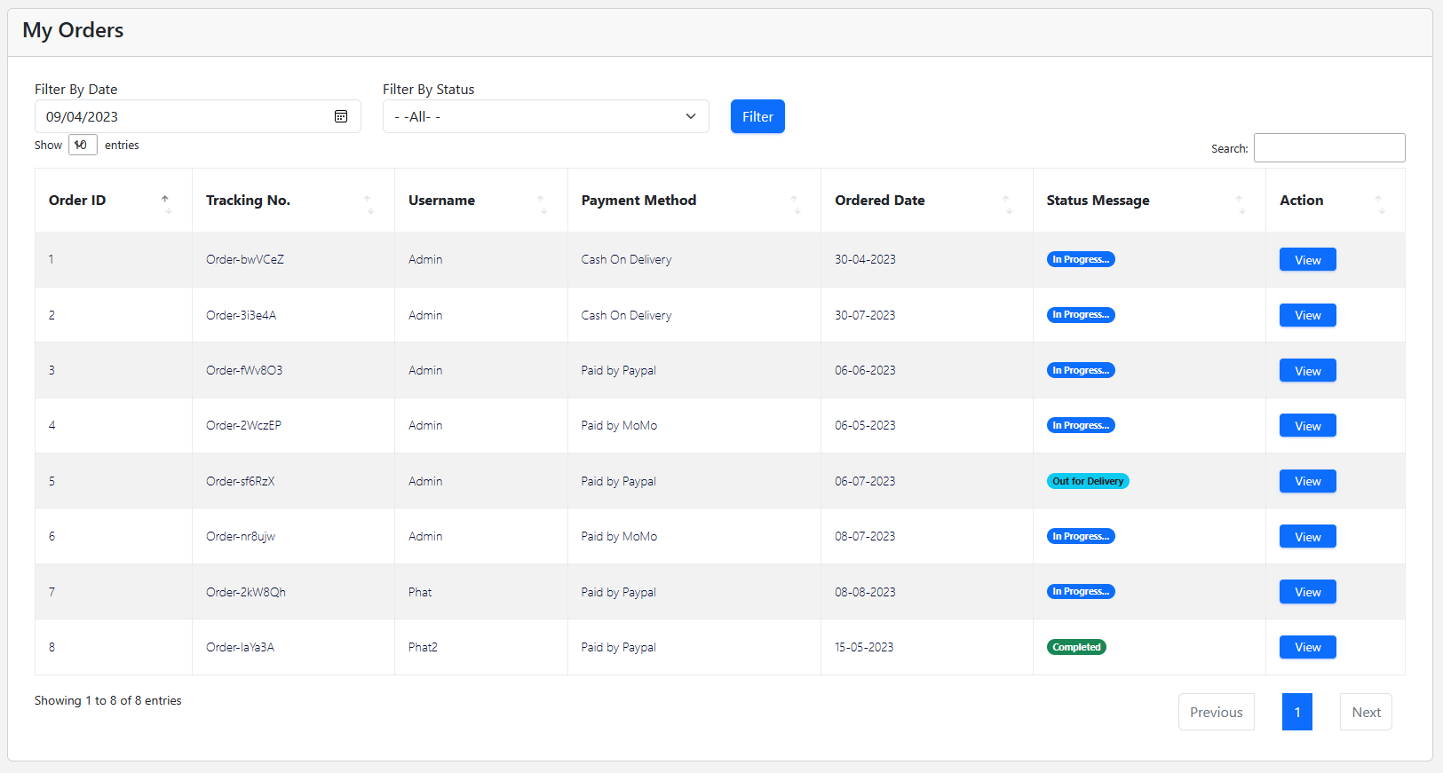
Orders View Page
Here is View Orders page appear when admin click Orders link

Slide 15

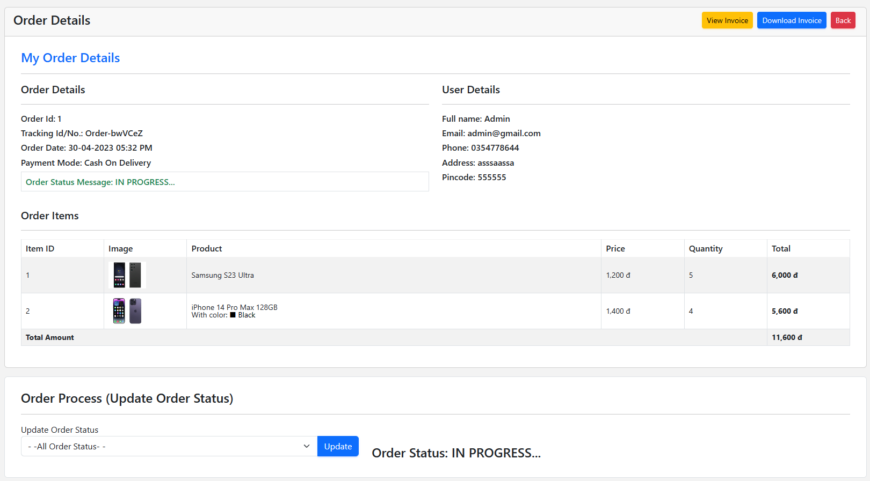
Invoice Details View Page
Here is View Invoice page appear when admin click View Invoice link on Orders details page.
Orders Details View Page
Here is View Order page appear when admin click View link on Orders page.

Slide 16
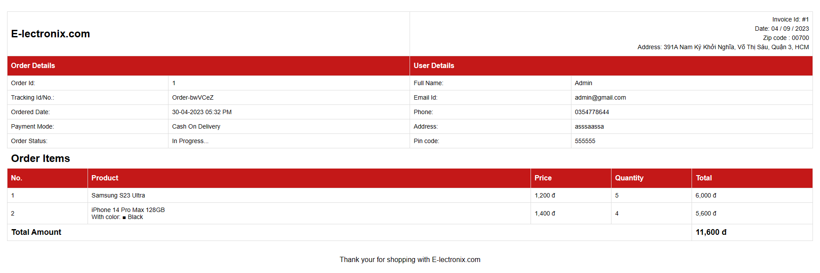
Invoice Details View Page
Here is View Invoice Details page appear when admin click View Invoice link on Orders page.

Slide 17
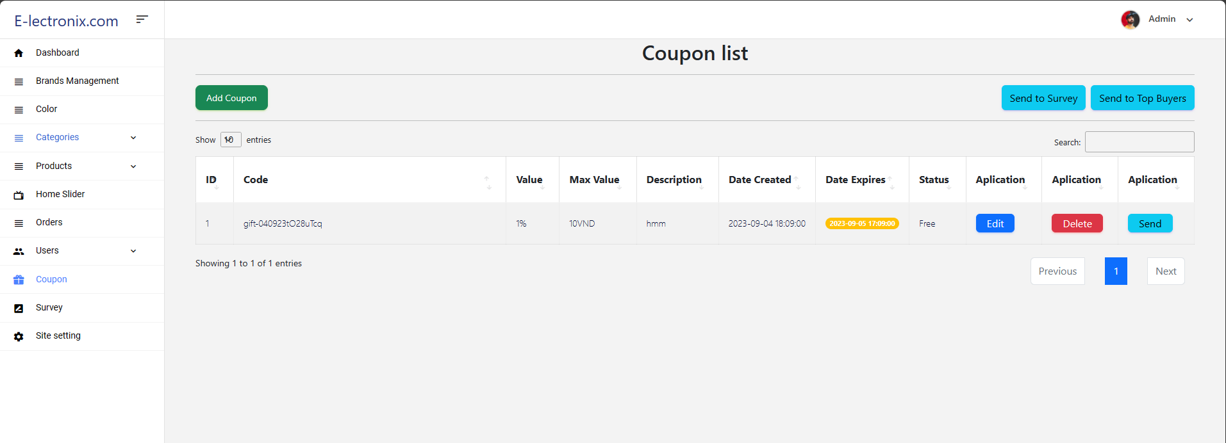
Coupons View Page
Here is View Coupon Details page appear when admin click Coupon link.

Slide 18
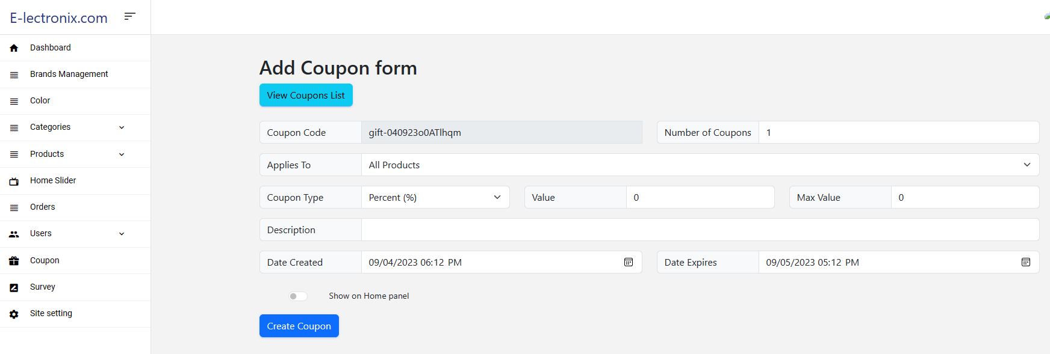
Coupon Create Page
Here is Coupon create page appear when admin click Add Coupon link on Coupon page.

Slide 19

THANK'S FOR WATCHING

