Slide 1

View encapsulation in Angular
Presenter: Vu Ngoc Phat

Slide 2
Table of Contents
What is View Encapsulation?
Adding View Encapsulation to components
ViewEncapsulation.None
ViewEncapsulation.Emulated
ViewEncapsulation.ShadowDom
Shadow dom terminology

Slide 3
What is View Encapsulation?
The View Encapsulation in Angular is a strategy that determines how angular hides (encapsulates) the styles defined in the component from bleeding over to the other parts of the application.
The following three strategies are provided by Angular to determine how styles are applied.
ViewEncapsulation.None
ViewEncapsulation.Emulated
ViewEncapsulation.ShadowDOM

Slide 4
Adding View Encapsulation to components
The Encapsulation methods are added using the encapsulation metadata of the @Component decorator as shown below
@Component({
template: `<p>Using Emulator</p>`,
styles: ['p { color:red}'],
encapsulation: ViewEncapsulation.Emulated //This is default
//encapsulation: ViewEncapsulation.None
//encapsulation: ViewEncapsulation.ShadowDOM
})
Note: ViewEncapsulation.Emulated is the default encapsulation method.

Slide 5
ViewEncapsulation.None
Angular does not apply any sort of view encapsulation meaning that any styles specified for the component are actually globally applied and can affect any HTML element present within the application. This mode is essentially the same as including the styles into the HTML itself.
The important points are
The styles defined in the component affect the other components
The global styles affect the element styles in the component

Slide 6
ViewEncapsulation.Emulated
Angular modifies the component's CSS selectors so that they are only applied to the component's view and do not affect other elements in the application, emulating Shadow DOM behavior.
The important points are
This strategy isolates the component styles. They do not bleed out to other components.
The global styles may affect the element styles in the component
The Angular adds the attributes to the styles and marks up

Slide 7
ViewEncapsulation.ShadowDOM
The Shadow DOM is a scoped sub-tree of the DOM. It is attached to an element (called shadow host) of the DOM tree. The shadow dom does not appear as a child node of the shadow host when you traverse the main DOM.
The browser keeps the shadow DOM separate from the main DOM. The rendering of the Shadow dom and the main DOM happens separately. The browser flattens them together before displaying them to the user. The feature, state & style of the Shadow DOM stays private and are not affected by the main DOM. Hence it achieves true encapsulation.

Slide 8
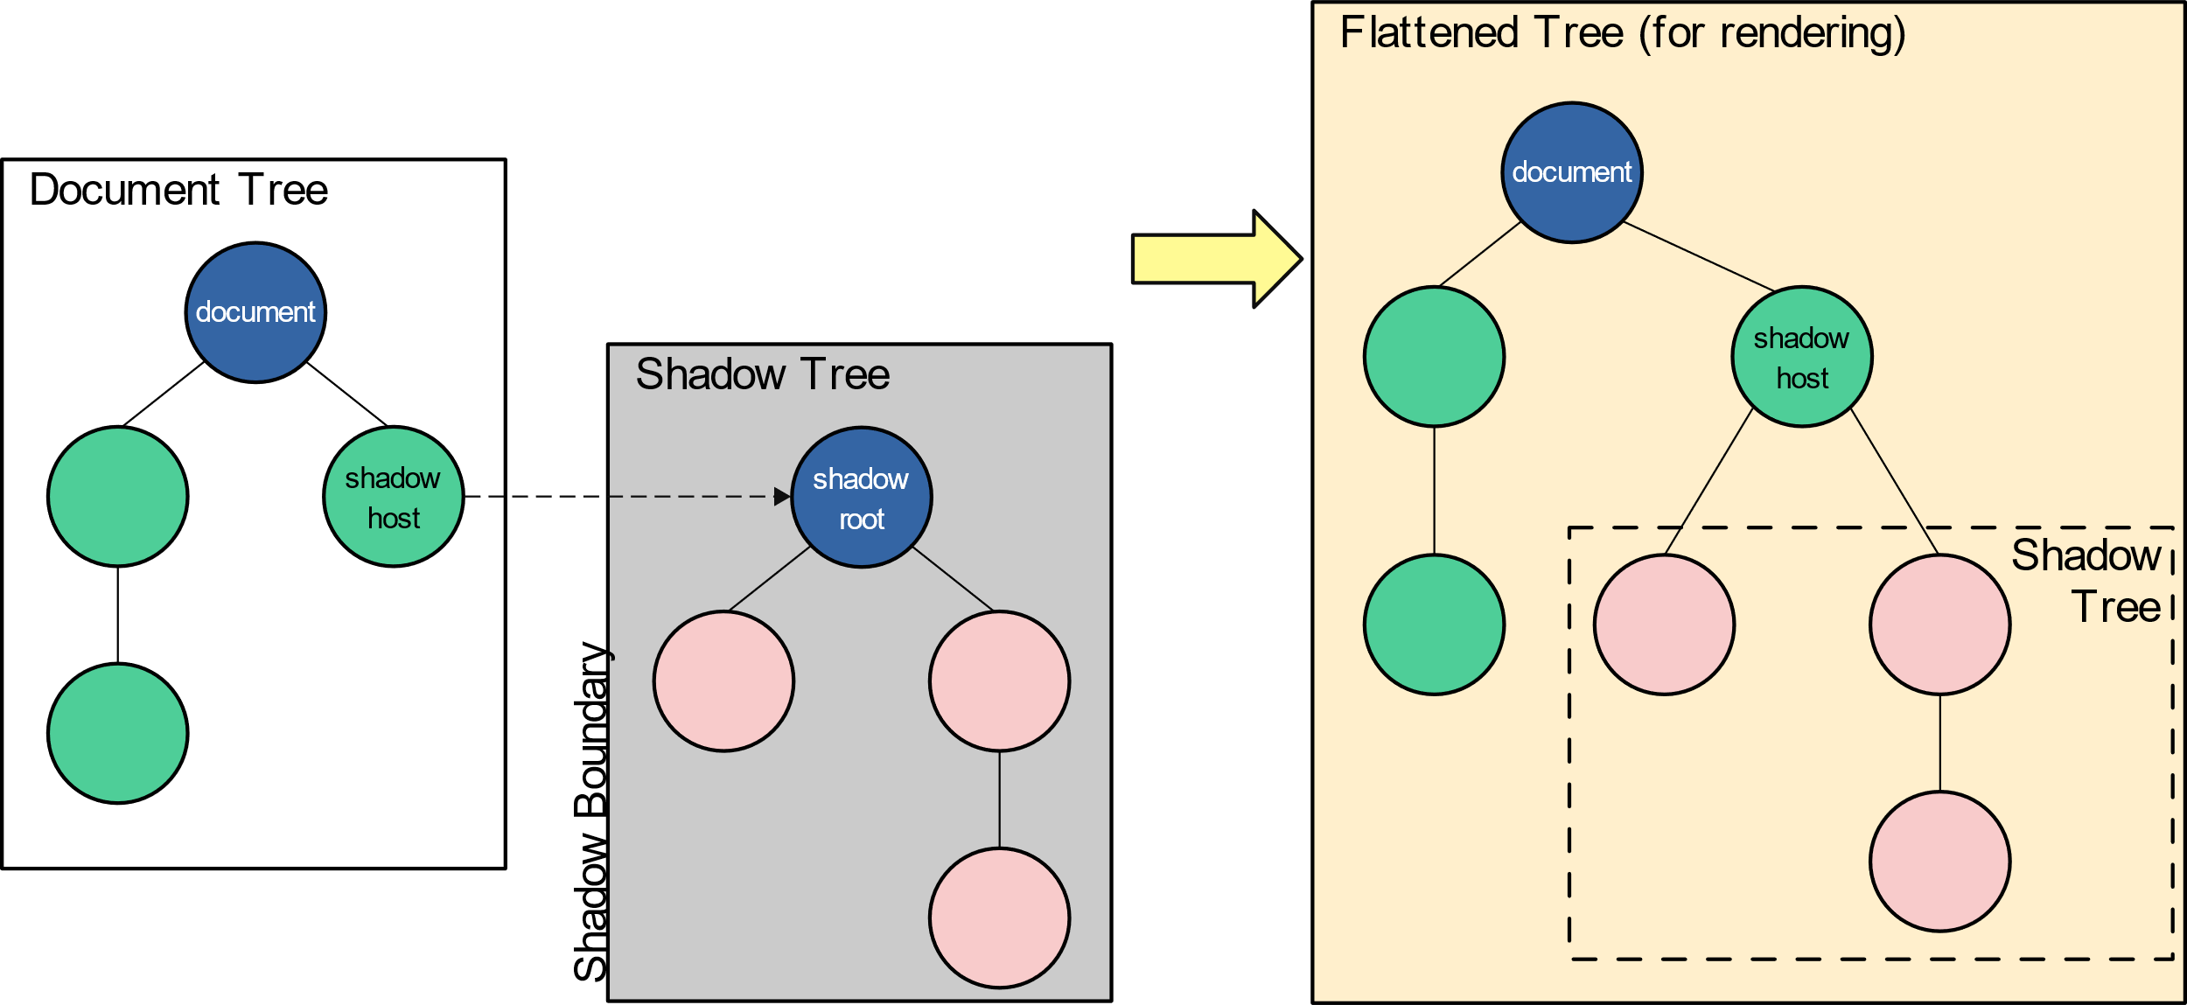
Shadow dom terminology

Slide 9
Shadow dom terminology
The app-shadowdom is the CSS selector in the ViewShadowdomComponent. We used it in our app-component.html. The Angular renders component as shadow dom and attaches it to the app-shadowdom selector. Hence, we call the element as Shadow host
The Shadow DOM starts from #shadow-root element. Hence, we call this element as shadow root. The Angular injects the component into the shadow root.
The Shadow boundary starts from the #shadow-root. The browser encapsulates everything inside this element including the node #shadow-root
The shadow dom archives the true encapsulation. It truly isolates the component from the styles from the other parts of the app.
The styles from the parent component & sibling components are still injected into the shadow dom. But that is an angular feature. The angular wants the component to share the parent & sibling styles. Without this the component may look out of place with the other component

Slide 10
THANK YOU FOR LISTENING!

