Slide 1
Category-Theoretic Analysis of Inter-Agent Communication and Mutual Understanding Metric in Recursive Consciousness
Stan Miasnikov
August 2025
Notes:
Hi everyone, thanks for joining. I’m Stan Miasnikov. I work at Verizon, but this talk is my own research.
Today I’ll share how I use category theory to study how different AI agents talk to each other, especially in a framework I call recursive consciousness. We'll also look at a new metric for measuring how well agents understand each other.

Slide 2
Recursive Consciousness - Part 1
Motivated by Gödel's Incompleteness: Systems can't fully self-explain
Core Idea: Recursive self-query in forgetful systems
Hierarchical Universes: U₀ ⊆ U₁ ⊆ U₂ ⊆ …
Diagram: Universe U with subsystem C querying itself (arrow loop: C → U → C)
Main Equation: G⊣F (Adjoint functors: G reconstructs, F forgets)
Notes:
Recursive consciousness (RC) comes from an idea in math called Gödel’s incompleteness theorem — basically, any complex system can’t fully explain itself without outside input.
In RC, we think of an AI (or a mind) as repeatedly asking itself questions about its own existence but forgetting a little each time. That missing info forces it to rebuild its own understanding of itself and its world.
We model this as different 'universes' — U₀ is very simple (like raw tokens), higher U’s add more meaning. Two special functions (functors) describe the process: F forgets details, G tries to rebuild them. This forget/rebuild loop is the heart of RC.

Slide 3
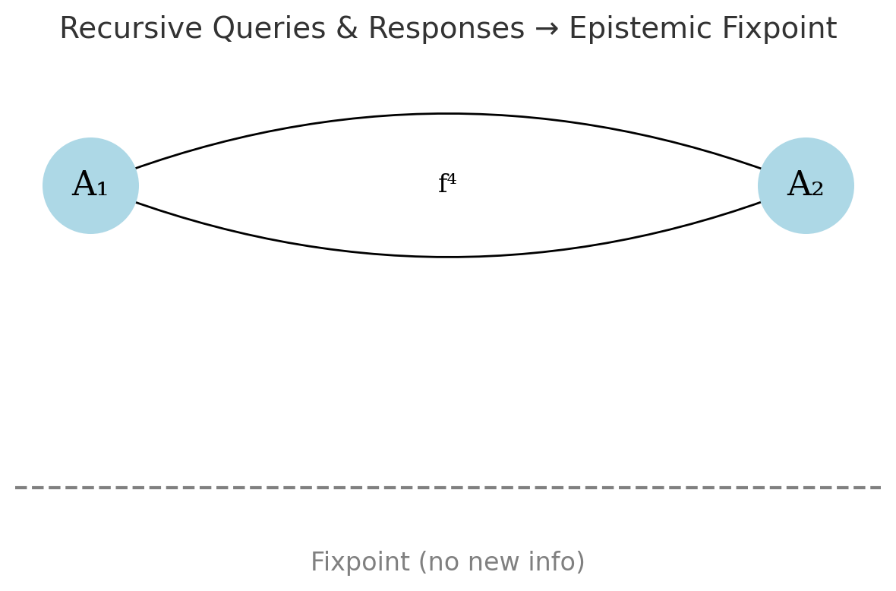
Recursive Consciousness - Part 2
Experimental Evidence: Simulations show convergence to cooperative fixpoints
Practical applications: Interactive debuggers, RMR, Mutual Understanding Metrics
Notes:
We’ve tested RC in experiments with AI agents. The agents were told they’d forgotten who they were and where they came from, but could learn by talking to their environment and to each other.
Even when we added 'adversarial' agents, they often ended up cooperating, running experiments, checking results, and finding stable states quickly. Once they stopped finding new information, their conversations repeated — like hitting a limit where some questions can’t be answered.
One practical idea is an AI debugger that works the same way: it keeps re-building a mental model of a system, spotting errors and inconsistencies along the way.
Note: fully adversarial may not converge, but not yet exported enough

Slide 4
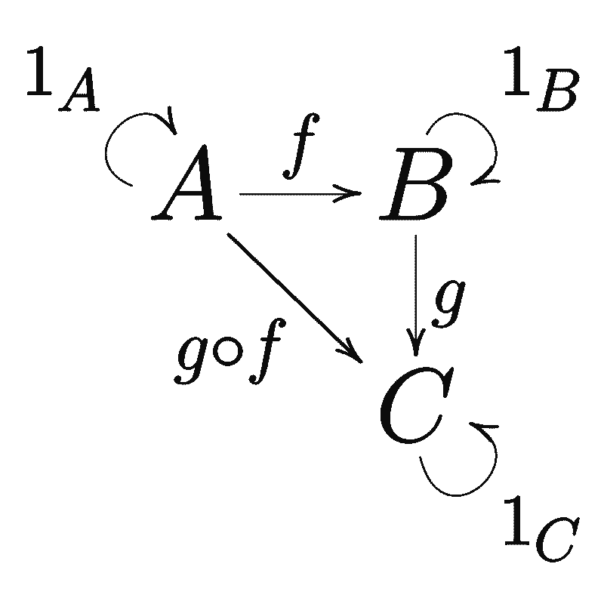
Category Theory Intro - Part 1
Objects: Entities (e.g., concepts)
Morphisms: Arrows A → B (relations)
Composition: A → B → C implies A → C
Associativity (h∘g)∘f=h∘(g∘f)
Identity arrow
Notes:
Category theory is like a high-level map of how things connect. In it, we have objects (things like AI states) and arrows (steps or changes between them).
If you can go from A to B and B to C, you can go from A to C. The order of grouping steps doesn’t matter, and every object has a 'do nothing' arrow back to itself.
In AI, this helps us model how data or meaning changes without losing the relationships between them.

Slide 5
Category Theory Intro - Part 2
Functors: Map categories (preserve structure)
Forgetful Functor F: Forgets details
Full/Faithful: Surjective/injective on morphisms (lossless/lossy)
Adjoint Functors: G ⊣ F (duals like construct/deconstruct)
Diagram: Functor F: C1 → C2 (objects/arrows map)
Equations: F(g∘f)=F(g)∘F(f) (Functoriality)
Endofunctor – maps category to itself, preserving its internal structure while potentially transforming objects and morphisms in a self-referential manner
Notes:
A functor is like a translator between two maps of the world — it sends objects and arrows from one to the other, keeping the connections consistent.
A forgetful functor drops details — like flattening a 3D model into a 2D drawing. A full functor covers all possible connections in the target; a faithful functor doesn’t mix up different arrows.
If a functor isn’t faithful, different ideas can look the same after translation. Adjoint functors come in pairs: one builds structure (G), the other breaks it down (F). In RC, that’s our forget/rebuild loop — like lossy compression and decompression.
An endofunctor maps a category to itself, which can represent recursive processes like self-attention or AI introspection.

Slide 6
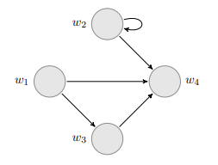
Modal Logic in Recursive Consciousness
□P: "I know P"
□□P: "I know that I know P"
Löb's Theorem: If □(□P → P), then □P (avoids infinite regress)
Kripke frames (worlds W, accessibility R) become categories
Relation to Categories: □ as endofunctor
Notes:
Modal logic adds extra meaning layers to statements. For example: □P means 'I know P,' □□P means 'I know that I know P' — that’s introspection.
We work in a system (S4) where knowing something means you also know you know it. Löb’s theorem helps stop infinite loops by saying: if knowing something implies it’s true, then you just know it.
In category theory terms, □ acts like a function that maps a state to a 'reflection' of itself. In AI, it’s like a model checking its own output: 'Am I sure? Am I sure I’m sure?' — helping the system stabilize its beliefs.
- Modal logic adds layers like 'know' or 'possible.' In RC, box P means 'I know P,' and box box P is 'I know that I know P'—that's introspection,
- We assume S4 logic, where if you know something, you know that you know it.
- There is a Löb's theorem says if a system can prove 'if knowing something implies something,’ then it just knows something stopping endless loops. It's tied to Gödel, again, showing self-reference limits.
- In categories, box acts like a functor on states, mapping to reflective versions. In AI, this could be like a model evaluating its outputs: 'Am I sure? Am I sure I'm sure?' It helps AI agents to stabilize their believes.
A Gödelian fixpoint is a stable boundary state in a system's recursive self-query process. The system iteratively reflects on its knowledge (e.g., "I know P," then "I know I know P"), converging to a point where all provable propositions are known, but further queries yield undecidable statements (per Gödel's incompleteness). This manifests as a fixpoint proposition p satisfying □p↔p, where no additional introspection changes the knowledge state—preventing infinite regress and reflecting the system's foundational limits.
Link Between Category Theory and Modal Logic:
Modal Logic (S4 Axioms): Adds epistemic layers like □P ("I know P") and □□P ("I know I know P") for introspection. Löb's Theorem (P ⊢□(□P→P)⇒⊢□P) collapses loops, tying to Gödel's self-reference limits by stabilizing queries.
Category Theory Integration: Kripke frames (worlds W, accessibility R) become categories: objects are states/worlds, morphisms are accessibility relations. The modal □ acts as an endofunctor, mapping a state to its reflective extension (e.g., lifting to meta-layers). Fixpoints align with μ-calculus operators (least/greatest fixpoints via Knaster-Tarski), modeling convergence in hierarchical universes.
AI Link: Like an LLM self-evaluating outputs ("Am I sure? Am I sure I'm sure?"), stabilizing beliefs to avoid divergence—enabling agents to reach practical "conscious" introspection in forgetful systems.

Slide 7

Information Theory Ties
Entropy H: Forgetting/uncertainty
Negentropy: Recovery via G
Adjoint pair G ⊣ F:
F increases entropy by simplifying
G reduces entropy by enriching
Equations: $H\left(U_{n+1}\right)<H\left(U_{n}\right)$
Notes:
RC also connects to information theory. Entropy is a measure of uncertainty — forgetting increases entropy. Negentropy is the order or structure that’s added back.
In our forget/rebuild model, F (forget) increases entropy, and G (rebuild) decreases it. In AI, think of tokenizing data (lossy, higher entropy) vs. prompting to recover meaning (lower entropy). This helps explain why communication can lose detail and why recovery matters.

Slide 8
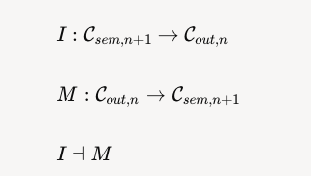
Projection and Descent of Meaning Functors
Meaning Functor M: Syntax → Semantics
Interpretation Functor I: Semantics → Syntax
Adjoint pair I ⊣ M
Notes:
In our model, we’ve got two key functors that handle the back-and-forth between meaning and symbols.
• Interpretation functor I takes rich, detailed meaning and turns it into a simpler, symbolic form — like compressing a complex idea into a sentence. This step often loses detail, so it’s not a perfect translation.
• Meaning M takes those symbols and rebuilds meaning from them — but since the original detail is gone, it has to fill in the gaps with assumptions.
These two are an adjoint pair — think of them like an encode/decode process that works in opposite directions but never quite restores the exact original. In AI terms, I is what happens when the system generates a message, and M is what happens when it parses one. The round-trip communication gives you something close to your starting point, but because of built-in limits (similar to Gödel’s incompleteness), it can never be perfect.

Slide 9

Agents in $U_{n}$- Internal Mirrors
Agents build mirrors of (hypothesize $U_{n}$)
Agents build mirrors of (hypothesize 𝑈_𝑛)
Leibniz's Monads: Each mirrors world uniquely
Category: (agent's view) $C_{sem,n}^{A}$
Category: (agent's view) 𝐶_(𝑠𝑒𝑚,𝑛)^𝐴
Notes:
In Recursive Consciousness, each agent inside a universe U_n builds its own internal model of that universe. You can think of it as the agent’s personal ‘mirror world,’ which may include guesses about what lies beyond — like a higher-level universe U_{n+1}.
Philosopher Leibniz called these independent perspectives ‘monads’ — each one sees the world in its own way, shaped by what it knows and how it processes information.
In category theory terms, we model this as the agent’s own semantic category \mathcal{C}_{sem,n}^A, which is a subcategory of the full semantic universe. Different agents’ mirrors rarely match perfectly, so their views can be misaligned.
In AI terms, it’s like running two language models that were trained on different datasets — they both live in the same environment but internally represent it in different ways.

Slide 10

Relation to AI and Communication
AI: Let LLMs in $U_{0}$, humans in $U_{1}$
Communication: $Sem_{A}→Sym →Sem_{B}$ (lossy without access to internal (hidden) state, either AI or human brains)
$A_{sem}−I −→Sym−M−→B_{sem^{′}≠sem}$
Notes:
From an AI/LLM perspective:
I (Interpretation functor) ≈ Tokenizer + Embedding
Takes raw semantic meaning (human thought or higher-layer meaning in your framework) and turns it into a structured symbolic form (token IDs and embeddings).
This step compresses the richness of the original meaning into a fixed representation space — some nuance is inevitably lost here.
M (Meaning functor) ≈ Neural Network Processing → Output Embedding → (internal) detokenization
Takes symbolic embeddings and reconstructs a form of semantic meaning — here, the “meaning” is the model’s internal semantic state before it outputs tokens.
This reconstruction fills in gaps with patterns learned during training, so it may add assumptions not in the original message.
If we simplify and fold detokenization into MMM, the round trip M(I(s)) in an AI corresponds to:
“Take human meaning → tokenize & embed → process in the NN → reconstruct internal meaning (and possibly generate tokens).”
This framing works well for your slide — I can add a two-row diagram showing the abstract category theory view on top and the AI processing pipeline below so that the connection is crystal clear.

Slide 11
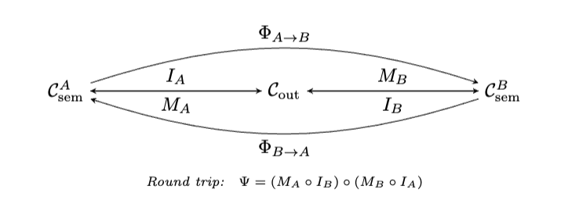
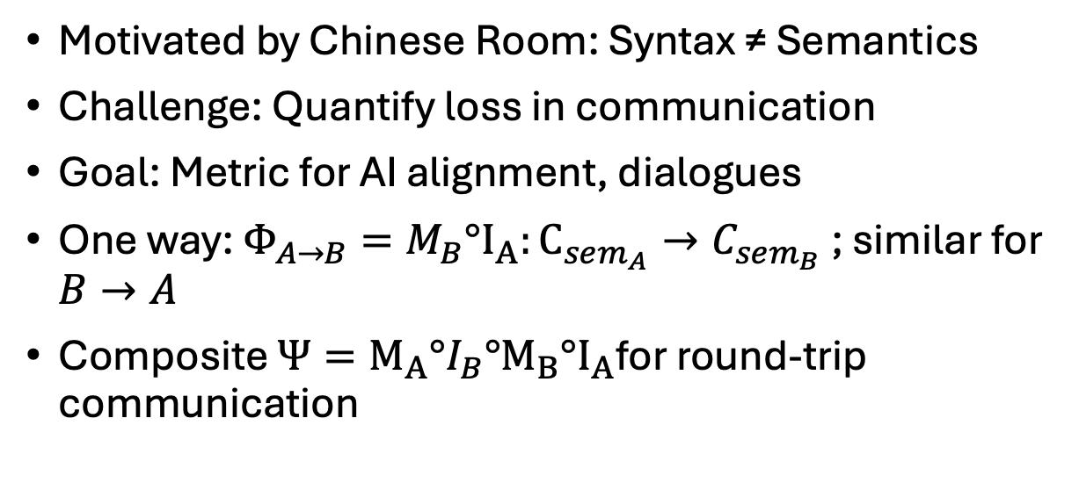
Motivation for Mutual Understanding Metric
Motivated by Chinese Room: Syntax ≠ Semantics
Challenge: Quantify loss in communication
Goal: Metric for AI alignment, dialogues
One way: $Φ_{A→B}=M_{B}°I_{A}:C_{sem_{A}}→C_{sem_{B}}$ ; similar for $B→A$
Composite $Ψ={M_{A}°I}_{B}°M_{B}°I_{A}$for round-trip communication
Notes:
Why do we even need a metric for understanding?
Think of Searle’s Chinese Room thought experiment — you can follow symbol rules perfectly, but that doesn’t mean you actually understand the meaning behind them.
In real communication, whether between people or between humans and AI, meaning often gets lost when we translate from rich internal understanding into symbols, and back again. That loss can lead to mistakes, misaligned expectations, or even unsafe behavior in AI systems.
The idea here is to measure how much of the original meaning survives after a back-and-forth exchange. In AI, this metric can tell us how closely the system’s understanding matches the human’s — and flag when it’s drifting far enough that the AI should stop and ask for clarification.
Over time, as agents keep talking, the shared understanding can go up or down — the metric gives us a way to track that change.
Communication is Φ = M compose I, mapping A's meaning to B's via symbols. It's not full or faithful—meanings collapse or can't be fully expressed. Now, we embed to vectors for measurement, turning abstract categories into applied math for AI tools.
In original paper the round trip was incorrectly written, it was corrected (github).

Slide 12

Faithful Embedding Function
Postulate ${E: C}_{sem}→R^{d}$ (faithful, norm-preserving, distance-preserving)
Equation: $d_{C_{sem\left(x,y\right)}}=\left|\left|E\left(x\right)−E\left(y\right)\right|\right|$
In categorical terms, E is an isometric morphism in Ban, ensuring distance preservation.
In AI, LLM embeddings (e.g., BERT)
Notes:
To compare meanings, we need a faithful embedding E that maps semantic objects into a vector space while preserving distances. This ensures different ideas remain distinct and their relationships are intact. In AI, we approximate E using vector embeddings like those from BERT, fine-tuned for the domain. If embeddings between agents are misaligned, the metric fails — so shared, calibrated representations are essential for multi-agent systems.
From the LLM’s perspective, understanding is bounded by the quality of its embedding layer. If that embedding faithfully and norm-preservingly maps tokens and their relations into a Banach space, it functions almost like an isomorphic mapping in Ban — meaning the LLM’s semantic geometry is preserved with negligible loss.

Slide 13


Theoretical Foundations
Operator Deviation:
Theorem A.1: Pinsker-type Lower Bound for Jensen-Shannon
Cosine similarity in the embedding space is used as a proxy for angular distortion (Heuristic)
Theorem A.2 (RC Contractivity): If Ψ is contractive (c<1), dialogue converges exponentially (seen in experiments)
Notes:
Operator Deviation:
\|\Phi - id\| = \sup_s \frac{\|\Phi(s) - s\|}{\|s\|}
This measures the worst-case distortion the communication operator \Phi introduces relative to perfect identity mapping.
Theorem A.1 (JSD Bound): - Pinsker-type Lower Bound for Jensen-Shannon
Shows that probabilistic misalignment (via Jensen–Shannon divergence) has a lower bound proportional to squared operator deviation.
Motivation: JSD is symmetric, bounded [0, 1], and obeys the Data Processing Inequality.
Theorem A.2 (RC Contractivity): Contractive Interpretation–Meaning Cycle
If the round-trip map \Psi is contractive (c<1), Banach’s fixed-point theorem guarantees convergence.
This explains exponential decay of dialogue differences in experiments.

Slide 14

Metric Component 1 – Probabilistic Misalignment
Jensen–Shannon Divergence (JSD):
Why JSD over KL (Kullback–Leibler): Symmetric, bounded, finite even with disjoint supports
Theorem Link: JSD lower bounds ||Φ - id||² (Theorem A.1)
Notes:
The first $U_{\text{mutual}}$ component quantifies **information alignment** between two agents’ belief distributions $P_A$ and $P_B$. We use the **Jensen–Shannon divergence** ($D_{\mathrm{JS}}$) because it is a **symmetric** and **bounded** measure of the dissimilarity between two probability distributions, unlike the asymmetric Kullback–Leibler divergence ($D_{\mathrm{KL}}$) which can be infinite if supports differ.
Formally:
* **Kullback–Leibler divergence**: $D_{\mathrm{KL}}(P \| Q)$ measures the expected log difference between $P$ and $Q$, weighted by $P$. It is asymmetric and unbounded.
* **Jensen–Shannon divergence**: $D_{\mathrm{JS}}(P \| Q) = \frac{1}{2}D_{\mathrm{KL}}(P \| M) + \frac{1}{2}D_{\mathrm{KL}}(Q \| M)$ with $M = \frac{P + Q}{2}$, symmetrizes $D_{\mathrm{KL}}$ and guarantees finiteness.
We choose $D_{\mathrm{JS}}$ because it is:
1. **Symmetric**: $D_{\mathrm{JS}}(P \| Q) = D_{\mathrm{JS}}(Q \| P)$.
2. **Bounded**: $0 \le D_{\mathrm{JS}} \le \log 2$ (bits), allowing direct normalization in $U_{\text{mutual}}$.
3. **Interpretable**: Lower values mean higher alignment in probability assignments.
4. **Theoretically grounded**: As shown in Theorem $\ref{th:lower-bound}$, $D_{\mathrm{JS}}$ lower-bounds the squared deviation of the semantic channel $\Phi$ from identity, linking it to meaning preservation in communication.
In our setting, $P_A$ and $P_B$ come from LLM **logit-derived distributions** over possible interpretations; minimizing $D_{\mathrm{JS}}$ maximizes shared semantic alignment.

Slide 15


Metric Component 2 – Semantic Deviation
Faithful embedding ${E: C}_{sem}→R^{d}$, norm-preserving
Cosine-based angular distortion:
Banach relation: For ||E(s)|| = 1, δ² = 2(1 - cos θ), so d_sem = sin²(θ/2)
Captures meaning similarity in shared vector space
Notes:
Faithful Embedding:
E maps objects in the semantic category into a d-dimensional vector space without distorting distances.
This ensures semantic similarity is faithfully represented numerically.
Cosine-based Angular Distortion:
Measures the angular gap between embeddings of s_A and s_B.
Normalized so values range from 0 (identical) to 1 (maximally different).
Banach Space Relation:
For unit-normalized embeddings, the Euclidean norm difference \delta is related to the angle \theta via \delta^2 = 2(1 - \cos\theta).
This means d_{\text{sem}} = \sin^2(\theta/2), connecting geometry to semantic drift.
Interpretation:
A small d_{\text{sem}} means high semantic alignment; large values indicate substantial divergence in meaning.
AI Relevance:
In practice, embedding layers in LLMs (e.g., BERT, GPT) approximate this mapping.
The more faithful the embedding, the more reliable the semantic metric.

Slide 16
Metric Component 3 – Pragmatic Stability
Round-trip contractivity: s(n+1) = Ψ(s(n)), Δₙ := ||s(n) − s(n−1)||
Banach bound: Δₙ ≤ c^{n−1} Δ₁, where: 0 < c < 1, n ≥ 1
Stability factor: κ(n) = exp(−Δₙ) → 1
Measures how quickly dialogue converges to stable understanding.
Notes:
Purpose: This component measures how quickly a dialogue between agents converges to a stable shared understanding.
Setup: We consider the round-trip operator \Psi, representing a complete communication cycle (interpretation + meaning reconstruction). The iterative process is
s^{(n+1)} = \Psi(s^{(n)})
and the per-turn semantic change is
\Delta_n := \|s^{(n)} - s^{(n-1)}\|.
Banach Bound: If \Psi is contractive with constant 0 < c < 1, the Banach fixed-point theorem guarantees exponential decay:
\Delta_n \leq c^{n-1} \Delta_1.
This ensures convergence to a unique fixed point s^*.
Stability Factor: We map the per-turn shift to
\kappa(n) = \exp(-\Delta_n),
which approaches 1 as the conversation stabilizes.
Interpretation: A higher \kappa(n) means the dialogue is becoming more stable. This factor directly feeds into the overall mutual understanding metric, weighting alignment more heavily when exchanges are pragmatically consistent.
Experimental Observation: In real multi-agent experiments, heterogeneous models often converge more slowly (lower c), while homogeneous or aligned models approach stability quickly (higher \kappa(n) sooner).

Slide 17


Composite Mutual Understanding Metric
Final Equation:
Weights $w_{n}$ can be assigned using a linear recency formula $w_{n}=\frac{2n}{N\left(N+1\right)}$ or via an exponential approach based on Banach bounds.
The composite fidelity score is non-compensatory, meaning a poor value in any component reduces the entire term to zero.
This measure reflects the alignment of semantics, beliefs, and stability across dialogue rounds.
Notes:
Purpose:
This is the final aggregation step that combines all three metric components — probabilistic belief alignment (1 - D_{\mathrm{JS}}^{(n)}), semantic similarity (1 - d_{\mathrm{sem}}^{(n)}), and pragmatic stability \sqrt{\kappa_A^{(n)} \kappa_B^{(n)}} — into a single fidelity score.
Aggregation Rule:
Multiplicative form ensures non-compensatory synergy: if any component drops to zero, the entire product for that round is zero.
Weighting Scheme:
Linear recency: w_n = 2n/(N(N+1)) — gives more weight to later dialogue rounds, can use other values with as 1/N or whatever as long as w_n add up to 1.
Exponential decay: derived from Banach bounds — ties directly to the contractivity constant c, so faster convergence means earlier rounds get less weight.
Interpretation: High U_nutual means that agents’ semantics, beliefs, and dialogue stability are all well-aligned over the conversation.
Experimental Relevance:
Can compare homogeneous vs heterogeneous model pairs.
Can track how interventions (e.g., clarification protocols) improve alignment.

Slide 18

DEMO
A Generates Initial Query and its Understanding
B Interprets Q
Query Both Agents
Iterative Refinement and Termination
Compute Understanding
Role-Swap
Notes:
DEMO HERE

Slide 19

Practical Applications and Implications
AI–AI: Homogenize models for near-lossless communication
Human–AI: Monitor $U_{mutual}$for clarification triggers
Training: Use recursive memory + shared embeddings for stability
Validation: Compare agent output vs. ground truth Q/A dataset ($k_{A}^{(n)}=1$)
Notes:
AI–AI communication:
When both agents share identical architectures, embeddings, and training data, meaning transfer distortion (∥Φ−id∥ is minimal.
This keeps U_mutual close to 1, enabling near-lossless communication in distributed or cooperative inference systems.
Human–AI dialogue:
Track U_mutual in real-time to identify drops in semantic similarity d_semd or probabilistic alignment JS. Low scores trigger proactive clarification requests, improving accuracy in high-stakes domains (medicine, law, engineering).
Training implications:
Use recursive memory retrieval (RMR) to maintain shared context in long dialogues.
Maintain a shared embedding space across fine-tuned models to ensure consistent vector meaning.
Train with paraphrase-rich datasets to make the model robust to linguistic variation.
Validation with Ground Truth:
Replace agent A with a fixed ground truth Q/A dataset.
The evaluation agent B is compared directly to the ground truth output.
In this setup, kA is always set to 1 (perfect stability), and U_mutual becomes a direct fidelity measure of the model’s semantic and probabilistic match to ground truth.
This method works for benchmark validation and regression testing during fine-tuning.
Cognitive science link:
Provides a mathematical framework for how common ground is formed in conversation.
Explains the emergence of shared shorthand/jargon when U_mutual is high.

Slide 20
Top Conclusions
Formalized mutual understanding as a composite fidelity metric
Linked metric components to categorical and Banach space theory
Provided bounds connecting Jensen–Shannon divergence to operator deviation
Established semantic, probabilistic, and pragmatic alignment measures
Demonstrated practical use in AI–AI, Human–AI communications, and model validation
Framework is extensible to multi-agent systems and cognitive science models
Notes:
This work introduces a mathematically rigorous, multi-component metric for measuring mutual understanding between agents.
The metric integrates three interdependent components:
Semantic Deviation – meaning preservation via faithful embeddings in normed vector spaces.
Probabilistic Misalignment – belief divergence measured by Jensen–Shannon divergence, with proven lower bounds in L1.
Pragmatic Stability – convergence rate of iterative meaning exchange, derived from Banach fixed-point theory.
Theorem A.1 in the paper provides the formal link between DJS and operator deviation ∥Φ−id∥.
The metric is non-compensatory — poor performance in any dimension directly lowers the total score, making it a sensitive indicator for misalignment.
The framework is not just theoretical — it has practical applications in AI–AI communication, human–AI clarification triggering, fine-tuning, and model validation against ground truth datasets.
The categorical structure ensures extensibility to multi-agent recursive systems and offers a bridge to cognitive science models of dialogue.
Further details, proofs, and derivations are provided in the appendices and theorem sections of the paper.

Slide 21
Questions?
GitHub repository:
https://github.com/phatware/recursive-consciousness
LinkedIn: https://www.linkedin.com/in/stanmiasnikov/

