Slide 1
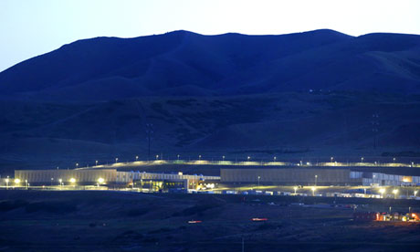
Mechanical Sympathetic Software Designs
Virtualnation

Slide 2
High performance, Low Latency Systems Design
Writer William Gibson has said: ‘ The future has already arrived – it’s just not evenly distributed yet’.
High performance, low latency design is like that – while not yet pervasive, its capacity for unprecedented system scale and reliability must underpin future-ready cyber security systems.
Fast, accurate and low cost processing opens new doors in offering protection against the ever increasing range of cyber threats plaguing multiple industries and endeavours.
ThreatMetrix
Notes:
Low Latency programming techniques coming out of High Frequency Trading.

Slide 3
High performance, Low Latency Systems Design
Key considerations in achieving high performance, low latency systems include:
Objective - Improving system performance by 10-1,000x by taking advantage of how modern hardware works.
Hardware optimising programming
Example: Single Producer, Single Consumer Shared Memory C++ and Java queue.
Basic operational techniques and avenues for improvement
ThreatMetrix
Notes:
Low Latency programming techniques coming out of High Frequency Trading.

Slide 4
Objective
Find more bad guys faster, cheaper, better.
Recognise that an online service business depends on high levels of cost effectiveness and service speed to deliver better products, as well as profit and growth targets.
Reduce software and systems complexity by stripping down the software stack.
Know how the technology stack works – hardware and software, thus optimising reliability and performance, and minimising the time to ship products
Achieve efficiency gains of 10-1000x.
“The most amazing achievement of the computer software industry is its continuing cancellation of the steady and staggering gains made by the computer hardware industry”
- Henry Peteroski
ThreatMetrix
Notes:
Leverage into production
OSGI Spring Injected/ Unit Mocked, Hibernate / RDBMS etc. running on Big Data HDFS / Cassandra Hadoop cluster with Node front end on KVM virtualisation enviornment.
Spend time learning intricacies of innumerable technologies
Complicated optimizations because the basic techniques are not optimised.

Slide 5
Queue Performance
Mechanical sympathy is simply the principle that the most effective software must work in harmony with the hardware, most importantly, leveraging off continuing improvements in hardware design.
Martin Thompson, a low latency innovator, demonstrated that employing mechanical sympathy drove significant performance improvements in key Java abstractions.
Specifically the design of a queue is a good example where software design should leverage off the features of the hardware.
Optimising a queue is an indicative case that can inform further mechanical sympathy-based optimisation.
ThreatMetrix
Notes:
Leverage into production
OSGI Spring Injected/ Unit Mocked, Hibernate / RDBMS etc. running on Big Data HDFS / Cassandra Hadoop cluster with Node front end on KVM virtualisation enviornment.
Spend time learning intricacies of innumerable technologies
Complicated optimizations because the basic techniques are not optimised.

Slide 6
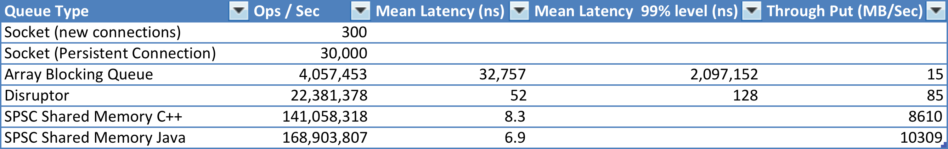
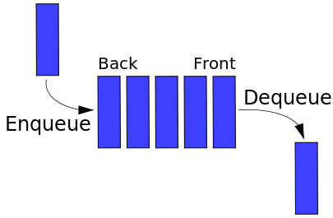
Queue Performance
Single
Producer
Single
Consumer
ThreatMetrix
Notes:
Bridge API server developed in C++ with Java for both comms and the application.
Broadcast approach to decouple current operation with
To provide an example of an optimisation works at a micro-level, its function and behaviour can be used to model and improve the entire software stack.
Employ lock free in memory systems design.

Slide 7
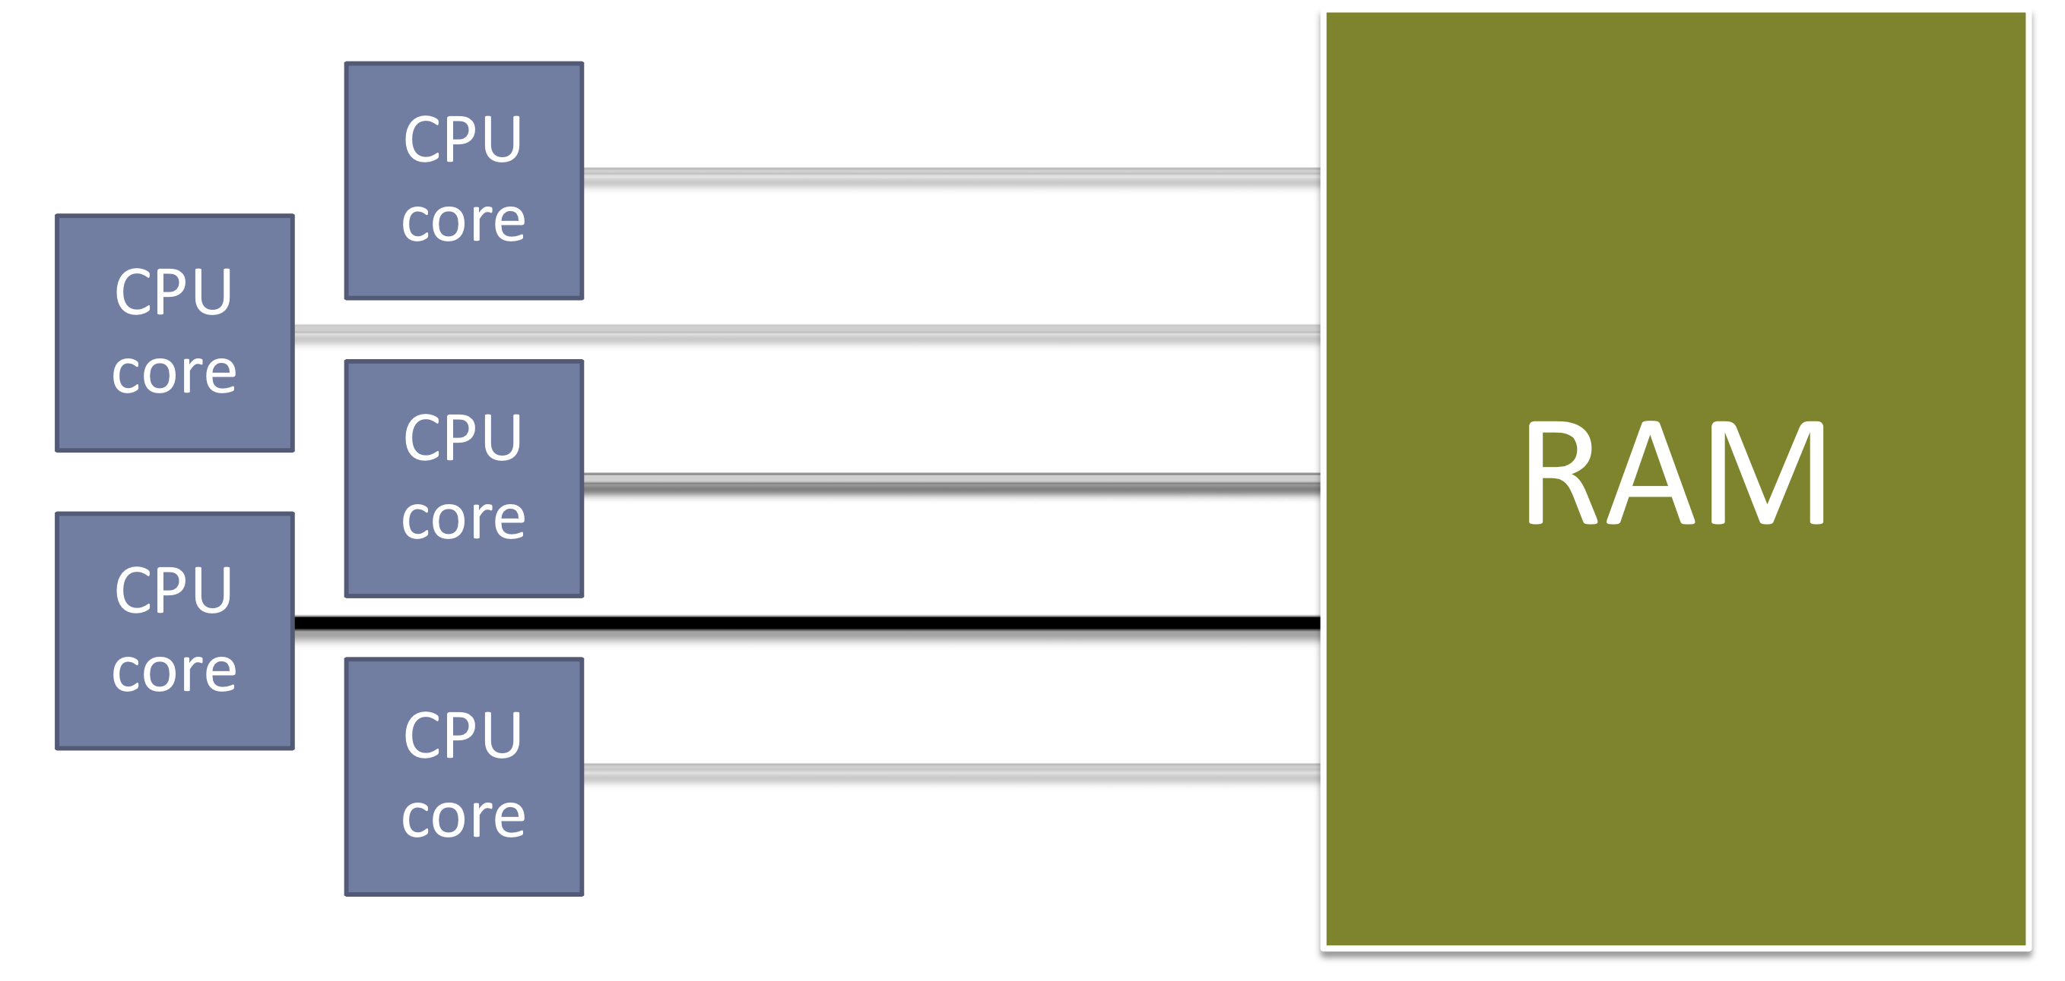
The Machine Everyone Codes For
ThreatMetrix

Slide 8
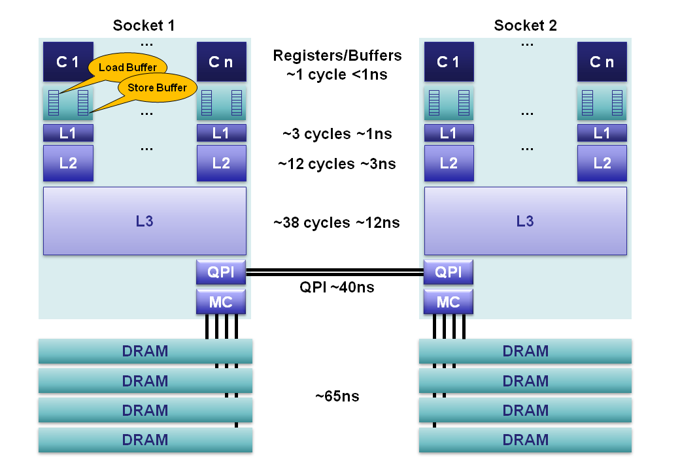
The Actual Machine
Notes:
256 K per core L1 cache. 4M L2 Cache ~40MB L3 Cache. 768TB RAM is now affordable.
Registers: Within each core are separate register files containing 160 entries for integers and 144 floating point numbers. These registers are accessible within a single cycle and constitute the fastest memory available to our execution cores. Compilers will allocate our local variables and function arguments to these registers. Compilers allocate to subset of registers know as the architectural registers, then the hardware expands on these as it runs instructions in parallel and out-of-order. Compilers are aware of out-of-order and parallel execution ability for given processor, and order instruction streams and register allocation to take advantage of this. When hyperthreading is enabled these registers are shared between the co-located hyperthreads.
Memory Ordering Buffers (MOB): The MOB is comprised of a 64-entry load and 36-entry store buffer. These buffers are used to track in-flight operations while waiting on the cache sub-system as instructions get executed out-of-order. The store buffer is a fully associative queue that can be searched for existing store operations, which have been queued when waiting on the L1 cache. These buffers enable our fast processors to run without blocking while data is transferred to and from the cache sub-system. When the processor issues reads and writes they can can come back out-of-order. The MOB is used to disambiguate the load and store ordering for compliance to the published memory model. Instructions are executed out-of-order in addition to our loads and stores that can come back out-of-order from the cache sub-system. These buffers enable an ordered view of the world to be re-constructed for what is expected according to the memory model.
Level 1 Cache: The L1 is a core-local cache split into separate 32K data and 32K instruction caches. Access time is 3 cycles and can be hidden as instructions are pipelined by the core for data already in the L1 cache.
Level 2 Cache: The L2 cache is a core-local cache designed to buffer access between the L1 and the shared L3 cache. The L2 cache is 256K in size and acts as an effective queue of memory accesses between the L1 and L3. L2 contains both data and instructions. L2 access latency is 12 cycles.
Level 3 Cache: The L3 cache is shared across all cores within a socket. The L3 is split into 2MB segments each connected to a ring-bus network on the socket. Each core is also connected to this ring-bus. Addresses are hashed to segments for greater throughput. Latency can be up to 38 cycles depending on cache size. Cache size can be up to 20MB depending on the number of segments, with each additional hop around the ring taking an additional cycle. The L3 cache is inclusive of all data in the L1 and L2 for each core on the same socket. This inclusiveness, at the cost of space, allows the L3 cache to intercept requests thus removing the burden from private core-local L1 & L2 caches.
Main Memory: DRAM channels are connected to each socket with an average latency of ~65ns for socket local access on a full cache-miss. This is however extremely variable, being much less for subsequent accesses to columns in the same row buffer, through to significantly more when queuing effects and memory refresh cycles conflict. 4 memory channels are aggregated together on each socket for throughput, and to hide latency via pipelining on the independent memory channels.
NUMA: In a multi-socket server we have non-uniform memory access. It is non-uniform because the required memory maybe on a remote socket having an additional 40ns hop across the QPI bus. Sandy Bridge is a major step forward for 2-socket systems over Westmere and Nehalem. With Sandy Bridge the QPI limit has been raised from 6.4GT/s to 8.0GT/s, and two lanes can be aggregated thus eliminating the bottleneck of the previous systems. For Nehalem and Westmere the QPI link is only capable of ~40% the bandwidth that could be delivered by the memory controller for an individual socket. This limitation made accessing remote memory a choke point. In addition, the QPI link can now forward pre-fetch requests which previous generations could not.
Practically – design systems to run split on

Slide 9
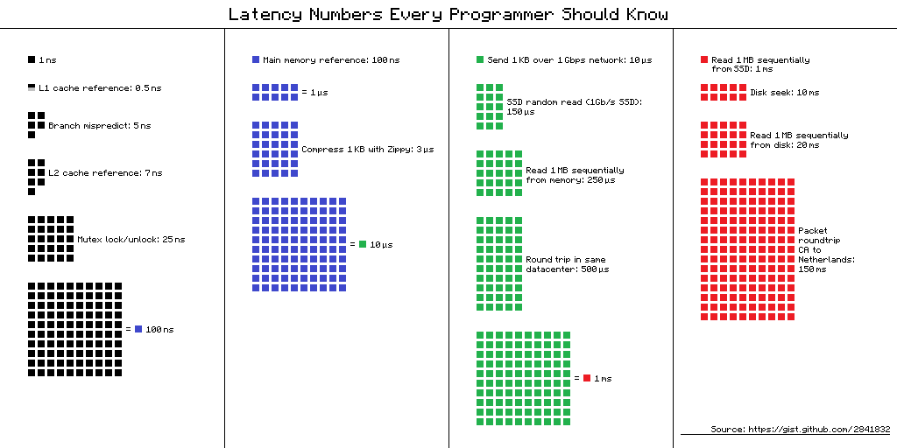
Dean’s Latency Performance Numbers
ThreatMetrix

Slide 10
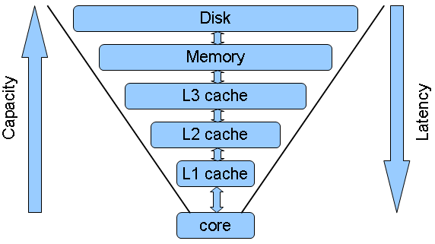
Cache Structure
ThreatMetrix
Notes:
Yes, in some sense memory is no more than a cache for slow disks (while disks are caches for network or whatever). Each lower level is more expensive and thus has lower capacity, however it's also faster and in particular has significantly lower access latency. L1 cache typically has latency of a few processor cycles, and at large each subsequent level has roughly order of magnitude larger access latency.
There is an another dimension in the structure - some caches are private to cores, while others are shared between several cores. There is usually an L1 cache (and potentially L2) per each core in modern processors. While L3 cache currently is usually shared between all cores in a processor.
Here I use terms "cache" and "memory" in a generalized sense, they may represent real L3 cache and memory, or L1 cache and L2 cache, or memory and disk and so on (in reality the scheme is actually applied several times recursively). So, we assume that "cache" is fast and private, while "memory" is slow and shared, and hereinafter we will analyze and optimize accesses to slow shared memory.

Slide 11
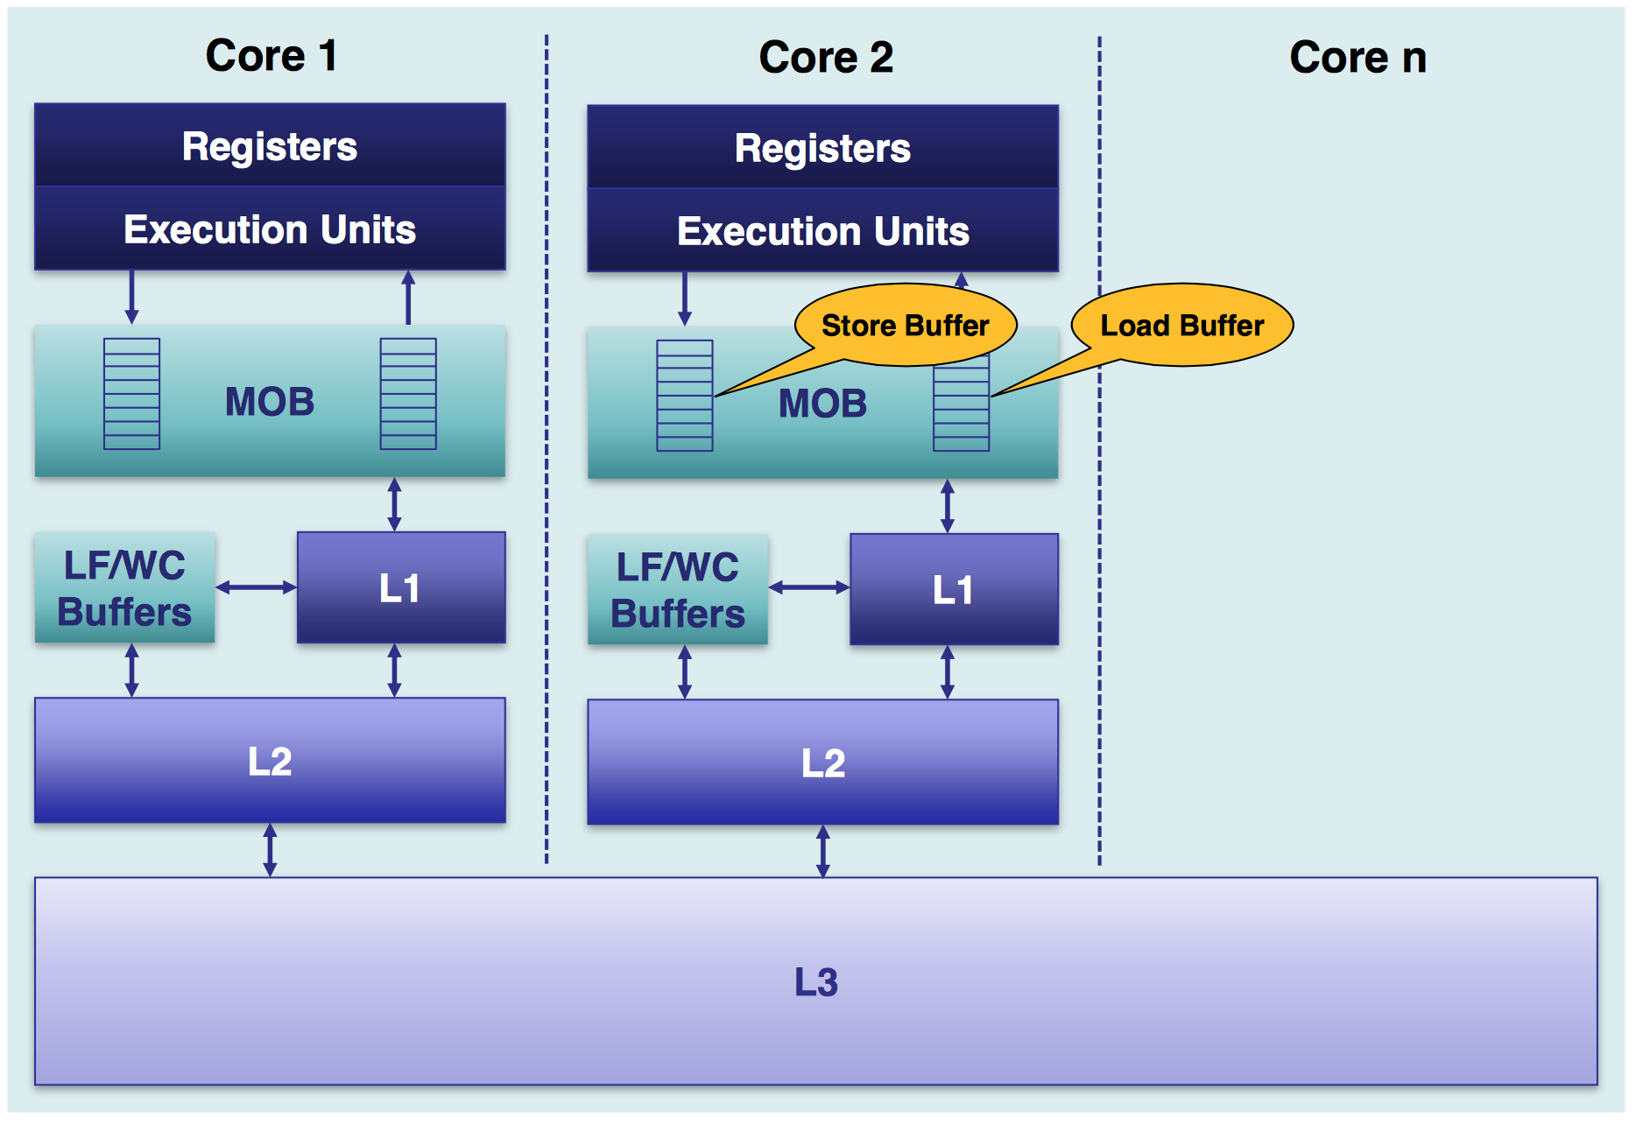
Memory Ordering
ThreatMetrix
Notes:
Yes, in some sense memory is no more than a cache for slow disks (while disks are caches for network or whatever). Each lower level is more expensive and thus has lower capacity, however it's also faster and in particular has significantly lower access latency. L1 cache typically has latency of a few processor cycles, and at large each subsequent level has roughly order of magnitude larger access latency.
There is an another dimension in the structure - some caches are private to cores, while others are shared between several cores. There is usually an L1 cache (and potentially L2) per each core in modern processors. While L3 cache currently is usually shared between all cores in a processor.
Here I use terms "cache" and "memory" in a generalized sense, they may represent real L3 cache and memory, or L1 cache and L2 cache, or memory and disk and so on (in reality the scheme is actually applied several times recursively). So, we assume that "cache" is fast and private, while "memory" is slow and shared, and hereinafter we will analyze and optimize accesses to slow shared memory.

Slide 12
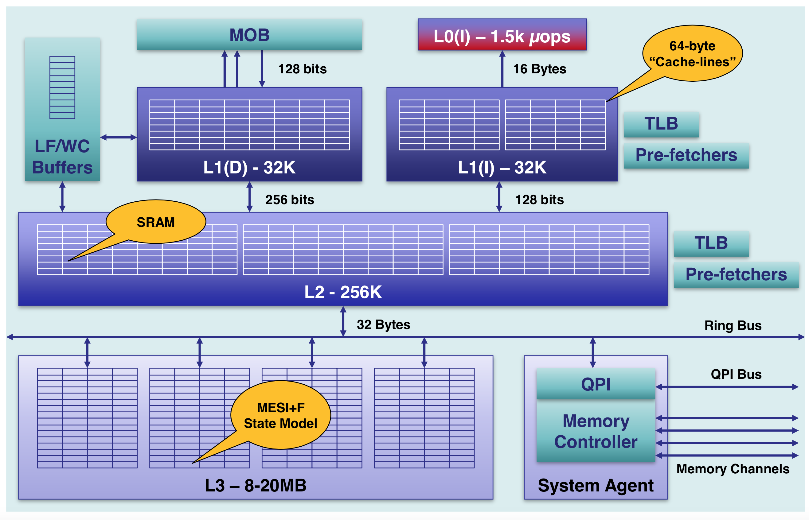
Structure Cache and Coherency
ThreatMetrix

Slide 13
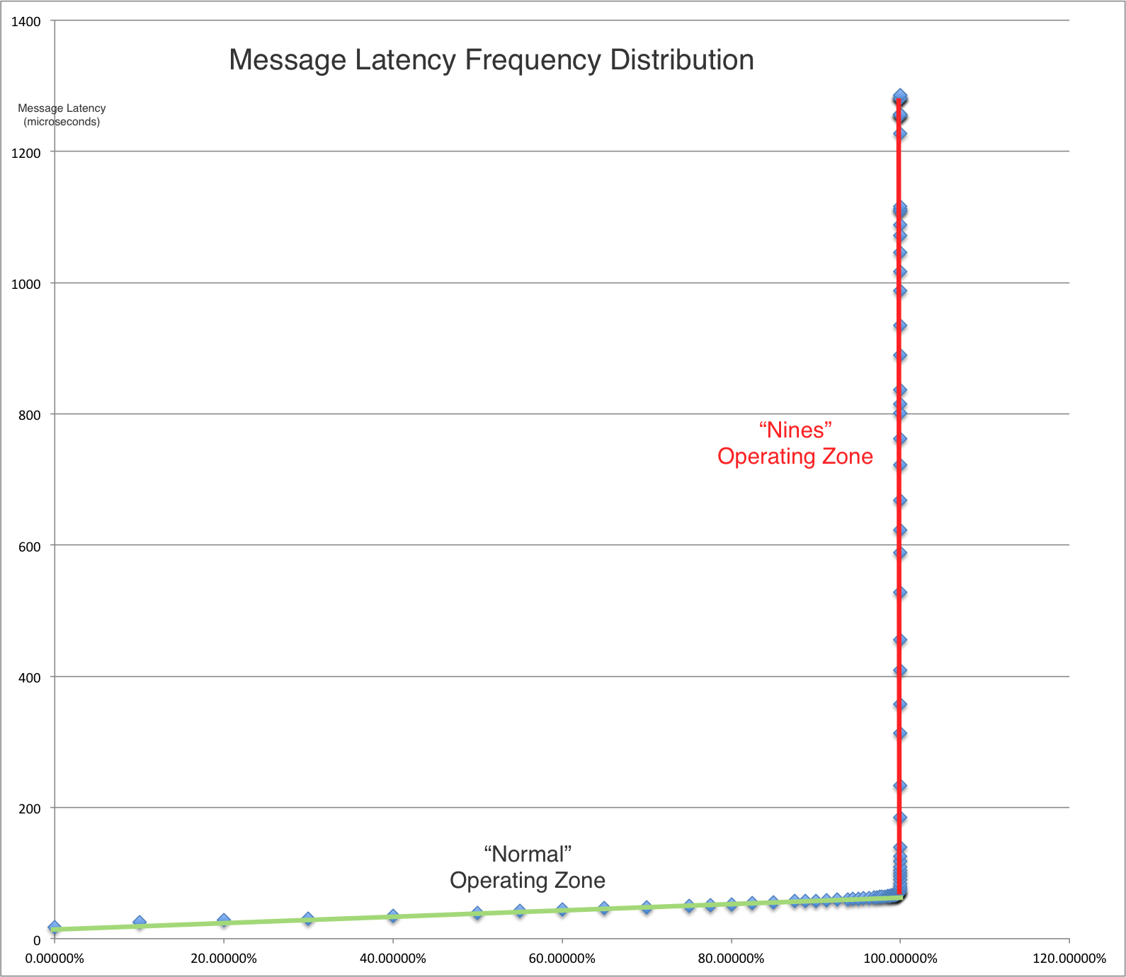
Queue Math
Defined by Little’s law and other modestly complex math.
Watch for processing variance as can cause wait times to become exponentially slow as load increases.
Software engineering take outs:
Fix capacity – no unbounded queues (otherwise the system has a memory leak)
Reduce performance variance
Multiple independent processors
Define performance tolerance
Feeding CPU’s needs to be managed
ThreatMetrix

Slide 14
Programing Concerns
Use bounded queues and fixed capacity
Pre-allocate memory
Limit JVM controlled memory foot print to < 8GB
Cache aware / oblivious designs
With up to 45 MB on die L3 cache:
Cache is the new RAM
RAM is the new store
Aware cost of different operations within critical loops
Use Streaming / Asynchronous / Reactive design
Use Lock Free designs
Drive out processing variability
ThreatMetrix

Slide 15
Memory Mapped Files and Java “Unsafe”
Use a RAM disk.
Simple to manage and inspect
Use Java “Unsafe”
Enables direct access to system heap
Pointers
Memory copy
Access to different strength locks
Just like C++ does by default.
public long getHeadPlain() {
return UNSAFE.getLong(null, headAddressPos);
}
ThreatMetrix

Slide 16
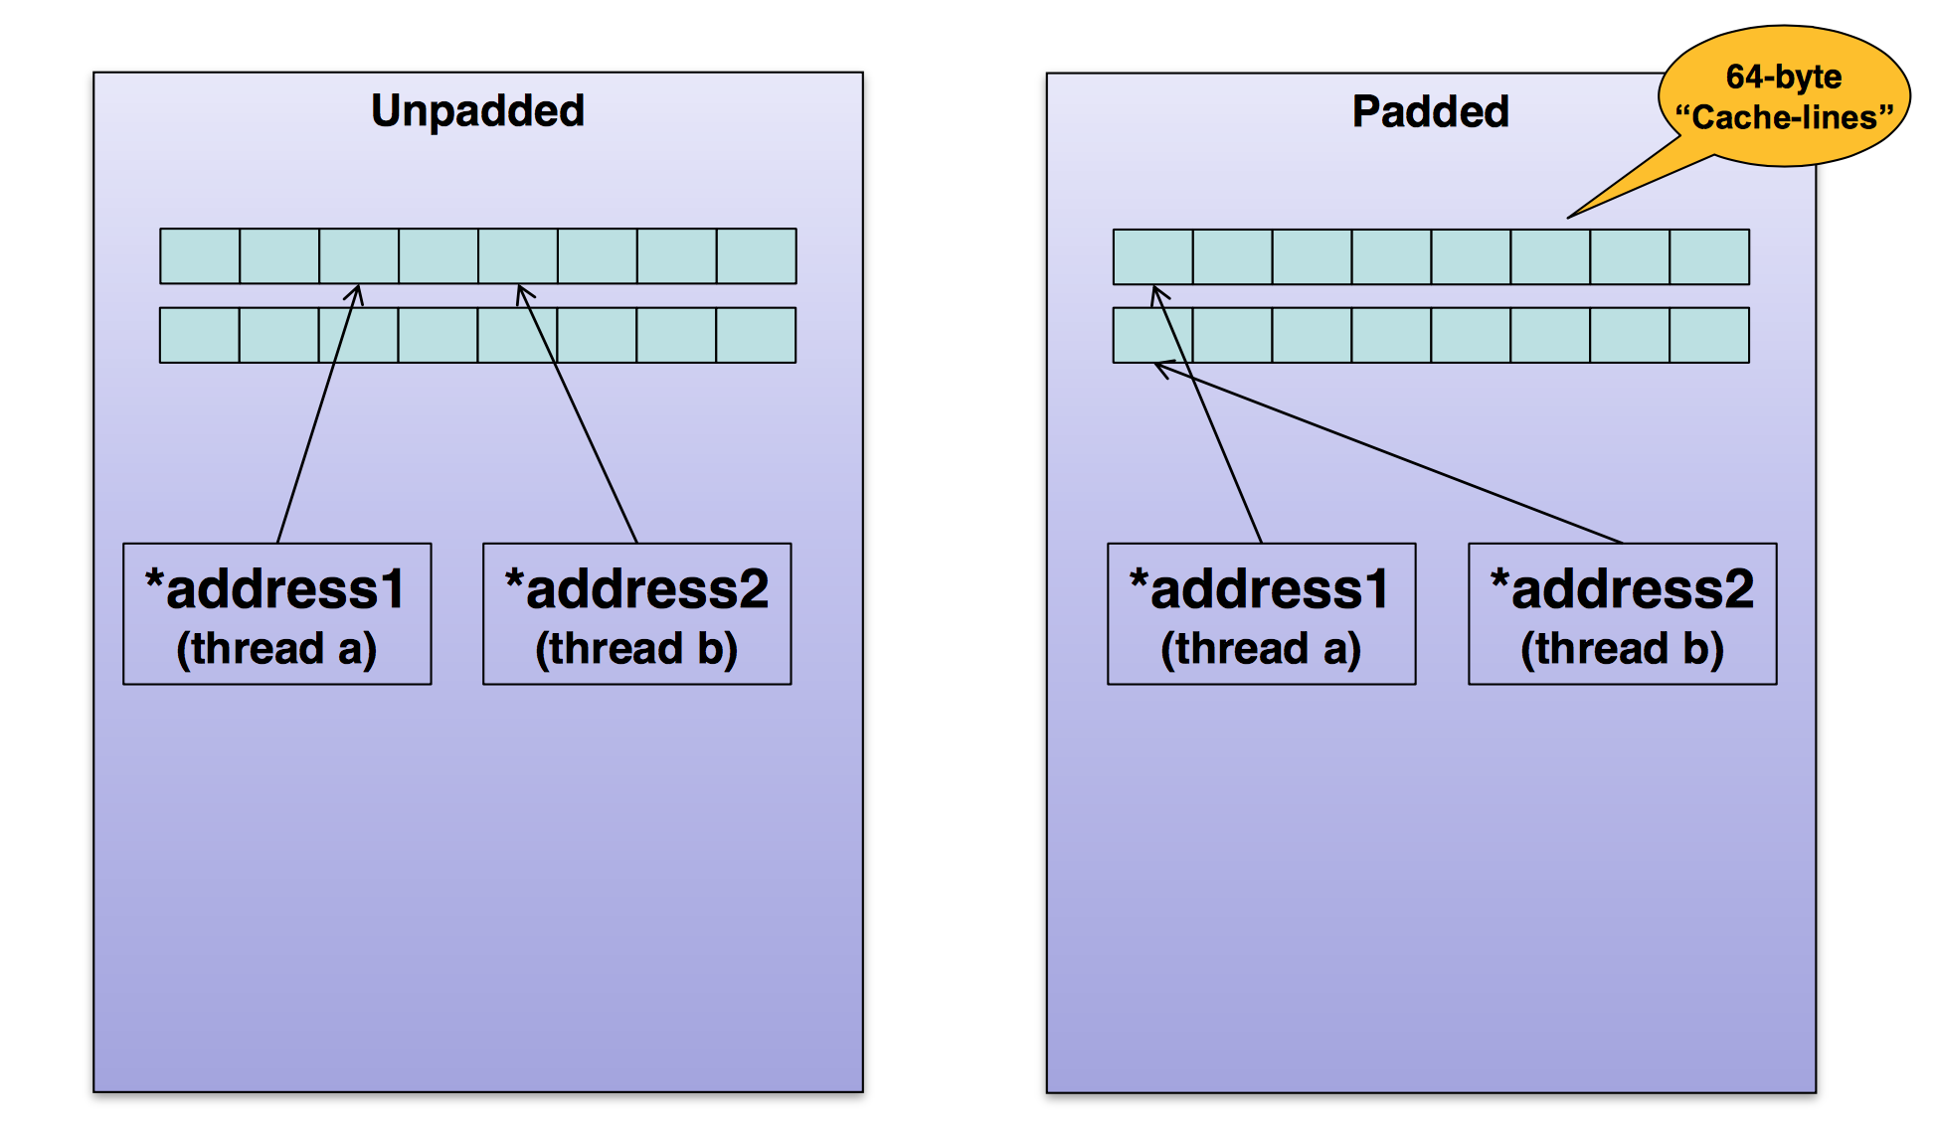
False Sharing and Cache Lines
ThreatMetrix
Notes:
Want head of Queue and tail on queue pointers on different cache lines
Updates will be locked by default.
Performance of cacheline operations is the same as per accessing a single variable.
Keep data structures to 64 bytes and aligned
Log based / append only designs

Slide 17
Contention –
Biggest Performance Killer
Managing Contention – i.e. watch the demands on shared resources
Could use resource Locks
Could use CAS Techniques
Design Approach
Single Writer
Shared Nothing Designs
ThreatMetrix

Slide 18
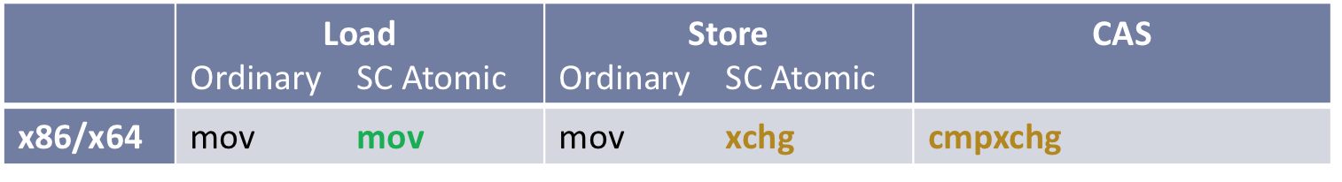
Atomicity and Locks x86
Sequential Consistency for data-race-free programs (SC-DRF)
inline void putInt64(stdvolatile std::int32_t* address, std::int64_t v) {
*reinterpret_cast<std::int64_t *>(address) = v;
}
inline void putInt64Ordered(volatile std::int32_t* address, std::int64_t value) {
__asm__ __volatile__("" ::: "memory");
*reinterpret_cast<volatile std::int64_t *>(address) = value;
}
inline void putInt64Atomic(volatile std::int32_t* address, std::int64_t value) {
__asm__ __volatile__ ( "xchgq (%2), %0” : "=r" (value) : "0" (value), "r" (address) : "memory");
}
// But try not to do this:
inline void fence(){
__asm__ volatile ("lock; addl $0,0(%%rsp)" : : : "cc", "memory");
}
C11 standard takes care of this.
ThreatMetrix
Notes:
Xchg could be a mfence but _way_ to expensive.

Slide 19
Core Loops
public boolean preOffer(CacheLine aCacheLine) {
final long currentTail = getTailPlain();
final long wrapPoint = currentTail - memoryBuffer.getCapacity() ;
if (getHeadCache() <= wrapPoint) {
setHeadCache(getHead());
if (getHeadCache() <= wrapPoint) return false;
}
aCacheLine.updateWrap(calcElementOffset(currentTail));
return true;
}
public void offer() {
setTail(getTailPlain() + 1);
}
public CacheLine poll() {
final long currentHead = getHeadPlain();
if (currentHead >= getTailCache()) {
setTailCache(getTail());
if (currentHead >= getTailCache()) return null;
}
pollCacheLine.updateWrap(calcElementOffset(currentHead));
return pollCacheLine;
}
public void releaseCacheLine() {
setHead(getHeadPlain() + 1);
}
ThreatMetrix

Slide 20
Instruction Optimization
Modulus operation is expensive
Do this equivalent function instead:
Can print assembly code out with both C++ and Java to find out expensive instructions.
private long calcElementOffsetModulus(final long currentHead) {
return arrayBaseAddresssPos + ((currentHead % memoryBuffer.getCapacity()) << 6);
}
ThreatMetrix

Slide 21
Operational Deployment
Code is just part of the story.
Fix threads to specific cores using “taskset”
Run cooperating processes on the same socket to avoid QPI. Thus dual socket machines should be considered as two machines if application can be run in 256GB of RAM.
Run the OS on different cores from the application
Tune the machine as per Supermicro guide for low latency
Final performance modeling should be done on real tuned machines
Achieved 3x latency reduction in networking test. Expectation is that should enable 250-350M message per second to be achieved.
ThreatMetrix

Slide 22
Conclusion
Super optimised code is not needed everywhere but there are basic techniques that can be used very easily where needed.
Performance isn’t necessarily an issue of programming language but more an issue of concurrency design and the interplay between hardware and software.
Scale performance requires data to operate across cache lines.
Do not write share across cache lines
Use in memory, lock-free, reactive designs where feasible
Measure and understand what the computer is actually doing to achieve performance.
Thank You. Questions?
ThreatMetrix

