Slide 1
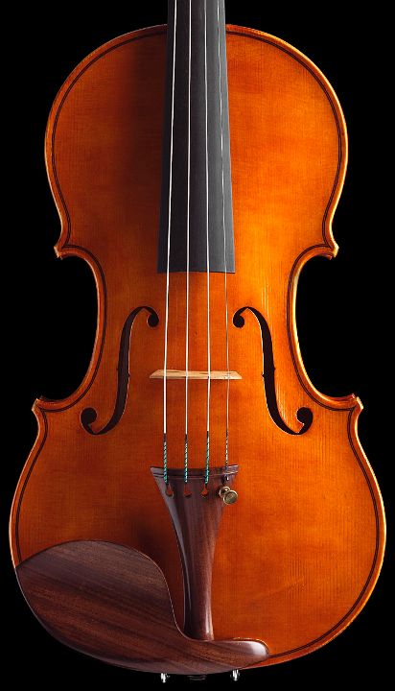

Index Tuning

Slide 2
Outline
Index Utilization
Heap Files
Definition: Clustered/Non clustered, Dense/Sparse
Access method: Types of queries
Constraints and Indexes
Locking
Index Data Structures
B+-Tree / Hash
LSM Tree / Fractal tree
Implementation in DBMS
Index Tuning
Index data structure
Search key
Size of key
Clustered/Non-clustered/No index
Covering

Slide 3
Heap Files
Rows appended to end of file as they are inserted
Hence the file is unordered
Good for scan
Deleted rows create gaps in file
File must be periodically compacted to recover space
Set
of
records

Slide 4
Index
An index is a data structure that provides efficient access to a set of records
The leaves of the index are (pointers to) records. The internal nodes of the index define its data structure.
Set
of
records
Matching records
Condition on attribute value
(a>2)
index
search key
(a)

Slide 5
Simple SQL Example
select ssnum,name
from employees
where hundreds2 > 10;
create index nc on employees (hundreds2);
create index nc1 on
employees (hundreds2, ssnum, name)
create table employees(
ssnum integer not null,
name varchar(20) not null,
lat real, long real,
hundreds1 real,
hundreds2 real
);

Slide 6
Search Keys
A (search) key is a sequence of attributes.
create index i1 on accounts(branchnum, balance);
Types of keys
Sequential: the value of the key is monotonic with the insertion order (e.g., counter or timestamp)
Non sequential: the value of the key is unrelated to the insertion order (e.g., social security number)

Slide 7
Clustered / Non clustered index
Clustered index (primary index)
A clustered index on attribute X co-locates records whose X values are near to one another.
Non-clustered index (secondary index)
A non clustered index does not constrain table organization.
There might be several non-clustered indexes per table.
Records
Records

Slide 8
Index-Organized Tables
Clustered indexes organized how data are stored on disk
Clustered index and storage can be orthogonal
A clustered index can be dropped in which case the table is organized as a heap file
A clustered index can be defined on a table (previously organized as a heap table), which is then reorganized
Index-organized table
The clustered index defines the table organization. It is required when the table is defined. It cannot be dropped.

Slide 9
Dense / Sparse Index
Sparse index
Pointers are associated to pages
Dense index
Pointers are associated to records
Non clustered indexes are dense
P1
P2
Pi
record
record
record

Slide 10
OLTP: Types of Queries
Point Query SELECT balance FROM accounts WHERE number = 1023;
Multipoint Query SELECT balance FROM accounts WHERE branchnum = 100;
Range Query SELECT number FROM accounts WHERE balance > 10000;
Prefix Match Query SELECT * FROM employees WHERE name = ‘Jensen’ and firstname = ‘Carl’ and age < 30;
Tables are in BNF, derived from entities and relationships

Slide 11
OLTP: Types of Queries
Extremal Query SELECT * FROM accounts WHERE balance = max(select balance from accounts)
Ordering Query SELECT * FROM accounts ORDER BY balance;
Grouping Query SELECT branchnum, avg(balance) FROM accounts GROUP BY branchnum;
Join Query SELECT distinct branch.adresse FROM accounts, branch WHERE accounts.branchnum = branch.number and accounts.balance > 10000;

Slide 12
OLAP
Types of Data
Types of Queries
Multidimensional data
Cube
Spatio-temporal data
Time series
Spatial data
Sensor data
Cube operators
Rollup / Drill down
Clustering & similarity
Nearest neighbors
Preferences
Top K
Skyline
See lecture on OLAP tuning

Slide 13
Constraints and Indexes
Primary Key, Unique
A non-clustered index is constructed on the attribute(s) that compose the primary key with the constraint that values are unique.
Foreign Key
By default, no index is created to enforce a foreign key constraint.

Slide 14
Locking
Tree locking
Updating a table, requires updating the index (leaves and possibly internal nodes)
Concurrent modifications must be scheduled
Should locking be used to make conflicts between index writes explicit?
Next key locking
How can indexes be used to implement a form of predicate locking
Records
We will review locking in the context of the B+-tree

Slide 15
Key Compression
Prefix compression (Oracle 8+, MySQL): only store that part of the key that is needed to distinguish it from its neighbors: Smi, Smo, Smy for Smith, Smoot, Smythe.
Front compression (Oracle 5): adjacent keys have their front portion factored out: Smi, (2)o, (2)y. There are problems with this approach:
Processor overhead for maintenance
Locking Smoot requires locking Smith too.

Slide 16
Data Structures
Most index data structures can be viewed as trees.
In general, the root of this tree will always be in main memory, while the leaves will be located on disk.
The performance of a data structure depends on the number of nodes in the average path from the root to the leaf.
Data structure with high fan-out (maximum number of children of an internal node) are thus preferred.

Slide 17
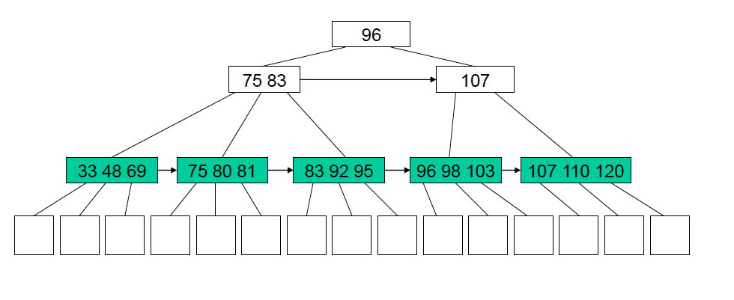
B+-Tree
A B+-Tree is a balanced tree whose nodes contain a sequence of key-pointer pairs.
Depth
Fan-out

Slide 18
B+-Tree
Nodes contains a bounded number of key-pointer pairs determined by b (branching factor)
Internal nodes: ceiling(b/ 2) <= size(node) <= b
Root node:
Root is the only node in the tree: 1 <= size(node) <= b
Internal nodes exist: 2 <= size(node) <= b
Leaves (no pointers):
floor(b/2) <= number(keys) <= b-1
Insertion, deletion algorithms keep the tree balanced, and maintain these constraints on the size of each node
Nodes might then be split or merged, possibly the depth of the tree is increased.
size(node) = number of key-pointer pairs

Slide 19
B+-Tree Performance #1
Memory / Disk
Root is always in memory
What is the portion of the index actually in memory?
Impacts the number of IO
Worst-case: an I/O per level in the B+-tree!
Fan-out and tree level
Both are interdepedent
They depend on the branching factor
In practise, index nodes are mapped onto index pages of fixed size
Branching factor then depends on key size (pointers of fixed size) and page utilization

Slide 20
B+-Tree Performance #2
Tree maintenance
On-line: textbook insertion and deletion algorithms that maintain balanced B+-tree as records are inserted
Off-line: inserted/deleted records are inserted in a specific data structure and indexes are modified offline (when the DBA requests it, regularly or when some condition is met).
Log-Structured Merge (LSM)-tree: Records inserted in RAM (C0-tree not necessarily organized as a B+-tree – e.g., sorted table), then merged with disk resident C1-tree pages opportunistically.
Heap file: insert buffer in MySQL, default mechanism in DB2.
Supports well
Point queries, Multipoint queries, Range queries, order queries, Extremal queries.
See LSM-Tree paper by Par O’neil et al.

Slide 21
B+-Tree Locking
See: VLDB journal survey, ARIES KVL
How to avoid locking the whole table and schedule concurrent modifications of the tree?
Mutexes are used. Top down traversal. Mutex released when it is clear that internal
Node will not be affected by insertion/deletion
e.g., new level requires holding mutex on root; insertion in leaf mutexes can be released as internal nodes are traversed.
1. How to support predicate-locking? Next-key locking. A mutex held on a pointer prevents access to all the records that are inserted, or could be inserted, below this pointer or in between this pointer and the next existing pointer. E.g. blue rectangles represent a lock on all records where key >= 80.

Slide 22
Hash Index
A hash index stores key-value pairs based on a pseudo-randomizing function called a hash function
Hashed key | values
0 | R1, R5
1 | R4, R6, R9
…
n
Hash
function
Overflow buckets
Key value
R14, R17, R21
R25

Slide 23
Hash Index Performance
Memory / Disk
Worst case: 1 IO per bucket
NOT balanced as number of IOs to reach a record depends on the hash function and key distribution.
Supports very well
Point queries

Slide 24
Fractal Tree Index
Trees of exponentially increasing size
(represented as arrays for ease of representation)
Trees are completely full or completely empty
Insert into smallest array
Merge arrays continuously
23
12 | 23
45
12 | 23
6 | 45 | 12 | 23
87
6 | 45 | 12 | 23

Slide 25
Fractal Tree Index Performance
Few, large, sequential IOs on several trees
Scales with large number of insertions (variation of LSM-tree)
Potential to leverage SSD parallelism

Slide 26
DBMS Implementation
Oracle 11g
B-tree vs. Hash vs. Bitmap
Index-organized table vs. heap
Non-clustered index can be defined on both
Reverse key indexes
Key compression
Invisible index (not visible to optimizer – allows for experimentation)
Function-based indexes
CREATE INDEX idx ON table_1 (a + b * (c - 1), a, b);
See: Oracle 11g indexes

Slide 27
DBMS Implementation
DB2 10
B+-tree (hash index only for db2 for z/OS)
Non-cluster vs. cluster
Key compression
Indexes on expression
SQL Server 2012
B+-tree (spatial indexes built on top of B+-trees)
Columnstore index for OLAP queries
Non-cluster vs. cluster
Non key columns included in index (for coverage)
Indexes on simple expressions (filtered indexes)
See: DB2 types of indexes, SQLServer 2012 indexes

Slide 28
Clustered Index
Benefits of a clustered index:
A sparse clustered index stores fewer pointers than a dense index.
This might save up to one level in the B-tree index.
A clustered index is good for multipoint queries
White pages in a paper telephone book
A clustered index based on a B-Tree supports range, prefix, extremal and ordering queries well.

Slide 29
Clustered Index
A clustered index (on attribute X) can reduce lock contention:
Retrieval of records or update operations using an equality, a prefix match or a range condition based on X will access and lock only a few consecutive pages of data
Cost of a clustered index
Cost of overflow pages
Due to insertions
Due to updates (e.g., a NULL value by a long string)

Slide 30
Clustered Index
Because there is only one clustered index per table, it might be a good idea to replicate a table in order to use a clustered index on two different attributes
Yellow and white pages in a paper telephone book
Low insertion/update rate

Slide 31
Non-Clustered Index
Benefits of non-clustered indexes
A dense index can eliminate the need to access the underlying table through covering.
It might be worth creating several indexes to increase the likelihood that the optimizer can find a covering index
A non-clustered index is good if each query retrieves significantly fewer records than there are pages in the table.
Where is the tipping point wrt heap file? You must experiment on your own system.

Slide 32
Covering Index - defined
Select name from employee where department = “marketing”
A priori:
Good covering index would be on (department, name)
Index on (name, department) less useful.
Index on department alone moderately useful.
Actual impact depends on underlying DBMS.

Slide 33
Index on Small Tables
Tuning manuals suggest to avoid indexes on small tables
If all data from a relation fits in one page then an index page adds an I/O
If each record fits in a page then an index helps performance
However, indexes on small tables allow the DBMS to leverage next key locking and thus reduce contention on small tables.

Slide 34
Key Compression
Use key compression
If you are using a B-tree
Compressing the key will reduce the number of levels in the tree
The system is not CPU-bound
Updates are relatively rare

Slide 35
Index Tuning Wizard
SQL Server 7 and above, Oracle 9 and above, DB2 V9 and above (design advisor)
In:
A database (schema + data + existing indexes)
Trace representative of the workload
Out:
Evaluation of existing indexes
Recommendations on index creation and deletion
The index wizard
Enumerates possible indexes on one attribute, then several attributes
Traverses this search space using the query optimizer to associate a cost to each index

Slide 36
Summary
Use a hash index for point queries only. Use a B-tree if multipoint queries or range queries are used
Use clustering
if your queries need all or most of the fields of each records returned
if multipoint or range queries are asked
Use a dense index to cover critical queries
Don’t use an index if the time lost when inserting and updating overwhelms the time saved when querying

