Slide 1
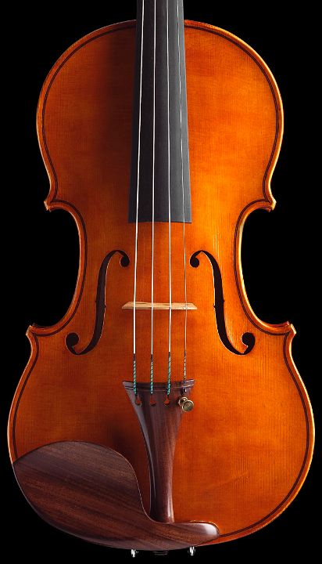

OLAP Tuning

Slide 2
Outline
OLAP 101
Data warehouse architecture
ROLAP, MOLAP and HOLAP
Data Cube
Star Schema and operations
The CUBE operator
Tuning the cube
Data Mining 101

Slide 3
OLAP
Online Analytical Processing
OLAP enables a user to interactively and selectively extract and view data from different points-of-view.
Typical OLAP queries
Find sales for seniors in Copenhagen (selection)
Find sales per age group, per city (aggregation)
Find sales per age group, per country (aggregation)
Find total sales (aggregation)
Find sales for seniors, per country (selection, aggregation)
Selections & Aggregations on Multi-dimensional Data

Slide 4
Data Warehouse
Data
Mart
Infrequent updates
Data in DW MUST NOT be
latest, up to date version
Production
Data
Data
Mart
Production
Data
Data
Warehouse
(DW)
Data
Mart
Production
Data
Data
Mart
Transactional Processing
Analytical Processing

Slide 5
ROLAP, MOLAP, HOLAP
MOLAP
DW is a proprietary system, tailored for multi-dimensional data manipulations
Relational OLAP
Multi-dimensional data mapped onto tables, and manipulations mapped onto relational queries
Hybrid OLAP
Relational systems extended with specific OLAP functionalities

Slide 6
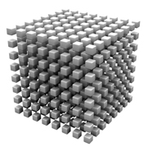
Star Schema
Fact table
Sales(Product_Id, Time_Id, City_id, Amount)
Multi-dimensional data
Can be represented as a (hyper-)cube
3 dimensions: Product, Time, City
The cube contains Amount values
Dimensions
Product(Product_id, Name, Category, Price)
Space(City_id, City, Country, Region)
Time(Time_id, Week, Month, Quarter)
Typically organized in a hierarchy

Slide 7
Drill Down and Roll Up
Dimensions as aggregation hierarchy
Drill down
Series of queries that moves down the aggregation hierarchy
E.g., per region, per country, per city
Roll up
Series of queries that moves up the aggregation hierarchy
E.g., per week, per month, per year
Same form of SQL query, different attributes
When rolling up, query results can be re-used
An aggregation can be used as a basis for an aggregation one or more levels up in the hierarchy

Slide 8
Pivoting
Data as a cube which is pivoted so that a user can “see” its various faces
Pivoting on dimensions D1, D2, D3 means grouping by attributes from these dimensions
New pivot on D3, D2, D1
Interesting in case a visualization software is used to represent 3 dimensions as x, y, z in space
Interesting if there are N dimensions, and the pivot concerns a subset of these dimensions

Slide 9
Slicing and Dicing
Slice
A value is given for a dimension attribute in the where clause
We take a “slice” of the cube
Dice
Multiple values (or a range) are given for a dimension attribute in the where clause
We are dicing, i.e., reduce the size of, the original cube

Slide 10
Star Schema Operations
Write the following sequence of queries in SQL on the sales star-schema
Original cube:
Sales amount per country, per week, per category
Roll-up on time
Sales amount per country, per month, per category
Sales amount per country, per year, per category
Drill-down on city
Sales amount per city, per year, per category
Pivot on product, time and space
Sales amount per category, per year, per city
Slice on year 2012
Sales amount per category, per city for 2012
Dice on the last three years
Sales amount per category, per city for 2010,2011,2012

Slide 11
Star Schema Operations
What are the SQL queries you need to construct the following table
 | Product 1 | Product 2 | Product 3 | Total
City 1 | 520 | 230 | 100 | 850
City 2 | 10 | 15 | 10 | 35
City 3 | 1000 | 1200 | 1000 | 3200
Total | 1530 | 1445 | 1110 | 4085

Slide 12
The CUBE Operator
SELECT city_id, product_id, SUM(amount) as sum_a
FROM SALES
GROUP BY CUBE (city_id, product_id)
Defined by Jim Gray et al. in 1996
Part of the SQL standard
Supported in Oracle, DB2, SQL Server
ROLAP implementation
City_id | Product_id | Sum_a
City1 | Product 1 | 520
City1 | product2 | 230
City1 | product3 | 100
City1 | ALL | 850
City2 | Product 1 | 10
City2 | product2 | 15
City2 | product3 | 10
City2 | ALL | 35
City3 | Product 1 | 1000
City3 | product2 | 1200
City3 | product3 | 1000
City3 | ALL | 3200
ALL | Product 1 | 1530
ALL | product2 | 1445
ALL | product3 | 1110
ALL | ALL | 4085

Slide 13
The ROLLUP Operator
SELECT city_id, product_id, SUM(amount) as sum_a
FROM SALES
GROUP BY city_id, product_id with ROLLUP
Part of the SQL standard
Supported in Oracle, DB2, SQL Server, MySQL
City_id | Product_id | Sum_a
City1 | Product 1 | 520
City1 | product2 | 230
City1 | product3 | 100
City1 | ALL | 850
City2 | Product 1 | 10
City2 | product2 | 15
City2 | product3 | 10
City2 | ALL | 35
City3 | Product 1 | 1000
City3 | product2 | 1200
City3 | product3 | 1000
City3 | ALL | 3200
ALL | ALL | 4085

Slide 14
Tuning the Cube
Materialized Views
To materialize the original cube and the result of important cube manipulations (those that are re-used often)
Indexes
Speeding up foreign-key/primary-key joins
Dimensions as index-organized tables (clustering index on primary key)
Non-clustered index on foreign key in fact table
Indexing low-cardinality attributes
Bitmap index (Oracle)
SQL Server columnstore indexes
Compression
Speeding up scans, reducing DW footprint on 2nd storage
Column-Oriented Representation
Great for slicing, dicing
Great for compression
Great for leveraging RAM, Processor cache
Parallelism
Work on dimensions in parallel, Speeding up scans
Tuning degree of parallelism in ORACLE, DB2

Slide 15
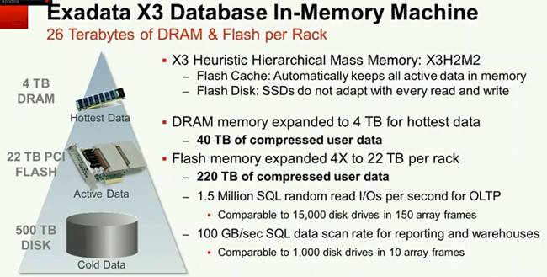
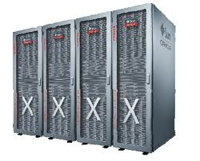
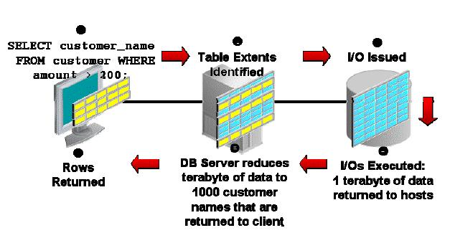
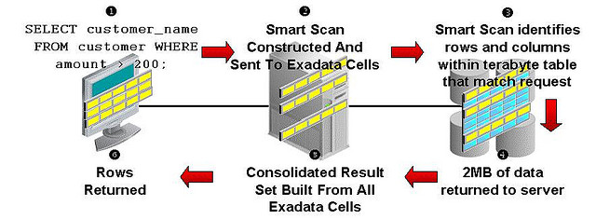
Data Warehouse Appliances
Exadata Data Sheet
Normal Table Scan vs. Exadata Smart Scan
See B.Durrett’s slides

Slide 16
Column Stores
Columnar representation
Compression & Scan efficiency
Tailored for RAM, processor cache utilization
VectorWise
SQL Server ColumnStore indexes

Slide 17
Data Mining 101
Boundaries of Data Management, Statistics and Machine Learning
Finding Patterns in Large Data Sets
Associations
Many buy Product1 and Product3 together
Classification
Given some predefined classes (e.g.., StaysInBusiness, GoesOutOfBusiness) train a classifier to distinguish in which class a store belongs based on its sales records
Might be used for prediction
Clustering
Like classfication but the classes are not given beforehand. They are discovered by the clustering algorithm.

Slide 18
Associations
An association is a correlation between values in the same or different columns
Noted Predicate1 => Predicate2
Example: Purchases_Diaper => Purchases_Beer
Confidence and Support
Confidence (rule): percentage of where Predicate2 is true when Predicate1 is true
Support (itemset): percentage of records where all attribute values needed by the rule are present
Confidence and support must be over a given threshold so that an association holds

Slide 19
Classification
Decision tree, Neural networks
Multiple variables analysis
Learning algorithm (training set)
Example: Titanic survivors
Sex == M
T
F
Age > 9.5
Survived (36%)
T
F
Number of Siblings > 2.5
Died (61%)
T
F
Died (2%)
Survived (2%)

Slide 20
Clustering
K-means algorithm
Each (of the given K) cluster is given a centroid
Form clusters by assigning points to cluster with closest centroid (distance is defined)
Recompute cluster centroid
Repeat 2,3 until centroids do not move
Other techniques
Hierarchical clustering (e.g., BIRCH), Support Vectors

Slide 21
Tuning for Mining
Tuning Scans
Most algorithms require several passes over the data
Parallelism & compression
Statistics features in systems
Predictive Analytics in SQL Server
Data mining features of DB2
Oracle DataMiner

