Slide 1
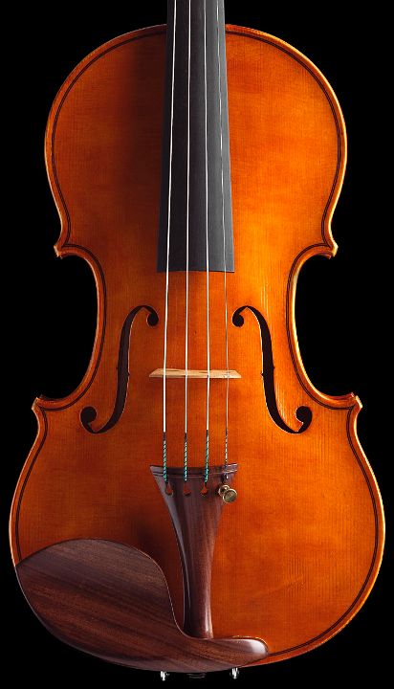

Query Tuning

Slide 2
Outline
Understanding Query Plans
Physical Operators
Cost Model
Query Optimization
Query Tuning
Rewriting Methods
Aggregate Maintenance
Tuning Triggers

Slide 3
Query Tuning
SELECT s.RESTAURANT_NAME, t.TABLE_SEATING, to_char(t.DATE_TIME,'Dy, Mon FMDD') AS THEDATE, to_char(t.DATE_TIME,'HH:MI PM') AS THETIME,to_char(t.DISCOUNT,'99') || '%' AS AMOUNTVALUE,t.TABLE_ID, s.SUPPLIER_ID, t.DATE_TIME, to_number(to_char(t.DATE_TIME,'SSSSS')) AS SORTTIME
FROM TABLES_AVAILABLE t, SUPPLIER_INFO s,
(SELECT s.SUPPLIER_ID, t.TABLE_SEATING, t.DATE_TIME, max(t.DISCOUNT) AMOUNT, t.OFFER_TYPE FROM TABLES_AVAILABLE t, SUPPLIER_INFO WHERE t.SUPPLIER_ID = s.SUPPLIER_ID and (TO_CHAR(t.DATE_TIME, 'MM/DD/YYYY') != TO_CHAR(sysdate, 'MM/DD/YYYY') OR TO_NUMBER(TO_CHAR(sysdate, 'SSSSS')) < s.NOTIFICATION_TIME - s.TZ_OFFSET) and t.NUM_OFFERS > 0 and t.DATE_TIME > SYSDATE and s.CITY = 'SF' and t.TABLE_SEATING = '2' and t.DATE_TIME between sysdate and (sysdate + 7) and to_number(to_char(t.DATE_TIME, 'SSSSS')) between 39600 and 82800 and t.OFFER_TYPE = 'Discount‘ GROUP BY s.SUPPLIER_ID, t.TABLE_SEATING, t.DATE_TIME, t.OFFER_TYP ) u
WHERE t.SUPPLIER_ID = s.SUPPLIER_ID and u.SUPPLIER_ID = s.SUPPLIER_ID and t.SUPPLIER_ID = u.SUPPLIER_ID and t.TABLE_SEATING = u.TABLE_SEATING and t.DATE_TIME = u.DATE_TIME and t.DISCOUNT = u.AMOUNT and t.OFFER_TYPE = u.OFFER_TYPE and (TO_CHAR(t.DATE_TIME, 'MM/DD/YYYY') != TO_CHAR(sysdate, 'MM/DD/YYYY') OR TO_NUMBER(TO_CHAR(sysdate, 'SSSSS')) < s.NOTIFICATION_TIME - s.TZ_OFFSET) and t.NUM_OFFERS > and t.DATE_TIME > SYSDATE and s.CITY = 'SF' and t.TABLE_SEATING = '2' and t.DATE_TIME between sysdate and (sysdate + 7) and to_number(to_char(t.DATE_TIME, 'SSSSS')) between 39600 and 82800 and t.OFFER_TYPE = 'Discount'
ORDER BY AMOUNTVALUE DESC, t.TABLE_SEATING ASC, upper(s.RESTAURANT_NAME) ASC,SORTTIME ASC, t.DATE_TIME ASC
Execution is too slow …
How is this query executed?
How to make it run faster?

Slide 4
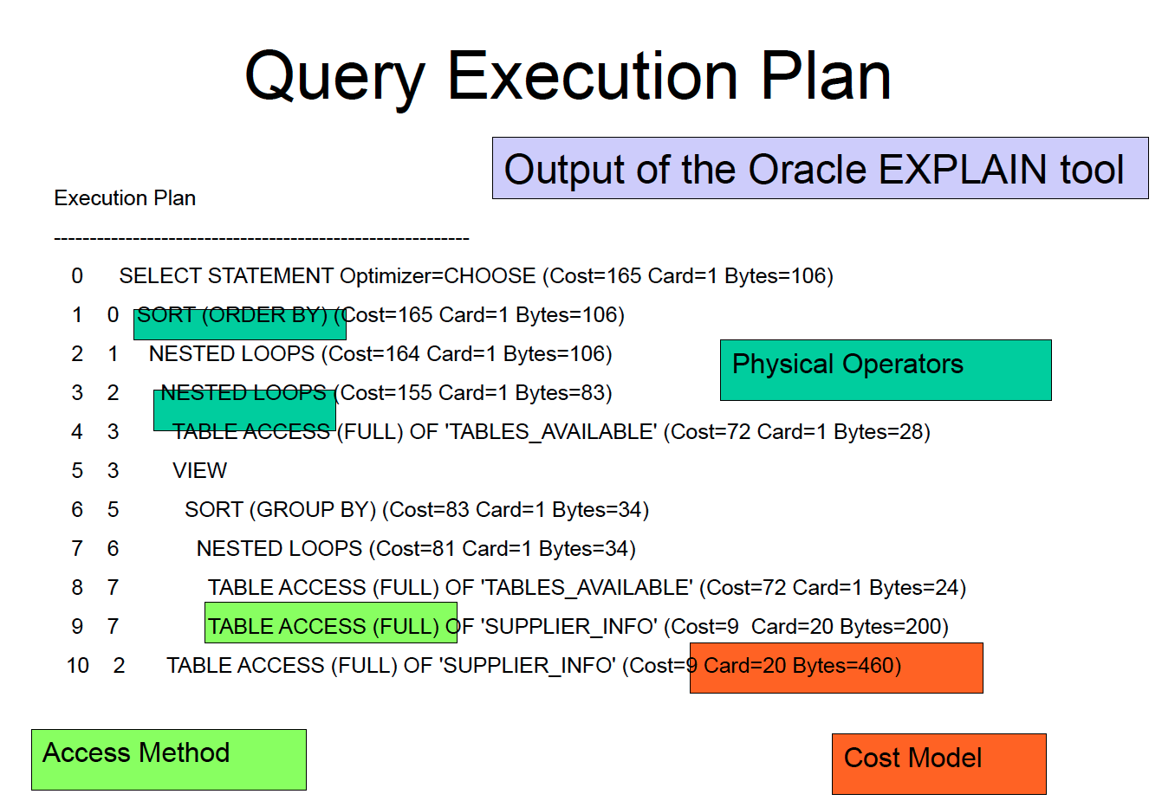

Slide 5
Physical Operators
Query Blocks
One block per SELECT-FROM-WHERE-GROUPBY-ORDERBY
VIEW isolate blocks optimized separately
Shape of the execution tree (right-deep, bushy, …)
Join order
Algorithms
Sort
Aggregates
Select
Project
Join
Nested Loop
Sort-Merge
Hash-Join

Slide 6
External Sorting
Sorting is used in implementing many relational operations
Problem:
Relations are typically large, do not fit in main memory
So cannot use traditional in-memory sorting algorithms
Approach used:
Combine in-memory sorting with clever techniques aimed at minimizing I/O
I/O costs dominate => cost of sorting algorithm is measured in the number of page transfers

Slide 7
External Sorting (cont’d)
External sorting has two main components:
Computation involved in sorting records in buffers in main memory
I/O necessary to move records between secondary storage and main memory

Slide 8
Duplicate Elimination
A major step in computing projection, union, and difference relational operators
Algorithm:
Sort
At the last stage of the merge step eliminate duplicates on the fly
No additional cost (with respect to sorting) in terms of I/O

Slide 9
Access Method
Table Scan
Index Scan
Find Index(es) matching expression in query
Extract constant or range from query
Index Search

Slide 10
Choosing an Access Path
Selectivity of an access path = number of pages retrieved using that path
If several access paths support a query, DBMS chooses the one with lowest selectivity
Size of domain of attribute is an indicator of the selectivity of search conditions that involve that attribute
Example: σ_{CrsCode=‘CS305’ AND Grade=‘B’} (Transcript)
a B⁺ tree with search key CrsCode has lower selectivity than a B⁺ tree with search key Grade

Slide 11
Computing Joins
The cost of joining two relations makes the choice of a join algorithm crucial
Simple block-nested loops join algorithm for computing r _{A=B} s
foreach page p_{r} in r do
foreach page p_{s} in s do
output p_{r} _{A=B} p_{s}

Slide 12
Join Algorithms
Nested Loop
Block-Nested Loop
Index-Nested Loop
Hash Join
Sort-Merge Join

Slide 13
Cost Model
Cost metric:
Cost = w1*IO_COST +w2*CPU_COST
We consider w2 = 0
Cost formula for each operator
Depends on operator algorithm
Depends on input size (nb tuples, nb pages)
Because operators are composed. Need to estimate size of operator output.
Rin
Rout
ơ
Rin_1
Rout
Rin_2

Slide 14
Query Execution Plan
Output of the Oracle EXPLAIN tool
Execution Plan
----------------------------------------------------------
0 SELECT STATEMENT Optimizer=CHOOSE (Cost=165 Card=1 Bytes=106)
1 0 SORT (ORDER BY) (Cost=165 Card=1 Bytes=106)
2 1 NESTED LOOPS (Cost=164 Card=1 Bytes=106)
3 2 NESTED LOOPS (Cost=155 Card=1 Bytes=83)
4 3 TABLE ACCESS (FULL) OF 'TABLES_AVAILABLE' (Cost=72 Card=1 Bytes=28)
5 3 VIEW
6 5 SORT (GROUP BY) (Cost=83 Card=1 Bytes=34)
7 6 NESTED LOOPS (Cost=81 Card=1 Bytes=34)
8 7 TABLE ACCESS (FULL) OF 'TABLES_AVAILABLE' (Cost=72 Card=1 Bytes=24)
9 7 TABLE ACCESS (FULL) OF 'SUPPLIER_INFO' (Cost=9 Card=20 Bytes=200)
10 2 TABLE ACCESS (FULL) OF 'SUPPLIER_INFO' (Cost=9 Card=20 Bytes=460)

Slide 15
Query Representation
Query Tree
Query graph
bid=100
(On-the-fly)
sname
Reserves
(Sort-Merge Join)
sid=sid
sid=sid
(Scan;
(Scan;
write to
bid=100
rating > 5
write to
temp T1)
temp T2)
Sailors
Reserves
Sailors
rating > 5

Slide 16
Query Representation
A query is decomposed into blocks
Aggregation
Order by
SPJ
Relations
Each block is represented and optimized independently

Slide 17
Overview of Query Optimization
Ideally: Want to find best plan.
Practically: Avoid worst plans!
Two main issues:
For a given query, what is the search space?
How is the search implemented?
Algorithm to search plan space for cheapest (estimated) plan.
How is the cost of a plan estimated?
Notes:
2

Slide 18
Search Algorithm
Naïve1
Enumerate all possible plans (o(n!))
Pick the best plan
Intractable
Naïve 2
Order of relations fixed by the query
Selections are pushed
No further transformations
Single multiway nested loop join for each block
Index used if they exist
Star tree

Slide 19
Search Algorithm
Semi-Naïve
Order of relations fixed by the query
Selections are pushed
No further transformations
Nested loop vs. sort merge join
Left-deep tree
Implementation problems:
expressions reference columns of tables
expressions must be adapted to the position of tables in the tree (including interm. tables)

Slide 20
Search Algorithm
Greedy
Cost model
Based on statistics (size of relation, distribution of attribute values)
I/O cost of each operator
Choice of join order using a greedy approach
For each outermost table
Find best join operator with one of the remaining table
Repeat until no remaining table
Keep best plan (left deep plan)

Slide 21
Search Algorithm
Dynamic programming (System R)
Enumerated using N passes (if N relations joined):
Pass 1: Find best 1-relation plan for each relation.
Pass 2: Find best way to join result of each 1-relation plan (as outer) to another relation. (All 2-relation plans.)
Pass N: Find best way to join result of a (N-1)-relation plan (as outer) to the N’th relation. (All N-relation plans.)
For each subset of relations:
Cheapest plan overall,
Cheapest plan for each interesting order of the tuples.

Slide 22
Query Monitoring
Two ways to identify a slow query:
It issues far too many disk accesses, e.g., a point query scans an entire table
Its query plan, i.e. the plan chosen by the optimizer to execute the query, fails to use promising indexes

Slide 23
Query Rewriting
The first tuning method to try is the one whose effects are purely local
Adding an index, changing the schema, modifying transactions have global effects that are potentially harmful
Query rewriting only impacts a particular query

Slide 24
Running Example
Employee(ssnum, name, manager, dept, salary, numfriends)
Clustering index on ssnum
Non clustering indexes (i) on name and (ii) on dept
Ssnum determines all the other attributes
Student(ssnum, name, degree_sought, year)
Clustering index on ssnum
Non clustering index on name
Ssnum determines all the other attributes
Tech(dept, manager, location)
Clustering index on dept; dept is key.

Slide 25
Query Rewriting Techniques
Index usage
DISTINCTs elimination
(Correlated) subqueries
Use of temporaries
Join conditions
Use of Having
Use of views
Materialized views.

Slide 26
Index Usage
Many query optimizers will not use indexes in the presence of:
Arithmetic expressions
WHERE salary/12 >= 4000;
Substring expressions
SELECT * FROM employee WHERE SUBSTR(name, 1, 1) = ‘G’;
Numerical comparisons of fields with different types
Comparison with NULL.

Slide 27
Eliminate unneeded DISTINCTs
Query: Find employees who work in the information systems department. There should be no duplicates.
SELECT distinct ssnum FROM employee WHERE dept = ‘information systems’
DISTINCT is unnecessary, since ssnum is a key of employee so certainly is a key of a subset of employee.

Slide 28
Eliminate unneeded DISTINCTs
Query: Find social security numbers of employees in the technical departments. There should be no duplicates.
SELECT DISTINCT ssnum FROM employee, tech WHERE employee.dept = tech.dept
Is DISTINCT needed?

Slide 29
Distinct Unnecessary Here Too
Since dept is a key of the tech table, each employee record will join with at most one record in tech.
Because ssnum is a key for employee, distinct is unnecessary.

Slide 30
Reaching
The relationship among DISTINCT, keys and joins can be generalized:
Call a table T privileged if the fields returned by the select contain a key of T
Let R be an unprivileged table. Suppose that R is joined on equality by its key field to some other table S, then we say R reaches S.
Now, define reaches to be transitive. So, if R1 reaches R2 and R2 reaches R3 then say that R1 reaches R3.

Slide 31
Reaches: Main Theorem
There will be no duplicates among the records returned by a selection, even in the absence of DISTINCT if one of the two following conditions hold:
Every table mentioned in the FROM clause is privileged
Every unprivileged table reaches at least one privileged table.

Slide 32
Reaches: Proof Sketch
If every relation is privileged then there are no duplicates
The keys of those relations are in the from clause
Suppose some relation T is not privileged but reaches at least one privileged one, say R. Then the qualifications linking T with R ensure that each distinct combination of privileged records is joined with at most one record of T.

Slide 33
Reaches: Example 1
SELECT ssnum FROM employee, tech WHERE employee.manager = tech.manager
The same employee record may match several tech records (because manager is not a key of tech), so the ssnum of that employee record may appear several times.
Tech does not reach the privileged relation employee.

Slide 34
Reaches: Example 2
Each repetition of a given ssnum vlaue would be accompanied by a new tech.dept since tech.dept is a key of tech
Both relations are privileged.
SELECT ssnum, tech.dept FROM employee, tech WHERE employee.manager = tech.manager

Slide 35
Reaches: Example 3
SELECT student.ssnum FROM student, employee, tech WHERE student.name = employee.name AND employee.dept = tech.dept;
Student is priviledged
Employee does not reach student (name is not a key of employee)
DISTINCT is needed to avoid duplicates.

Slide 36
Types of Nested Queries
Uncorrelated subqueries with aggregates in the nested query
SELECT ssnum FROM employee WHERE salary > (select avg(salary) from employee)
Uncorrelated subqueries without aggregate in the nested query
SELECT ssnum FROM employee WHERE dept in (select dept from tech)
Correlated subqueries with aggregates
SELECT ssnum FROM employee e1 WHERE salary = (SELECT avg(e2.salary)
FROM employee e2, tech WHERE e2.dept = e1.dept AND e2.dept = tech.dept)
Correlated subqueries without aggregates
(unusual)

Slide 37
Rewriting of Uncorrelated Subqueries without Aggregates
Combine the arguments of the two FROM clauses
AND together the where cluases, repacing in by =
Retain the SELECT clause from the outer block
SELECT ssnum FROM employee WHERE dept in (select dept from tech)
becomes SELECT ssnum FROM employee, tech WHERE employee.dept = tech.dept

Slide 38
Rewriting of Uncorrelated Subqueries without Aggregates
Potential problem with duplicates
SELECT avg(salary) FROM employee WHERE manager in (select manager from tech)
SELECT avg(salary) FROM employee, tech WHERE employee.manager = tech.manager
The rewritten query may include an employee record several times if that employee’s manager manages several departments.
The solution is to create a temporary table (using DISTINCT to eliminate duplicates).

Slide 39
Rewriting of Correlated Subqueries
Query: find the employees of tech departments who earn exactly the average salary in their department
SELECT ssnum FROM employee e1
WHERE salary = (SELECT avg(e2.salary FROM employee e2, tech WHERE e2.dept = e1.dept AND e2.dept = tech.dept);

Slide 40
Rewriting of Correlated Subqueries
INSERT INTO temp SELECT avg(salary) as avsalary, employee.dept FROM employee, tech WHERE employee.dept = tech.dept GROUP BY employee.dept;
SELECT ssnum FROM employee, temp WHERE salary = avsalary AND employee.dept = temp.dept

Slide 41
Rewriting of Correlated Subqueries
Query: Find employees of technical departments whose number of friends equals the number of employees in their department.
SELECT ssnum FROM employee e1 WHERE numfriends = COUNT(SELECT e2.ssnum FROM employee e2, tech WHERE e2.dept = tech.dept AND e2.dept = e1.dept);

Slide 42
Rewriting of Correlated Subqueries
INSERT INTO temp SELECT COUNT(ssnum) as numcolleagues, employee.dept FROM employee, tech WHERE employee.dept = tech.dept GROUP BY employee.dept;
SELECT ssnum FROM employee, temp WHERE numfriends = numcolleagues AND employee.dept = temp.dept;
Can you spot the infamous COUNT bug?

Slide 43
The Infamous COUNT Bug
Let us consider Helene who is not in a technical department.
In the original query, helene’s number of friends would be compared to the count of an empty set which is 0. In case helene has no friends she would survive the selection.
In the transformed query, helene’s record would not appear in the temporary table because she does not work for a technical department.
This is a limitation of the correlated subquery rewriting technique when COUNT is involved.

Slide 44
Abuse of Temporaries
Query: Find all information department employees with their locations who earn at least $40000.
INSERT INTO temp SELECT * FROM employee WHERE salary >= 40000
SELECT ssnum, location FROM temp WHERE temp.dept = ‘information systems’
Selections should have been done in reverse order. Temporary relation blinded the optimizer.

Slide 45
Join Conditions
It is a good idea to express join conditions on clustering indexes.
No sorting for sort-merge.
Speed up for multipoint access using an indexed nested loop.
It is a good idea to express join conditions on numerical attributes rather than on string attributes.

Slide 46
Use of Having
Don’t use HAVING when WHERE is enough.
SELECT avg(salary) as avgsalary, dept FROM employee GROUP BY dept HAVING dept = ‘information systems’;
SELECT avg(salary) as avgsalary, dept FROM employee WHERE dept= ‘information systems’ GROUP BY dept;
Having should be reserved for aggregate properties of the groups.
SELECT avg(salary) as avgsalary, dept FROM employee GROUP BY dept HAVING count(ssnum) > 100;

Slide 47
Use of Views
CREATE VIEW techlocation AS SELECT ssnum, tech.dept, location FROM employee, tech WHERE employee.dept = tech.dept;
SELECT location FROM techlocation WHERE ssnum = 43253265;
Optimizers expand views when identifying the query blocks to be optimized.
The selection from techlocation is expanded into a join:
SELECT location FROM employee, tech WHERE employee.dept = tech.dept AND ssnum = 43253265;

Slide 48
Aggregate Maintenance
The accounting department of a convenience store chain issues queries every twenty minutes to obtain:
The total dollar amount on order from a particular vendor
The total dollar amount on order by a particular store outlet.
Original Schema:
Ordernum(ordernum, itemnum, quantity, purchaser, vendor)
Item(itemnum, price)
Ordernum and Item have a clustering index on itemnum
The total dollar queries are expensive. Can you see why?

Slide 49
Aggregate Maintenance
Add:
VendorOutstanding(vendor, amount), where amount is the dollar value of goods on order to the vendor, with a clustering index on vendor
StoreOutstanding(purchaser, amount), where amount is the dollar value of goods on order by the purchaser store, with a clustering index on purchaser.
Each update to order causes an update to these two redundant tables (triggers can be used to implement this explicitely, materialized views make these updates implicit)
Trade-off between update overhead and loopup speed-up.

Slide 50
Materialized Views in Oracle9i
Oracle9i supports materialized views:
CREATE MATERIALIZED VIEW VendorOutstanding BUILD IMMEDIATE REFRESH COMPLETE ENABLE QUERY REWRITE AS SELECT orders.vendor, sum(orders.quantity*item.price) FROM orders,item WHERE orders.itemnum = item.itemnum group by orders.vendor;
Some Options:
BUILD immediate/deferred
REFRESH complete/fast
ENABLE QUERY REWRITE
Key characteristics:
Transparent aggregate maintenance
Transparent expansion performed by the optimizer based on cost.
It is the optimizer and not the programmer that performs query rewriting

Slide 51
Triggers
A trigger is a stored procedure (collection of SQL statements stored within the database server) that executes as a result of an event.
Events are of two kinds:
Timing events
Modifications: inserts, deletes or updates
A trigger executes as part of the transaction containing the enabling event.

Slide 52
Reason to Use Triggers
A trigger will fire regardless of the application that enables it.
This makes triggers valuable for auditing purposes or to reverse suspicious actions, e.g. a salary changed on a Saturday.
Triggers can maintain integrity constraints, e.g., referential integrity or aggregate maintenance
Triggers are located on the database server and are thus application independent.

Slide 53
Life without Triggers
Application must display the latest data inserted into a table
Without triggers, the application must poll data repeatedly:
SELECT * FROM table WHERE inserttime >= lasttimelooked + 1;
Update lasttimelooked based on current time.
Poll too often and you cause lock conflicts.
Poll too seldom and you will miss updates.

Slide 54
Triggers Can Help
Implement an interrupt-driven approach:
CREATE TRIGGER todisplay ON table FOR insert AS SELECT * FROM inserted
The trigger avoids concurrency conflicts and provide new data exactly when produced.

Slide 55
Problems with Triggers
In the presence of triggers, no update can be analyzed in isolation, because triggers might cause further updates.
The interaction between triggers might be hard to maintain when the number of triggers grow:
A modification might potentially fire several triggers: which ones are fired? in which order?

Slide 56
Tuning Triggers
A triggers executes only after a given operation has taken place. The programmer might make use of this information to suggest a specific execution strategy.
Non clustered indexes to speed-up referential integrity if records are inserted one at a time.

Slide 57
Tuning Triggers
It is easy to write triggers that execute too often or return too much data.
Example: write records to table Richdepositor everytime account balance increases over $50000.
A naïve implementation: CREATE TRIGGER nr ON account FOR update AS INSERT INTO Richdepositor FROM inserted WHERE inserted.balance > 50000;
A more efficient implementation:
CREATE TRIGGER nr ON account FOR update AS if update(balance) BEGIN INSERT INTO RichDepositor FROM inserted, deleted WHERE inserted.id = deleted.id AND inserted.balance > 500000 AND deleted.balance < 500000 END

