Slide 1
Tuning across instances
SOME CASES

Slide 2
Overview
Configuration
  Disaster-proof systems, interoperability among different languages and different databases.
Global systems
  Semantic replication, rotation ownership, chopping batches
Tuning
  Clustering, concurrency and hashing, forcing plans

Slide 3
Preparing for Disaster
Far from the simple model of stable storage that we sometimes teach, though the principle still apply.
Memory fails, disk fail (in batches), fires happen and power grids fail. If your system is still alive you have a big advantage.
You can even let your competitors use your facilities … for a price.

Slide 4
Case #1
Application used a few days per month, but with a heavy load (Server for trading bond futures having to do with home mortgages)
Downtime should be minimal during these few days:
  Operating System failure
  Disk failure
  Power failure
  Building in fire (Credit Lyonnais, NYSE)

Slide 5
Solution1: Shared Disk
High Availability Servers
Primary and backup attached to RAID disks
If primary fails then backup takes over (warm start from disks)
If a disk fails, RAID masks it
Does not survive disasters or correlated failures
Application
Server
Primary
Backup
Disk Subsystem

Slide 6
Solution2: Dump and Load
Full dump from primary to back up at night.
Incremental dumps every 10 minutes
If primary fails, backup takeover from last dump.
  Lose transactions committed on primary since last dump
  There must be a (manual) record of these transactions
Back up can be far away
Application
Server
Primary
Backup

Slide 7
Solution3: Replication Server
Full dump of primary transferred to backup at night.
Each SQL transaction committed on the primary is sent to the backup
If primary fails, backup takes over from last committed transaction
  May lose a few seconds of committed transactions
Administration overhead
Application
Server
Log sniffer
Primary
Backup

Slide 8
Solution4: Remote Mirroring
Writes to local disks are mirrored to disks on a remote site. The commit at the local machine is delayed until the remote disks responds
Backup problem may cause primary to halt.
Application
Server
Primary
Backup

Slide 9
Solution5: Two Phase Commit
A transaction manager coordinates the commits between primary and backup
Blocking occurs if transaction manager fails
Backup problem may cause primary to halt.
Application
Server
Transaction Manager
Primary
Backup

Slide 10
Solution6: Wide-area Quorum Approach
Servers are peers and interconnected via a highly redundant wide-area interconnect
Servers coordinate via a distributed lock manager
Disks are connected with servers at several points and to one another by a second wide area interconnect
Application
Server
Processor WAN
Distributed Lock Manager
Disk WAN
Primary
Backup

Slide 11
Solution6: Wide-area Quorum Approach
Heartbeats monitor the connectivity among disks and processors
If a break is detected, one partition holding a majority of votes continues to execute
Any single failure of a processor, disk, site o r network is invisible to end-user.
Application
Server
Processor WAN
Distributed Lock Manager
Disk WAN
Primary
Backup

Slide 12
Review Case#1
Wide-area quorum solution used by traders applications
Dump and Load or replication server used for back-office applications
Symmetric approaches (shared disk and two phase commit) are not used in practice for implementing remote backup
Don’t buy batches of disks from one vendor.

Slide 13
Case #2
Front-office system records trade for profit and loss.
  A trade is a transaction: You sell or buy X stocks of company Y at price Z.
Trades have to be sent to the back-office for final clearing.
No trades should be lost!

Slide 14
Solution1: Two-Phase Commit
Phase1: preparation
  Coordinator sends prepare-to-commit message to all participants
Prepare to commit
Source
(coordinator
& participant)
Destination
(participant)

Slide 15
Solution 1: Two-Phase Commit
Phase1: preparation
  Coordinator sends prepare-to-commit message to all participants
  All participants send a notification to the coordinator (OK/NotOK)
OK/NotOK
OK/NotOK
Source
(coordinator
& participant)
Destination
(participant)

Slide 16
Solution 1: Two-Phase Commit
Phase1: preparation
  Coordinator sends prepare-to-commit message to all participants
  All participants send a notification to the coordinator (OK/NotOK)
Phase2: commit/abort
  If all participants return OK then coordinator sends a commit message to all participants, else it sends an abort message.
commit
commit
Source
(coordinator
& participant)
Destination
(participant)

Slide 17
Solution 1: Two-Phase Commit
Commits are coordinated between the source and the destination
If one participant fails then blocking can occur
Not all db systems support prepare-to-commit interface
Source
(coordinator
& participant)
Destination
(participant)

Slide 18
Solution 2: Replication Server
At night, full dump of source db is transferred to destination db
During the day, all SQL transactions committed on the source db are sent to the destination
Source
Destination

Slide 19
Solution 2: Replication Server
Destination within a few seconds of being up-to-date
Decision support queries can be asked on destination db
Administrator is needed when network connection breaks!
Source
Destination

Slide 20
Solution3: Buffer Tables
A buffer table is created on the source db
Whenever a trade transaction is committed a tuple is inserted in the buffer table
The destination reads new tuple t from buffer table and performs transaction locally
After processing t, the destination database deletes t
Source
Destination

Slide 21
Solution3: Buffer Tables
No specific mechanism is necessary at source or destination
Blocking can occur!
  Problem: Source and destination update the buffer table (insert/delete)
Buffer table
Source
Destination

Slide 22
Solution3: Buffer Tables
No specific mechanism is necessary at source or destination
Blocking can occur!
  Problem: Source and destination update the buffer table (insert/delete)
  Solution: Introduce a new table TuplesToBeDeleted. Destination updates TuplesToBeDeleted and only reads from Buffer.
Buffer table
read
Source
Write
Destination

Slide 23
Review Case#2
Two Phase Commit for the coordination of commits (aborts) on distributed databases
  1: preparation
  2: commit (abort)
In practice Two Phase Commit is not used for data replication because it introduces a dependency between source and destination
The ‘Buffer table’ solution does not require any specific system support to replicate data between a source and a destination
Backup at Scale at Facebook

Slide 24
Case #3
Accounts data are replicated on 2 sites
Updates can take place on both sites
Accounts data have to be kept consistent

Slide 25
Solution1: Eager Replication
All replicas are exactly synchronized at all nodes by updating all replicas as part of one atomic transaction
Two phase commit ensures serial execution of T0 and T1
  Delays or aborts transactions if committing would violate serialization
Low update performance
T0
Site A
T1
Site B

Slide 26
Solution2: Lazy Replication
Replication server ensures that replica updates are propagated to other nodes after the updating transaction commits
Improved response time
Problem: lost updates
Site A
Site B

Slide 27
Lost updates
Time 0:
  Site A has cash position of 10M$ on Account X
  Site B has cash position of 10M$ on Account X
Time 1:
  T0: Site A increases position of account X by 2M$
  T1: Site B increases position of account X by 1M$
  Replication server: Update at both sites are translated into a delete followed by an insert which are sent to the other site
Time 2:
  Site A writes the value obtained from B
  Site B writes the value obtained from A
Time 3:
  Site A has cash position of 11M$ on Account X
  Site B has cash position of 12M$ on Account X
Need for reconciliation
Notes:
Discuss delete/insert instead of +/- operations
Discuss more complex case

Slide 28
Review Case#3
Eager replication vs. Lazy replication for synchronizing replicated data
  Eager replication
    No concurrency anomalies
    Poor update performances
  Lazy replication
    High throughput
    Need for reconciliation to avoid lost updates

Slide 29
Case #4
Each trader accesses local trade information as well as global exchange rate information.
When traders run a calculation they expect the most up-to-date exchange rate
Current solution: trades are stored locally and exchange rates centrally.
Problem: Calculations are slow!
Trade@C
Trade@D
Trade@B
Exchange rates
Trade@A
Trade@E
Trade@F

Slide 30
Solution1: Master replication
Update central site and replicate updates on all local sites
Problem: Calculations are still slow.
  If a trader changes a rate and runs a calculation, the calculation should reflect the new rate
Trade@C
Trade@D
Trade@B
Exchange rates
Trade@A
Trade@E
Trade@F

Slide 31
Solution2: Group Replication
Update on a site are replicated to all other sites
Problem: Two sites can update the exchange rates.
  All sites should agree on a new exchange rate after a short time
Trade@C
Trade@D
Trade@B
Exchange rates
Trade@A
Trade@E
Trade@F

Slide 32
Solution2: Clock-based Replication
Synchronize clocks at the different sites.
Attach a timestamp to each update of an exchange rate.
An update is accepted locally if the timestamp of the update is greater than the timestamp of the exchange rate in that database.
Trade@C
Trade@D
Trade@B
Exchange rates
Trade@A
Trade@E
Trade@F

Slide 33
Review Case#4
Lazy replication schemes for reconciliation
  Master replication
    Works well for any kind of updates
    Poor performance
  Clock-based replication:
    Works well for write only transactions

Slide 34
Case #5
When the trading day is over, there are many operations that must be done to move trades to the backoffice, to clear out positions that have fallen to zero, and so on. Call it “rollover”.
Straightforward provided no trades are hitting the database at the same time.
In a global trading situation however, rollover in New York may interfere with trading in Tokyo.

Slide 35
Solution
Chop the rollover transaction into smaller ones.
New trades do not conflict with rollover. Lock conflicts are due to the fact that rollover uses scans.

Slide 36
Data Integration
Fact table
  Sales(id, itemid, customerid, storeid, amount, qty)
The itemid field must be checked against the item table, the customerid field must be checked against the customer table and the storeid field must be checked against the store table.
This can be done in linear time.

Slide 37
Circumventing Superlinearity
Create an empty table successfulsales
Then issue the query:
  insert into successfulsales
  select sales.id, sales.itemid, sales.customerid,
  sales.storeid, sales.amount, sales.qty
  from sales, item, store, customer
  where itemid in (select itemid from item)
  and customerid in (select customerid from item)
  and storeid in (select storeid from store)

Slide 38
Circumventing Superlinearity
Now comes the difficult part: create a table with the sales that did not make it into successfulsales.
One way is to initialize the unsuccessfulsales table with all sales and then to delete the successful ones:
  insert into unsuccessfulsales
  select * from sales;
  delete from unsuccessfulsales
  where id in (select id from successfulsales);
If neither successfulsales nor successfulsales is indexed then response time is proportional to the square of the number of sales (most sales are successful).

Slide 39
Circumventing Superlinearity
A first solution is to index the tables successfulsales and unsuccessfulsales
A second solution is to insert the data in small batches (response time is then proportional to the size of those batches – not to the size of the complete sales table).

Slide 40
Circumventing Superlinearity
A third solution is to use an outer join when inserting data into the successfulsales table.
  insert into successfulsales
  select sales.id, item.id, store.id, customer.id,
  sales.amount, sales.qty
  from (((sales left outer join item
  on sales.itemid = item.id)
  left outer join store
  on sales.storeid = store.id)
  left outer join customer
  on sales.customerid =
  customer.id);

Slide 41
Circumventing Superlinearity
Unsuccessful sales are obtained as follows:
insert into unsuccessfulsales
select * from successfulsales
where itemid is null
or customerid is null
or storeid is null;
Successful sales are obtained as follows:
  delete from successfulsales
  where itemid is null
  or customerid is null
  or storeid is null;

Slide 42
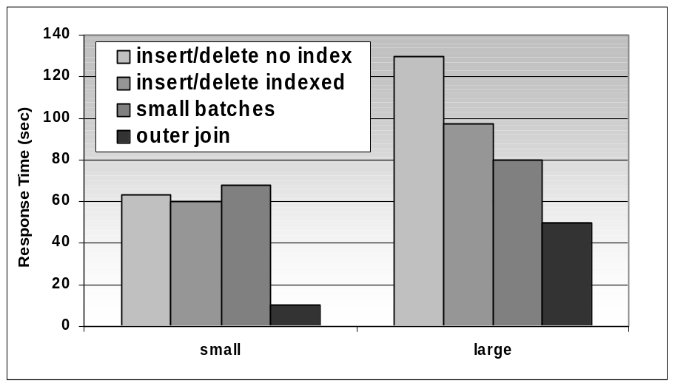
Circumventing Superlinearity
Small: 500000 sales
Large: 1000000 sales
SQL Server 2000
Outer join achieves the best response time.
Small batches do not provide benefits for the small database. The overhead of crossing the application interface is higher than the benefit of joining with smaller tables.

Slide 43
Tuning in the Cloud
The cloud is Utility Computing
  Packaging of computing resources, such as computation, storage and services, as a metered service. This model has the advantage of a low or no initial cost to acquire computer resources; instead, computational resources are essentially rented

Slide 44
What is the Cloud
The cloud is many things
  Daas: Data as a Service
    Application-dependant: e.g., Urban Mapping
  Saas: Software as a Service
    RDBMS functionalities: e.g., MS SQL Azure, Amazon RDS, SimpleDB, Google Cloud SQL
  Paas: Platform as a Service
    Virtualized servers E.g., Amazon EC2

Slide 45
Provisioning
AWS RDS allows to access Oracle, MySQL or SQL Server on the AWS infrastructure
  Specially interesting if you are developing a server to be deployed on an EC2 instance
Provisioning in terms of capacity and IOPS
  3 TB and 30000 IOPS
  EC2 instances with CPU provisioning
  Note that there is NO network provisioning

Slide 46
Tuning in the Cloud
Virtualized Environment
  No HW tuning
  No HW information; just provisioning
Cyclical/Unstable environment
  Network fluctuates
  Workload fluctuates
  HW resources actually available fluctuate
  Tuning target is moving!
Cost depends on traffic
  Tuning how the application interface is crossed is a key issue!

