Slide 1
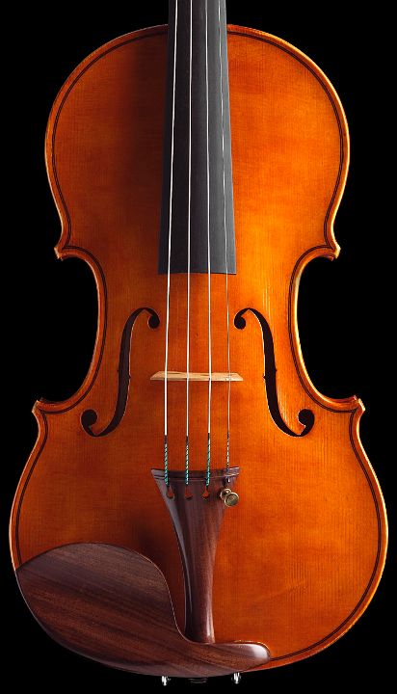

Tuning Concurrency

Slide 2
Outline
Correctness and Performance
Concurrency control principles
Serialization graph
Read consistency
2-phase locking
Lock granularity
The Phantom Problem
Next-key locking
Lock implementation
Lock Tuning
Isolation levels
Transaction chopping

Slide 3
Context
How can the DBMS handle concurrent transactions efficiently?
Query agent
Query agent
Query agent
VOLATILE MEMORY
 | Pi |  | Pj
DATABASE BUFFER

Slide 4
Transactions Execution
Each transaction is a sequence of operations
Read (select)
Write (update, insert, delete)
Execution model
Batch: transactions are submitted and executed later on
Interactive: transactions are executed as they are submitted
The DBMS contains a scheduler that interleaves the execution of all transaction operations as they are submitted

Slide 5
Scheduling
How can the schedules interleave operations so that isolation is preserved?
Each transaction should execute as if it was the only one in the system
This is the definition of a correct schedule
A schedule is correct if it is equivalent to a serial schedule
Two schedule are equivalent if all they operations commute
Most operations commute
Two operations on different data items
Two read operations

Slide 6
Scheduling
Operations do not commute, if they conflict
Two transactions conflict when:
They contain operations applied on the same data
One of these operations is a write
Example conflicts:
W-W: lost update
W-R: inconsistent read
R-W-R: unrepeatable read
I-R/W: Phantom

Slide 7
Scheduling
Locking is used to make conflicts explicit for the scheduler
Locking protocol to determine when transaction acquire/release locks
In case of conflict, a transaction is delayed
Direct impact on performance (throughput and latency)
Trade-off between correctness and performance

Slide 8
Serialization Graph
For a given schedule:
Vertices are defined for all transactions
Edges are defined for all conflicting transactions
There is an edge from Ti to Tj iff Ti contains an operation pi that conflicts with an operation pj, and Pi precedes pj in S
Theorem: A schedule is conflict serializable if and only if its serialization graph has no cycles

Slide 9
Example#1
Consider the nonserializable schedule S
r₁(x) w₂(x) r₂(y) w₁(y)
Intuition
T1 and T2 conflict on x
T1 reads x before T2 writes it
Schedule S must be equivalent to a serial schedule where T1 precedes T2
T1 and T2 conflict on y
T2 writes y before T1 writes it
Schedule S must be equivalent to a serial schedule where T2 precedes T1
S is not equivalent to any serializable schedule
S does not guarantee isolation
T₁ T₂

Slide 10
Concurrency Control
Arriving schedule
Scheduler
serializable schedule
Concurrency control cannot see entire schedule:
It sees one request at a time and must decide whether to allow it to be serviced
Two (complementary) strategies:
Avoid (some) conflicts – Read consistency
Restrict conflicts to W-W
Read and write executed on distinct copies of the data
Make conflicts explicit - Locking
Delay operations that are conflicting with non committed operations

Slide 11
Read Consistency
Also called snapshot isolation
Each transaction executes against the version of the data items that was committed when the transaction started:
No locks for read
Locks for writes
Costs space (old copy of data must be kept – undo record)
Almost serializable level:
T1: x:=y
T2: y:= x
Initially x=3 and y =17
Serial execution: x,y=17 or x,y=3
Snapshot isolation: x=17, y=3 if both transactions start at the same time.
R(Y) returns 1
R(X) returns 0
R(Z) returns 0
T1
W(Y:=1)
T2
W(X:=2, Z:=3)
T3
X=Y=Z=0
TIME

Slide 12
Locking
A transaction can read a database item if it holds a read (shared - S) lock on the item
It can read or update the item if it holds a write (exclusive - X) lock
If the transaction does not already hold the required lock, a lock request is automatically made as part of the (read or write) request

Slide 13
Locking
Request for read lock on an item is granted if
no transaction currently holds write lock on the item
Cannot read an item written by an active transaction
Request for write lock granted if
no transaction currently holds any lock on item
Cannot write an item read/written by an active transaction
Transaction is delayed if request cannot be granted

Slide 14
Locking Implementation
Lock table
To each database item which is accessed is associated
A lock set L(x) that contains an entry for each granted lock on x
A wait set W(x) that contains an entry for each pending request
Granting a lock boils down to promoting a pending request from W(x) into a granted lock in L(x) based on a scheduling policy (e.g., first come first serve).
Lock list
To each transaction Ti, is associated a lock list Li that links Ti entries in all L and W lists together.
The Li list is used to release locks when a transaction commits/aborts.

Slide 15
Locking Implementation
Database Item (e.g., row or table) | Lock set L | Wait set W
x | LO1(T1,S), LO3(T3,S) | LW2(T2,X)
y | LO2(T2,X) | LW4(T4, S), LW5(T5, X)
Transaction ID | Locks
T1 | LO1
T2 | LO2, LW2
T3 | LO3
T4 | LW4
T5 | LW5

Slide 16
Latches and Locks
Locks are used for concurrency control
Requests for locks are queued
Priority queue
Lock data structure
Locking mode (S, lock granularity, transaction id.
Lock table
Latches are used for mutual exclusion
Requests for latch succeeds or fails
Active wait (spinning) on latches on multiple CPU.
Single location in memory
Test and set for latch manipulation

Slide 17
Locking Protocol
Locking does not guarantee serializability. It depends on the locking protocol!
Example protocol:
Release lock on item when finished accessing the item
It can lead to non-serializable schedules
T₁: l(x) r(x) u(x) l(y) r(y) u(y)
T₂: l(x) l(y) w(x) w(y) u(x) u(y)
commit

Slide 18
Two-Phase Locking
Transaction does not release a lock until it has all the locks it will ever require.
Transaction has a locking phase followed by an unlocking phase
T′s first unlock
Number
of locks
held by T
T commits
time

Slide 19
Deadlock
Problem: Conflicts that cause transactions to wait can cause deadlocks
Example: T1: w(x) r(y)
T2: w(y) r(x)
Wait-for graph: For a schedule S
Vertices for each transaction
Edges when a transaction wait for another
Deadlock in case of cycle in a wait-for graph
Solution:
Detect deadlock: Use wait-for graph to detect cycle when a request is delayed, pick one of the transaction in the cycle and abort it
Assume a deadlock when a transaction waits longer than some time-out period

Slide 20
Lock Granularity
Table lock
T1.Read(row1) conflicts with T2.write(row2)
The scope of conflicts is artificially large
Row lock
T1.read(row1) does not conflict with T2.write(row2)
T1.read(row1) conflicts with T2.write(row1)
The scope of conflict is narrow
Row 1
Row 2
Table

Slide 21
Lock Granularity
Case:
transaction T1 is granted a table lock in mode shared on Table T
T2 requests a row lock in mode exclusive on Row1
Should T2’s lock request be granted?
Row 1
Row 2
Table T

Slide 22
Lock Granularity
A row lock request is preceded by an intention lock request at the table level:
S (resp. X) lock on Row tied to IS (resp. IX) lock on Table
Lock compatibility table
Row 1
Lock held
Row 2
 | S | IS | X | IX
S | X | X
IS | X | X |  | x
X
IX |  | x |  | x
Lock requested
Table

Slide 23
Lock Escalation
The DBMS might choose to convert many row locks into a table lock
DB2 allows lock escalation; Oracle does not
Problem: lock escalation might cause the DBMS to cause a deadlock, e.g.,
T1 holds a row lock on row1
T2 holds a row lock on a million rows in the Table include row2
T1 requests a lock on row2
The DBMS decides to escalate T2 row locks to a table lock
Row 1
Row 2
Table

Slide 24
Phantom Problem
Table R
T1: Insert into R values (03, Smythe, 42) into R
T2: Select max(age) from R where Name like ‘Sm%’
Select max(age) from R where Name like ‘Sm%’
Any serializable execution returns twice the same max value (either 35 if T2 is executed before T1, or 42 if T1 is executed before
E# | Name | age
01 | Smith | 35
02 | Jones | 28
[row1]
[row2]
Snapshot isolation not in effect
Time
T1: insert(03,Smythe, 42), commit
T2: get locks on existing rows, read all rows, compute max, read all rows, compute max, release locks, commit
35
42
2 Phase locking with row locks does not prevent concurrent insertions as they only protect existing rows.
This schedule returns two
Different max values!

Slide 25
Solution to Phantom Problem
Solution#1:
Table locking (mode X)
No insertion is allowed in the table
Problem: too coarse if predicate is used in transactions
Solution #2:
Predicate locking – avoid inserting tuples that satisfy a given predicate
E.g., 30 < age < 40
Problem: very complex to implement
Solution #3:
Next key locking (NS)
See index tuning
Set of
Tuples in R
Tuples that satisfy predicate P
Set of all tuples that can be inserted in R

Slide 26
Locking in SQL Server
syslockinfo
spid
dbid
objid
lock granularity
lock mode
lock owner
lock waiter
10
1
117
RID
X
LO1
LW1, LW4
10
1 117 PAG IX
LO1
10
1 117 TAB IX
LO1
LW3
10
1 118 RID S
LO2, LO3
LW2
Lock – 32 bytes
Lock owner block – 32 bytes Lock waiter block – 32 bytes

Slide 27
Locking in Oracle
session
trans
s1
t1
s2
t2
Data block
T1
Array of resources
Undo segment
row1
Interested transaction list (fixed array - INITRANS – MAXTRANS)
Transaction
table
T1, T2, T3
(start scn)
row
Undo block
row1
owner
converter
waiter
Undo record
S1
S2
Undo record
Undo record
Deadlock detection:
Enqueue wait (time out ~ 3sec)
Source: Oracle Core by Jonathan Lewis

Slide 28
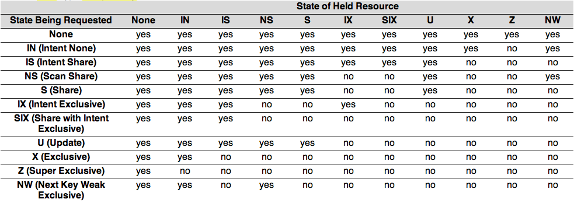
Lock Compatibility Table in DB2
None/IN: no lock
SIX: combination of S and IX
U: Similar to S
Z: lock held when table is created/dropped, indexes are created, table is reorganized
NW: next key locking
Source: DB2 10.1 LUW lock compatiblity , lock mode

Slide 29
Concurrency Control Goals
Performance goals
Reduce blocking
One transaction waits for another to release its locks
Avoid deadlocks
Transactions are waiting for each other to release their locks
Correctness goals
Serializability: each transaction appears to execute in isolation
The programmer ensures that serial execution is correct.
Trade-off between correctness and concurrency

Slide 30
Ideal Transaction
Acquires few locks and favors shared locks over exclusive locks
Reduce the number of conflicts -- conflicts are due to exclusive locks
Acquires locks with fine granularity
Reduce the scope of each conflict
Holds locks for a short time
Reduce waiting

Slide 31
Lock Tuning
Transaction Chopping
Rewriting applications to obtain best locking performance
Isolation Levels
Relaxing correctness to improve performance
Counters
Using system features to circumvent bottlenecks

Slide 32
Example: Simple Purchases
A customer (with a given available amount of cash) performs the following three actions to purchase an item I (from the inventory) for price P
If cash < P then roll back transaction (constraint)
Inventory(I) := inventory(I)+P
Cash := Cash – P
Two purchase transaction P1 and P2
P1 gets item I1 for price 50
P2 gets item I2 for price 75
Cash is 100

Slide 33
Example: Simple Purchases
If 1-2-3 as one transaction then one of P1 executes and P2 rolls back.
If 1, 2, 3 as three distinct transactions:
P1 checks that cash > 50. It is.
P2 checks that cash > 75. It is.
P1 completes. Cash = 50.
P2 completes. Cash = - 25.

Slide 34
Example: Simple Purchases
Orthodox solution
Make whole program a single transaction
Cash becomes a bottleneck!
Chopping solution
Find a way to rearrange and then chop up the transactions without violating serializable isolation level.

Slide 35
Example: Simple Purchases
Chopping solution:
If Cash < P then roll back. Cash := Cash – P.
Inventory(I) := inventory(I) + P
Chopping execution:
P11: 50 < 100. Cash := 50.
P21: 75 > 50. Rollback.
P12: inventory := inventory + 50.

Slide 36
Transaction Chopping
Execution rules:
When pieces execute, they follow the partial order defined by the transactions.
If a piece is aborted because of a conflict, it will be resubmitted until it commits
If a piece is aborted because of an abort, no other pieces for that transaction will execute.

Slide 37
Transaction Chopping
Let T1, T2, …, Tn be a set of transactions. A chopping partitions each Ti into pieces ci1, ci2, …, cik.
A chopping of T is rollback-safe if (a)T does not contain any abort commands or (b) if the abort commands are in the first piece.

Slide 38
Correct Chopping
Chopping graph (variation of the serialization graph):
Nodes are pieces
Edges:
C-edges: C stands for conflict. There is a C-edge between two pieces from different transactions if they contain operations that access the same data item and one operation is a write.
S-edges: S stands for siblings. There is an S-edge between two pieces, iff they come from the same transaction.
A chopping graph contains an S-C cycle if it contains a cycle that includes at least one S-edge and one C-edge.

Slide 39
Correct Chopping
A chopping is correct if it is rollback safe and its chopping graph contains no SC-cycle.
T1: r(x) w(x) r(y) w(y)
T2: r(x) w(x)
T3: r(y) w(y)
T11: r(x) w(x)
T12: r(y) w(y)
T11: r(x) T12: w(x) T13: r(y) w(y)
T11
S
T12
C
C
T11
S
T12
S
T13
T1
T2
T3
C
C
C
T2
T3
T2
T3
CORRECT
NOT CORRECT

Slide 40
Chopping Example
T1: RW(A) RW (B)
T2: RW(D) RW(B)
T3: RW(E) RW(C)
T4: R(F)
T5: R(E)
T6: R(A) R(F) R(D) R(B) R(E) R(G) R(C)

Slide 41
Chopping Example
T61: R(A) R(F) R(D) R(B)
T62: R(E) R(G) R(C)
T1
C
T2
T3
C
T5
C
C
T4
C
S
T61
T62

Slide 42
Finest Chopping
A private chopping of transaction Ti, denoted private(Ti) is a set of pieces {ci1, ci2, …, cik} such that:
{ci1, ci2, …, cik} is a rollback safe chopping
There is no SC-cycle in the graph whose nodes are {T1, …, Ti-1, ci1, ci2, …, cik, Ti+1, … Tn}
The chopping consisting of {private(T1), private(T2), …, private(T2)} is rollback-safe and has no SC-cycles.

Slide 43
Finest Chopping
In: T, {T1, .. Tn-1}
Initialization
If there are abort commands
then p_1 := all writes of T (and all non swappable reads)that may occur before or concurrently with any abort command in T
else p_1 := first database access
P := {x | x is a database operation not in p_1}
P := P U {p_1}

Slide 44
Finest Chopping
Merging pieces
Construct the connected components of the graph induced by C edges alone on all transactions {T1, …, Tn-1} and on the pieces in P.
Update P based on the following rule:
If p_j and p_k are in the same connected component and j < k, then
add the accesses from p_k to p_j
delete p_k from P

Slide 45
Sacrificing Isolation for Performance
A transaction that holds locks during a screen interaction is an invitation to bottlenecks
Airline Reservation
Retrieve list of seats available
Talk with customer regarding availability
Secure seat
Single transaction is intolerable, because each customer would hold lock on seats available.
Keep user interaction outside a transactional context
Problem: ask for a seat but then find it’s unavailable. More tolerable.

Slide 46
Isolation Levels
Read Uncomitted (No lost update)
Exclusive locks for write operations are held for the duration of the transactions
Lock for writes until commit time. No locks for reads
Read Committed (No inconsistent retrieval)
Lock for writes until commit time.
Shared locks are released as soon as the read operation terminates.
Repeatable Read (no unrepeatable reads)
Strict two phase locking: lock for writes and reads until commit time.
Serializable (no phantoms)
Table locking or index locking to avoid phantoms

Slide 47
Logical Bottleneck: Sequential Key generation
Consider an application in which one needs a sequential number to act as a key in a table, e.g. invoice numbers for bills.
Ad hoc approach: a separate table holding the last invoice number. Fetch and update that number on each insert transaction.
Counter approach: use facility such as Sequence (Oracle)/Identity(SQL Server).

