Slide 1
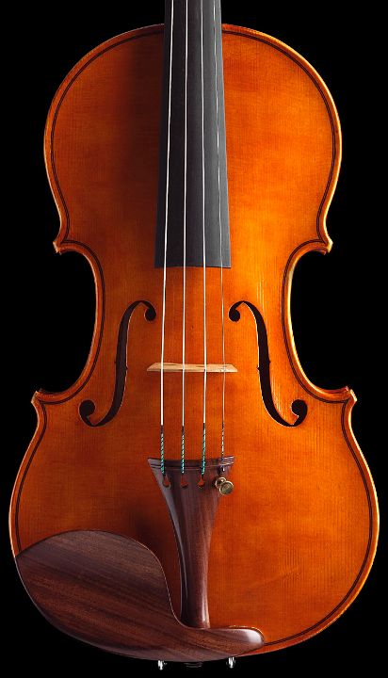

Tuning the Guts

Slide 2
Outline
Configuration
Tuning
IO stack
SSDs and HDDs
RAID controller
Storage Area Network
block layer and file system
virtual storage
Multi-core
Network stack
Tuning IO priorities
Tuning Virtual Storage
Tuning for maximum concurrency
Tuning for RAM locality
The priority inversion problem
Transferring large files
How to throw hardware at a problem?

Slide 3
IO Architecture
Processor
[core i7]
2x21GB/sec
RAM
SSD
16 GB/sec
Memory bus
PCI Express
HDD
Southbridge
Chipset
[z68]
RAID controller
5 GB/sec
PCI
3 GB/sec
SATA ports
3 GB/sec
HDD
SSD
SSD
SSD
SSD
Byte addressable
Block addressable
LOOK UP: Smart Response Technology (SSD caching managed by z68)

Slide 4
IO Architecture
Exercise 3.1:
How many IO per second can a core i7 processor issue (assume that the core i7 performs at 180 GIPS and that it takes 500000 instructions per IO).
Exercise 3.2:
How many IO per second can your laptop CPU issue (look up the MIPS
number associated to your processor).
Exercise 3.3:
Define the IO architecture for your laptop/server.

Slide 5
Hard Drive (HDD)
tracks
spindle
platter
read/write head
actuator
disk arm
Controller
disk interface

Slide 6
Solid State Drive (SSD)
Read
Write
Scheduling & Mapping
Read
Program
Erase
Channels
Logical address space
Physical address space
Chip
Chip
Chip
Chip
Chip
Chip
Chip
Chip
Garbage collection
Wear Leveling
…
…
…
…
Chip
Chip
Chip
Chip
Flash memory array
Example on a disk with 1 channel and 4 chips
Chip bound
Channel bound
Chip bound
Chip1
Page
transfer
Page program
Chip2
Page program
Chip3
Page
read
Page program
Chip4
Command
Page program
Four parallel reads
Four parallel writes

Slide 7
RAID Controller
PCI bridge
Batteries
CPU
RAM
Host Bus Adapter
Caching
Write-back / write-through
Logical disk organization
JBOD
RAID

Slide 8
RAID
Redundant Array of Inexpensive Disks
RAID 0: Striping [n disks]
RAID 1: Mirroring [2 disks]
RAID 10: Each stripe is mirrored [2n disks]
RAID 5: Floating parity [3+ disks]
Exercise 3.4:
A – What is the advantage of striping over magnetic disks?
B- what is the advantage of striping over SSDs?

Slide 9
Storage Area Network (SAN)
“A storage area network is one or more devices communicating via a serial SCSI protocol (such as FC, SAS or iSCSI).” Using SANs and NAS, W. Preston, O’Reilly
SAN Topologies
Point-to-point
Bus
Synchronous (Parallel SCSI, ATA)
CSMA (Gb Ethernet)
Arbitrated Loop (FC)
Fabric (FC)

Slide 10
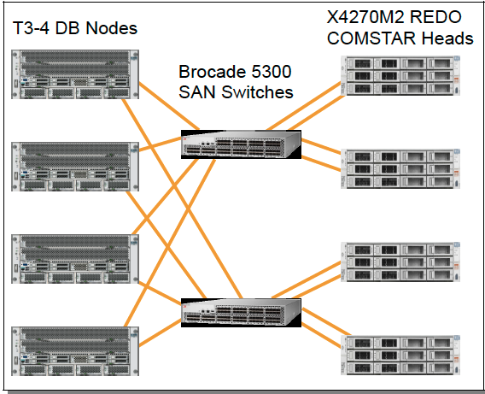
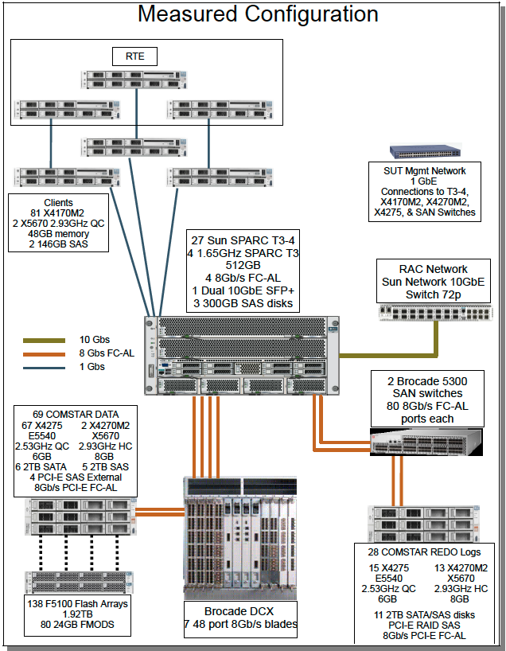
Case: TPC-C Top Performer (01/13)
Redo Log Configuration
Total system cost | 30,528,863 USD
Performance | 30,249,688 tpmC
Total #processors | 108
Total #cores | 1728
Total storage | 1,76 PB
Total #users | 24,300,000
LOOK UP: TPC-C OLTP Benchmark
Source: http://www.tpc.org/tpcc/results/tpcc_result_detail.asp?id=110120201

Slide 11
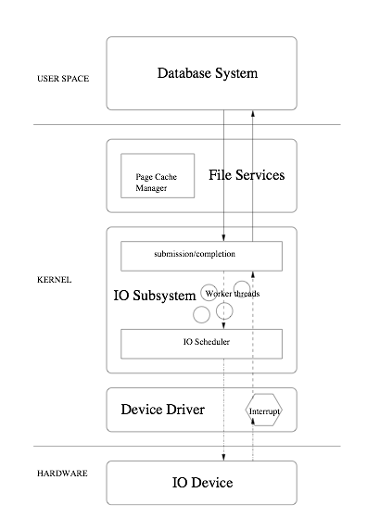
IO Stack
DBMS
DBMS IOs:
Asynchronous IO
Direct IO

Slide 12
Block Device Interface
Linear Space of Logical Block Addresses (LBA)
B0
B1
B2
B3
B4
B5
B6
B7
B8
B9
…
Block device specific driver
Memory Abstraction:
@content <- read(LBA)
write(LBA, @content)
Bi
Bi+1

Slide 13
Performance Contract
HDD
The block device abstraction hides a lot of complexity while providing a simple performance contract:
Sequential IOs are orders of magnitude faster than random IOs
Contiguity in the logical space favors sequential Ios
SSD
No intrinsic performance contract
A few invariants:
No need to avoid random IOs
Applications should avoid writes smaller than a flash page
Applications should fill up the device IO queues (but not overflow them) so that the SSD can leverage its internal parallelism

Slide 14
Virtual Storage
No Host Caching.
The database system expects that the IO it submits are transferred to disk as directly as possible. It is thus critical to disable file system caching on the host for the IOs submitted by the virtual machine.
Hardware supported IO Virtualization.
A range of modern CPUs incorporate components that speed up access to IO devices through direct memory access and interrupt remapping (i.e., Intel’s VT-d and AMD’s AMD-vi)). This should be activated.
Statically allocated disk space
Static allocation avoids overhead when the database grows and favors contiguity in the logical address space (good for HDD).

Slide 15
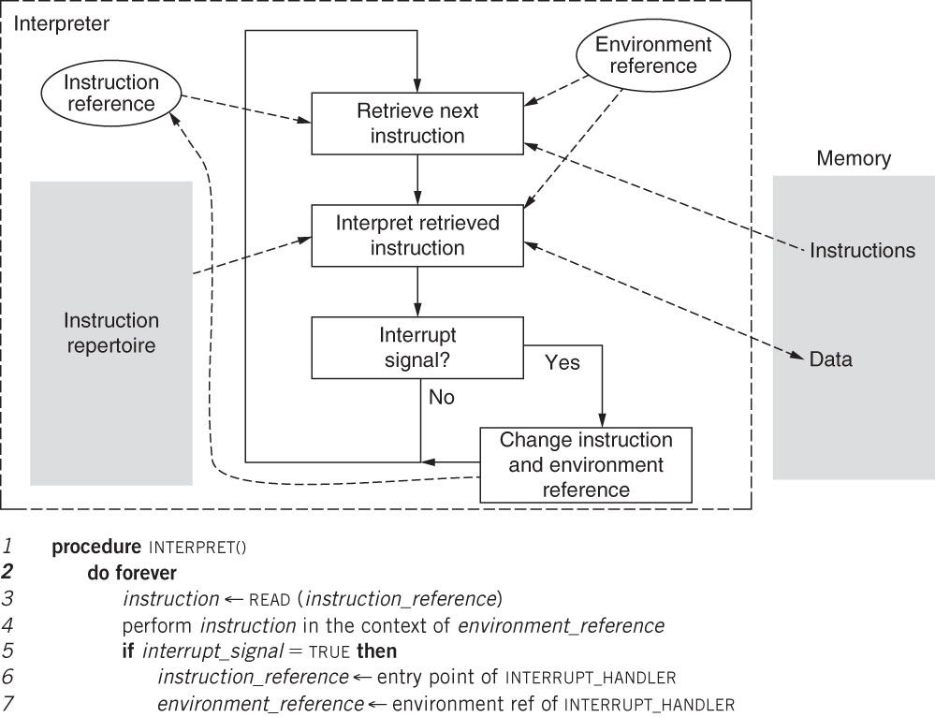
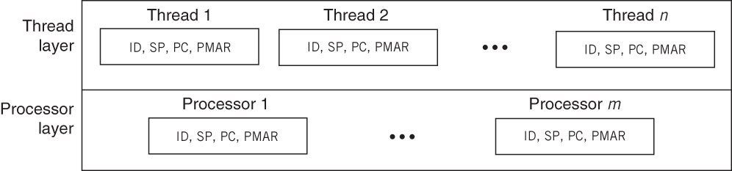
Processor Virtualization
Source: Principles of Computer System Design, Kaashoek and Saltzer.

Slide 16
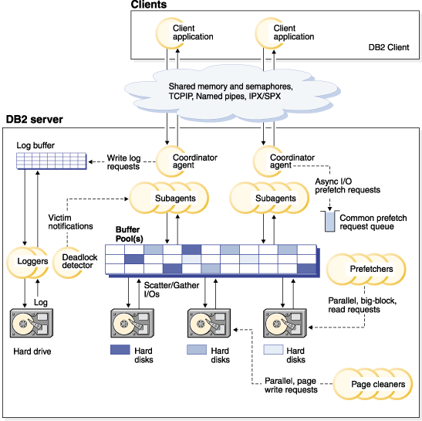
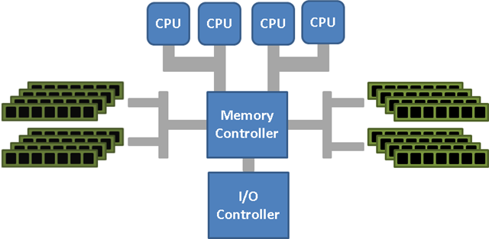
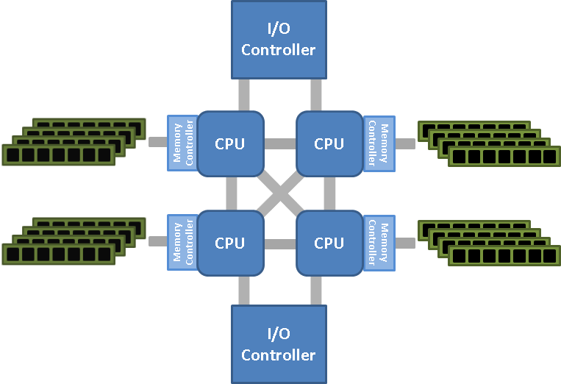
Dealing with Multi-Core
SMP: Symmetric Multiprocessor
NUMA: Non-Uniform Memory Access
LOOK UP: Understanding NUMA
Source: http://pic.dhe.ibm.com/infocenter/db2luw/v9r7/topic/com.ibm.db2.luw.admin.perf.doc/doc/00003525.gif

Slide 17
Dealing with Multi-Core
Socket 0
Socket 1
Cache locality is king:
Processor affinity
Interrupt affinity
Spinning vs. blocking
Core 0
Core 1
Core 2
Core 3
CPU
CPU
CPU
CPU
L1 cache
L1 cache
L1 cache
L1 cache
L2 Cache
L2 Cache
RAM
System Bus
IO, NIC Interrupts
LOOK UP: SW for shared multi-core, Interrupts and IRQ tuning

Slide 18
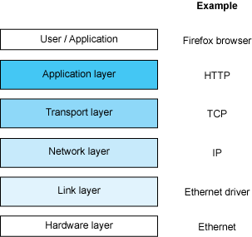
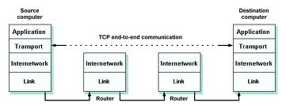
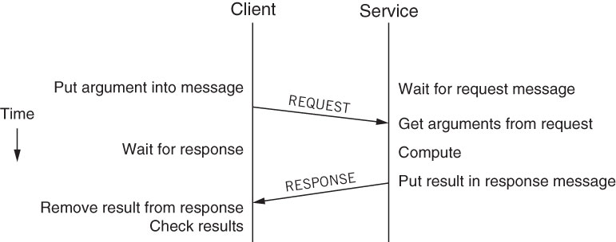
Network Stack
DBMS
(host, port)
LOOK UP: Linux Network Stack

Slide 19
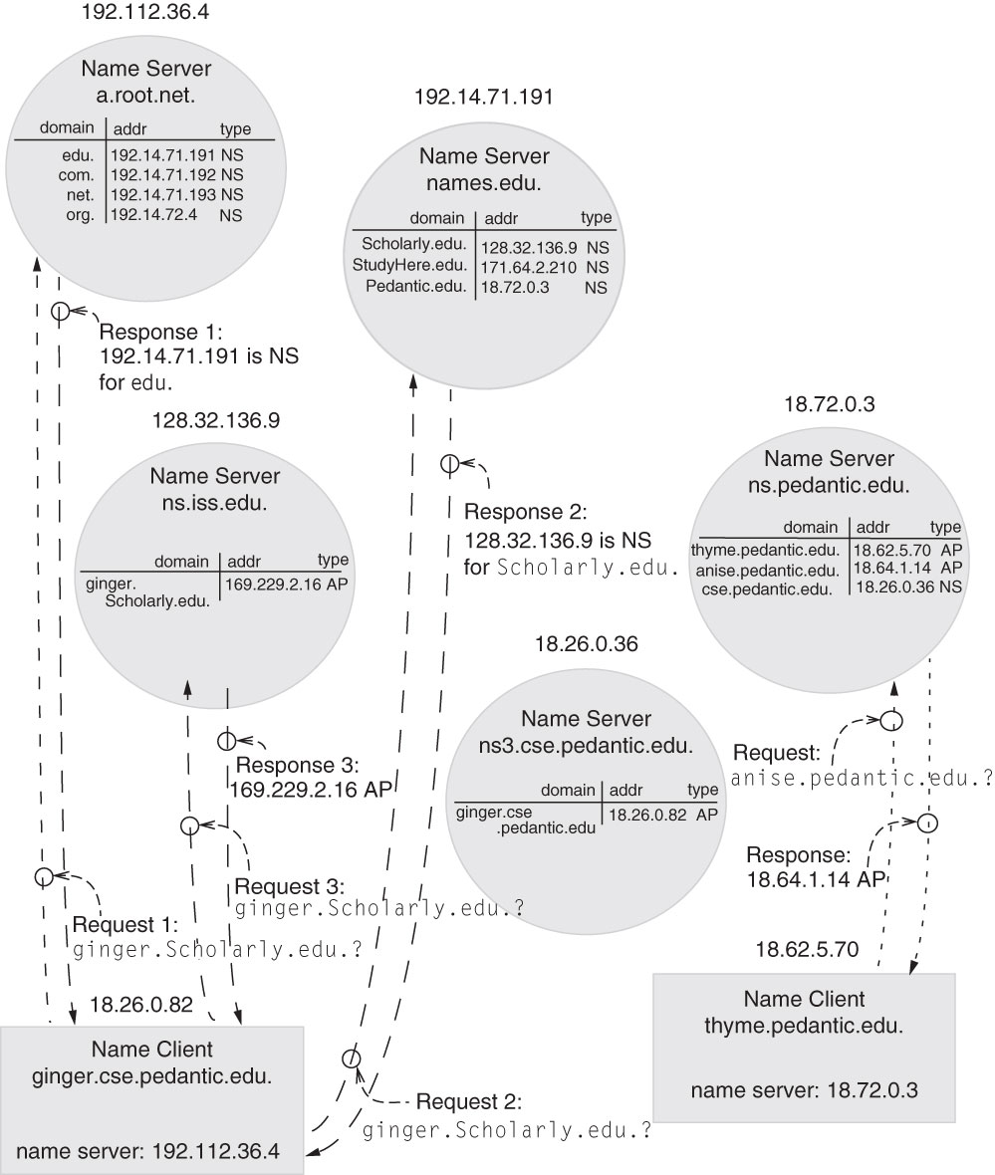
DNS Servers
Source: Principles of Computer System Design, Kaashoek and Saltzer.

Slide 20
Tuning the Guts
RAID levels
Controller cache
Partitioning
Priorities
Number of DBMS threads
Processor/interrupt affinity
Throwing hardware at a problem

Slide 21
RAID Levels
Log File
RAID 1 is appropriate
Fault tolerance with high write throughput. Writes are synchronous and sequential. No benefits in striping.
Temporary Files
RAID 0 is appropriate
No fault tolerance. High throughput.
Data and Index Files
RAID 5 is best suited for read intensive apps.
RAID 10 is best suited for write intensive apps.

Slide 22
Controller Cache
Read-ahead:
Prefetching at the disk controller level.
No information on access pattern.
Not recommended.
Write-back vs. write through:
Write back: transfer terminated as soon as data is written to cache.
Batteries to guarantee write back in case of power failure
Fast cache flushing is a priority
Write through: transfer terminated as soon as data is written to disk.

Slide 23
Partitioning
There is parallelism (i) across servers, and (ii) within a server both at the CPU level and throughout the IO stack.
To leverage this parallelism
Rely on multiple instances/multiple partitions per instance
A single database is split across several instances. Different partitions can be allocated to different CPUs (partition servers) / Disks (partition).
Problem#1: How to control overall resource usage across instances/partitions?
Fix: static mapping vs. Instance caging
Control the number/priority of threads spawned by a DBMS instance
Problem#2: How to manage priorities?
Problem#3: How to map threads onto the available cores
Fix: processor/interrupt affinity

Slide 24
Instance Caging
Allocating a number of CPU (core) or a percentage of the available IO bandwidth to a given DBMS Instance
Two policies:
Partitioning: the total number of CPUs is partitioned across all instances
Over-provisioning: more than the total number of CPUs is allocated to all instances
# Cores
Instance A
(2 CPU)
Max #core
Instance A
(2 CPU)
Instance B
(3 CPU)
Instance B
(2 CPU)
Instance C
(2 CPU)
Instance C
(1 CPU)
Instance D
(1 CPU)
Instance C
(1 CPU)
Partitioning
Over-provisioning
LOOK UP: Instance Caging

Slide 25
Number of DBMS Threads
Given the DBMS process architecture
How many threads should be defined for
Query agents (max per query, max per instance)
Multiprogramming level (see tuning the writes and index tuning)
Log flusher
See tuning the writes
Page cleaners
See tuning the writes
Prefetcher
See index tuning
Deadlock detection
See lock tuning
Fix the number of DBMS threads based on the number of cores available at HW/VM level
Partitioning vs. Over-provisioning
Provisioning for monitoring, back-up, expensive stored procedures/UDF

Slide 26
Priorities
Mainframe OS have allowed to configure thread priority as well as IO priority for some time. Now it is possible to set IO priorities on Linux as well:
Threads associated to synchronous IOs (writes to the log, page cleaning under memory pressure, query agent reads) should have higher priorities than threads associated to asynchronous IOs (prefetching, page cleaner with no memory pressure) – see tuning the writes and index tuning
Synchronous IOs should have higher priority than asynchronous IOs.
LOOK UP: Getting Priorities Straight, Linux IO priorities

Slide 27
The Priority Inversion Problem
Three transactions: T1, T2, T3 in priority order (high to low)
T3 obtains lock on x and is preempted
T1 blocks on x lock, so is descheduled
T2 does not access x and runs for a long time
Net effect: T1 waits for T2
Solution:
No thread priority
Priority inheritance
request X
Priority #1
T1
Priority #2
lock X
T2
Priority #3
T3
Transaction states
running
waiting

Slide 28
Processor/Interrupt Affinity
Mapping of thread context or interrupt to a given core
Allows cache line sharing between application threads or between application thread and interrupt (or even RAM sharing in NUMA)
Avoid dispatch of all IO interrupts to core 0 (which then dispatches software interrupts to the other cores)
Should be combined with VM options
Specially important in NUMA context
Affinity policy set at OS level or DBMS level?
LOOK UP: Linux CPU tuning

Slide 29
Processor/Interrupt Affinity
IOs should complete on the core that issued them
I/O affinity in SQL server
Log writers distributed across all NUMA nodes
Locking of a shared data structure across cores, and specially across NUMA nodes
Avoid multiprogramming for query agents that modify data
Query agents should be on the same NUMA node
DBMS have pre-set NUMA affinity policies
LOOK UP: Oracle and NUMA, SQL Server and NUMA

Slide 30
Transferring large files (with TCP)
With the advent of compute cloud, it is often necessary to transfer large files over the network when loading a database.
To speed up the transfer of large files:
Increase the s ize of the TCP buffers
Increase the socket buffer size (Linux)
Set up TCP large windows (and timestamp)
Rely on selective acks
LOOK UP: TCP Tuning

Slide 31
Throwing hardware at a problem
More Memory
Increase buffer size without increasing paging
More Disks
Log on separate disk
Mirror frequently read file
Partition large files
More Processors
Off-load non-database applications onto other CPUs
Off-load data mining applications to old database copy
Increase throughput to shared data
Shared memory or shared disk architecture

Slide 32
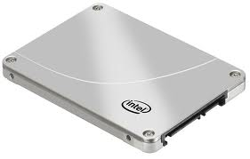
Virtual Storage Performance
Host: Ubuntu 12.04
noop scheduler
VM: VirtualBox 4.2 (nice -5)
all accelerations enabled
4 CPUs
8 GB VDI disk (fixed) SATA Controller
Guest: Ubuntu 12.04 noop scheduler
Core i5 CPU 750 @ 2.67GHz
4 cores
Intel 710
(100GN, 2.5in SATA 3Gb/s, 25nm, MLC)
170 MB/s sequential write
85 usec latency write
38500 iops Random reads (full range; 32 iodepth)
75 usec latency reads
[randReads]
ioengine=libaio
Iodepth=32
rw=read
bs=4k,4k
direct=1
Numjobs=1
size=50m
directory=/tmp
[seqWrites]
ioengine=libaio
Iodepth=32
rw=write
bs=4k,4k
direct=1
Numjobs=1
size=50m
directory=/tmp
Experiments with flexible I/O tester (fio):
- sequential writes (seqWrites.fio)
- random reads (randReads.fio)

Slide 33
Virtual Storage - seqWrites
Default page size is 4k, default iodepth is 32
Performance on Host
Performance on Guest

Slide 34
Virtual Storage - seqWrites
Page size is 4k, iodepth is 32

Slide 35
Virtual Storage - randReads
Page size is 4k*
* experiments with 32k show negligible difference

