Slide 1
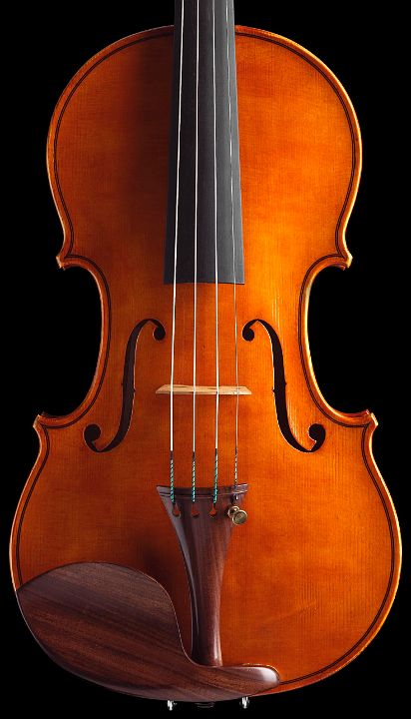

Tuning the Writes

Slide 2
Outline
Characteristics of the DBMS writes
Transactional context
Write ahead logging and Lazy writers
External algorithms
Tablespaces
DBMS data containers
Tuning the writes
Objectives
Tablespace tuning
Log tuning

Slide 3
Context#1
Modification of the database state
Transactions contain update, delete, insert statements
The challenge for the DBA is to
minimize performance performance overhead
while the DBMS guarantees Atomicity and Durability
We ignore
Isolation issues – see lock tuning
Consistency issues – see query tuning
Database loading – see tuning the application interface

Slide 4
Atomicity and Durability
Every transaction either commits or aborts. It cannot change its mind
Even in the face of (some) failures:
Effects of committed transactions should be permanent;
Effects of aborted transactions should leave no trace.
COMMITTED
COMMIT
Ø
ACTIVE
(running, waiting)
BEGIN TRANS
ROLLBACK
ABORTED
Transactions aborted by:
User (e.g., cancel button)
Transaction manager (e.g., deferred constraint check)
DBMS (e.g., deadlock, lack of resources)

Slide 5
(Some) Failures
Processor failure, system crash, power outage, software bug
Program behaves unpredictably, possibly erasing or corrupting RAM contents (volatile memory)
Contents of stable storage generally unaffected
Active transactions interrupted, database left in inconsistent state
Media failures
Contents of stable storage is corrupted

Slide 6
Other Failures
The failures indicated in the previous slides do not include
Multiple hardware failures (e.g., CPU and controller failure)
Disaster (e.g., building on fire)
Fault-tolerance ≠ durability
Fault-tolerance requires solutions that are beyond the scope of atomicity and durability
Replication, redundant hardware, Geo-plexing

Slide 7
Update/insert/delete Processing
Query agent
Query agent
Query agent
VOLATILE MEMORY
 | Pi |  | Pj
DATABASE BUFFER
How to handle
writes from memory
to secondary storage
so that the DBMS
guarantees atomicity
and durability?
DATA
DATA
DATA
STABLE STORAGE

Slide 8
Buffer Management
When are dirty pages written to disk?
Modified pages are called dirty pages
Depends on buffer management policy
Four types of buffer management policy
Steal vs. No Steal
Steal: Dirty pages modified by non-committed transactions might be written to disk
No Steal: Dirty pages modified by non-committed transactions might NOT be written to disk
Force vs. No Force
Force: Dirty pages modified by transaction T are forced to disk when T commits
No Force: Dirty pages modified by transaction T are NOT forced to disk when T commits

Slide 9
Buffer Management
When a dirty page is stolen, the effect of a non-committed transaction is reflected on stable storage
Must be undone in case the transaction aborts, or the system crashes.
When no-force is used, the effect of a committed transaction is NOT reflected on stable storage
Must be redone in case the transaction aborts, or the system crashes
No Steal
Steal
Undo
Force
Undo Redo
No Force
Redo

Slide 10
Logging
REDO and UNDO information stored in a log.
Sequence of log records
Log records as compact as possible to minimize the amount of data written to disk (typically multiple records per log page)
Update records contains:
LSN, XID, LastLSN, <pageID, offset, length, old data, new data>
To each log record is associated
LSN: a log sequence number, i.e., a logical time stamp for the log record
XID: the transaction ID that owns the record
LastLSN: the log sequence number of the previous log record for the given XID
Log file implemented as circular buffer
Unless media recovery is activated
Current database state = current state of data on disks + log
Notes:
7

Slide 11
Write-Ahead Logging (WAL)
The Write-Ahead Logging Protocol:
Must force the log record for an update to disk before the corresponding data page is stolen.
Guarantees Atomicity (undo)
Must write to disk all log records for a transaction before it commits.
Guarantees Durability (undo & redo)
The log is used to (a) abort transactions and (b) perform crash recovery in case of crash or failure.
The assumption is that locking is in effect when log records are created – see lock tuning.
In terms of performance, the goal is to minimize
The time spent writing to the log
The time spent aborting a transaction
The time spent performing crash recovery
Note that there are limits on the size of individual log files and on the number of log files. These limits actually form the boundaries of how much load can be accepted by a DBMS instance.
LOOK UP: ARIES

Slide 12
Transaction Abort
How can a log be used to abort transaction T_{i}?
The effects of the stolen pages must be rolled back, using the before image [undo] in the update records associated to T_{i}
The log is scanned backwards
Each update is undone in last-in first-out order
Problem#1: When to stop scanning backwards?
Solution: Append a begin record for each transaction prior to its first update record

Slide 13
Transaction Abort
Problem#2: Should the undo operation be logged?
YES. If three operations have to be rolled back and the system crashes, then it must be possible to find out from the log which updates have been rolled back
Solution:
Introduce an Abort record that marks the start of the abort procedure
Distinguish rollbacks from updates. Introduce new log record, called Compensation log record (CLR) that contains the before image that has been restored and a pointer (LSN) to the next record to be undone in this transaction
Introduce an End record when the abort procedure completes

Slide 14
Example log
LSN | XID | LastLSN | TYPE | RECORD
0 | 1 | null | Update | <pid: P3, old: 111, new: 222>
1 | 2 | null | Update | <pid: P4, old:777, new: 111>
2 | 3 | null | Update | <pid: P6, old:999, new: 222>
3 | 1 | 0 | Update | <pid: P2, old: 123, new: 321>
4 | 2 | 1 | Update | <pid:P0, old:000, new:111>
5 | 2 | 4 | Abort
6 | 2 | 5 | CLR | <pid: P0, old:000, undoNextLSN: 1>
7 | 2 | 6 | CLR | <pid: P4, old:777, undoNextLSN: null>
8 | 3 | 2 | Update | <pid: P5, old:444, new:098>
9 | 2 | 7 | End

Slide 15
Crash Recovery
Using the log, it must be efficient to answer the following questions:
What were the transactions active at the time of the crash?
Their effects must be undone (if necessary)
What were the committed/aborted transactions at the time of the crash?
Their effects must be redone (if necessary)

Slide 16
Log records
Log records should allow to distinguish between active, committed and aborted transactions
Commit record appended to the log when transaction commit procedure starts
End record appended to the log when transaction has committed
The recovery procedure should not have to scan the entire log whenever there is a crash
Checkpoint Record (CK) contains XID of the active transactions at a given point in time (LSN)

Slide 17
Checkpoint
Sharp checkpoint
Procedure:
System stops at time t
Dirty pages for all transactions active at time t are forced to disk
CK record is written to the log
System restarts
This way:
All of the effects of the transactions active at checkpoint time are reflected on disk
No need to look up the log records prior to the checkpoint to roll database forward when performing recovery

Slide 18
Recovery with Sharp Checkpoint
Scan log backward until CK record to maintain a list of all transactions that were active at the time of the crash
The first record encountered for a given transaction (XID) is not an End record
XID is contained in the checkpoint record
Log is scanned forward until end of the log
The after images (new) in all update records are used to roll the database forward
Log is scanned backward until lastLSN is null for all active transactions at the time of the crash. The before images are used to roll the database backward
Each active transaction at the time of the crash is in effect aborted, abort/CLR/end records are appended to the log as the rollback proceeds

Slide 19
Example log
LSN | XID | LastLSN | TYPE | RECORD
0 | 1 | null | Update | <pid: P3, old: 111, new: 222>
1 | 2 | null | Update | <pid: P4, old:777, new: 111>
2 |  |  | CK | <XIDs: [<XID:1, LSN:0>,<XID:2,LSN:1>]>
3 | 3 | null | Update | <pid: P6, old:999, new: 222>
4 | 1 | 0 | Update | <pid: P2, old: 123, new: 321>
5 | 2 | 1 | Update | <pid:P0, old:000, new:111>
6 | 2 | 5 | Abort
7 | 2 | 6 | CLR | <pid: P0, old:000, undoNextLSN: 1>
8 | 2 | 7 | CLR | <pid: P4, old:777, undoNextLSN: null>
9 | 3 | 3 | Update | <pid: P5, old:444, new:098>
10 | 2 | 8 | End
3
1
2

Slide 20
Fuzzy Checkpoint
Problem with sharp checkpoint:
The DBMS stops while all dirty pages are flushed
Solution: Fuzzy checkpoint
The DBMS does not stop at checkpoint time
The system records the list of dirty pages at the time of the checkpoint together with the list active transactions
All recorded dirty pages have to be written to disk before the next fuzzy checkpoint
CK record replaced by Begin Checkpoint and End Checkpoint log records

Slide 21
Recovery with Fuzzy Checkpoint
Scan log backward until second End checkpoint record is encountered to maintain a list of all transactions that were active at the time of the crash
The first record encountered for a given transaction (XID) is not an End record
XID is contained in the second End checkpoint record
Log is scanned forward until end of the log
The after images (new) in all update records are used to roll the database forward
Log is scanned backward until lastLSN is null for all active transactions at the time of the crash. The before images are used to roll the database backward
Each active transaction at the time of the crash is in effect aborted, abort/CLR/end records are appended to the log as the rollback proceeds

Slide 22
Physical Logging
Update records contain before and after images
Roll-back: install before image
Roll-forward: install after image
Pros:
Idempotent. If a crash occurs during recovery, then recovery simply restart as phase 2 (rollforward) and 3 (rollback) rely on operations that are indempotent.
Cons:
A single SQL statement might touch many pages and thus generate many update records
The before and after images are large

Slide 23
Logical Logging
Update records contain logical operations and its inverse instead of before and after image
E.g., <op: insert t in T, inv: delete t from T>
Pro: compact
Cons:
Not idempotent.
Solution: Include a LastLSN in each database page. During phase 2 of recovery, an operation is rolled forward iff its LSN is higher than the LastLSN of the page.
Not atomic
What if a logical operation actually involves several pages, e.g., a data and index page? And possibly several index pages?
Solution: Physiological logging

Slide 24
Physiological Logging
Physiological logging
Physical across pages
Logical within a page
Combines the benefits of logical logging and avoids the problem of atomicity, as logical mini-operations are bound to a single page
Logical operations split into mini-operations on each page
A log record is created for each mini-operation
Mini-operations are not idempotent, thus page LSN have to be used in phase 2 of recovery

Slide 25
How to deal with Media Failures?
Double-write buffer
If problem when writing to the separate buffer, dataspace is not corrupted. Write can be repeated on buffer.
If problem when copying the page from buffer to tablespace, then dataspace might get corrupted. But a valid copy of the page exists in the buffer and copy can be reexecuted.
P_{i}
1
2
buffer
DATA

Slide 26
How to deal with Media Failure?
Regular backup + roll forward recovery
Backup database/tablespace
Archived logs
Apply records from archived and active log to bring current state of data on disk up to date
Note: On Oracle, switching active log files when a log file is full triggers a media recovery checkpoint (i.e., a roll forward from the full log)
LOG
DATA
Source: Oracle Core by Jonathan Lewis

Slide 27
Logging in SQL Server, DB2
Log entries:
- LSN - before and after images or logical log
Physiological logging
Free Log caches
Current Log caches
Flush Log caches
free | Pi | free | Pj
DATABASE BUFFER
Waiting
processes
db writer
Flush Log caches
Lazy- writer
Flush queue
Synchronous I/O
Asynchronous I/O
LOG
DATA

Slide 28
Logging in Oracle prior to 10g
Physiological logging
Before images
Free list
Redo allocation latch
Redo copy latch
Rollback segments (fixed size)
 | Pi |  | Pj
Redo log buffer
After images (redo entries)
DATABASE BUFFER
LGWR (log writer)
DBWR (database writer)
LOG
Rollback Segments
Log File #1
Log File #2
DATA

Slide 29
Logging in Oracle after 10g
Physiological logging
Free list
In-memory undo
(public) Redo allocation latch
In-memory undo
Redo log buffer
In-memory undo
 | Pi |  | Pj
Redo copy latches
In memory undo latch
Redo log
records
(redo+undo)
In memory undo latch
DATABASE BUFFER
Private redo
Redo log
records
(redo+undo)
In memory undo latch
Redo log
records
(redo+undo)
Private redo
Private redo
redo allocation latch
redo allocation latch
redo allocation latch
DBWR (database writer)
LGWR (log writer)
LOG
UNDO
Log File #1
Log File #2
DATA

Slide 30
Context#1 Wrap-up
The application submits transactions that insert/delete/update tables
What write IOs are performed?
Case#1: The buffer is not full
Log records are written to the log at commit time
Dirty data/index pages modified by these transactions are written to the data tablespaces at some point after the transaction commits, and before the next checkpoint
Case#2: The buffer is full
Dirty pages (possibly modified by other transactions) are stolen to make room for new pages as they are required
Log records are written to the log at commit time, and when dirty pages are stolen
Dirty data/index pages modified by these transactions are written to the data tablespaces at some point after the transaction commits, and before the next checkpoint

Slide 31
Context #2
External algorithms for sorting/hashing manipulate a working set which is larger than RAM (or larger than the buffer space allocated for sorting/hashing)
Sort or hash is performed in multiple passes
In each pass data is read from disk, hashed/sorted/merged in memory and then written to secondary
Pass N+1 can only start when Pass N is done writing data back to secondary storage

Slide 32
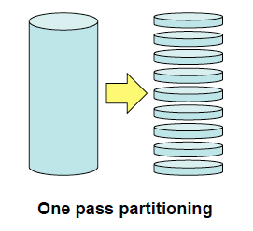
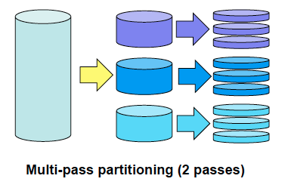
RAM occupation vs. Page size
For hashing: RAM occupation = 2 * page size * Nb partitions
How to set page size?
Large page size (up to 1MB) is good for IO throughput , …
… but it might cause multiple passes

Slide 33
External Storage
The buckets written/read during an external algorithm contain temporary data
Buckets are not relations
The data should not persist
Most systems allow to define tablespaces for temporary data
In MySQL external algorithms do not rely on the storage manager, they directly access the file system

Slide 34
Tablespaces
Layer of storage abstraction on top of the file system
Database objects (tables, indexes, large objects, temporary data)
The log is not stored on a tablespace, but on dedicated files
Oracle and DB2 distinguish between
System (catalog) vs. user tablespaces
Manually vs. automatically managed
Whether logging is turned on for a given tablespace
DB2 associates buffer pools to tablespaces
A tablespace is mapped onto one or more files
LOOK UP: Oracle tablespace, DB2 tablespace, SQL Server file groups, InnoDB tablespaces

Slide 35
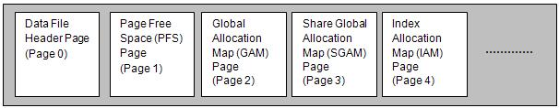
Tablespace Structure
SQL Server
Extent-based allocation
1 Extent = 8 pages
Mixed/Uniform extents
GAM bitmap over 64000 extents
Is extent allocated?
SGAM bitmap over 64000 extents
Is extent mixed and has at least 1 unused page?
PFS page over 8000 pages
1B per page: How much is page used?
Source: Karen Delaney

Slide 36
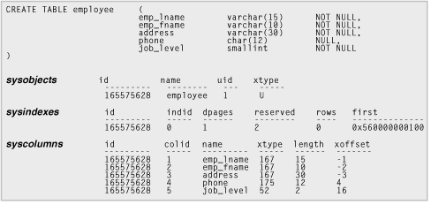
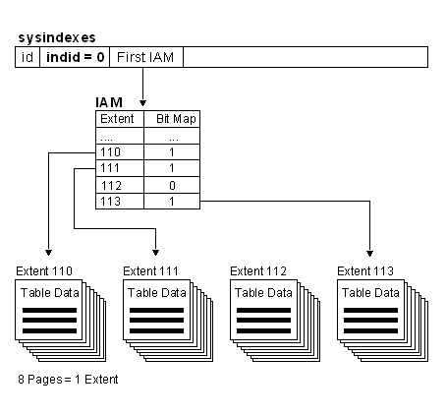
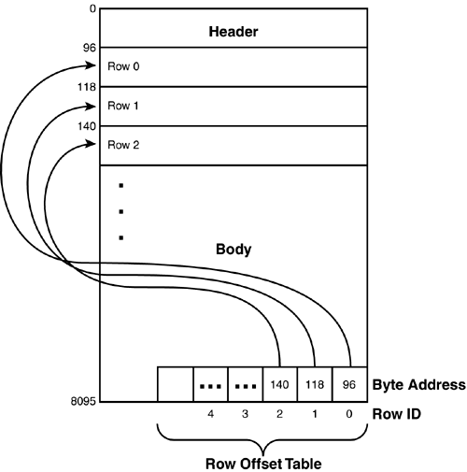
Finding Data Pages
Source: Karen Delaney

Slide 37
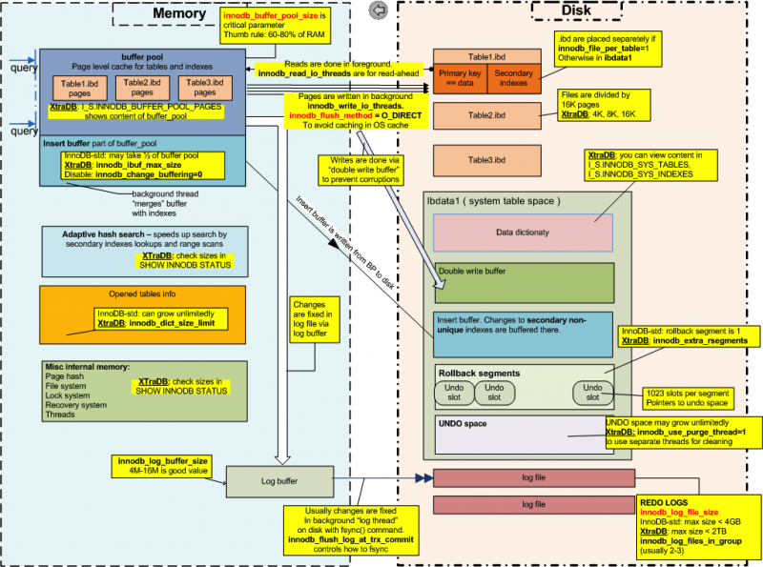
InnoDB/XtraDB Storage Model
Source: Percona

Slide 38
Tablespace Parameters
Tablespace size
Costly resizing needed if tablespace too small
Page size
Default value (4K), set when creating a tablespace
Extent size
Number of pages per extent
Tradeoff:
Many pages favours contiguity in the logical space and thus favours sequential access
Few pages reduces fragmentation
Prefetch size
Number of consecutive pages read by prefetcher

Slide 39
Tuning the Writes
The overall objective when modifying the database state is:
Avoid full logs
Worste case it stops all transactions. It might also cause media recovery checkpoint.
Minimize performance overhead as writes are performed
When the DBMS bufer is not full
Only writes to the log are relevant
When the DBMS buffer is full
Both writes to the log and asynchronous writes to data tablespaces are relevant
Ideally, writes to the log are as fast as sequential writes on the fastest disk in the system
Minimize the time needed to abort a transaction or perform crash recovery
Ideally, aborting a transaction does not require IOs
Crash recovery based on three sequential passes on the log
The overall objective for external algorithms is to
Avoid multiple passes
Minimize the time requires for sequentially writing/reading multiple buckets

Slide 40
Tuning Goals
Choose and maintain appropriate size for log files
Manage checkpoint frequency
Avoid very long updates
Bridge the gap between (i) sequential write performance on a file and writes to the log, and (ii) sequential read/write performance on a file and read/writes on temporary data
Avoid IO interferences to the log file(s)
Log on a separate disk/SAN? Temp tablespaces on a separate disk?
Favour IO contiguity when writing to the log or temp data
Adjust page and extent size
Avoid any waits when writing the the log buffer, when flushing the log buffer
Group commits

Slide 41
Mind The Gap
Need to establish a reference performance for sequential read/writes on log disk and temporary data, and for random writes on data disks
Use flexible IO tester tool – fio
Simple job descriptions for sequential writes/reads and for random writes
Asynchronous, direct IOs
numjobs
1 [1 log writer per instance]
max(nb partitions, #cores) [number of lazy writers]
iodepth: 1..32 [depends on rate of writes], 1 for reads
Page size: 4k,8k,16k,32k

Slide 42
Mind the Gap
Tune DBMS (page size, extent size, log buffer size, number of lazy writers) to get write performance close to reference on file system
Should be a constant overhead in terms of throughput for a given workload
Measure disk throughput in GB/sec with OS tool (iostat) while transactions are executed

Slide 43
Rightsizing Log Files
The active log is defined as the portion of the log which is required for crash recovery.
The size of the active log is the maximum of:
Checkpoint frequency
Determines the start of roll forward phase
Transaction duration
Determines the end of roll back phase

Slide 44
Reduce the Size of Large Update Transactions
Consider an update-intensive batch transaction (concurrent access is not an issue):
It can be broken up in short transactions (mini-batch): + Does not overfill the log buffers
+ Does not overfill the log files
Example: Transaction that updates, in sorted order, all accounts that had activity on them, in a given day. Break-up to mini-batches each of which access 10,000 accounts and then updates a global counter.
Note: DB2 has a parameter limiting the portion of the log used by a single transaction (max_log)

Slide 45
Rightsizing Log Files
Find out how much data is written to the log at peak load
Pick checkpoint frequency so that active log is smaller than maximal log file size, i.e., use a single log file per DBMS instance!
High frequency of checkpoints will lead to writes to the data tablespaces, but at least those writes are performed at a steady rather than in batches whenever roll forward recovery is needed.
This is a trade-off between write performance overhead and recovery performance
Two log files only to tolerate media failure of a log file.
As a result:
Length of roll forward recovery (needed for media recovery or crash recovery) fixed by checkpoint frequency

Slide 46
Put Log on a Separate Disk
Improve log writer performance
HDD: sequential IOs not disturbed by random IOs
SSD: minimal garbage collection/wear leveling
Isolate data and log failures

Slide 47
Group Commits
For small transactions, log records might have to be flushed to disk before a log page is filled up
When many small transactions are committed, many IOs are executed to flush half empty pages
Group commits allow to delay transaction commit until a log page is filled up
Many transactions committed together
Pros: Avoid too many round trips to disk, i.e., improves throughput
Cons: Increase mean response time

