Slide 1
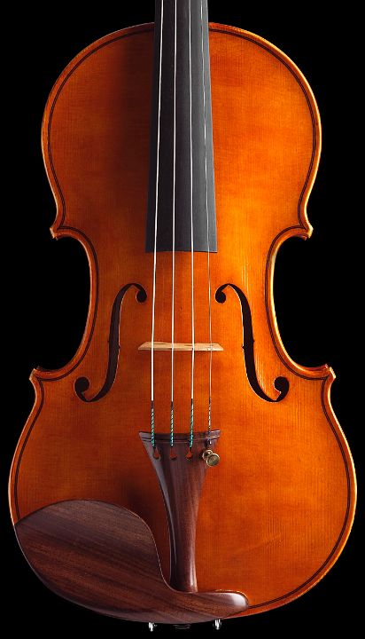

Troubleshooting techniques

Slide 2
Outline
DBMS architecture overview
Overview for now
More details as we progress through lectures
Troubleshooting and experimentation
Troubleshooting methodologies
Resource consumption model
Time-spent model

Slide 3
Traditional Architecture
Q
Client
server
Application
DBMS
DBMS
DATA
OS
HW
Result Set

Slide 4
Streaming Architecture
Data (stream)
DBMS
Q
LOOK UP: DEBS2013 Grand Challenge
Result Set (stream)

Slide 5
DBMS Components
Parser
Query Processor
Compiler
Execution Engine
Indexes
Storage Subsystem
Indexes
Concurrency Control
Recovery
Buffer Manager

Slide 6
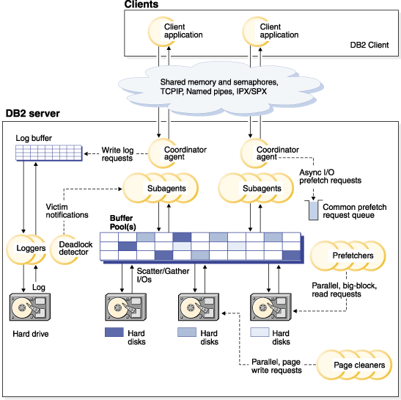
DB2 9.7 Process Architecture
Exercise 2.1:
Is intra-query parallelism possible with this process model? In other words, can a query be executed in parallel within a same instance (or partition)?
Source: http://pic.dhe.ibm.com/infocenter/db2luw/v9r7/topic/com.ibm.db2.luw.admin.perf.doc/doc/00003525.gif

Slide 7
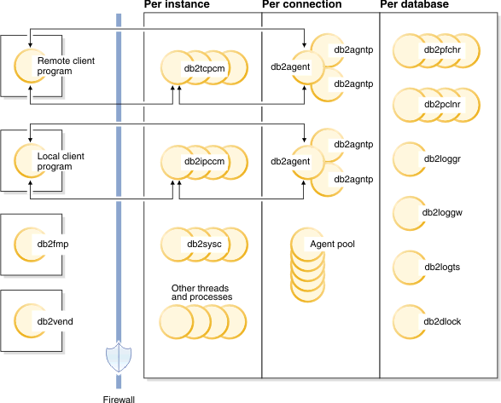
DB2 10.1 Process Architecture
No need to know much more about the process abstractions. We will cover much more on the memory abstractions (log tuning), and on the communication abstractions (tuning the application interface, tuning across instances).
Source: http://pic.dhe.ibm.com/infocenter/db2luw/v10r1/index.jsp?topic=%2Fcom.ibm.db2.luw.admin.perf.doc%2Fdoc%2Fc0008930.html

Slide 8
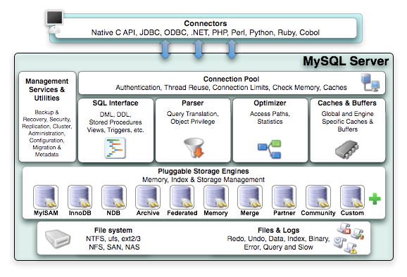
MySQL Architecture
Source: http://docs.oracle.com/cd/E19957-01/mysql-refman-5.5/storage-engines.html

Slide 9
Troubleshooting: Why
Production
Users/manager complaints.
Needs monitoring. What is going on NOW?
Once identified, a problem should be represented in a synthetic form (so that others can avoid the problem, or as a request for new features from DBMS/OS)
Test
New application / New system / New functionalities / New scale
Can system keep performance up in new settings?
Needs Experiments.

Slide 10
Troubleshooting: How
You MUST measure system performance (black box)
Profiling tools
You MUST instrument your system to get some insight about the internal processes (white box)
System instrumentation
You MUST follow a systematic approach for troubleshooting / experimentation
Scientific Method
Troubleshooting methodology

Slide 11
Experimental Framework
System
Application + DBMS + OS + HW
Parameters (fixed/factors)
Metrics
Throughput / Response Time
DBMS performance indicators
OS performance indicators
Workload
Actual users (production), replay trace or synthetic workload (e.g., TPC benchmark)
Experiments
What factor to vary?
Exercise 2.2:
Is throughput always the inverse of response time?
Exercise 2.3:
Define an experiment to measure the write throughput of the file system on your laptop

Slide 12
Performance Indicators
Type
Counter
Watermark
Gauge
Timestamp
Scope
System-wide (snapshot) vs. workload-specific (activity detail)
Collection
switched on/off vs. triggered by a specific event
File dump vs. materialized view
Frequency of update of the materialized view
Access
Table functions, views, XML files
Alert triggered by a specific event
Exercise 2.4:
What are system-wide indicators good for?
LOOKUP: DB2 monitor elements and interfaces for monitoring, Oracle dynamic performance views

Slide 13
Example
DBMS
OS
Statement number: 1
select C_NAME, N_NAME
from DBA.CUSTOMER join DBA.NATION on C_NATIONKEY = N_NATIONKEY
where C_ACCTBAL > 0
Number of rows retrieved is: 136308
Number of rows sent to output is: 0
Elapsed Time is: 76.349 seconds
…
Buffer pool data logical reads = 272618
Buffer pool data physical reads = 131425
Buffer pool data writes = 0
Buffer pool index logical reads = 273173
Buffer pool index physical reads = 552
Buffer pool index writes = 0
Total buffer pool read time (ms) = 71352
Total buffer pool write time (ms) = 0
…
Summary of Results
==================
Elapsed Agent CPU Rows Rows
Statement # Time (s) Time (s) Fetched Printed
1 76.349 6.670 136308 0
Windows: Performance monitor
Linux: iostat, vmstat
More on this in tuning the guts.
Exercise 2.7:
Which are the profiling tools on your laptop OS?
Exercise 2.6:
What are the 11 system wide indicators recommended for DB2 10.1?

Slide 14
Troubleshooting Methodologies
Resource Consumption Model (Chapter 7)
Primary, DBMS system resources
Applications as consumers
Instrumentation through counters/watermarks/gauge
Time Spent Model
response time = execution time + wait time
Instrumentation through timestamps
Exercise 2.5:
Does DB2 top follow the resource consumption or time spent model?

Slide 15
Resource Consumption Model
Effects are not always felt first where the cause is!
An overloading high-level consumer
A poorly parameterized subsystem
An overloaded primary resource

Slide 16
Resource Consumption Model
Extract indicators to answer the following questions
Question 1: Are critical queries being served in the most efficient manner?
Question 2: Are subsystems making optimal use of resources?
Question 3: Are there enough primary resources available?

Slide 17
Methodology
Which are the critical queries?
Ask users.
Use query log to find queries that take longest.
Resource Usage
Check out system-wide performance indicators.
Use rules of thumbs to check whether they are ok.

Slide 18
Fine Granularity Analysis
LOOK UP:
Index usage analysis in DB2 10.1
Event and resource monitoring in DB2 10.1

Slide 19
Time Spent Model
Given a critical query / session
Where does the time go?
Throughout DBMS/OS/HW components
Waiting / Executing
Find out which components cause a session to be slow.
Issues:
How to instrument ONLY a given critical query/sesssion
What timestamps indicators are available?
LOOK UP: Cary Millsap’s book: Oracle Operational Timing Presentation

Slide 20
Example: IBM DB2 10.1
Time-spent monitors
Scope
Wait time
Processing time
Elapsed time
Database
Application handle
Workload
Resource (lock, buffer, …)
LOOK UP: DB2 10.1 GET SNAPSHOT, MON_GET_ACTIVITY_DETAILS table function, work identification by origin with workloads

Slide 21
Exercise 2.8:
Assume your DBMS is DB2 10.1 express C. How can you answer the following questions:
How many IOs are performed from the command line for the execution of a given query?
How many pages are actually read? How much space is used in the buffer pool?
How much time is spent performing those IOs?
What percentage of the total execution time does it take to perform those IOs?
What portion of those IOs are sequential?
How much overhead is there in obtaining the answer to those questions?

Slide 22
Exercise 2.8: mon_IO.sql
SELECT A.AGENT_ID,
B.ROWS_RETURNED,
B.ROWS_READ,
(B.POOL_TEMP_DATA_L_READS + B.POOL_INDEX_L_READS +
B.POOL_TEMP_DATA_L_READS + B.POOL_TEMP_INDEX_L_READS) as BUFFER_POOL_READS,
(B.POOL_DATA_P_READS + B.POOL_DATA_P_READS +
B.POOL_TEMP_DATA_P_READS + B.POOL_TEMP_INDEX_P_READS) as IO_TOTAL,
B.POOL_READ_TIME as IO_TIME,
B.CLIENT_IDLE_WAIT_TIME as CLIENT_WAIT_TIME,
B.TOTAL_RQST_TIME as DB2_SPENT_TIME,
B.TOTAL_WAIT_TIME as DB2_WAIT_TIME,
B.TOTAL_COMPILE_TIME as DB2_COMPILE_TIME,
B.TOTAL_SECTION_PROC_TIME as DB2_SECTION_TIME,
B.TOTAL_COMMIT_PROC_TIME as DB2_COMMIT_TIME,
B.TOTAL_ROLLBACK_PROC_TIME as DB2_ROLLBACK_TIME,
B.TOTAL_RUNSTATS_PROC_TIME as DB2_RUNSTATS_TIME,
B.TOTAL_REORG_PROC_TIME as DB2_REORG_TIME,
B.TOTAL_LOAD_PROC_TIME as DB2_LOAD_TIME
FROM SYSIBMADM.APPLICATIONS A,
TABLE(MON_GET_CONNECTION(cast(NULL as bigint), -1)) B
WHERE A.DB_NAME = 'TUNING'
AND SUBSTR(A.APPL_NAME,1,5) = 'db2bp'
AND A.AGENT_ID = B.APPLICATION_HANDLE
;

Slide 23
Exercise 2.8:
Let us assume you are done with the GettingStarted exercise, then the aircraft table has been populated inside the tuning database on the db2inst1 instance
db2inst1@student-VirtualBox:~$ db2 connect to tuning
db2inst1@student-VirtualBox:~$ db2 –f mon_IO.sql
db2inst1@student-VirtualBox:~$ db2 –f mon_IO.sql
db2inst1@student-VirtualBox:~$ db2 “select * from aircraft”
db2inst1@student-VirtualBox:~$ db2 –f mon_IO.sql

