Slide 1
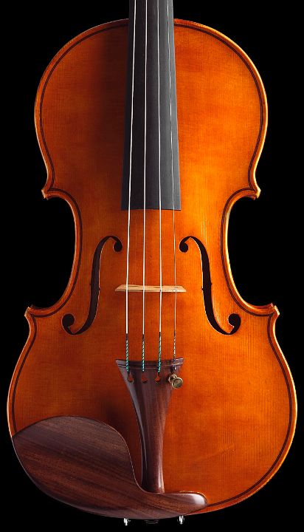

Introduction

Slide 2
Outline
What is database tuning
What is changing
The trends that impact database systems and their applications
What is NOT changing
The principles that underly our approach
What these lectures are about

Slide 3
Definition
Database tuning is the activity of making database applications run faster
Faster means higher throughput or/and lower response time
Avoiding transactions that create bottlenecks or avoiding queries that run for hours unnecessarily is a must

Slide 4
Why database tuning
Troubleshooting:
Make managers and users happy given an application as well as DBMS/OS/Hardware
• Capacity Sizing:
Buy the right DBMS/OS/Hardware given application requirements
• Application Programming:
Code your application for performance given DBMS/OS/Hardware

Slide 5
Why do we teach database tuning?
Simple case study:
The following query runs too slowly
select * from R where R.a > 5;
What do you do?

Slide 6
Trends
Data
Sense making and the data deluge
Hardware
Towards dark silicon
The age of semiconductor based persistence
The importance of parallelism

Slide 7
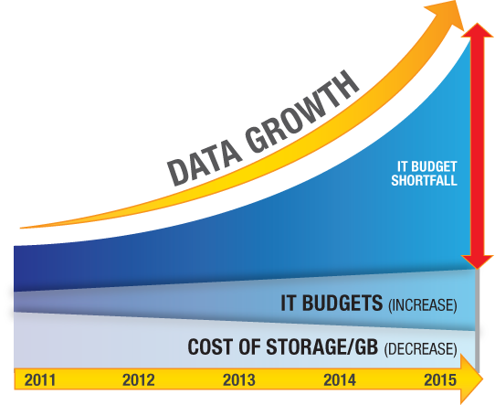
Data Growth #1: Volume
Source: http://permabit.com/media-center/blogs/

Slide 8
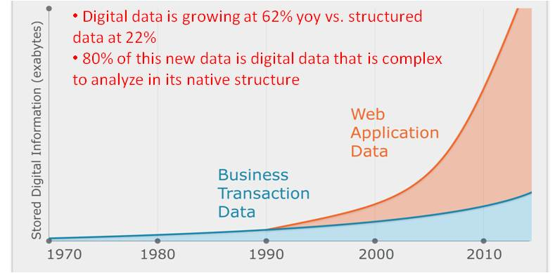
Data Growth #2: Data Complexity
Source: https://practicalanalytics.wordpress.com/2011/11/06/explaining-hadoop-to-management-whats-the-big-data-deal/

Slide 9
Sense making #1: Current Paradigm
Build conceptual model
Build a physical model
Answer the questions
Questions to answer
Build a logical model
Collect the data
Load the data
(Tune)
t →
Time to Insight: Weeks to Months
Source - http://www.youtube.com/watch?v=2YWvmBtEymE

Slide 10


Sense making #2: Paradigm shift
Available
Data
Scope of
Analysis
Model
Available
Data
Model
Traditional
System
Model
Traditional
System
Model
Model
New
System
Model
Source – http://www.vldb.org/2011/files/slides/keynotes/campbell_keynote.pptx

Slide 11
Sense making #3: New Paradigm
Monitor, Mine, Manage
Knowledge
Application
Knowledge
Application
Knowledge
Knowledge
Model Generation
Structure / Value
Information
Information
Data
Data
Transform & Load
Information Production
Signal
Digital Shoebox
t →
Time to Insight
Effort / Latency
Source: http://www.vldb.org/pvldb/vol4/p694-campbell.pdf

Slide 12
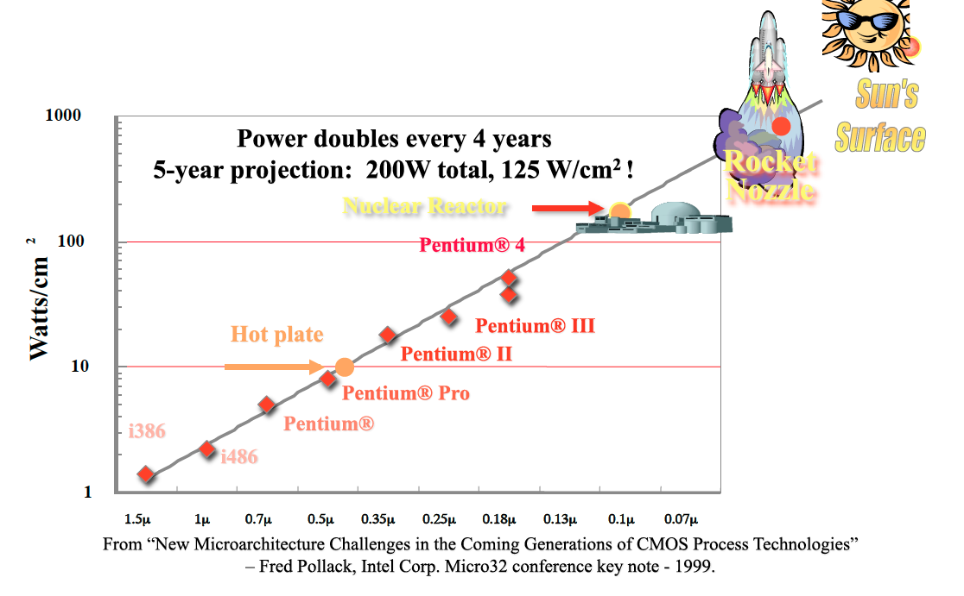
Towards Dark Silicon
Source: http://darksilicon.org/horsemen/horsemen_slides.pdf

Slide 13
The End of Multicore Scaling
Utilization Wall: With each successive process generation, the percentage of a chip that can actively switch drops exponentially due to power constraints.
4 cores @ 1.8 GHz
4 cores @ 2x1.8 GHz (12 cores dark)
65 nm
32nm
Source: http://darksilicon.org/horsemen/horsemen_slides.pdf

Slide 14
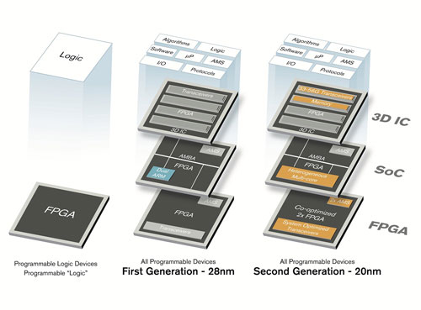
Hardware Acceleration
Source: http://eecatalog.com/fpga/2012/11/13/xilinx-20nm-all-programmable-portfolio-builds-on-28nm-breakthroughs-to-stay-a-generation-ahead/

Slide 15
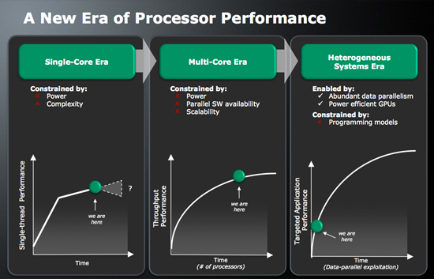
Slotnik’s Law of Effort #1: Heterogeneous Systems
LOOK UP: Slotnik vs. Amdahl (AFIPS’67), Michael Flynn’s talk on dataflow machines, Ryan Johnson’s paper on bionic databases.
Source: http://www.anandtech.com/show/2933

Slide 16
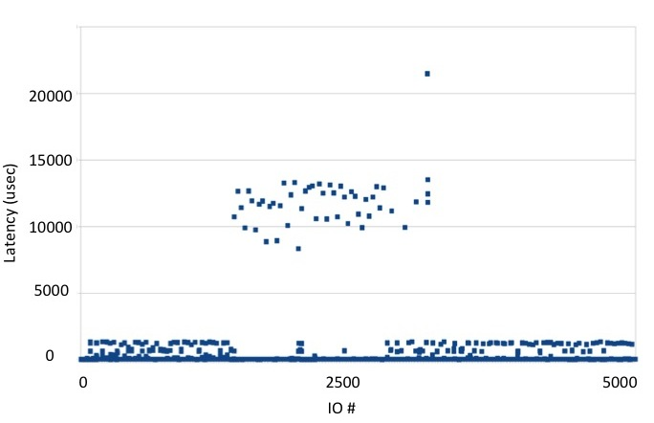
Slotnik’s Law of Effort #2: The emergence of SSDs
Latency of 5000 random writes on an Intel
710 SSD (10 successive passes over 250 KB with 512B
random writes on a random formatted device).
Throughput for 4K read IOs from product specifications
Read
Write
Scheduling & Mapping
Read
Program
Erase
Channels
Logical address space
Physical address space
Chip
Chip
Chip
Chip
Chip
Chip
Chip
Chip
Garbage collection
Wear Leveling
…
…
…
…
Chip
Chip
Chip
Chip
Flash memory array
LOOK UP: The necessary death of the block device interface

Slide 17
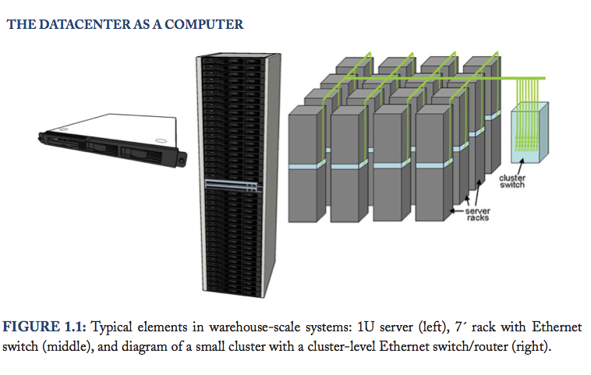
Warehouse-Scale Computer
LOOK UP: Werner Voegels on virtualization.
Source: http://www.morganclaypool.com/doi/abs/10.2200/S00193ED1V01Y200905CAC006

Slide 18
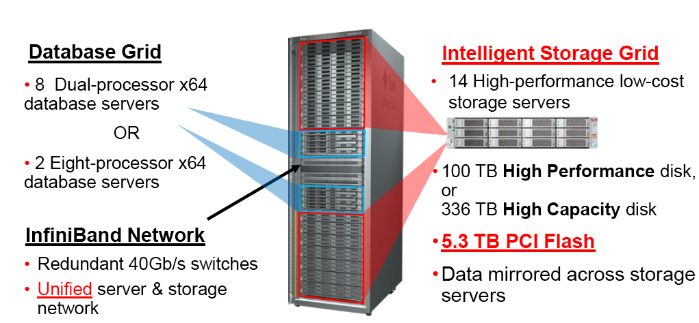
Database Appliances
Source: http://www.oracle.com/us/products/database/exadata/overview/index.html

Slide 19
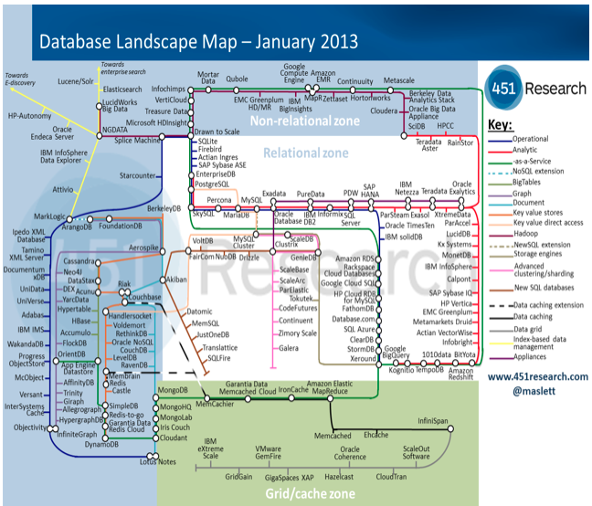
Trends and Database Systems
Source: http://451research.com/

Slide 20

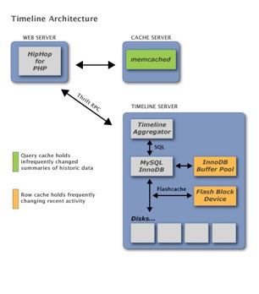
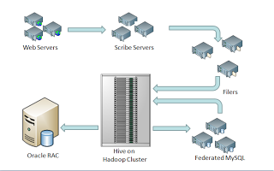
Trends and Database Applications
Source: https://www.facebook.com/notes/facebook-engineering/building-timeline-scaling-up-to-hold-your-life-story/10150468255628920; http://www.vldb.org/pvldb/2/vldb09-938.pdf

Slide 21
Trends & Database Tuning
Compression is of the essence
Different classes of systems adapted to different classes of applications
Data outgrows any well-defined model
Time to insight is impacting all applications
Energy is a key metric
Dealing with parallelism requires efforts
RAM locality is king
Incorporating hardware acceleration
Emergence of utility computing/storage
Vertical integration removes abstraction layers

Slide 22
Database Systems Invariants
The power of transactions
LOOK UP: Virtues and limitations by Jim Gray, reflections on the CAP theorem by Eric Brewer.
The primacy of data independence
LOOK UP: System R
The beauty of declarative queries
LOOK UP: The birth of SQL
A success story for parallelism
LOOK UP: Parallel Database Systems

Slide 23
Tuning Invariants
Think globally; fix locally
Partitioning breaks bottlenecks
Start-up costs are high; running costs are low
Render unto server what is due unto server
Be prepared for trade-off

Slide 24
Classes of Applications/Systems
OLAP + OLTP applications
Relational systems:
Oracle 12g
IBM DB2 10.1
SQL Server 2012
MySQL 6 & InnoDB 5
Exadata

Slide 25
System Architecture
Web Server
Web Server
Web Server
Web Server
Web Server
Web Server
Web Server
Web Server
Application Server
Query Processor
Application Server
Application Server
Application Server
DBMS
Storage Manager
(RAM)
Storage Manager
(c-store,
HDD)
Storage Manager
(c-store,
SSD)
Storage Manager
(r-store,
HDD)
Storage Manager
(r-store, SSD)
OS
Hardware
instance

Slide 26
Lectures
Troubleshooting techniques
Tuning the guts
Tuning transactions
Tuning the writes
Index tuning
Schema tuning
Query tuning
Tuning the application interface
Tuning across instances
OLAP tuning
OLTP tuning

