Slide 1
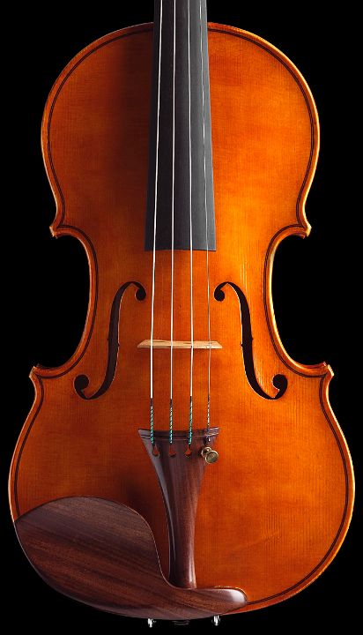

Troubleshooting techniques

Slide 2
Outline
DBMS architecture overview
More details as we progress through lectures
Troubleshooting and experimentation
Troubleshooting methodologies
Resource consumption model
Time-spent model

Slide 3
Traditional Architecture
Q
Client
server
Application
DBMS
DBMS
DATA
OS
HW
Result Set

Slide 4
Streaming Architecture
Data (stream)
DBMS
Q
LOOK UP: DEBS2013 Grand Challenge
Result Set (stream)

Slide 5
DBMS Components
Parser
Query Processor
Compiler
Execution Engine
Indexes
Storage Subsystem
Indexes
Concurrency Control
Recovery
Buffer Manager

Slide 6
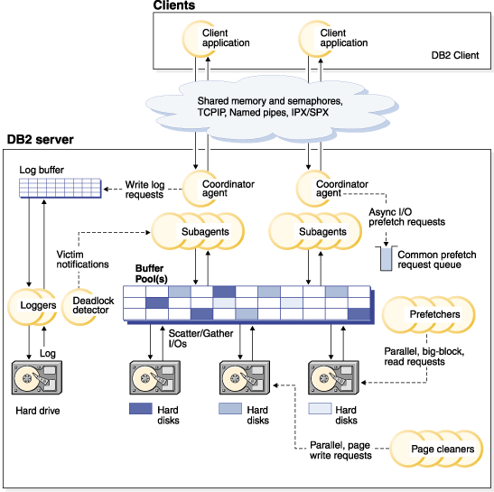
DB2 9.7 Process Architecture
Source: http://pic.dhe.ibm.com/infocenter/db2luw/v9r7/topic/com.ibm.db2.luw.admin.perf.doc/doc/00003525.gif

Slide 7
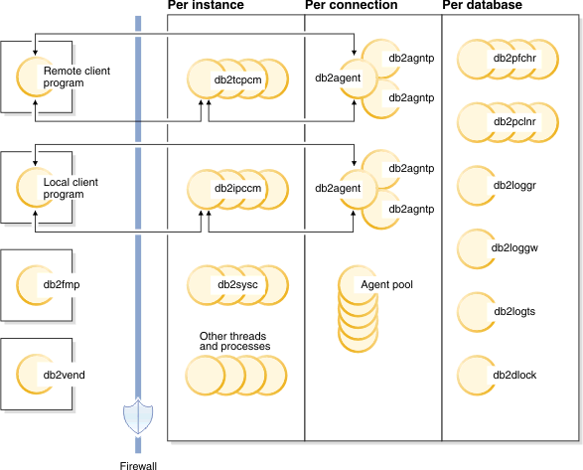
DB2 10.1 Process Architecture
Source: http://pic.dhe.ibm.com/infocenter/db2luw/v10r1/index.jsp?topic=%2Fcom.ibm.db2.luw.admin.perf.doc%2Fdoc%2Fc0008930.html

Slide 8
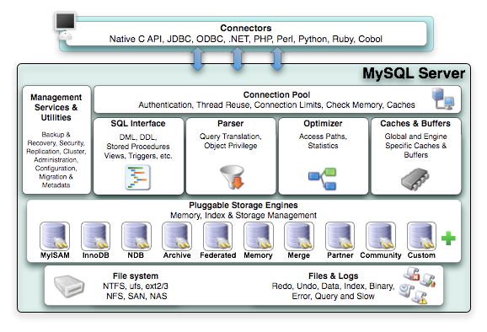
MySQL Architecture
Source: http://docs.oracle.com/cd/E19957-01/mysql-refman-5.5/storage-engines.html

Slide 9
Troubleshooting: Why
Production
Users/manager complaints.
Needs monitoring. What is going on NOW?
Once identified, a problem should be represented in a synthetic form (so that others can avoid the problem, or as a request for new features from DBMS/OS)
Test
New application / New system / New functionalities / New scale
Can system keep performance up in new settings?
Needs Experiments.

Slide 10
Troubleshooting: How
You MUST measure system performance (black box)
Profiling tools
You MUST instrument your system to get some insight about the internal processes (white box)
System instrumentation
You MUST follow a systematic approach for troubleshooting / experimentation
Scientific Method
Troubleshooting methodology

Slide 11
Experimental Framework
System
Application + DBMS + OS + HW
Parameters (fixed/factors)
Metrics
Throughput / Response Time
Workload
Actual users (production), replay trace or synthetic workload (e.g., TPC benchmark)
Experiments
What factor to vary?
Exercise 2.1:
Is throughput always the inverse of response time?
Exercise 2.2:
Define an experiment to measure the write throughput of the file system on your laptop

Slide 12
Troubleshooting Methodologies
Resource Consumption Model (Chapter 7)
Primary, DBMS system resources
Applications as consumers
Instrumentation through aggregate probes
Time Spent Model
response time = execution time + wait time
Instrumentation to obtain session-based time series
Exercise 2.3:
Does DB2 top follow the resource consumption or time spent model?

Slide 13
Resource Consumption Model
Effects are not always felt first where the cause is!
An overloading high-level consumer
A poorly parameterized subsystem
An overloaded primary resource

Slide 14
Resource Consumption Model
Extract indicators to answer the following questions
Question 1: Are critical queries being served in the most efficient manner?
Question 2: Are subsystems making optimal use of resources?
Question 3: Are there enough primary resources available?

Slide 15
Methodology
Which are the critical queries?
Ask users.
Use query log to find queries that take longest.
Resource Usage
Check out system-wide performance indicators.
Use rules of thumbs to check whether they are ok.

Slide 16
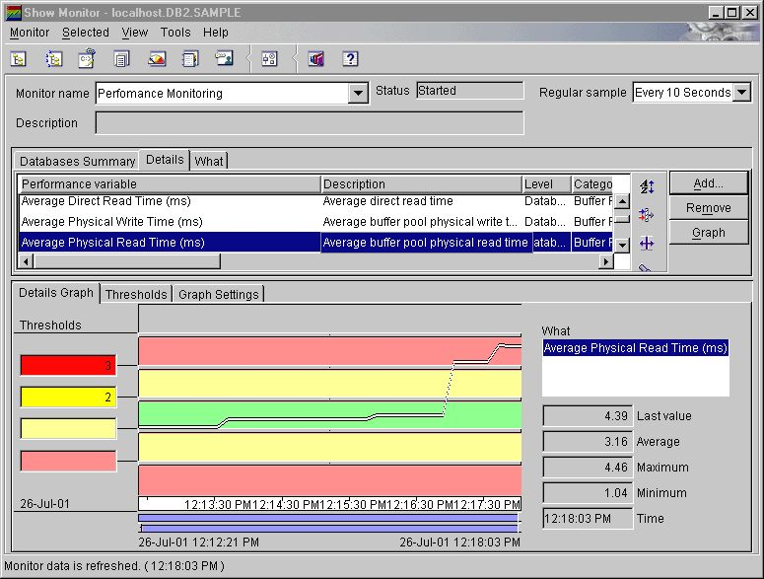
Example
DBMS
OS
Statement number: 1
select C_NAME, N_NAME
from DBA.CUSTOMER join DBA.NATION on C_NATIONKEY = N_NATIONKEY
where C_ACCTBAL > 0
Number of rows retrieved is: 136308
Number of rows sent to output is: 0
Elapsed Time is: 76.349 seconds
…
Buffer pool data logical reads = 272618
Buffer pool data physical reads = 131425
Buffer pool data writes = 0
Buffer pool index logical reads = 273173
Buffer pool index physical reads = 552
Buffer pool index writes = 0
Total buffer pool read time (ms) = 71352
Total buffer pool write time (ms) = 0
…
Summary of Results
==================
Elapsed Agent CPU Rows Rows
Statement # Time (s) Time (s) Fetched Printed
1 76.349 6.670 136308 0
Exercise 2.5:
Which are the profiling tools on your laptop OS?
Exercise 2.4:
What are the 11 system wide indicators recommended for DB2 10.1?

Slide 17
Fine Granularity Analysis
LOOK UP:
Index usage analysis in DB2 10.1
Event and resource monitoring in DB2 10.1

Slide 18
Time Spent Model
Given a critical query / session
Where does the time go?
Throughout DBMS/OS/HW components
Waiting / Executing
Find out which components cause a session to be slow.

Slide 19
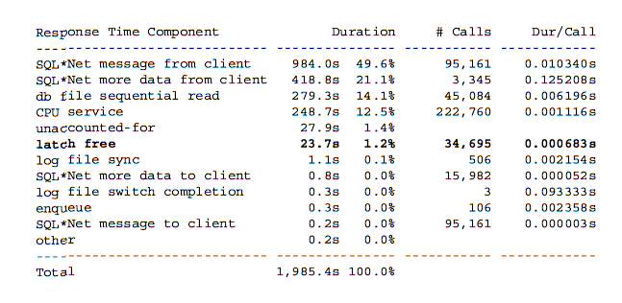
Example: Oracle
Source: Cary Millsap: Oracle Operational Timing Presentation

Slide 20
Example: IBM DB2 10.1
Time-spent monitors
Scope
Wait time
Processing time
Elapsed time
Database
Application handle
Resource (lock, buffer, …)
LOOK UP: MON_GET_ACTIVITY_DETAILS table function

Slide 21
Exercise 2.6:
Assume your DBMS is DB2 10.1. How can you answer the following questions:
How many IOs are performed while a given query is running?
How much time is spent performing those IOs?
What percentage of the total execution time does it take to perform those IOs?
What portion of those IOs are sequential?
Hint, LOOK UP:
Workloads in DB2
Table space utilization view
Physical reads and writes monitor elements

