Slide 1

A Semi-Supervised Self-Organizing Map with Adaptive Local Thresholds
Pedro H. M. Braga and Hansenclever F. Bassani
{phmb4, hfb}@cin.ufpe.br
Recife, Brasil
July, 2019

Slide 2
Outline
Introduction
Background
Adaptive Local Thresholds Semi Supervised Self-Organizing Map (ALTSS-SOM)
Experimental Results and Analysis
Conclusion and Future Work

Slide 3
1.
Introduction

Slide 4
Introduction
Recent research on Artiﬁcial Neural Networks with supervised learning has shown signiﬁcant advances.
A key to the success is the sufﬁciently large labeled training data.
Unfortunately, creating it is not an easy task.
Expensive, time-consuming, and challenging.
The use of supervised learning became impractical in many applications:
Medical ﬁeld.
Robotics: new categories of elements may frequently arise
.

Slide 5
Introduction
Unlabeled data usually can be easily obtained due to advances in technology that have produced datasets of increasing size:
Samples and Features.
There has been a growing interest in Semi-Supervised Learning (SSL)
Combine both types of data to improve the performance of the models
A halfway between supervised and unsupervised learning, that can be used to both clustering and classiﬁcation tasks

Slide 6
Introduction
It is possible to highlight the prototype-based methods as a start point for introducing modiﬁcations to perform semi-supervised learning, as SOM-based models (Liu et al., 2015; Dozono et al., 2016), but also approaches ranging from generative models (Kingma et al., 2014) to transfer learning (Oliver et al., 2018).
Kohonen proposed two very inﬂuential prototype-based methods:
Self-Organizing Map (SOM) – Unsupervised (Kohonen, 1982)
Learning Vector Quantization (LVQ) – Supervised (Kohonen, 1995)
Why not a hybrid model?

Slide 7
2.
Background

Slide 8
Background
Supervised
Unsupervised
Clustering involves not only clustering the data but also identifying subsets of the input dimensions which are relevant to characterize each cluster (how relevant each dimension is)
Semi-Supervised
K-means-based methods
Label propagation
Label Spreading
SOM-based models

Slide 9
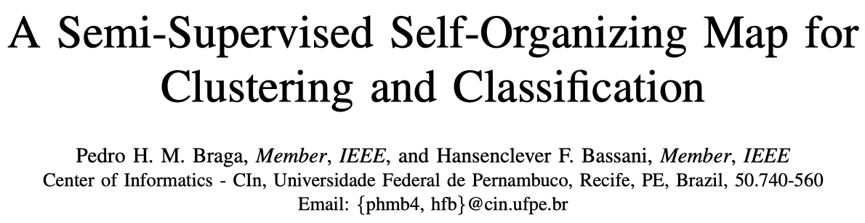
Semi-Supervised Self-Organizing Map (SS-SOM)
A semi-supervised SOM with a time-varying structure, based on LARFDSSOM, that includes concepts from LVQ when the class label of some input pattern is given , and can learn in a supervised or unsupervised way
Three phases:
Learns incrementally by:
Inserting prototypes when the existing ones do not represent well the input data (according to a threshold)
Removing prototypes when they are not required
Organization
Convergence
Classification and Clustering

Slide 10
3.
Adaptive Local Thresholds Semi Supervised Self-Organizing Map (ALTSS-SOM)

Slide 11
ALTSS-SOM
Estimates the uncentered variance of the nodes in each dimension
Rejection Options
Local Adaptive Thresholds
Sample Efficient
Low sensitive to the parameters

Slide 12
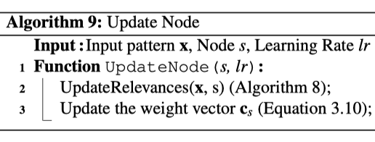
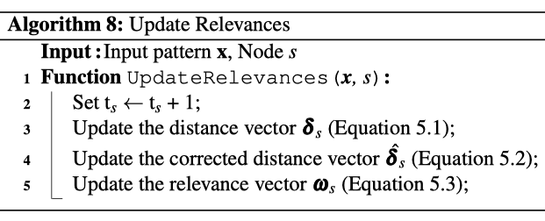


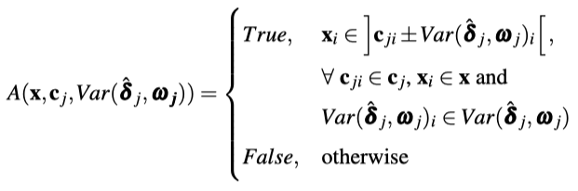
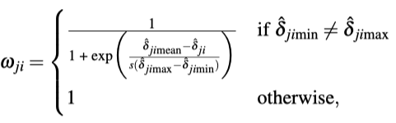
ALTSS-SOM
Aspects in Common for Both Modes:
Structure of the Nodes
Node Update
Relevance Update
Bias-corrected moving averages estimate
Local Thresholds

Slide 13
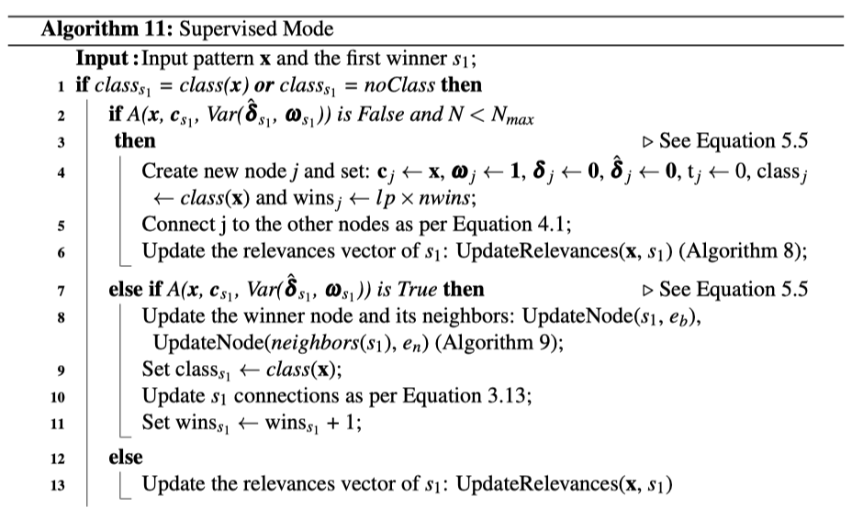
ALTSS-SOM
Local Thresholds and Rejection Option
x_{i}
Nodes of Class 1
Nodes of Class 2
Nodes of Undefined Class

Slide 14
ALTSS-SOM
Straightforward Acceptance Rule
x_{i}
Nodes of Class 1
Nodes of Class 2
Nodes of Undefined Class

Slide 15
ALTSS-SOM
Local Thresholds and Rejection Option
x_{i}
Nodes of Class 1
Nodes of Class 2
Nodes of Undefined Class

Slide 16
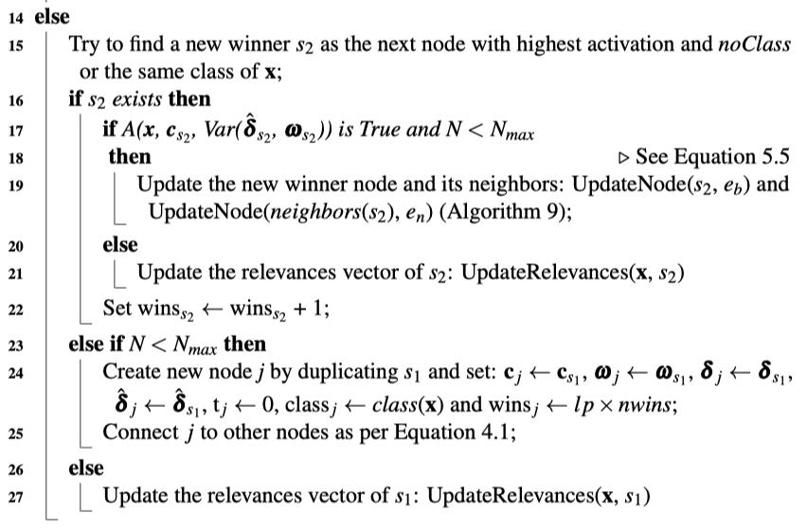
ALTSS-SOM
Node Duplication: when there are no new nodes to replace the first winner, and the map is not full
X
x_{i}
Nodes of Class 1
Nodes of Class 2
Nodes of Undefined Class

Slide 17
ALTSS-SOM
Clustering and Classification:
All the nodes labeled;
Some nodes labeled;
No nodes labeled.

Slide 18
4.
Experimental Results and analysis

Slide 19
Evaluation
Latin Hypercube Sampling (LHS)
Sensitivity
Accuracy
Clustering Error (CE)

Slide 20
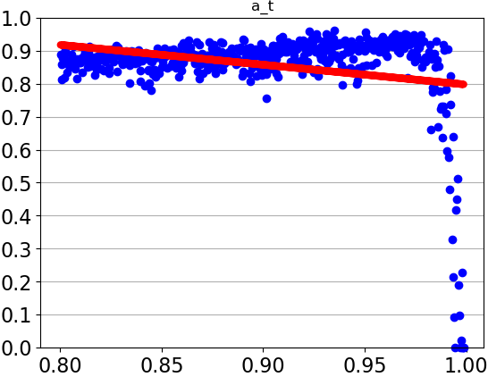
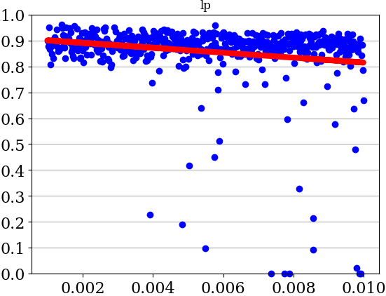
Previous Model (SS-SOM): Sensitivity Analysis with Pendigits
Accuracy
Parameter Value

Slide 21
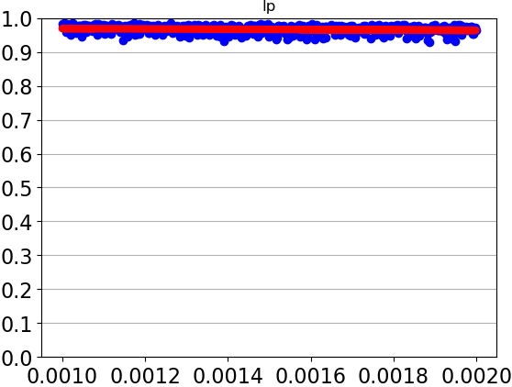
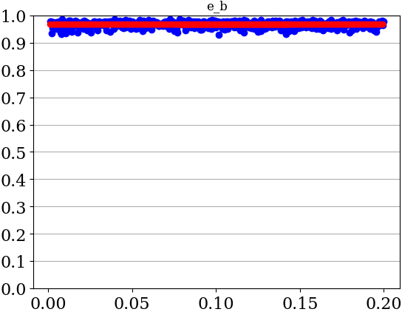
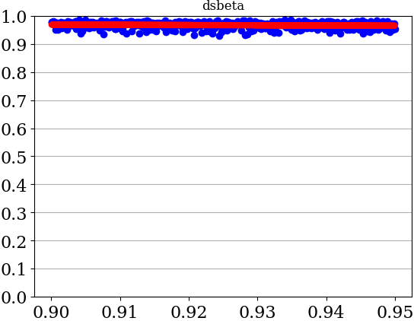
ALTSS-SOM: Sensitivity Analysis Pendigits – All Parameters
Accuracy
Parameter Value

Slide 22
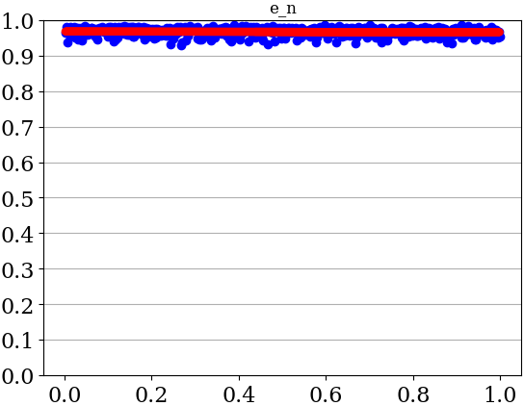
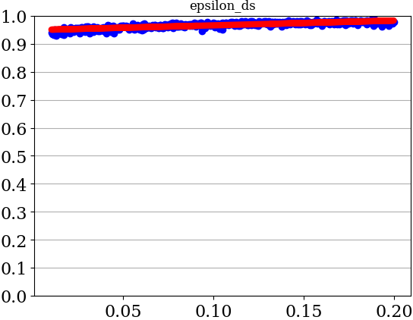
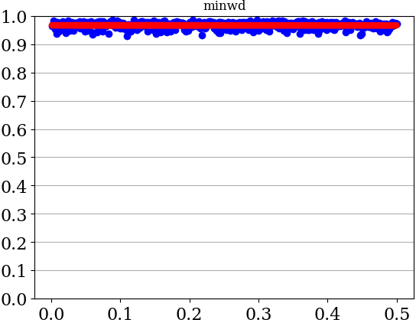
ALTSS-SOM: Sensitivity Analysis Pendigits – All Parameters
Accuracy
Parameter Value

Slide 23
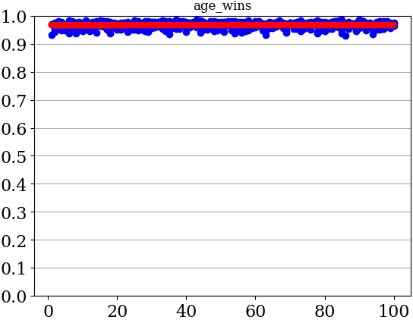
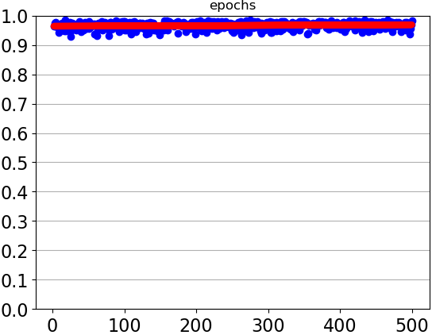
ALTSS-SOM: Sensitivity Analysis Pendigits – All Parameters
Accuracy
Parameter Value

Slide 24
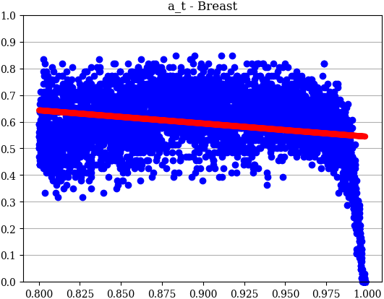
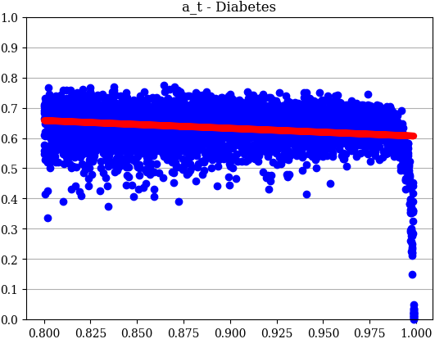
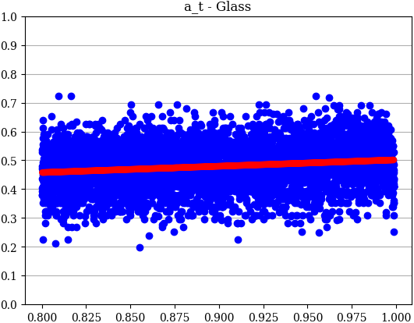

Previous Models (SS-SOM): Sensitivity Analysis of$a_{t}$
Accuracy
Parameter Value

Slide 25
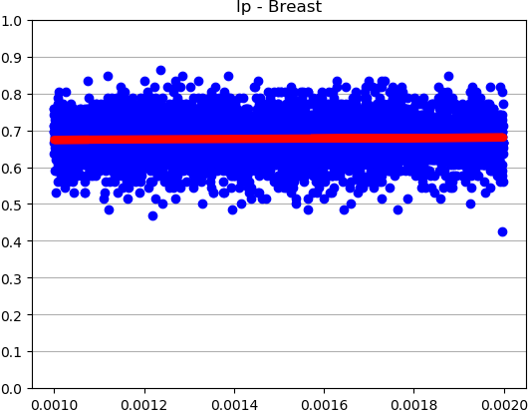
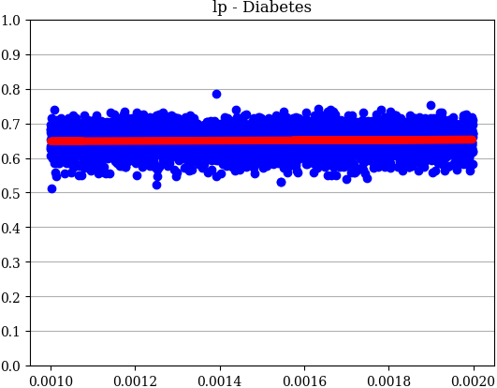
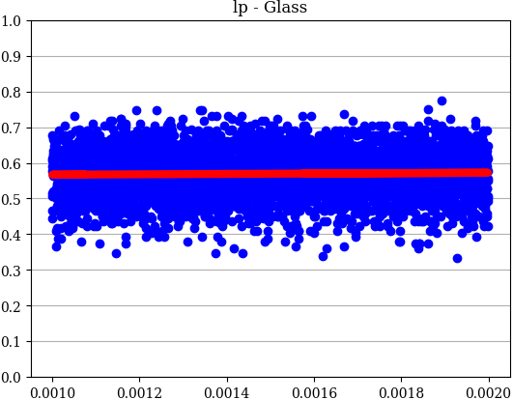
ALTSS-SOM: Sensitivity Analysis lp – All Datasets
Accuracy
Parameter Value

Slide 26
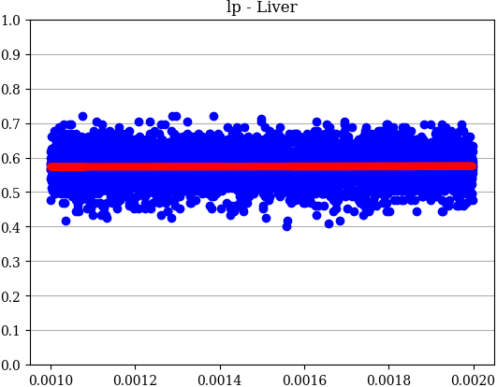
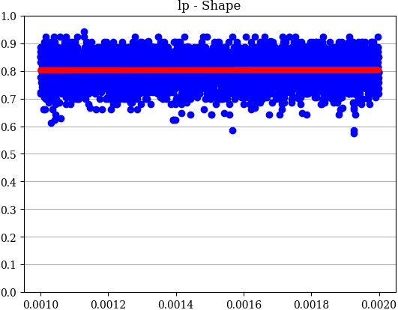
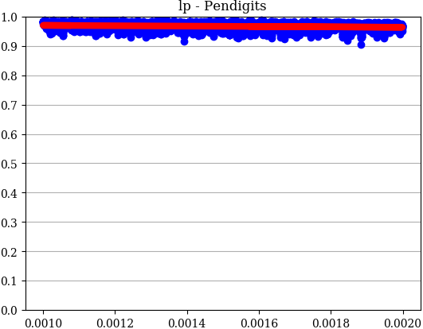
ALTSS-SOM: Sensitivity Analysis lp – All Datasets
Accuracy
Parameter Value

Slide 27
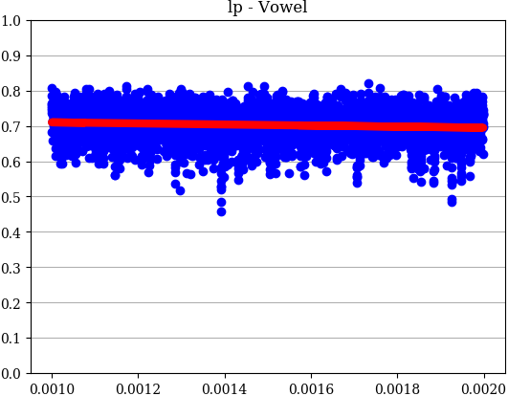
ALTSS-SOM: Sensitivity Analysis lp – All Datasets
Accuracy
Parameter Value

Slide 28
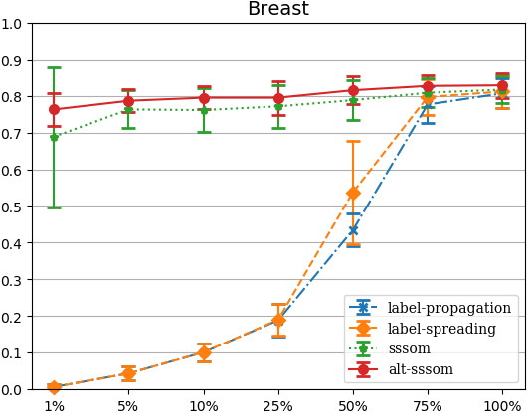
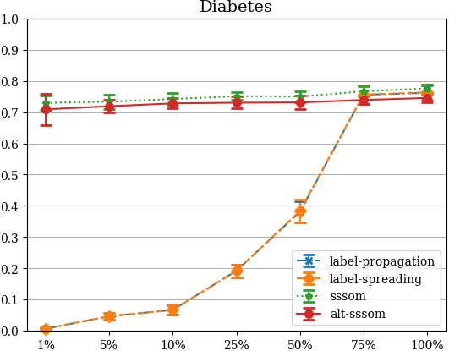
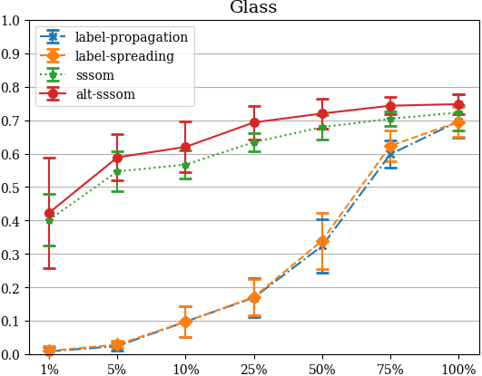
ALTSS-SOM: Classiﬁcation Accuracy with Different Percentages of Labeled Data
Accuracy
Percentage of available labeled data

Slide 29
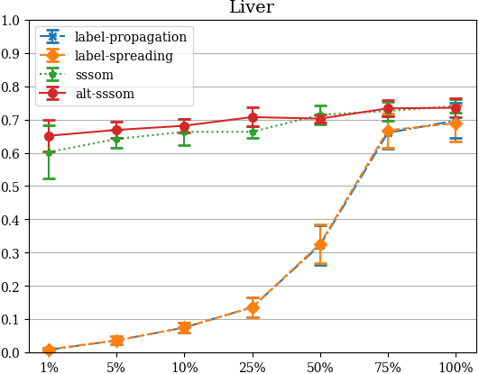
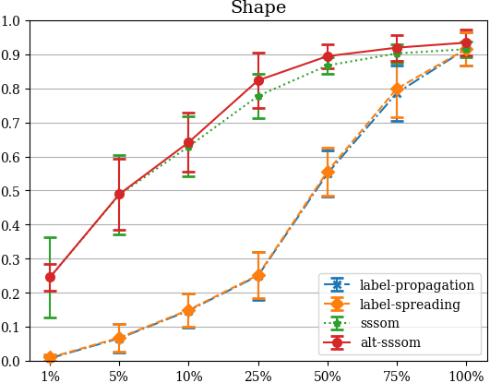
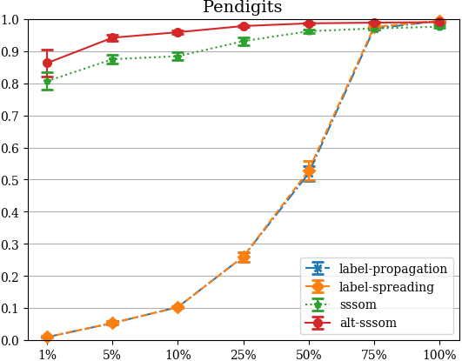
ALTSS-SOM: Classiﬁcation Accuracy with Different Percentages of Labeled Data
Accuracy
Percentage of available labeled data

Slide 30
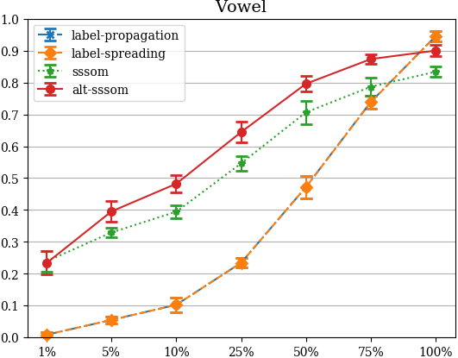
ALTSS-SOM: Classiﬁcation Accuracy with Different Percentages of Labeled Data
Accuracy
Percentage of available labeled data

Slide 31
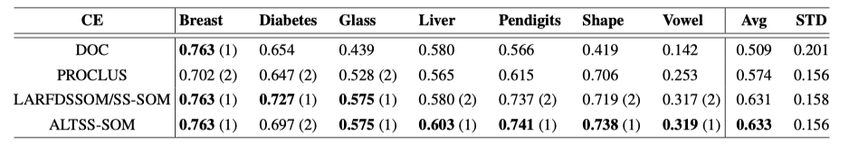
ALTSS-SOM: Clustering Performance
ALTSS-SOM for clustering tasks solely, without using any labels in comparison with other clustering methods.
500 different parameters set

Slide 32
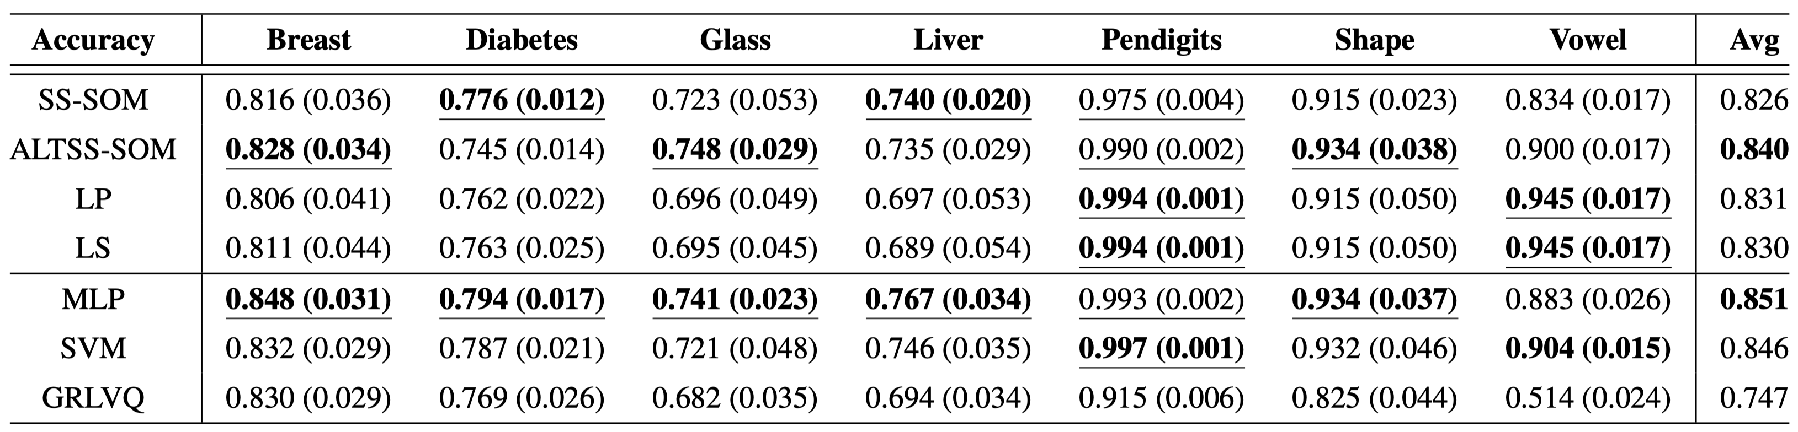
ALTSS-SOM: Fully Supervised Performances

Slide 33
5.
Conclusion and Future Work

Slide 34
Conclusion
ALTSS-SOM was put on trial in a scenario of full supervision, even though not being built for that, and presented good results, being better than or at least close to the best methods.
ALTSS-SOM was able to reduce in two the number of parameters whereby improving the performance (classiﬁcation and clustering)
ALTSS-SOM improved the sample efﬁciency by not merely discarding data in certain cases but kept digging into its characteristics in order to establish a better understanding of their statistics.

Slide 35
Future work
Use the unsupervised error to build a model with more than one layer.
Deﬁne a hierarchical approach to provide better exploitation of the data statistics and to increase the abstraction level autonomously.
Adjust the models for online learning.

Slide 36


Thanks!
Questions?
Pedro Henrique Magalhães Braga
phmb4@cin.ufpe.br
ALT-SSSOM source code available at
github.com/phbraga/alt-sssom

