Slide 1



[LPP 30.09.2022]
EMA Workshop
Sejin Oh

Slide 2
1. What is EMA? | 03
2. When do you use EMA? | 14
3. How to parse gestures (MVIEW) | 26
4. How to analyze EMA data | 37
Outline

Slide 3
1. What is EMA?

Slide 4
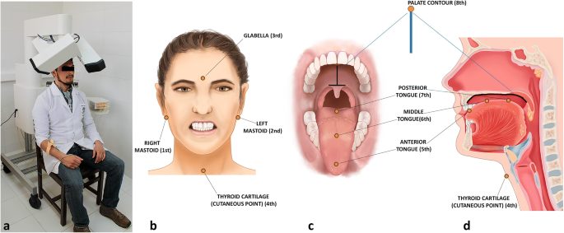
Phonetic diagnostics for complex segmenthood
Electromagnetic Articulography (EMA)
01

Slide 5
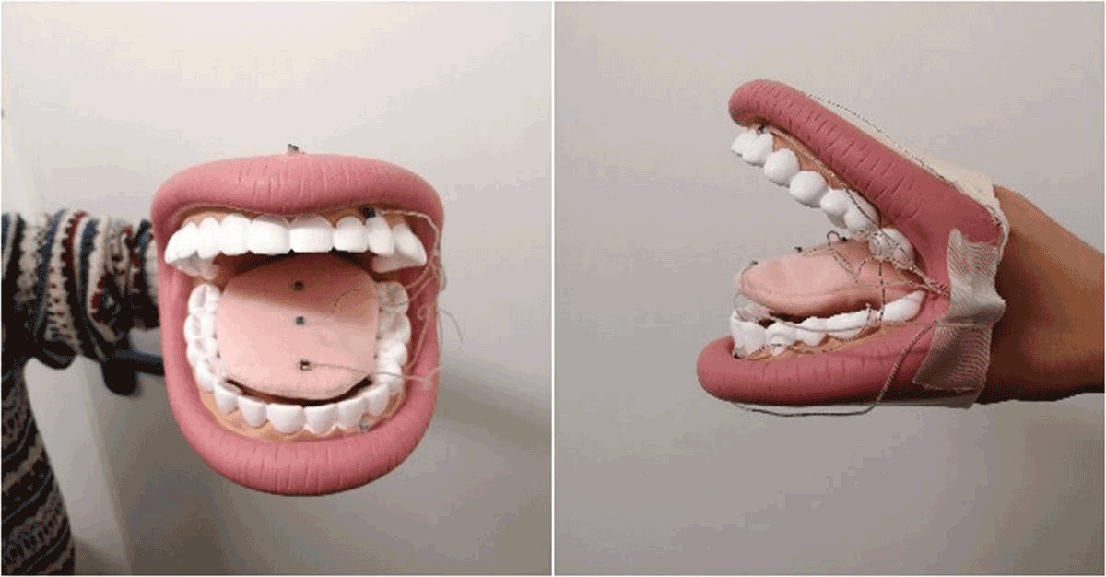
Phonetic diagnostics for complex segmenthood
Electromagnetic Articulography (EMA)
01

Slide 6
Phonetic diagnostics for complex segmenthood
Electromagnetic Articulography (EMA)
01
https://www.youtube.com/watch?v=6oIejoZ17j0

Slide 7

2. When do you use EMA?

Slide 8
Background: Temporal coordination of syllable structure
Temporal coordination of gestures
01
A gesture in a syllable onset is coordinated in-phase with the following vowel, with two gestures triggered at the same time.
C1
V

Slide 9
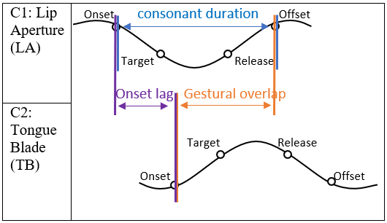
Temporal coordination of gestures
01

Slide 10
Spatial location of gestures
01
Figure 4: A gestural score for ‘ten themes.’

Slide 11

3. How to parse gestures (MVIEW)

Slide 12
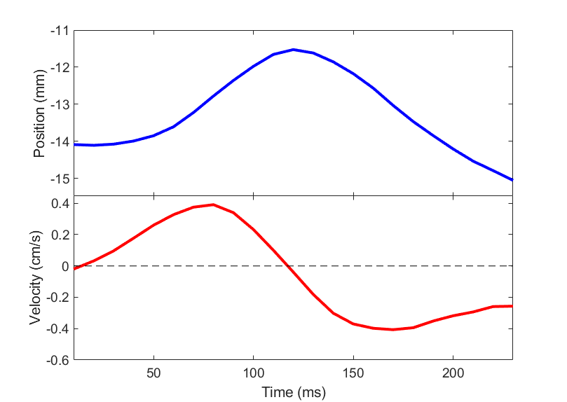
Landmarks: Onset, Target, Release, Offset determined by 20% threshold of peak velocity in Mview (Tiede 2005)
01
Target
Release
Mview
Offset
Onset
peak velocity
peak velocity

Slide 13
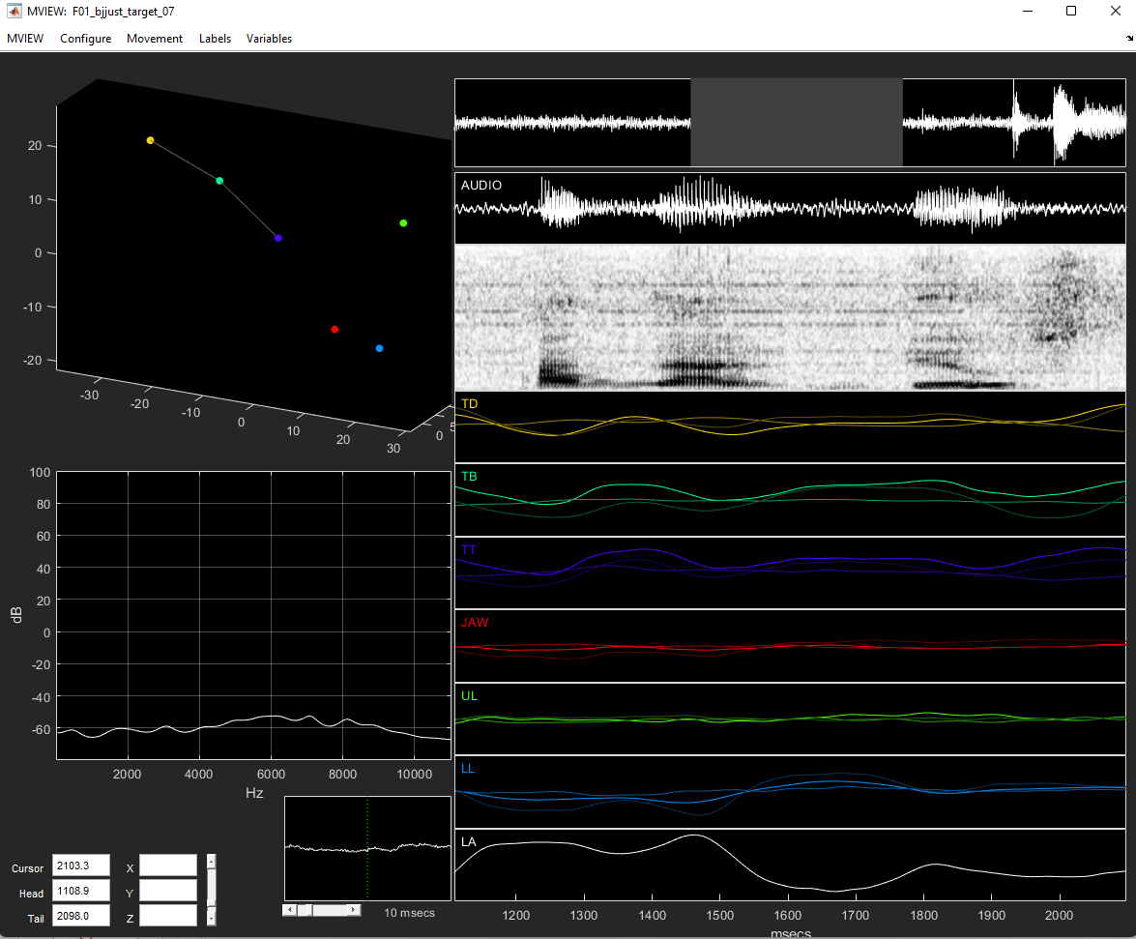
01
Mview

Slide 14
4. How to analyze EMA data

Slide 15
03
Data measurement
Lip aperture for labial gesture; TB for /j/
The correlation between first gesture duration and onset lag
The spatial position of the TB sensors at movement onset
G₁ duration = Offset (G₁) – Onset (G₁)
G₁
G₂
Onset lag = Onset (G₂) – Onset (G₁)

Slide 16
Merci !

