Slide 1


1.Computer Organization
Notes:
NOTE:
To change the image on this slide, select the picture and delete it. Then click the Pictures icon in the placeholder to insert your own image.

Slide 2
Content
1.1 Turing model
1.2 Von Neumann model
1.3 Computer generations
1.4 Subsystems and the role of subsystems
1.5 Central Processing Unit
1.6 Memory: main memory and cache memory
1.7 Input/Output subsystems
1.8 Different architectures

Slide 3
Objectives
After studying this chapter, the student should be able to:
Define the Turing model of a computer.
Define the von Neumann model of a computer.
Describe the three components of a computer: hardware, data, and software.
List topics related to computer hardware.
List topics related to data.
List topics related to software.
Give a short history of computers.

Slide 4
1-TURING MODEL

Slide 5
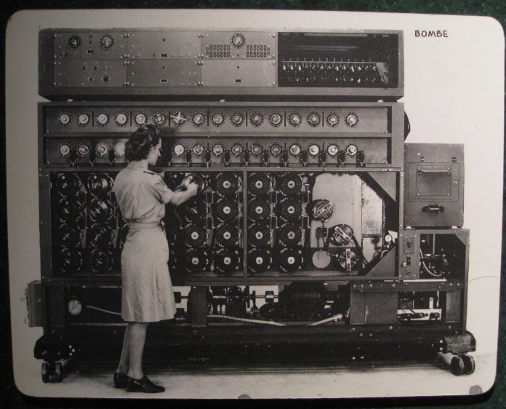
1. Introduction
The idea of a universal computational device was first described by Alan Turing in 1937.
All computation could be performed by a special kind of a machine, now called a Turing machine.
The model on the actions that people perform when involved in computation.
Actions into a model for a computational machine that has really changed the world.

Slide 6
2. Data processors
A computer acts as a black box that accepts input data, processes the data, and creates output data (Figure 1.1).
This model could represent a specific-purpose computer (or processor) that is designed to do a single job, such as controlling the temperature of a building or controlling the fuel usage in a car.
However, computers, as the term is used today, are general-purpose machines. They can do many different types of tasks
Figure -1.1 A single-purpose computing machine

Slide 7
3. Programmable data processors
An extra element is added to the specific computing machine: the program.
A program is a set of instructions that tells the computer what to do with data.
The output data depends on the combination of two factors: the input data and the program.
With the same input data, we can generate different output if we change the program.
Similarly, with the same program, we can generate different outputs if we change the input data.
Figure -1.2 : A computer based on the Turing model: programmable data processor

Slide 8
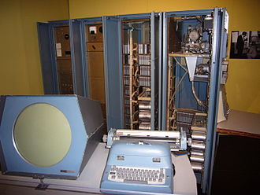
4. The universal Turing machine
A universal Turing machine, a machine that can do any computation if the appropriate program is provided, was the first description of a modern computer.
It can be proved that a very powerful computer and a universal Turing machine can compute the same thing
A universal Turing machine is capable of computing anything that is computable.
Figure - 1.3 Programmed Data Processor (PDP-1)

Slide 9
2-Von Neumann model

Slide 10
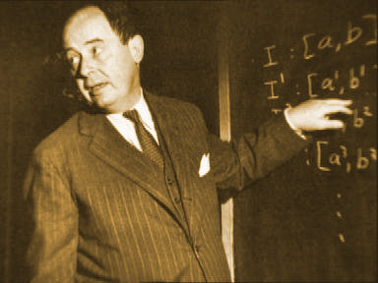
1. Introduction
The modern microcomputer has roots going back to USA in the 1940’s.
Of the many researchers, the Hungarian-born mathematician, John von Neumann (1903-57), is worthy of special mention.
He developed a very basic model for computers which we are still using today.
Figure - 1.4. John von Neumann (1903-57). Progenitor of the modern, electronic PC.

Slide 11
2. Von Neumann Model Subsystems
Von Neumann model is divided into 4 subsystems :
Memory is the storage area. This is where programs and data are stored during processing
Arithmetic logic unit (ALU) is where calculation and logical operations take place
Control unit controls the operations of the memory, ALU, and the input/output
The input subsystem accepts input data and the program from outside the computer, while the output subsystem sends the result of processing to the outside world.
Figure 1.5 The Von Neumann model Subsystems

Slide 12
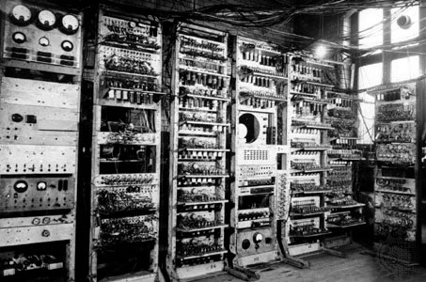
3. The stored program concept
The von Neumann model states that the program must be stored in memory.
This is totally different from the architecture of early computers in which only the data was stored in memory: the programs for their task were implemented by manipulating a set of switches or by changing the wiring system.
The memory of modern computers hosts both a program and its corresponding data
Figure 1.6 The Manchester Mark I, the first stored-program digital computer, 1949.

Slide 13
4. Sequential execution of instructions
A program is made of a finite number of instructions. In this model, the control unit fetches one instruction from memory, decodes it, then executes it.
One instruction may request the control unit to jump to some previous or following instruction, but this does not mean that the instructions are not executed sequentially.
Figure 1.7 Fetches Execute cycle

Slide 14
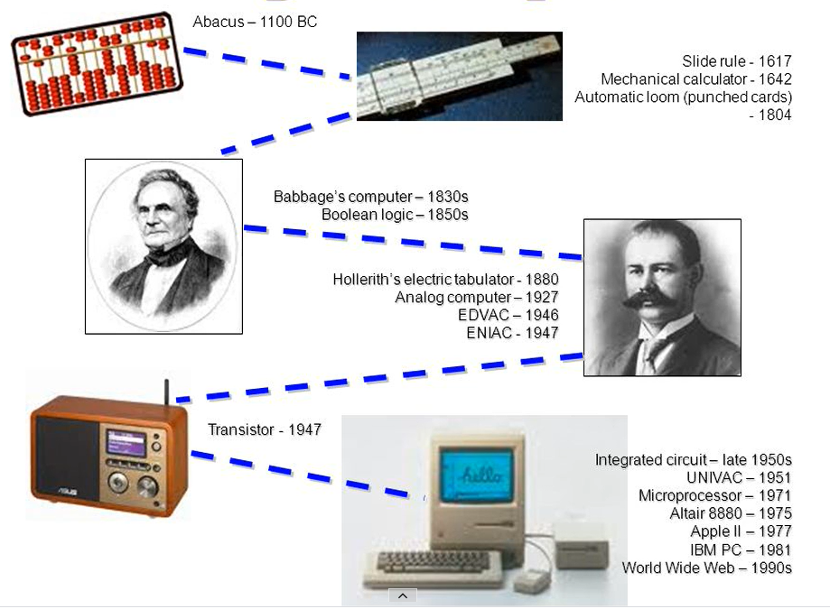
History of Computers
Figure 1.7 History of Computers

Slide 15
3 - Computer generations

Slide 16
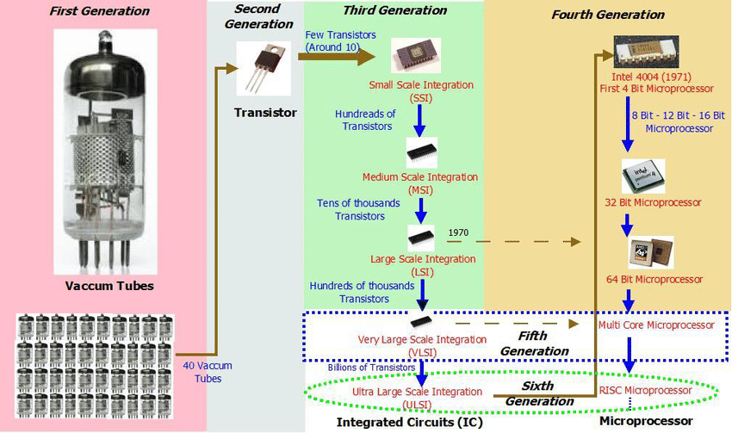
1. Overview
Figure 1.8 Generation of Computers

Slide 17
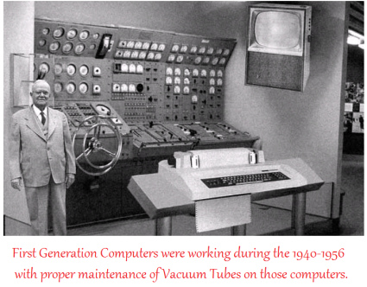
2. First Generation (1945-1956)
First Generation Computers were working during the 1940-1956 with proper maintenance of Vacuum Tubes on those computers. Vacuum Tubes most useful to process the data in memory.
First generation computers use more power from electricity and that produce high heat.
Those devices vulnerable to the attacks and get malfunctions.
Figure 1.9 First Generation Computers

Slide 18
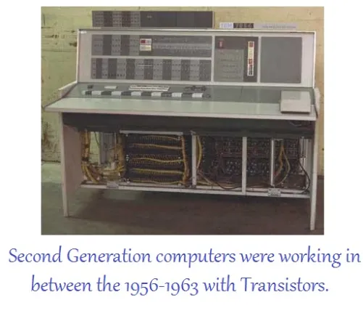
3. Second Generation Computers (1959-1965)
Second-generation computers (roughly 1959–1965) used transistors instead of vacuum tubes. This reduced the size of computers, as well as their cost, and made them affordable to small and medium-size corporations.
Two high-level programming languages, FORTRAN and COBOL (see Chapter 9), were invented and made programming easier.
Figure 1.10 Second Generation Computers

Slide 19
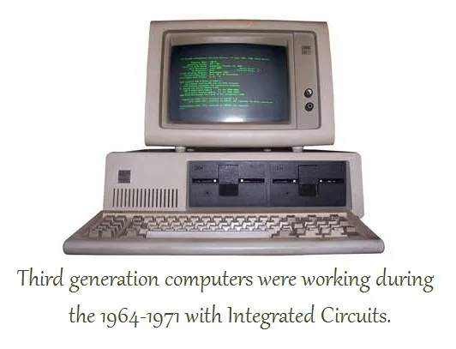
4. Third Generation Computers (1965-1975)
The invention of the integrated circuit (transistors, wiring, and other components on a single chip) reduced the cost and size of computers even further.
Minicomputers appeared on the market. Canned programs, popularly known as software packages, became available.
A small corporation could buy a package, for example for accounting, instead of writing its own program.
Figure 1.11 Third Generation Computers

Slide 20
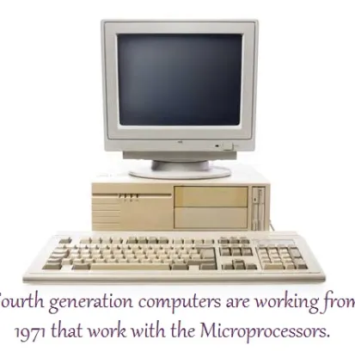
5. The fourth generation (1975–1985)
The fourth generation (approximately 1975–1985) saw the appearance of microcomputers.
The first desktop calculator, the Altair 8800, became available in 1975.
Advances in the electronics industry allowed whole computer subsystems to fit on a single circuit board.
Figure 1.12 The fourth Generation Computers

Slide 21
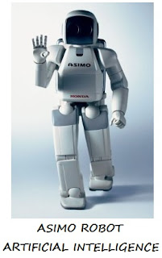
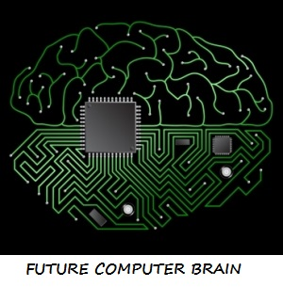
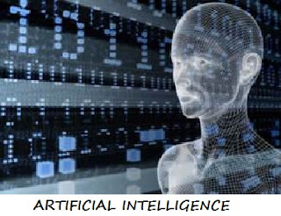
6. Fifth generation (Present and Beyond)
Fifth Generation computing devices, based on artificial intelligence, are still in development, though there are some applications such as voice recognition, that are being used today.
The ability to translate a foreign language is also moderately possible with fifth generation computers.
The goal of fifth generation computing is to develop devices that respond to natural language input and are capable of learning and self-organization.
Figure 1.13 The Fith Generation Computers

Slide 22
4 - Subsystems and the role of subsystems

Slide 23
INTRODUCTION
We can divide the parts that make up a computer into three broad categories or subsystem: the central processing unit (CPU) , the main memory, and the input/output subsystem.
Figure 1.18 Computer hardware (subsystems)

Slide 24
5 - CENTRAL PROCESSING UNIT

Slide 25
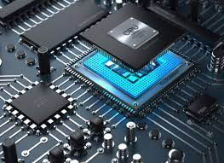
Introduction
The central processing unit (CPU) performs operations on data.
In most architectures It has three parts: an arithmetic logic unit (ALU), a control unit, and a set of registers
Figure 1.19 Central processing unit (CPU)

Slide 26
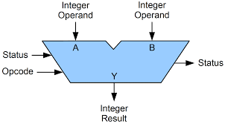
The arithmetic logic unit (ALU)
The arithmetic logic unit (ALU) performs logic, shift, and arithmetic operations on data.
Logic operations: NOT, AND, OR, and XOR.
Shift operations: logic shift operations and arithmetic shift operations
Arithmetic operations: arithmetic operations on integers and reals.
Figure 1.20 Construction of an ALU

Slide 27
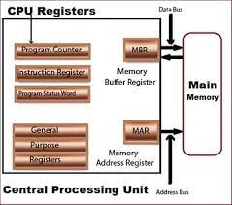
Registers
Registers are fast stand-alone storage locations that hold data temporarily. Multiple registers are needed to facilitate the operation of the CPU.
Figure 1.21 Construction of an Register

Slide 28
The control unit
The control unit controls the operation of each subsystem. Controlling is achieved through signals sent from the control unit to other subsystems.
Figure 1.22 Using an control unit

Slide 29
6-MAIN MEMORY

Slide 30
Introduction
Main memory consists of a collection of storage locations, each with a unique identifier, called an address.
Data is transferred to and from memory in groups of bits called words.
Figure 1.23 Main memory

Slide 31
Address space
To access a word in memory requires an identifier. Although programmers use a name to identify a word (or a collection of words), at the hardware level each word is identified by an address.
The total number of uniquely identifiable locations in memory is called the address space. For example, a memory with 64 kilobytes and a word size of 1 byte has an address space that ranges from 0 to 65,535.
Table 6.1 Memory units

Slide 32
Examples
Example 5.1
A computer has 32 MB (megabytes) of memory. How many bits are needed to address any single byte in memory?
Solution The memory address space is 32 MB, or 225 (25 × 220). This means that we need log2 225, or 25 bits, to address each byte.
Example 5.2
A computer has 128 MB of memory. Each word in this computer is eight bytes. How many bits are needed to address any single word in memory?
Solution The memory address space is 128 MB, which means 227. However, each word is eight (23) bytes, which means that we have 224 words. This means that we need log2 224, or 24 bits, to address each word.

Slide 33
Memory types
Two main types of memory exist: RAM and ROM.
Random access memory (RAM)
Read-only memory (ROM)

Slide 34
Memory hierarchy
Computer users need a lot of memory, especially memory that is very fast and inexpensive. This demand is not always possible to satisfy— very fast memory is usually not cheap. A compromise needs to be made.
The solution is hierarchical levels of memory.
Figure 1.24 Hierarchical levels of memory.

Slide 35
Cache memory
Cache memory is faster than main memory, but slower than the CPU and its registers.
Cache memory, which is normally small in size, is placed between the CPU and main memory.
Figure 1.25 Hierarchical levels of memory.

Slide 36
7 - INPUT/OUTPUT SUBSYSTEM

Slide 37
Introduction
The input/output (I/O) subsystem in a computer is the collection of devices. T
his subsystem allows a computer to communicate with the outside world and to store programs and data even when the power is off.
Input/output devices can be divided into two broad categories: non-storage and storage devices.

Slide 38
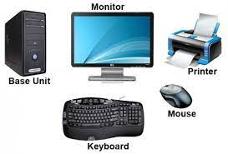
Non-storage & Storage devices
Non-storage devices allow the CPU/memory to communicate with the outside world, but they cannot store information.
Storage devices, although classified as I/O devices, can store large amounts of information to be retrieved at a later time. They are cheaper than main memory, and their contents are nonvolatile—that is, not erased when the power is turned off. They are sometimes referred to as auxiliary storage devices. We can categorize them as either magnetic or optical.

Slide 39
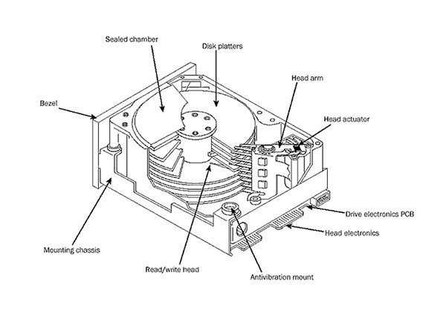
Storage devices (Magnetic or Optical)
HDD disk
CD-ROM
Storage devices
Figure 1.26 Storage devices

Slide 40
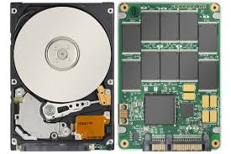
SSD – Solid State Disk
A solid-state drive (SSD uses NAND-based flash memory, which retains data without power.
It is also known as a solid-state disk or electronic disk, though it contains no actual "disk" of any kind, nor motors to "drive" the disks.
SSD technology uses electronic interfaces compatible with traditional block input/output (I/O) hard disk drives, thus permitting simple replacement in common applications, like SATA Express.
SSDs are about 7 to 8 times more expensive per unit of storage than HDDs.
Storage devices
Figure 1.27 Solid State Disk

Slide 41
8 - SUBSYSTEM INTERCONNECTION

Slide 42
Introduction
In this section, we explore how these three subsystems (CPU, main memory, and I/O) are interconnected.
The interconnection plays an important role because information needs to be exchanged between the three subsystems.

Slide 43
Connecting CPU and memory
The CPU and memory are normally connected by three groups of connections, each called a bus: data bus, address bus and control bus.
Figure 1.28 CPU and memory

Slide 44
Connecting I/O devices
I/O devices are electromechanical, magnetic, or optical devices and also operate at a much slower speed than the CPU/memory.
There is a need for some sort of intermediary to handle this difference. Input/output devices are therefore attached to the buses through input/output controllers or interfaces.
There is one specific controller for each input/output device
Figure 1.29 Connecting I/O devices

Slide 45
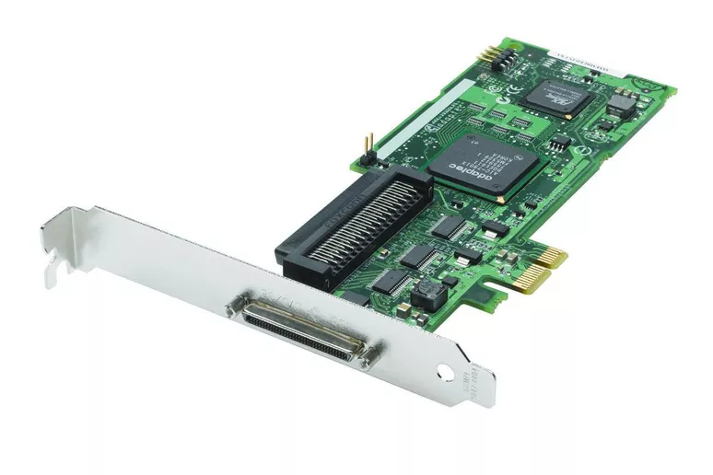
SCSI controller to connect I/O devices
Small Computer System Interface (SCSI is created in 1984): 32 components
Figure 1.30 SCSI controller

Slide 46
FireWire controller to connect I/O devices
IEEE Standard 1394: 400Mbps and 63 devices
Figure 1.31 FireWire controller

Slide 47
USB controller to connect I/O devices
Figure 1.32 USB controller

Slide 48
Addressing input/output devices
The CPU usually uses the same bus to read data from or write data to main memory and I/O device. The only difference is the instruction.
If the instruction refers to a word in main memory, data transfer is between main memory and the CPU.
If the instruction identifies an I/O device, data transfer is between the I/O device and the CPU.
here are two methods for handling the addressing of I/O devices: isolated I/O and memory-mapped I/O.

Slide 49
Addressing input/output devices (cont)
Figure 1.33 Addressing input/output

Slide 50
9 - Different architectures

Slide 51
Introduction
The architecture and organization of computers has gone through many changes in recent decades.
In this section we discuss some common architectures and organization that differ from the simple computer architecture we discussed earlier.

Slide 52
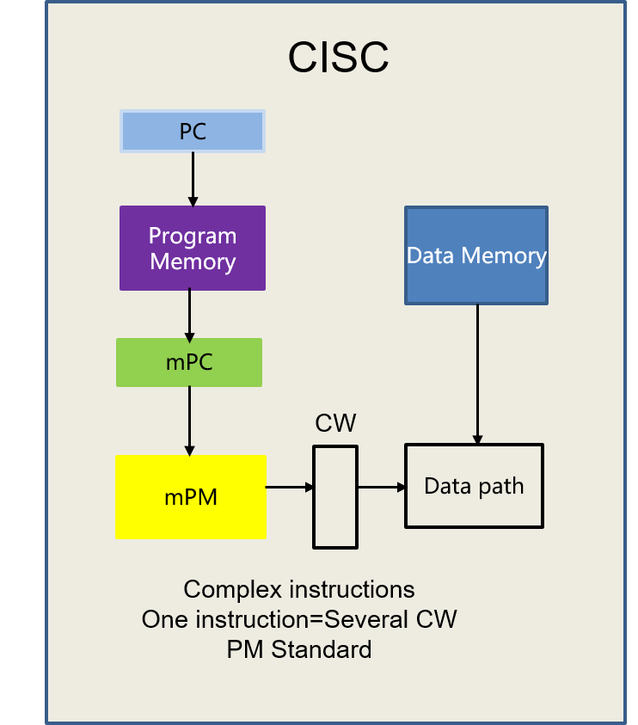
CISC
CISC stands for complex instruction set computer. The strategy behind CISC architectures is to have a large set of instructions, including complex ones.
Programming CISC-based computers is easier than in other designs because there is a single instruction for both simple and complex tasks. Programmers, therefore, do not have to write a set of instructions to do a complex task.
Figure 1.34 Complex instruction set computer.

Slide 53
RISC
RISC stands for reduced instruction set computer. The strategy behind RISC architecture is to have a small set of instructions that do a minimum number of simple operations.
Complex instructions are simulated using a subset of simple instructions. Programming in RISC is more difficult and time-consuming than in the other design, because most of the complex instructions are simulated using simple instructions.
Figure 1.35 Reduced instruction set computer.

Slide 54
Pipelining
Modern computers use a technique called pipelining to improve the throughput (the total number of instructions performed in each period of time).
The idea is that if the control unit can do two or three of these phases simultaneously, the next instruction can start before the previous one is finished.
Figure 1.36 Pipelining technique.

Slide 55
Parallel processing
Traditionally a computer had a single control unit, a single arithmetic logic unit and a single memory unit. With the evolution in technology and the drop in the cost of computer hardware, today we can have a single computer with multiple control units, multiple arithmetic logic units and multiple memory units.
This idea is referred to as parallel processing. Like pipelining, parallel processing can improve throughput.

Slide 56
Parallel processing (cont)
Figure 1.36 SISD organization

Slide 57
Parallel processing (cont)
Figure 1.37 SIMD organization

Slide 58
Parallel processing (cont)
Figure 1.38 Parallel processing.

Slide 59
Parallel processing (cont)
Figure 1.38 MIMD organization

