Slide 1


11. Databases
Notes:
NOTE:
To change the image on this slide, select the picture and delete it. Then click the Pictures icon in the placeholder to insert your own image.

Slide 2
Content
11.1 Introduction
11.2 Database architecture
11.3 Database model
11.4 The relationship database model
11.5 Database design
11.6 Guide do practice set (database)

Slide 3
Objectives
After studying this chapter, the student should be able to:
Define a database and a database management system (DBMS) and describe the components of a DBMS.
Describe the architecture of a DBMS based on the ANSI/SPARC definition.
Define the three traditional database models: hierarchical, networking, and relational.
Describe the relational model and relations.
Understand operations on a relational database based on commands available in SQL.
Describe the steps in database design.
Define ERM and E-R diagrams and explain the entities and relationships in this model.
Define the hierarchical levels of normalization and understand the rationale for normalizing the relations.
List database types other than the relational model.

Slide 4
1 - Introduction

Slide 5
1. Introduction
Data storage traditionally used individual, unrelated files, sometimes called flat-files. In the past, each application program in an organization used its own file.
In a university, for example, each department might have its own set of files: the record office kept a file about the student information and their grades, the financial aid office kept its own file about students that needed financial aid to continue their education, the scheduling office kept the name of the professors and the courses they were teaching, the payroll department kept its own file about the whole staff (including professors), and so on.
Today, however, all of these flat-files can be combined in a single entity, the database for the whole university.

Slide 6
2. Advantages of databases
Less redundancy In a flat-file system there is a lot of redundancy. For example, in the flat-file system for a university, the names of professors and students are stored in more than one file.
Inconsistency avoidance If the same piece of information is stored in more than one place, then any changes in the data need to occur in all places that data is stored. For example, if a female student marries and accepts the last name of her husband, the last name of the student needs to be changed in all files that hold information about the student. Lack of care may create inconsistency in the data.
Efficiency A database is usually more efficient that a flat-file system, because a piece of information is stored in fewer locations.
Data integrity In a database system it is easier to maintain data integrity (see Chapter 16) because a piece of data is stored in fewer locations.
Confidentiality It is easier to maintain the confidentiality of the information if the storage of data is Centralized in one location.

Slide 7
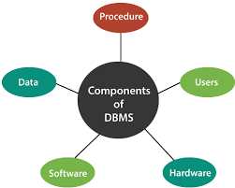
3. Database management systems
A database management system (DBMS) defines, creates, and maintains a database. The DBMS also allows controlled access to data in the database. A DBMS is a combination of five components: hardware, software, data, users, and procedures (Figure 14.1).
Hardware is the physical computer system that allows access to data.
Software is the actual program that allows users to access, maintain, and update data
Data in a database is stored physically on the storage devices. In a database, data is a separate entity from the software that accesses it.
Users are the people who control and manage the databases and perform different types of operations on the databases in the database management system.
Procedures refer to general rules and instructions that help to design the database and to use a database management system.
Figure 11.1 DBMS components

Slide 8
2- Database architecture

Slide 9
1. Introduction
The American National Standards Institute/Standards Planning and Requirements Committee (ANSI/SPARC) has established a three-level architecture for a DBMS: internal, conceptual, and external (Figure 14.2).
Internal level determines where data is actually stored on the storage devices. This level deals with low-level access methods and how bytes are transferred to and from storage devices.
Conceptual level defines the logical view of the data. The data model is defined on this level, and the main functions of the DBMS, such as queries, are also on this level.
External level interacts directly with the user (end users or application programs). It changes the data coming from the conceptual level to a format and view that is familiar to the users.
Figure 11.2 Database architecture

Slide 10
2. The internal level
The internal level has an internal schema, which describes the physical storage structure of the database. The internal schema uses a physical data model and describes the complete details of data storage and access paths for the database.
Physical representation of the DB on the computer.
How the data is stored in the database.
Physical implementation of the DB to achieve optimal run, time performance and storage space utilization, Storage space allocation for data and indexes, Record description for storage, Record placement, Data compression, encryption

Slide 11
3. The conceptual level
The conceptual level has a conceptual schema, which describes the structure of the whole database for a community of users. The conceptual schema hides the details of physical storage structures and concentrates on describing entities, data types, relationships, user operations, and constraints. Usually, a representational data model is used to describe the conceptual schema when a database system is implemented.
What data is stored in the database.
The logical structure of the entire database as seen by DBA.
The relationships among the data.
Complete view of the data requirements of the organization, independent of any storage consideration.
Represents: - Entities, attributes, relations , constraints on data , semantic information on data and security integrity information

Slide 12
4. The external or view level
The external or view level includes a number of external schemas or user views. Each external schema describes the part of the database that a particular user group is interested in and hides the rest of the database from that user group. The external level interacts directly with the user (end users or application programs). It changes the data coming from the conceptual level to a format and view that is familiar to the users.
For example, one user may view dates in theform (day, month, year), while another mayview dates as (year, month, day).
Consists of a number of different external views of the DB.
The user’s view of the database
Describes part of the DB for particular group of users.
Provides a powerful and flexible security mechanism by hiding parts of the DB from certain users. The user is not aware of the existence of any attributes that are missing from the view.
It permits users to access data in a way that is customized to their needs, so that the same data can be seen by different users in different ways, at the same time.

Slide 13
3 - DATABASE MODELS

Slide 14
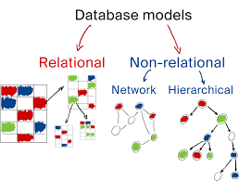
1. Introduction
A database model defines the logical design of data. The model also describes the relationships between different parts of the data. In the history of database design, three models have been in use:
the hierarchical model,
the network model, and
the relational model.
Figure 11.3 Database models

Slide 15
2. The hierarchical model
In the hierarchical model, data is organized as an inverted tree. Each entity has only one parent but can have several children. At the top of the hierarchy, there is one entity, which is called the root. Figure 14.3 shows a logical view of an example of the hierarchical model.
As the hierarchical model is obsolete, no further discussion of this model is necessary
Figure 11.4 An example of the hierarchical model representing a university

Slide 16
3. The network model
In the network model, the entities are organized in a graph, in which some entities can be accessed through several paths (Figure 14.4). There is no hierarchy. This model is also obsolete and needs no further discussion.
Figure 11.5 An example of the network model representing a university

Slide 17
4. The relational model
In the relational model, data is organized in two-dimensional tables called relations. There is no hierarchical or network structure imposed on the data. The tables or relations are, however, related to each other, as we see in Figure 14.5.
Figure 11.6 An example of the relational model representing a university

Slide 18
4- The relationship database model

Slide 19
1. Relation
Relation, in appearance, is a two-dimensional table. The RDBMS organizes the data so that its external view is a set of relations or tables. This does not mean that data are stored as tables: the physical storage of the data is independent of the way in which the data is logically organized. Figure 14.6 shows an example of a relation.
A relation in an RDBMS has the following features:
Name. Each relation in a relational database should have a name that is unique among other relations.
Attributes. Each column in a relation is called an attribute. The attributes are the column headings in the table in Figure 14.6. Each attribute gives meaning to the data
Tuples. Each row in a relation is called a tuple. A tuple defines a collection of attribute values. The total number of rows in a relation is called the cardinality of the relation.
Figure 11.7 An example of a relation

Slide 20
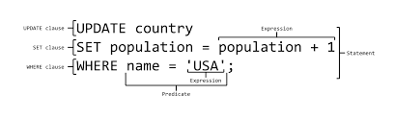
2. Operations on relations
In a relational database we can define several operations to create new relations based on existing ones. We define nine operations in this section: insert, delete, update, select, project, join, union, intersection, and difference. Instead of discussing these operations in the abstract, we describe each operation as defined in the database query language SQL (Structured Query Language).
Structured Query Language (SQL) is the language standardized by the American National Standards Institute (ANSI) and the International Organization for Standardization (ISO) for use on relational databases
Figure 11.8 An example of a SQL sentence

Slide 21
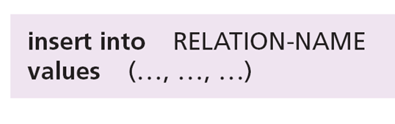
3. Insert
The insert operation is a unary operation—that is, it is applied to a single relation. The operation inserts a new tuple into the relation. The insert operation uses the following format:
Figure 11.9 An example of a Insert sentence

Slide 22

4. Delete
The delete operation is also a unary operation. The operation deletes a tuple defined by a criterion from the relation. The delete operation uses the following format:
Figure 11.10 An example of a Delete sentence

Slide 23
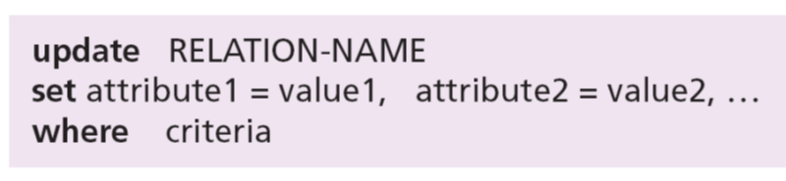
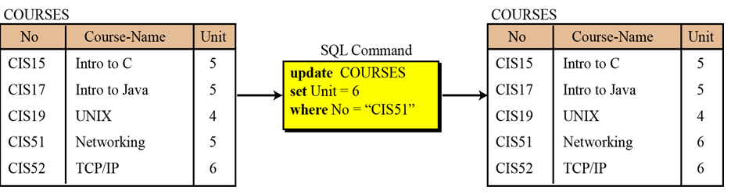
5. Update
The update operation is also a unary operation that is applied to a single relation. The operation changes the value of some attributes of a tuple. The update operation uses the following format:
Figure 11.11 An example of a Update sentence

Slide 24
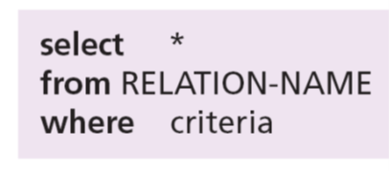
6. Select
The select operation is a unary operation. The tuples (rows) in the resulting relation are a subset of the tuples in the original relation.
Figure 11.12 An example of a Select sentence

Slide 25

7. Join
The join operation is a binary operation that combines two relations on common attributes.
Figure 11.13 An example of a Join sentence

Slide 26
8. Union
The union operation takes two relations with the same set of attributes.
Figure 11.14 An example of a Union sentence

Slide 27
5 - DATABASE DESIGN

Slide 28
1. Introduction
The design of any database is a lengthy and involved task that can only be done through a step-by-step process.
The first step normally involves a lot of interviewing of potential users of the database, for example in a university, to collect the information needed to be stored and the access requirements of each department.
The second step is to build an entity–relation model (ERM) that defines the entities for which some information must be maintained, the attributes of these entities, and the relationship between these entities.

Slide 29
2. Entity–relation model (ERM)
In this step, the database designer creates an entity–relationship (E-R) diagram to show the entities for which information needs to be stored and the relationship between those entities. E-R diagrams uses several geometric shapes,
Rectangles represent entity sets
Ellipses represent attributes
Diamonds represent relationship sets
Lines link attributes to entity sets and link entity sets to relationship sets
Figure 11.15 Entities, attributes, and relationships in an E-R diagram

Slide 30
3. From E-R diagrams to relations
Relations for entity sets
For each entity set in the E-R diagram, we create a relation (table) in which there are n columns related to the n attributes defined for that set.
Example 14.2
We can have three relations (tables), one for each entity set defined in Figure 14.16, as
shown in Figure 14.17.
Figure 11.16 Relations for entity set in Figure 14.16

Slide 31
From E-R diagrams to relations (cont)
Relations for relationship sets
For each relationship set in the E-R diagram, we create a relation (table). This relation has one column for the key of each entity set involved in this relationship and also one column for each attribute of the relationship itself if the relationship has attributes (not in our case).
Example 11.3
There are two relationship sets in Figure 14.16, teaches and takes, each connected to two
entity sets. The relations for these relationship sets are added to the previous relations for
the entity set and shown in Figure 14.18.
Figure 11.17 Relations for E-R diagram in Figure 14.16
S-

Slide 32
4. Normalization
Normalization is the process by which a given set of relations are transformed to a new set of relations with a more solid structure.
Normalization is needed to allow any relation in the database to be represented, to allow a languages like SQL to use powerful retrieval operations composed of atomic operations, to remove anomalies in insertion, deletion, and updating, and reduce the need for restructuring the database as new data type are added.
The normalization process defines a set of hierarchical normal forms (NFs). Several normal forms have been proposed, including 1NF, 2NF, 3NF, BCNF (Boyce–Codd Normal Form), 4NF, PJNF (Projection/Joint Normal Form), 5NF, and so on.

Slide 33
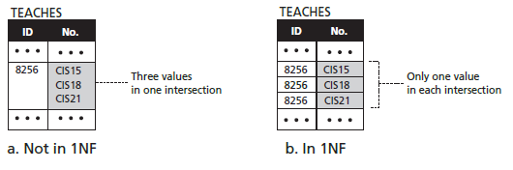
5. First normal form (1NF)
When we transform entities or relationships into tabular relations, there may be some relations in which there are more values in the intersection of a row or column.
For example, in our set of relations in Figure 14.18, there are two relations, teaches and takes, that are not in first normal form. A professor can teach more than one course, and a student can take more than one course. These two relations can be normalized by repeating the rows in which this problem exists.
Figure 11.18 An example of 1NF

Slide 34
6. Second normal form (2NF)
In each relation we need to have a key (called a primary key) on which all other attributes (column values) needs to depend.
For example, if the ID of a student is given, it should be possible to find the student’s name. However, it may happen that when relations are established based on the E-R diagram, we may have some composite keys (a combination of two or more keys).
In this case, a relation is in second normal form if every non-key attribute depends on the whole composite key
Figure 11.19 An example of 2NF

Slide 35
6- Guide do practice set (database in Ms SQL)

Slide 36
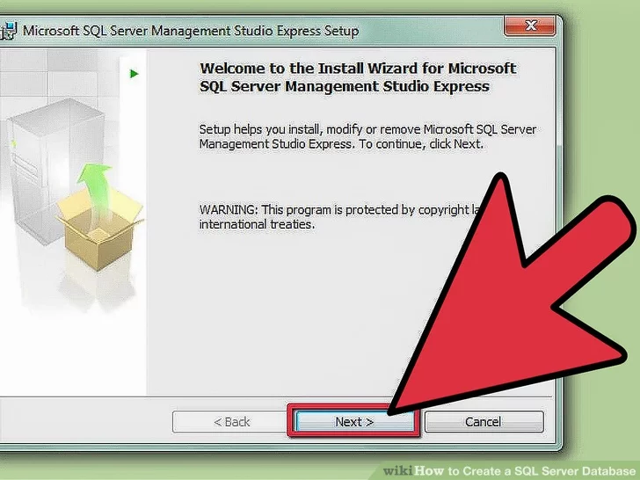
1. Install the SQL Server
Install the SQL Server Management Studio software. This software is available for free from Microsoft, and allows you to connect to and manage your SQL server from a graphical interface instead of having to use the command line

Slide 37
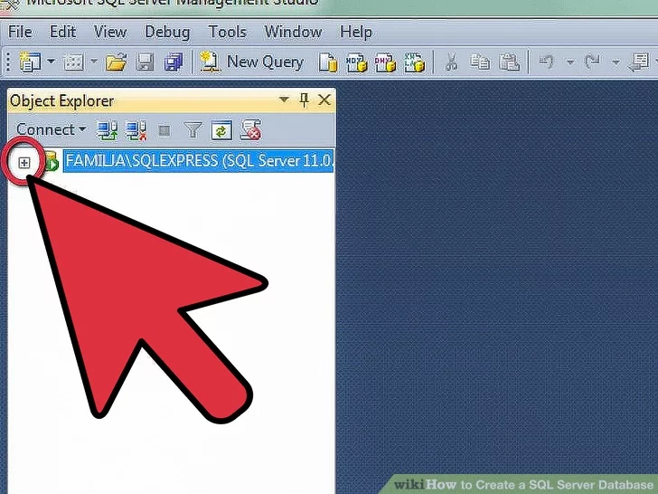
2. Start up SQL Server Management Studio
Start up SQL Server Management Studio. When you first start the program, you will be asked what server you would like to connect to.
If you already have a server up and running, and have the permissions necessary to connect to it, you can enter the server address and authentication information.
If you want to create a local database, set the Database Name to … and the authentication type to "Windows Authentication".

Slide 38
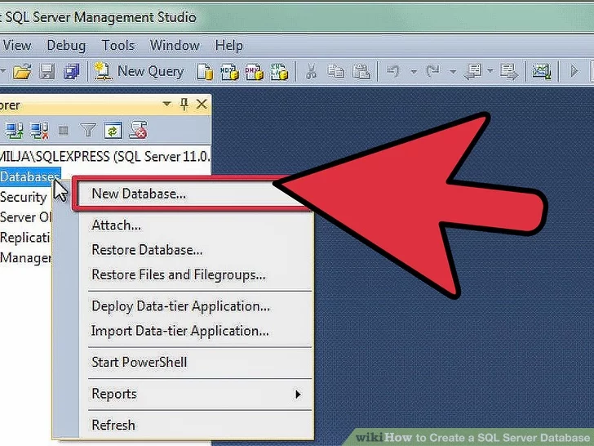
3. Locate the Database folder
Locate the Database folder. After the connection to the server, either local or remote, is made, the Object Explorer window will open on the left side of the screen.
At the top of the Object Explorer tree will be the server you are connected to. if it is not expanded, click the "+" icon next to it. Located the Databases folder.[

Slide 39
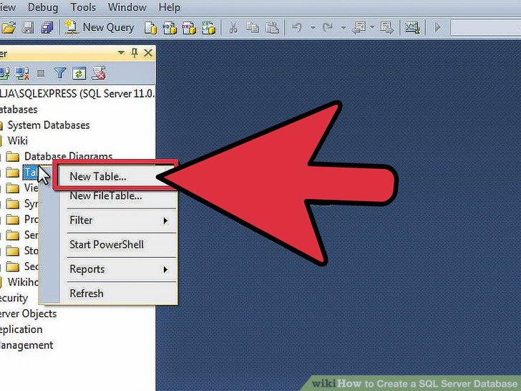
4. Create a new database
Create a new database. Right-click on the Databases folder and select "New Database...".
A window will appear, allowing you to configure the database before creating it. Give the database a name that will help you identify it.
Most users can leave the rest of the settings at their default.

Slide 40
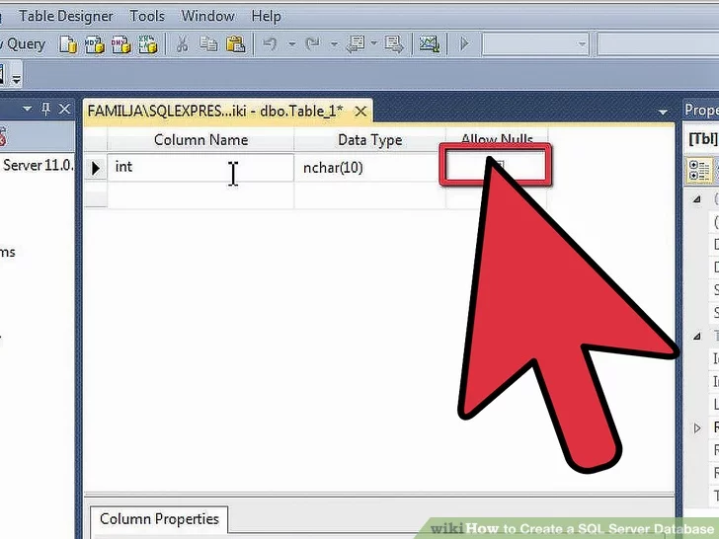
5. Create a table
Create a table. A database can only store data if you create a structure for that data.
A table holds the information that you enter into your database, and you will need to create it before you can proceed.
Expand the new database in your Database folder, and right-click on the Tables folder and select "New Table...".

Slide 41
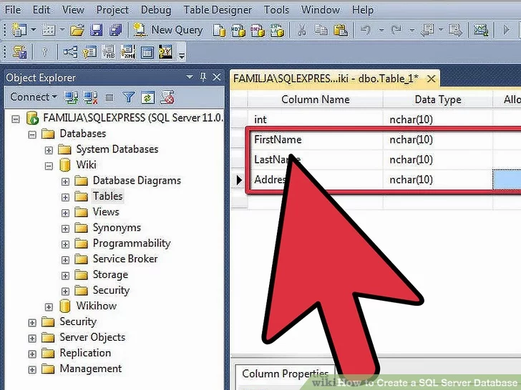
6. Create the Primary Key
Create the Primary Key. It is highly recommended that you create a Primary Key as the first column on your table. This acts as an ID number, or record number, that will allow you to easily recall these entries later.
To create this, enter "ID" in the Column Name field, type int into the Data Type field, and uncheck the "Allow Nulls." Click the Key icon in the toolbar to set this column as the Primary Key.

Slide 42
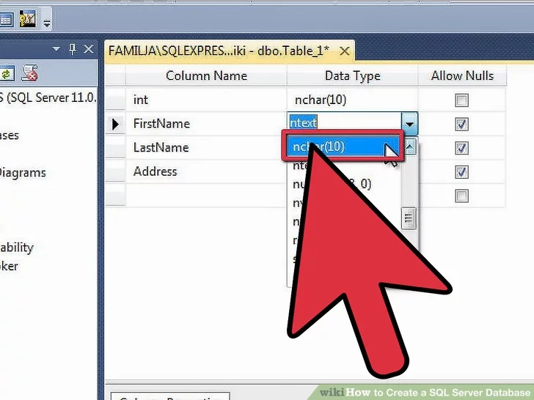
7. Understand how tables are structured
Understand how tables are structured. Tables are composed of fields or columns. Each column represents one aspect of a database entry.
For example, if you were creating a database of employees, you might have a "FirstName" column, a "LastName" column, an "Address" column, and a "PhoneNumber" column.

