Slide 1
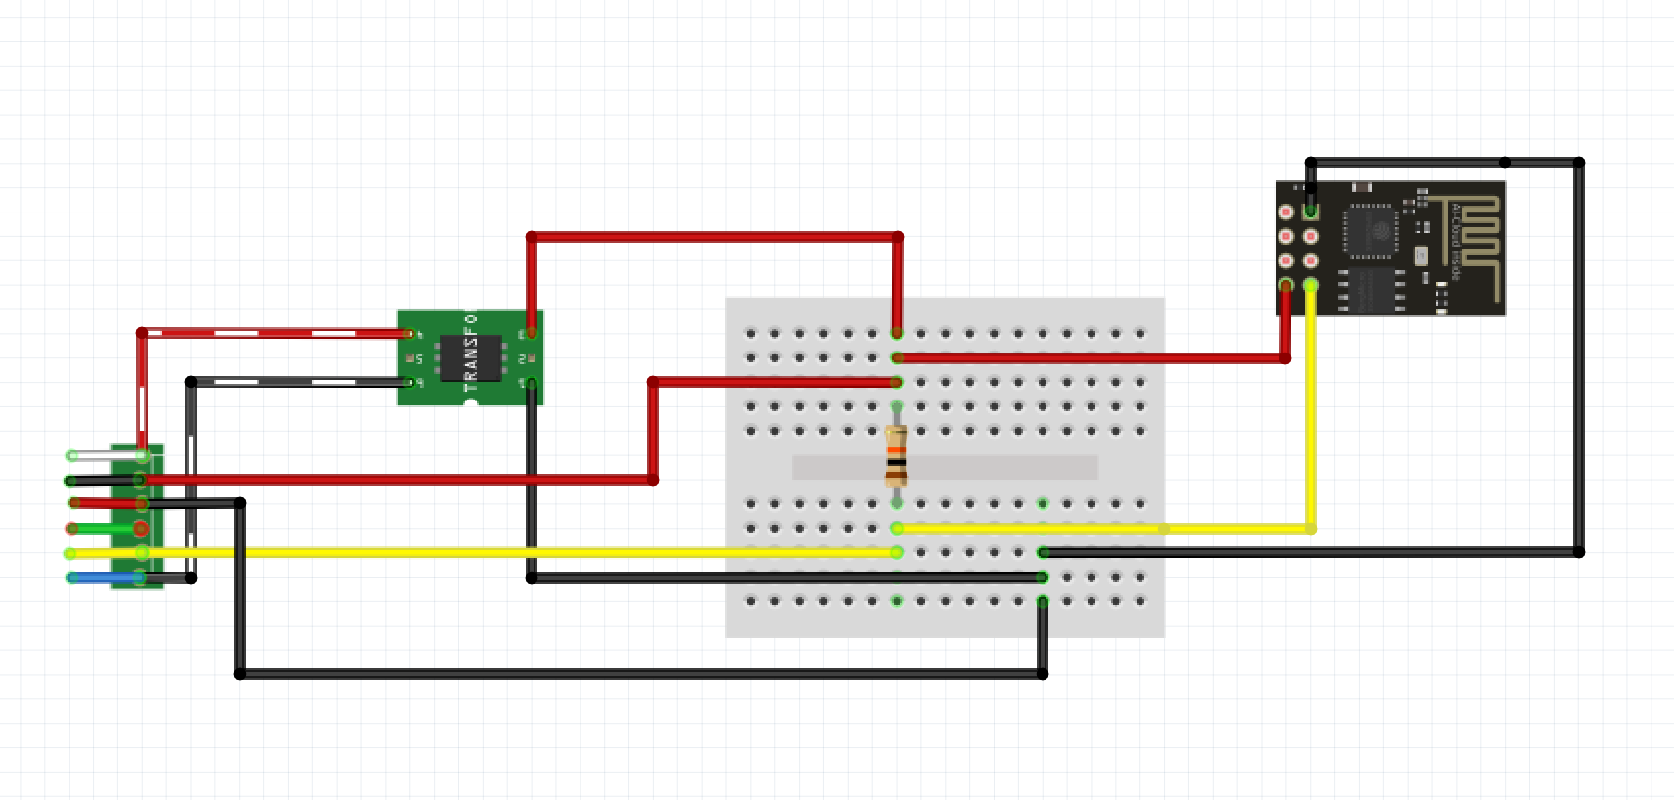
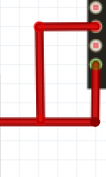
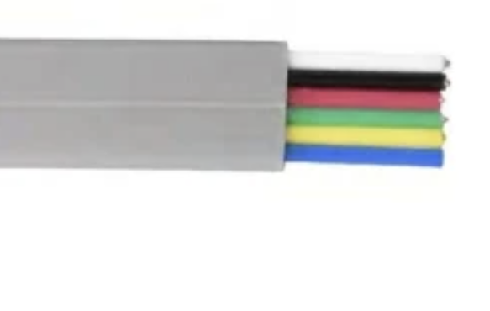
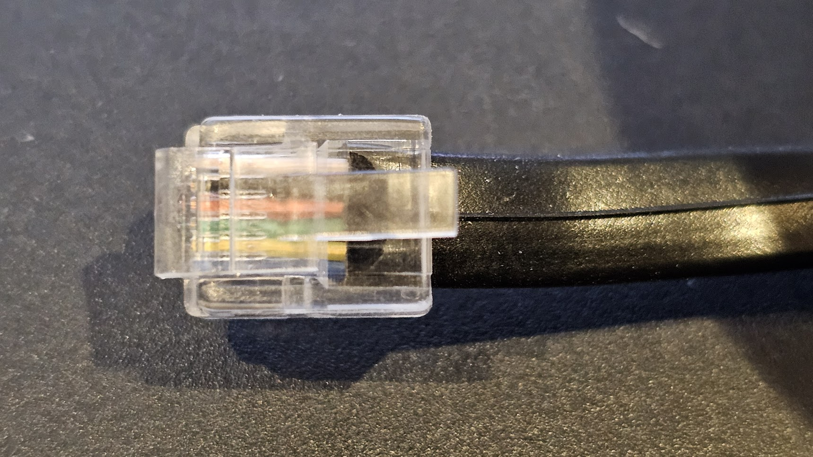
ESP8266 (ESP-01)
GND
RJ12 (P1 Port)
5v ->3.3v
EN
5V
Rx
RTS
10KΩ
3.3v
GND
RXD
GND

Slide 2
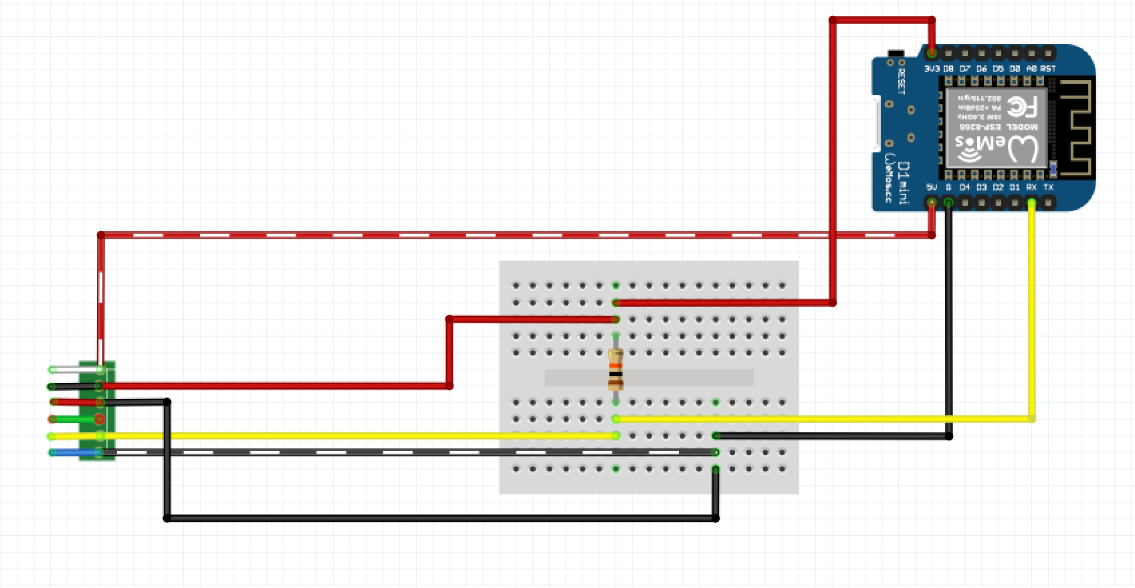
ESP8266 (Wemos D1)
3.3v
5v
RJ12 (P1 Port)
Rx
GND
5V
RTS
10KΩ
GND
RXD
GND

Slide 3
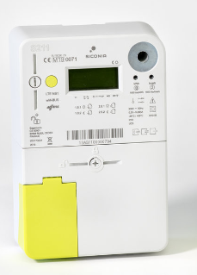


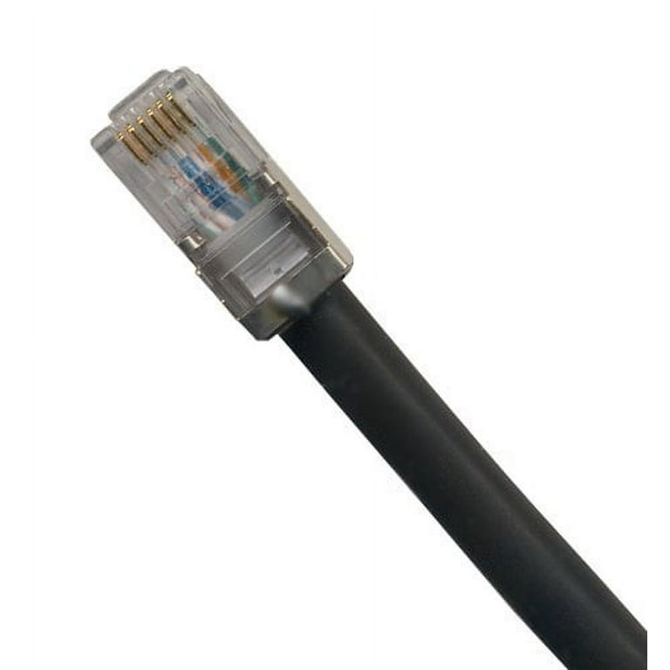
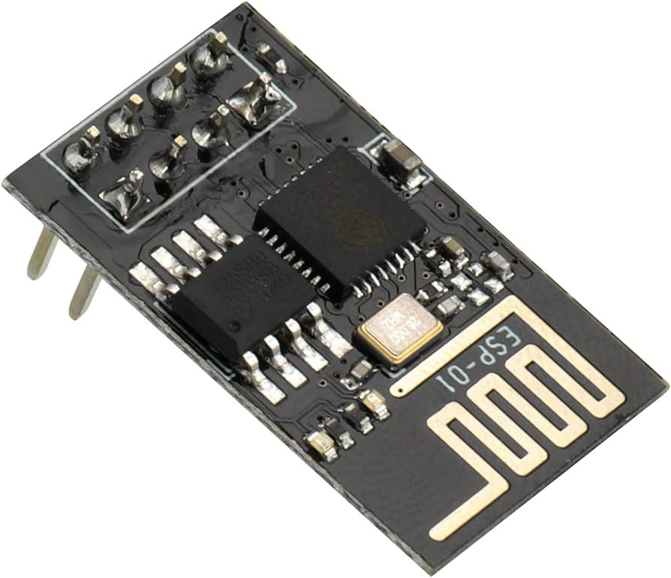

Smart Meter
Google Sheet
ESP8266 (ESP-01)
Google App Script
P1 Port
WiFi
RJ12
Google App Script
code
Serial UART
DSMR Telegrams
HTTPs POST Requests
Json Payload
Arduino code

