Slide 1
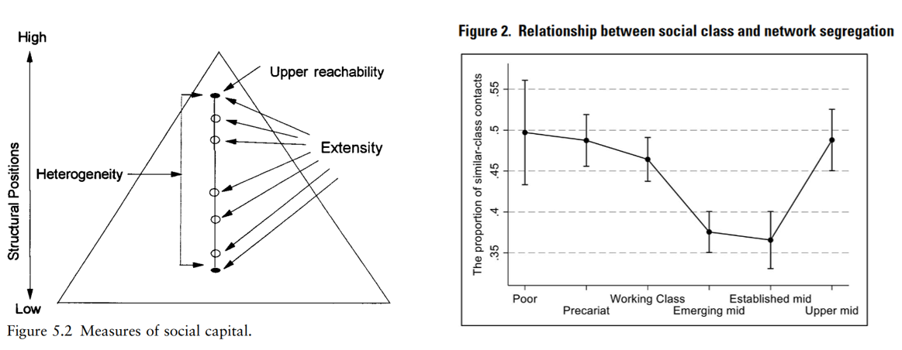

Slide 2
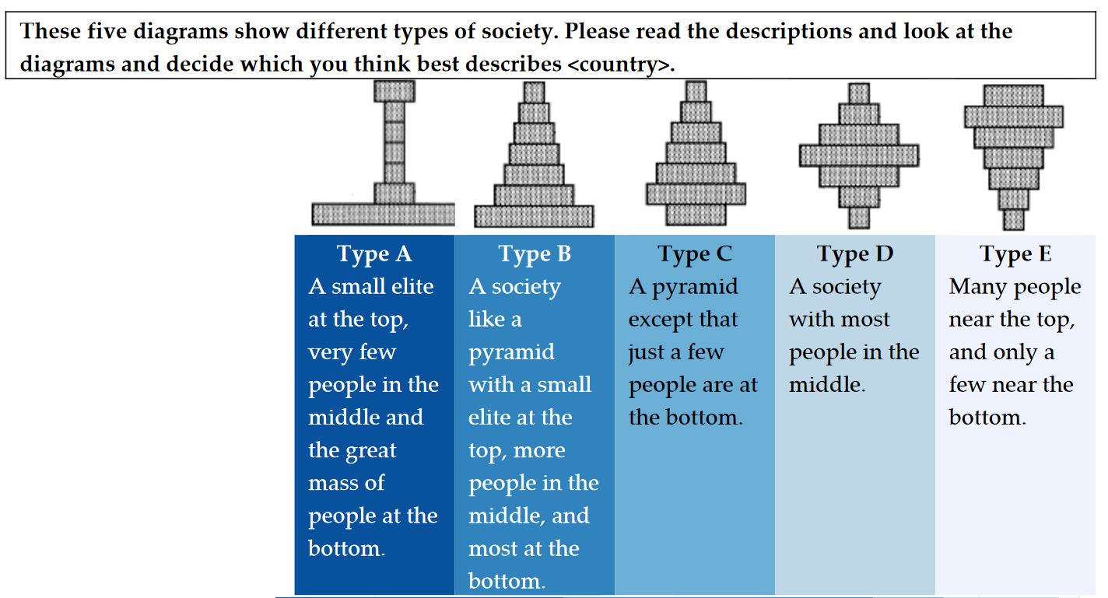


Slide 3
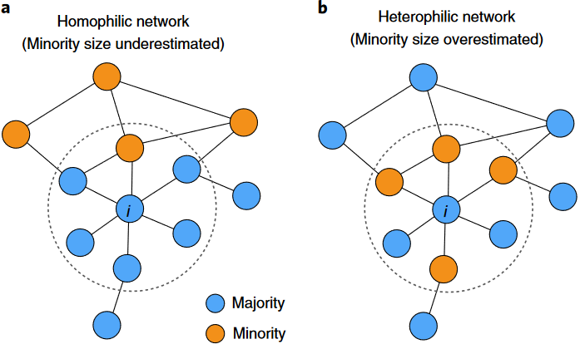
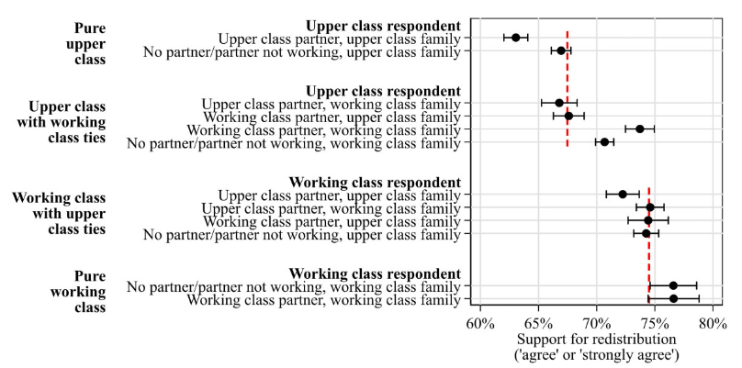

Slide 4
Study 1: “Economic inequality, social networks, and redistributive preferences: A cross-national study of 33 countries”
Data: International Social Survey Programme - Social Networks 2017 (Ni=44,492; Nj=33). Variables: respondents’ redistributive preferences, perceived economic inequality and egocentric networks. Methods: multilevel regression model, mediation analysis for the indirect effect and cross-level interactions with random slopes.
Study 2: “Residential segregation, social networks and market distribution of social services: longitudinal evidence”
Data: Chilean Longitudinal Social Survey -ELSOC (2016–2022, N = 2,927). Variables: respondents’ preferences marketisation of welfare provision "people with higher income can have access to better social services“ (e.g. education, health, or pensions) and egocentric networks. Methods: longitudinal multilevel regression model and cross-level interactions with random slopes.
Study 3: “Reference groups similarity and social solidarity: A vignette study”
Data: subsample of ELSOC (Chile); online sample Cohesion Panel of the RISC (Germany). Variables: willingness to provide help to the person [vignette] (e.g. money, job, support). Similarity* as the matched attributes (similar=1)
Methods (tbd): linear regression + cluster SE.
* If the respondent and vignette have the same attribute =1 (different = 0). For example, both have the same educational level.
Country level
Individual level
Individual
Observation (time)
Country (Germany/Chile)
Economic Inequality
Respondent level
Vignette level
Spatial Segregation
H3
H2
H1
Redistributive preferences
H3
Network
Diversity
Reference group
Similarity *
(e.g. SES, ethnicity)
Solidarity
Network
Diversity
H1
Welfare Marketisation
H2
Perceived
Inequality

