Slide 1




More Diverse, More Skeptical? How Changes in Class-based Network Diversity Shape Public Support for Commodified Welfare Services: Longitudinal Evidence from Chile
Julio Iturra-Sanhueza
Bremen International Graduate School of Social Sciences
Rabat, 2025
Supervisors:
Dr. Patrick Sachweh (U. Bremen)
Dr. Olaf Groh-Samberg (U. Bremen)
Dr. Simone Schneider (U. Pompeu Fabra)

Slide 2
Social networks and political attitudes
Social networks and attitudes towards inequality
Attitudes in the economic domain can be affected by: (i) social influence and (ii) segregation.(Lindh et al., 2021; Paskov & Weisstanner, 2022). For example, the status of family ties can affect support for government income redistribution (Paskov & Weisstanner, 2022).
Increased social integration in diverse networks contributes to critical views on inequality (Otero & Mendoza, 2023). Networks operate as inferential spaces that highlight the link between economic inequality and rewards in the labour market (Mijs, 2018).
Individual structural position and attitudes
Structurally advantaged positions in the labor market justify inequality to a greater extent compared to those in greater labor market risk, low-demanded skills, and lower income (Castillo, Salgado, Carrasco, & Laffert, 2024; Lee & Stacey, 2023).
Gap: most of the theories on the class-attitude link are based in cross-sectional evidence.
Therefore, they have underscored the role of “class experiences” – understood as the socialization processes linked to individual experiences within the class structure across the life course (Ares, 2020; Helgason & Rehm, 2024; Langsæther, Evans, & O’Grady, 2022).

Slide 3
Attitudes toward market distributions
Social services in the market
In contexts of high inequality and modest public provision of welfare, the capacity of citizens to contribute or pay largely constraints access to welfare services (Immergut & Schneider, 2020; Lindh, 2015; Castillo et al 2024)
Unlike state redistribution, in these contexts market actors plays a salient role the provision of welfare (Svallfors, 2006)
Welfare is object of commodification on a gradient from market-led, mixed or state provision - can be traded as commodity, valued and priced (Busemeyer & Iversen, 2020)
Inequality and market justice
When market agents (e.g., firms) have a greater presence in welfare provision, the role of (market) income inequality can enhance inequalities in other social domains (e.g., education, health) (Lindh & McCall, 2022)
The set of principles and norms that entail greater relevance to merit-based rewards in the labor market has been addressed under the concept of market justice (Kluegel, Mason, & Wegener, 1999; Lane, 1986).
The market-based distribution of social services implies that it is legitimized that welfare is determined on the basis of payment capacity (out-of-pocket) (Svallfors, 2007)
Thus, labour market inequalities should also be reflected in people's attitudes towards the commodification of social services (Lindh, 2015)

Slide 4
This study: changing networks, changing attitudes?
By providing access to information—in this case, diversity—networks are likely to contribute to social learning processes (Druckman & Lupia, 2000; Lin, 2001).
Networks as a “social convoy” (Kahn and Antonucci, 1980) that structure information and support over the life course (Hollstein, 2023).
It is assumed that weak ties tend to change more over time as they are fed by diverse contacts (Granovetter, 1973).
Diversity could affects attitudes as it changes existential standards as they play a role of “referential structures” that provide concrete benchmarks for fairness evaluations (Immergut & Schneider, 2020; Shepelak & Alwin, 1986).
Diversity offers non-redundant information and unfamiliar perspectives (Burt, 2004; Vedres, 2022).
As individuals encounter different life experiences, they may develop critical views towards market justice (market skepticism hypothesis)
H1: the greater the changes in network diversity, the less support market justice.

Slide 5
Chile: unequal but prosperous
Recent history
Structural reforms mainly in period of adjustment in the 1980s (Arrizabalo, 1995)
As a result, the "size" of the welfare state was reduced, encouraging the private sector by liberalising or subsidising private services (Ferre, 2023)
On the basis of social policy design (inclusiveness, generosity and equity) it has been characterised as a closer to a "liberal" social policy regime (Huber & Stephens, 2012)
Chile today
In 2024, Chile has been classified as a middle-income country (14,226.5 per cap. U$2015) with a low poverty rate (6.5%).
However, in terms of income distribution it shows a high level of income inequality
(Gini = 0.47; P90/10 = 15.9) and modest levels of redistribution (5%)
Important: Chile shows a high-presence of private-based provision of welfare services (see next slide)
Notes:
- citizens from market dependency
- rather focusing on the state than in market provision of welfare
- a market is a ‘social structure for exchange of property rights, which enables people, firms and products to be evaluated and priced’ (Aspers 2006: 427)
Commodification
Market conveys specific justice principle ‘market justice’ affording legitimacy to the allocation of goods and services on the bases of prices an ability to pay
Market mechanism in stratifying life chances and quality of life among the population
state-organized welfare can be understood as a political device for delimiting the relative scope and force of the market nexus in determining life chances and living conditions
state-led welfare policy can be understood as a ‘social investment’ that facilitates the functioning of a large-scale market economy
“Since the labour market is the main arena structuring rewards and opportunities in market capitalist society, conflicts rooted in production and the labour market have been given primary attention” (Lindh, 2015)

Slide 6
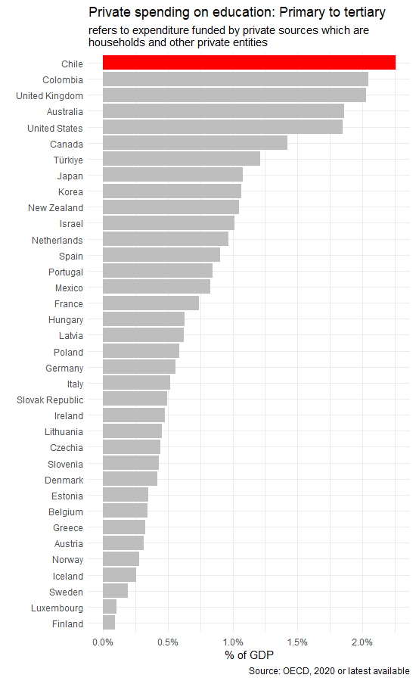
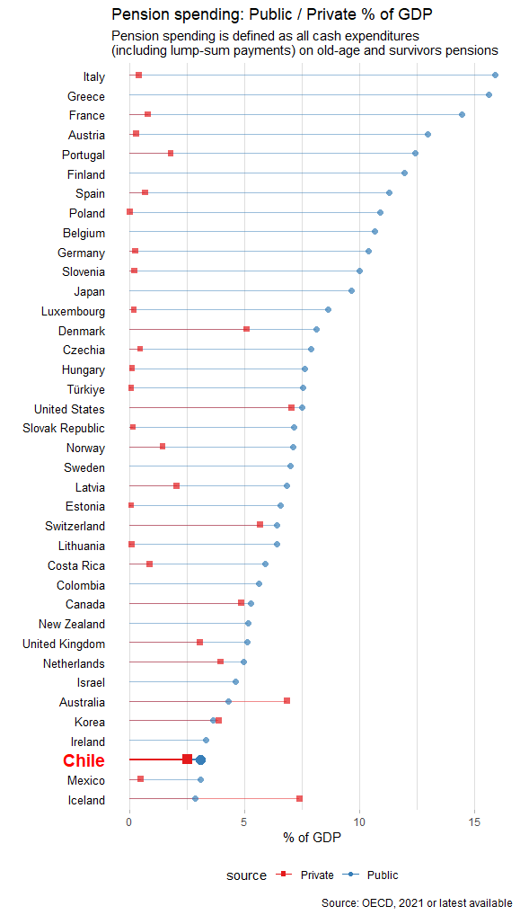
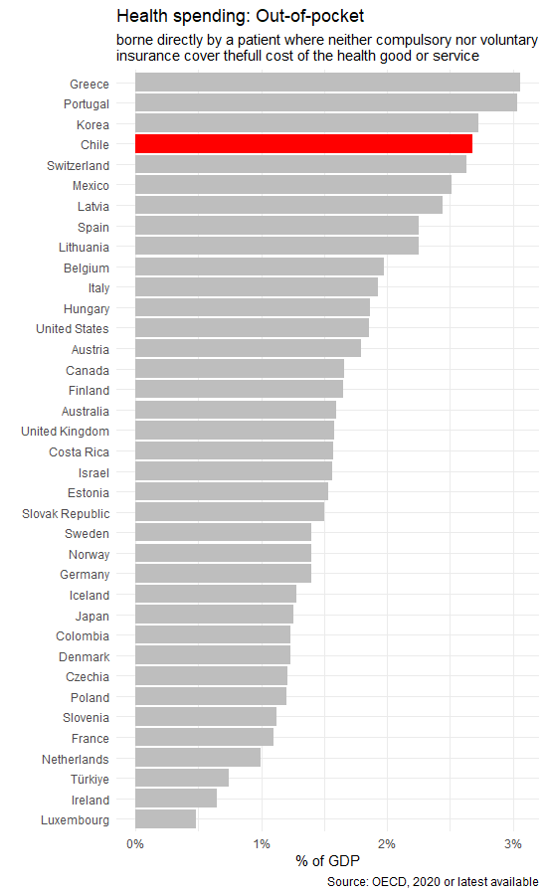
Notes:
In the OECD context Chile is:
First place in terms of private spending in education, in this case private sources are households or private entities
Similar in out-of-pocket health expenditure, what means the share of the medical service that IS NOT covered by insurance
Regarding the pension system, Chile is known for having a “fully funded capitalization system run by private sector pension funds”. The red dots are private and the blue dot are public.

Slide 7
To what extent do individual changes in socioeconomic network diversity influence changes in market justice preferences?

Slide 8
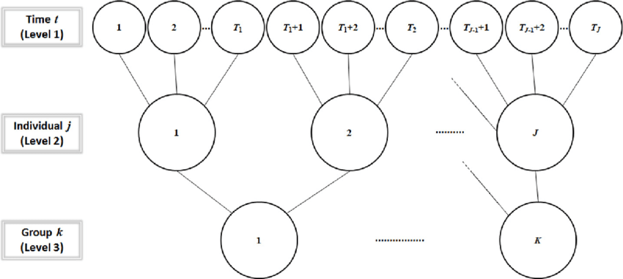
Data, variable and method
Data
ELSOC Survey (3 waves)
  Individual panel data
    same individuals across time
  Focus on urban population
  Spatial representativeness of cities
Method
Fixed effects regression models (within estimation)
    Observations t (~6200) nested in
    Individuals j (~2800)
Notes:
“the degree to which two or more groups live separately from one another, in different parts of the urban environment”
Based on null model: 6% city level, 42% individual changes

Slide 9
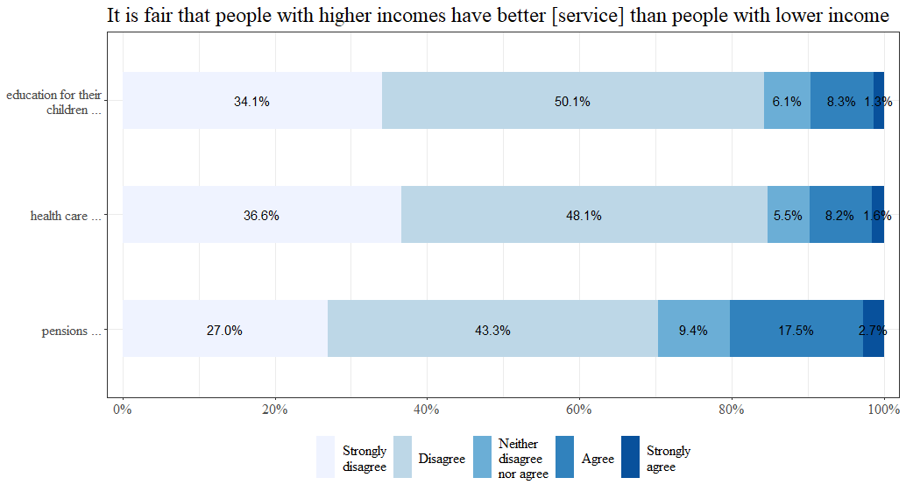
Market justice preferences
In this study:
The Cronbach alpha is close to 0.8 in all time points (α1 =.82, α2=.86, α3=.83)
Single indicator based on the combination of the three items
Higher values represent greater support for market justice.
Notes:
The three indicators show that people tend more than the half of the respondents disagree that people with higher income should get better education, health and pensions.
However, on time, the changes show that in average people have become more pro-market than before (Covid between second and third measurement)
Alpha = 0.82, ,0.85, 0.79

Slide 10
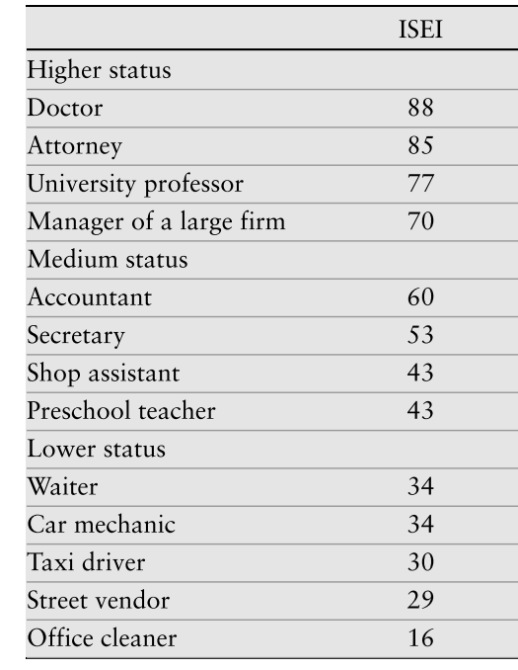
II. Social networks: position generator
“Now I will ask you about some of your acquaintances. It doesn't matter if they are close to you (family or friends) or not. A person is your acquaintance if you at least know their first name, and if you could have a conversation with them if you meet them on the street or in a shopping centre.
Thinking only of people living in Chile, could you tell me, based on the following sheet and even approximately, how many people you know are...?”
1. None
2. One
3. Between 2 and 4
4. Between 5 and 7
5. Between 8 and 10
6. Between 11 and 15
7. 16 or more
Notes:
Firs

Slide 11
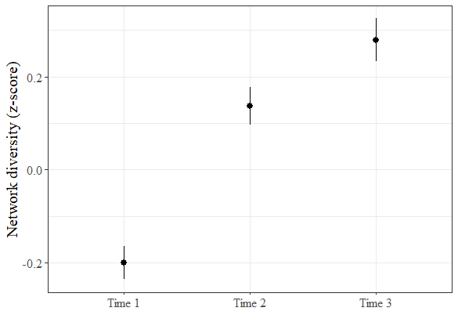
III. Network diversity index
Studies recommend using a single dimension to more accurately capture the network attribute (Sapin et al., 2020;Otero & Mendoza, 2023).
PCA*:
Extensivity (1 – 13): degree of variety as the total number of known occupations.
Generalized Entropy (0 – 1): degree of balance across groups based on the number of acquaintances in each occupation.
This strategy consider both the possible ties to the available occupations (Variety) and how these ties are distributed across each group (Balance) (Koopmans & Schaeffer, 2015).
Higher values represent greater socio-economic diversity in the networks of acquaintances.
*Note: ~90% of explained variance
Notes:
overdispersion is generally produced in large part by homophily (Di Prete)

Slide 12
Results

Slide 13
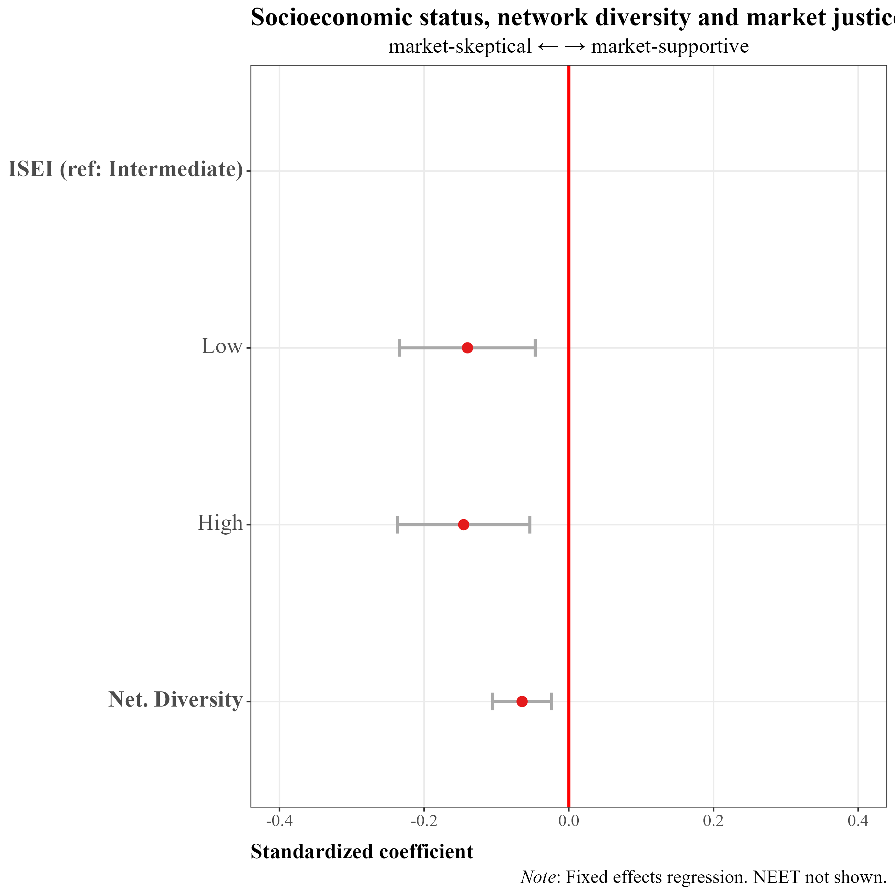
Longitudinal results on network diversity and market justice
Moving down from a middle to a low status occupation increase their support for market justice (β = -0.14, p<.01), but also from moving up from a middle to a higher status occupation (β = -0.14, p<.01).
Increasing network socioeconomic diversity decrease support for market justice (β = -0.07, p<.01).
Notes:
Meter bettas luego mostrar los predicted values para ver “tamaño de efecto”
Effects sizes are rather small

Slide 14
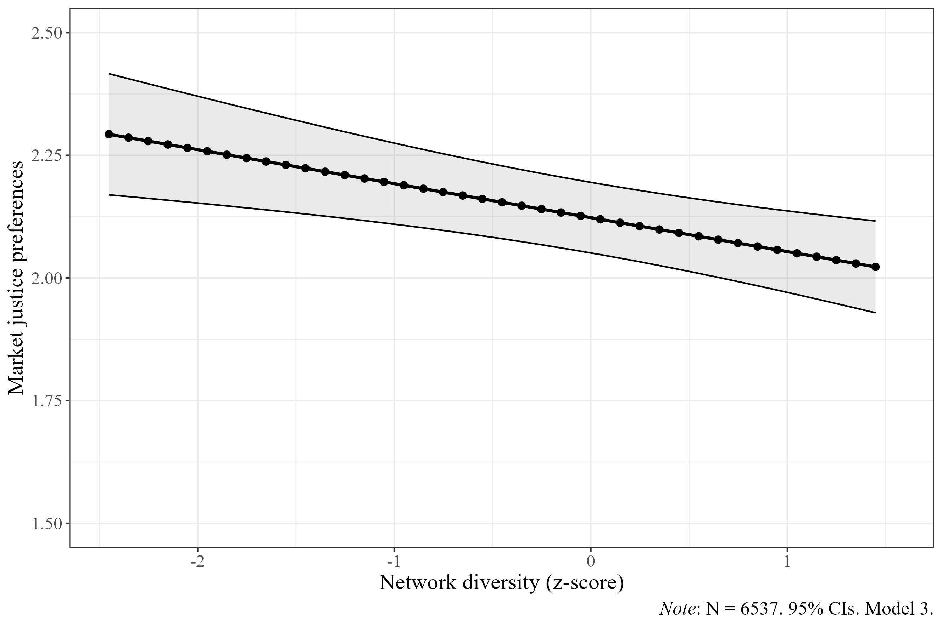
Changes on network diversity
Under conditions of low network diversity levels (M-1SD) the support for market justice is 2.19 (95% CI: 2.11 – 2.27)
Under conditions of high network diversity (M+1SD) support for market justice is 2.05 (95% CI: 1.97 – 2.14)
Moving from a low to a high diversity network implies a decrease of 0.14 in support for market justice – which represents a change of 3.5% in the original scale (1 to 5)
Notes:
- 4.04 (- 1 SD) the average predicted market justice preferences are 0.17
network diversity is at its mean value, the average predicted market justice preferences are -0.05
when diversity rises to 1.27 (+ 1 SD) 0.07 (-0.14– 0.00)

Slide 15
Conclusions
On network diversity
Consistent with H1, individual change decreases the degree of agreement of people in Chile that income should govern access to social services - supporting the market skepticism hypothesis. Those who increase their network diversity tend to become more critical towards the market mechanism as a legitimate way of allocating social welfare
According to theorization, evidence here shows that network change attitudes. It could be through the (non-exclusive) channels of :
(i) socialization: overtime, individuals normatively adapt to their new social milieus which is reflected in attitudes (Ares, 2020; Helgason & Rehm, 2024; Otero & Mendoza, 2023). Alternatively, could be that
(ii) information plays a role itself as non-redundant environments motivate attitudinal changes in line with the inferential/social learning approach (Druckman & Lupia; Mijs, 2018).
Note on individual changes in SES
Moving down from middle to lower status occupation decrease support for market justice –however it does also decreases when people are moving up from middle to higher status occupation.

Slide 16
Thank you
jiturra@bigsss.uni-bremen.de

Slide 17
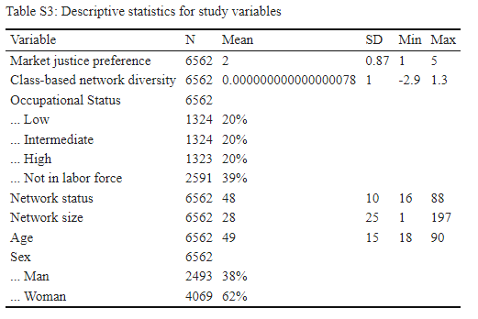
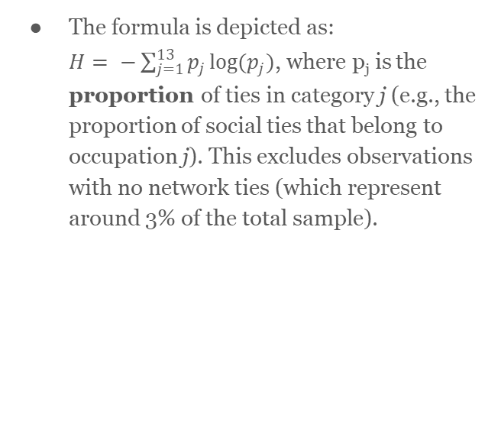
Supplementary material
The formula is depicted as:
$H= −\sum_{j=1}^{13}{p_{j}\log{(p_{j})}}$, where p_{j}​ is the proportion of ties in category j (e.g., the proportion of social ties that belong to occupation j). This excludes observations with no network ties (which represent around 3% of the total sample).

