Slide 1

Customer Churn Prediction in Telecommunications Industry
Big Data Parallel Programming (DT8034): Project Report
Analysis of Programs (1 and 2)
By Mohammad Hammoud

Slide 2
Introduction
Customer churn refers to?
Telco Customer Churn dataset: https://www.kaggle.com/blastchar/telco-customer-churn
Predict the likelihood of the customer churning
Apache Spark's MLlib library
Binary classification problem
retain customers, enhance customer loyalty, and ultimately improve overall business performance

Slide 3

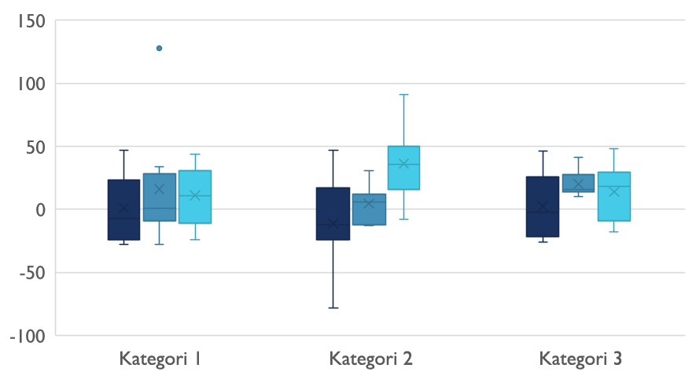
Data Preprocessing

Slide 4
Introduction
Data Cleaning and Transformation
Exploratory Data Analysis
Feature Selection
Data Balancing

Slide 5

Spark Implementation
DecisionTreeClassifier
RandomForestClassifier
GBTClassifier
LogisticRegression

Slide 6
Results
Performance Metrics Across Varying Data Partitions with Workers:
  - Partitions: 2, 4, 8, 16, and 32
  - Workers: 2, 4, and 7
Performance Metrics Across Varying Workers:
  - 2, 4, 6, and 7 workers

Slide 7
Performance Metrics Across Varying Data Partitions with Workers

Slide 8
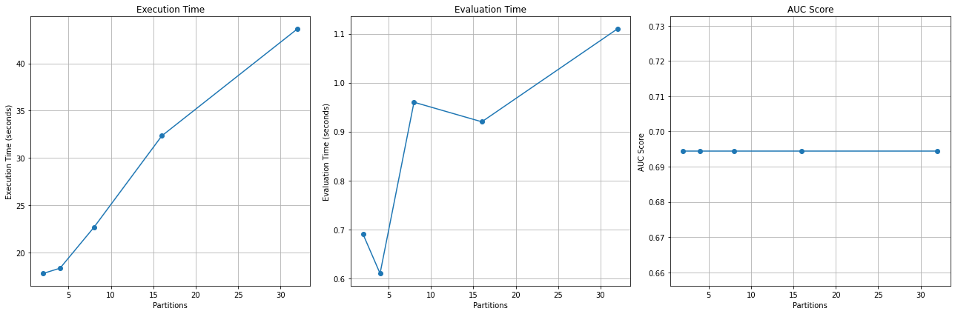
DecisionTreeClassifier
2 workers:
Partitions | AUC Score | Time Taken (seconds) | Evaluation Time (seconds)
2 | 0.6944 | 17.80 | 0.69
4 | 0.6944 | 18.36 | 0.61
8 | 0.6944 | 22.68 | 0.96
16 | 0.6944 | 32.34 | 0.92
32 | 0.6944 | 43.65 | 1.11

Slide 9
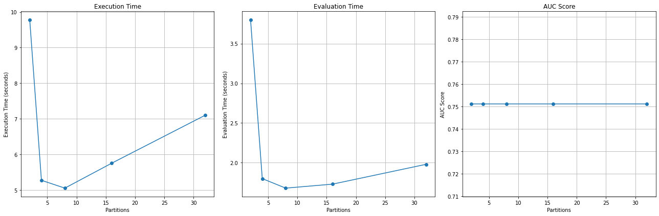
DecisionTreeClassifier
4 workers:
Partitions | AUC Score | Time Taken (seconds) | Evaluation Time (seconds)
2 | 0.7512 | 9.78 | 3.80
4 | 0.7512 | 5.27 | 1.80
8 | 0.7512 | 5.05 | 1.68
16 | 0.7512 | 5.75 | 1.73
32 | 0.7512 | 7.10 | 1.98

Slide 10
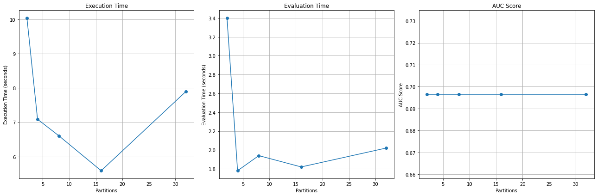
DecisionTreeClassifier
7 workers:
Partitions | AUC Score | Time Taken (seconds) | Evaluation Time (seconds)
2 | 0.6965 | 10.04 | 3.40
4 | 0.6965 | 7.09 | 1.78
8 | 0.6965 | 6.61 | 1.94
16 | 0.6965 | 5.59 | 1.82
32 | 0.6965 | 7.90 | 2.02

Slide 11
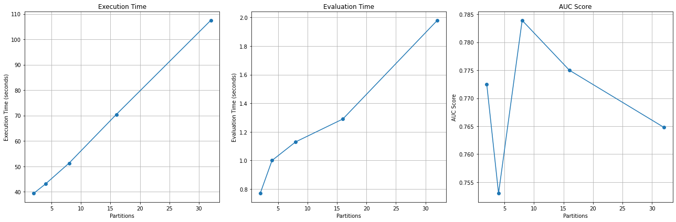
RandomForestClassifier
2 workers:
Partitions | AUC Score | Time Taken (seconds) | Evaluation Time (seconds)
2 | 0.7725 | 39.37 | 0.77
4 | 0.7530 | 43.06 | 1.00
8 | 0.7839 | 51.28 | 1.13
16 | 0.7750 | 70.43 | 1.29
32 | 0.7648 | 107.47 | 1.98

Slide 12
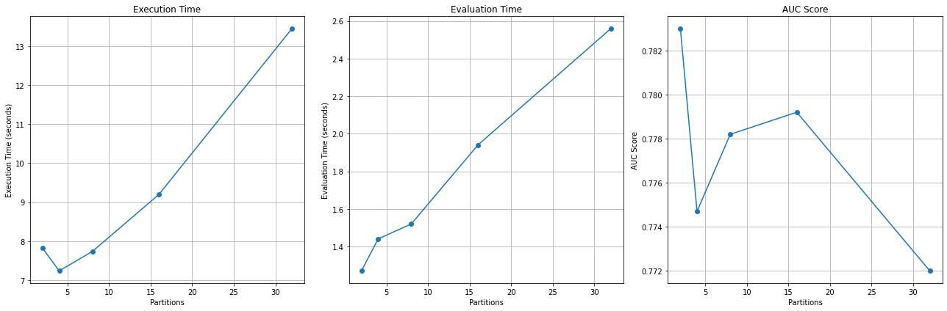
RandomForestClassifier
4 workers:
Partitions | AUC Score | Time Taken (seconds) | Evaluation Time (seconds)
2 | 0.7830 | 7.82 | 1.27
4 | 0.7747 | 7.24 | 1.44
8 | 0.7782 | 7.74 | 1.52
16 | 0.7792 | 9.20 | 1.94
32 | 0.7720 | 13.45 | 2.56

Slide 13
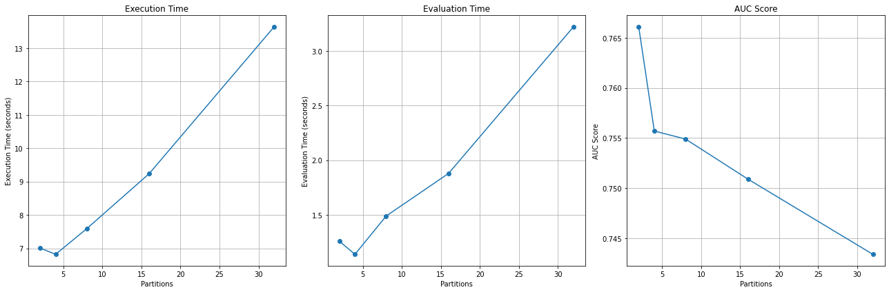
RandomForestClassifier
7 workers:
Partitions | AUC Score | Time Taken (seconds) | Evaluation Time (seconds)
2 | 0.7661 | 7.01 | 1.26
4 | 0.7557 | 6.82 | 1.14
8 | 0.7549 | 7.59 | 1.49
16 | 0.7509 | 9.24 | 1.88
32 | 0.7434 | 13.64 | 3.22

Slide 14
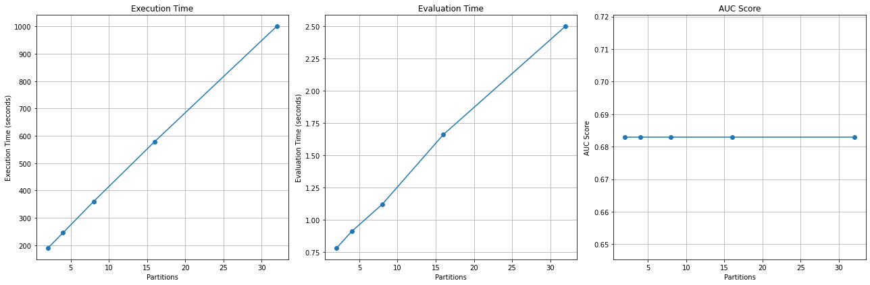
GBTClassifier
2 workers:
Partitions | AUC Score | Time Taken (seconds) | Evaluation Time (seconds)
2 | 0.6829 | 188.99 | 0.78
4 | 0.6829 | 245.37 | 0.91
8 | 0.6829 | 359.66 | 1.12
16 | 0.6829 | 578.96 | 1.66
32 | 0.6829 | 1001.33 | 2.50

Slide 15
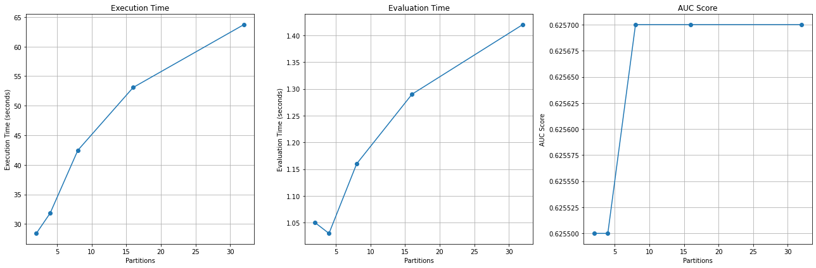
GBTClassifier
4 workers:
Partitions | AUC Score | Time Taken (seconds) | Evaluation Time (seconds)
2 | 0.6255 | 28.40 | 1.05
4 | 0.6255 | 31.83 | 1.03
8 | 0.6257 | 42.46 | 1.16
16 | 0.6257 | 53.09 | 1.29
32 | 0.6257 | 63.72 | 1.42

Slide 16
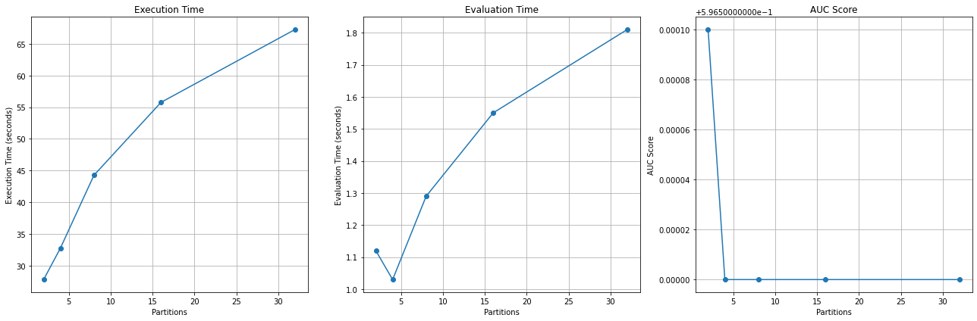
GBTClassifier
7 workers:
Partitions | AUC Score | Time Taken (seconds) | Evaluation Time (seconds)
2 | 0.5966 | 27.78 | 1.12
4 | 0.5965 | 32.74 | 1.03
8 | 0.5965 | 44.25 | 1.29
16 | 0.5965 | 55.76 | 1.55
32 | 0.5965 | 67.27 | 1.81

Slide 17
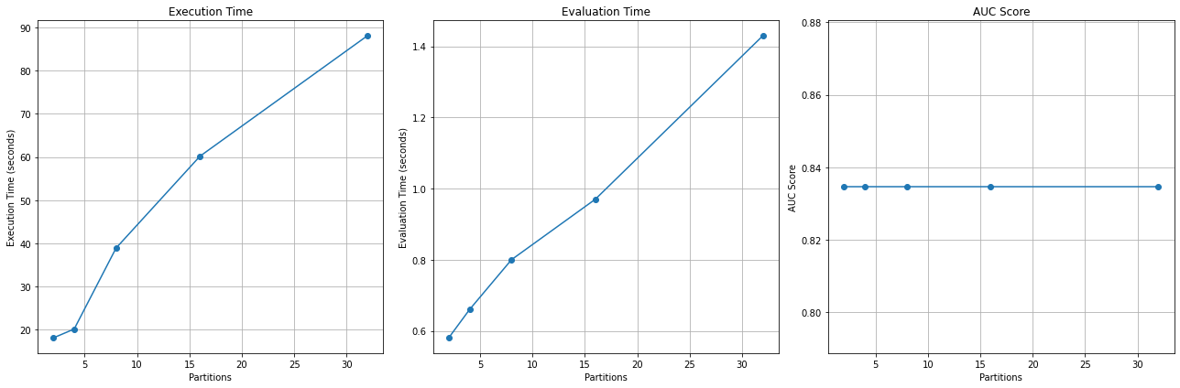
LogisticRegression
2 workers:
Partitions | AUC Score | Time Taken (seconds) | Evaluation Time (seconds)
2 | 0.8346 | 18.07 | 0.58
4 | 0.8346 | 20.13 | 0.66
8 | 0.8346 | 38.91 | 0.80
16 | 0.8346 | 60.18 | 0.97
32 | 0.8346 | 88.14 | 1.43

Slide 18
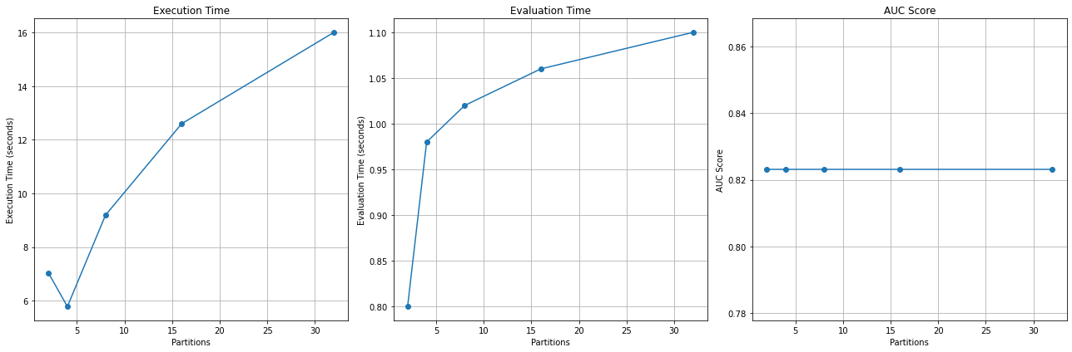
LogisticRegression
4 workers:
Partitions | AUC Score | Time Taken (seconds) | Evaluation Time (seconds)
2 | 0.8231 | 7.04 | 0.80
4 | 0.8231 | 5.78 | 0.98
8 | 0.8231 | 9.19 | 1.02
16 | 0.8231 | 12.60 | 1.06
32 | 0.8231 | 16.01 | 1.10

Slide 19
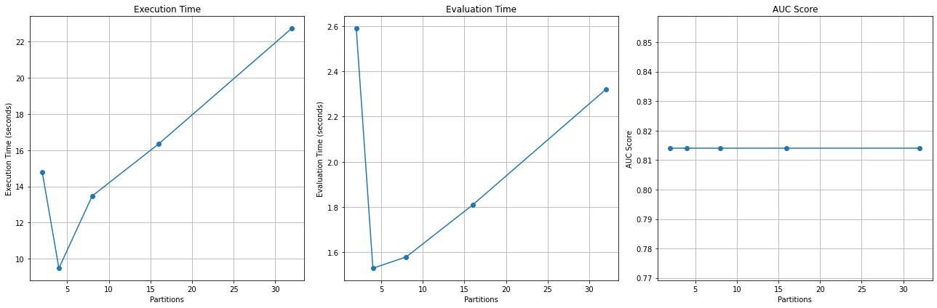
LogisticRegression
7 workers:
Partitions | AUC Score | Time Taken (seconds) | Evaluation Time (seconds)
2 | 0.8140 | 14.78 | 2.59
4 | 0.8140 | 9.48 | 1.53
8 | 0.8140 | 13.47 | 1.58
16 | 0.8140 | 16.35 | 1.81
32 | 0.8140 | 22.73 | 2.32

Slide 20
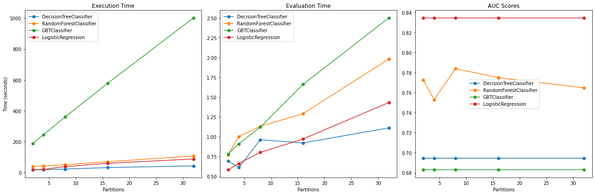
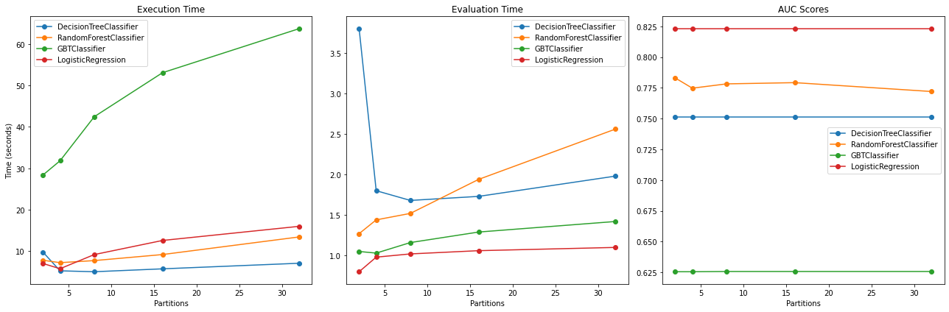
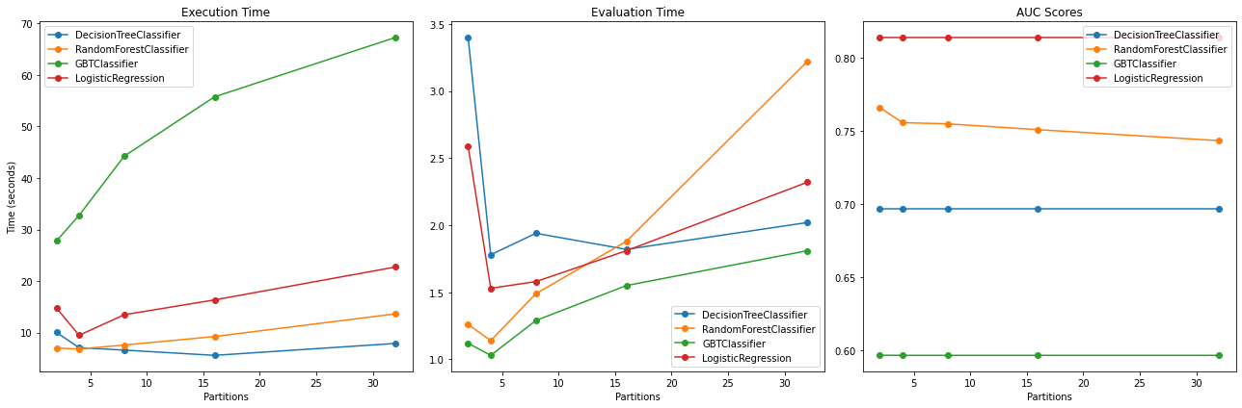
Model Comparison and Conclusion
Figure 20: Comparative Visualization of All Models with partitions using two workers.
Figure 21: Comparative Visualization of All Models with partitions using four workers.
Figure 22: Comparative Visualization of All Models with partitions using seven workers.

Slide 21
result
DecisionTree: consistent results across different partition sizes. The time taken for training was increased with larger partition sizes.
For RandomForest achieved higher AUC scores than the DecisionTree. Training time increased with larger partition sizes, but the evaluation time remained stable.
The GBTClassifier showed lower AUC scores across all partitions. The training time was increased with larger partition sizes.
The LogisticRegression consistently achieved high AUC scores. The training time increased with larger partition sizes, but the evaluation time remained stable.
Overall, the RandomForestClassifier demonstrated the best performance regarding AUC scores and scalability. The LogisticRegression also performed well but showed limited scalability compared to the RandomForestClassifier.
In terms of running time. The DecisionTreeClassifier's training time increased as the partition size grew.
RandomForestClassifier's training time increased with larger partition sizes. Nevertheless, the evaluation time remained consistent.
GBTClassifier exhibited significant increases in training time as the partition size grew more extensive, suggesting potential scalability challenges.
LogisticRegression displayed a similar pattern, increasing training time as the partition size increased. However, the evaluation time remained stable across different partition sizes.

Slide 22
Performance Metrics Across Varying Workers
Workers | Model | AUC Score | Training Time (Seconds) | Evaluation Time (Seconds)
2 | DecisionTree | 0.7271 | 9.9492 | 1.9701
2 | RandomForest | 0.7583 | 9.7997 | 1.5379
2 | GBTClassifier | 0.5940 | 34.7232 | 1.7151
2 | LogisticRegression | 0.8216 | 9.0247 | 1.3609
4 | DecisionTree | 0.6856 | 10.4694 | 4.0456
4 | RandomForest | 0.7562 | 9.3998 | 1.6949
4 | GBTClassifier | 0.6157 | 37.2921 | 1.4036
4 | LogisticRegression | 0.8241 | 8.5571 | 1.1517
6 | DecisionTree | 0.7129 | 10.5315 | 2.6206
6 | RandomForest | 0.7814 | 9.7788 | 1.6876
6 | GBTClassifier | 0.5804 | 38.8643 | 1.7392
6 | LogisticRegression | 0.8386 | 8.6998 | 1.1169
7 | DecisionTree | 0.6845 | 10.8111 | 3.0871
7 | RandomForest | 0.7368 | 9.8017 | 1.6610
7 | GBTClassifier | 0.6165 | 40.4467 | 1.3737
7 | LogisticRegression | 0.8146 | 10.1691 | 1.1760

Slide 23
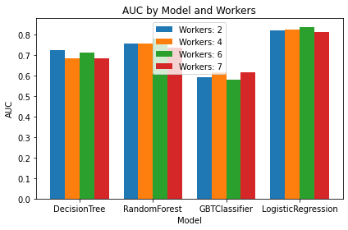
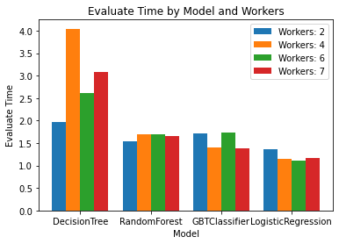
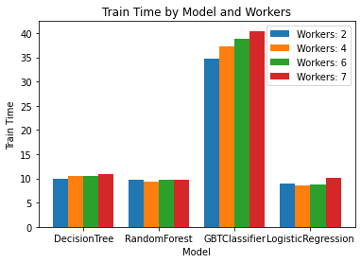

Slide 24
result
Logistic Regression reached an AUC score of 0.8386 when deployed with six workers.
Among all models and worker configurations, the RandomForest and DecisionTree models exhibit the fastest training times, thus suggesting their efficiency.
Logistic Regression shows the least evaluation time (1.11686182 seconds) when six workers are employed.
Considering all information, the Logistic Regression model emerges as the most balanced choice.
However, the RandomForest model is an excellent alternative if speed is critical.

Slide 25
CONCLUSION
LogisticRegression came out on top regarding AUC and evaluation time, making it an ideal choice for situations requiring fast prediction outputs. The RandomForest and DecisionTree models were particularly efficient in training time, which would benefit applications necessitating quick model training.
The LogisticRegression model emerged as the most balanced choice. RandomForest could be an effective alternative when speed is of the essence, displaying solid performance in all aspects.

Slide 26

Thanks for listening

