Slide 1







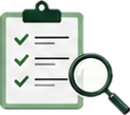






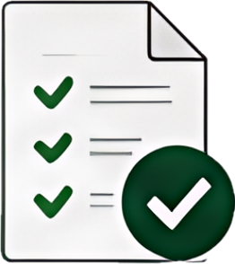
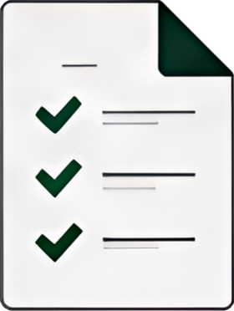












How the New Way of Working Lands for Agentic AI Governance
The new way of working streamlines agentic Al governance by creating one clear route from early triage
to proportionate 2LoD engagement, independent validation, approval and ongoing oversight.
Identify the route upfront
2
Engage the right 2LoD teams
3
Validate proportionately
4
Monitor, learn and reuse
Single front door and risk-based triage
Targeted engagement and shared evidence
Independent validation where required
Ongoing oversight and reusable patterns
Identify applicable policies, owners,
evidence and approval route early.
Route the use case to relevant 2LoD
teams based on the risk profile.
Validation depth follows risk, materiality,
autonomy and Al system type.
Define monitoring, incident handling
and change reassessment expectations.
Assess autonomy, tool use, third-party
dependency and business impact.
Use common evidence expectations
to reduce repeat requests.
For agentic Al, review documentation,
architecture, controls, testing, monitoring
and residual risks.
Capture outcomes, residual risks and
lessons learned.
Determine light, standard or
enhanced governance route.
Clarify decision rights, ownership
and escalation points.
Reuse validated patterns to accelerate
future Al reviews.
Capture findings, limitations, actions
and evidence in a consistent way.
Lands as:
Lands as:
Lands as:
Lands as:
Clearer route, fewer late
surprises and reduced duplication.
Earlier engagement, clearer
ownership and more consistent
challenge.
Independent assurance over
higher-risk GenAI / agentic AI
use cases.
Repeatable, scalable and
evidence-based Al governance.
This is how the framework lands in practice
One clear route
from early triage
Targeted 2LoD
engagement
Proportionate
independent validation
Ongoing oversight
Reusable patterns for
future agentic AI use cases

