Slide 1













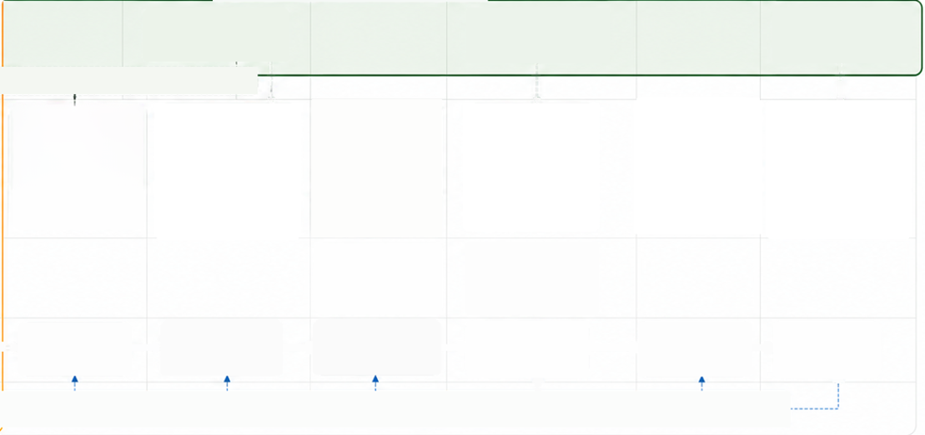




















































Al Risk Triaging Tool - Capability Workflow
UPDATED BASED ON AIRO FEEDBACK
Technology-agnostic workflow - implementation can
use existing workflow tools or a dedicated platform.
High-level workflow and tooling capabilities for Al Risk Oversight coordination with other 2LoD teams
1
2
3
4
5
6
7
UPDATED:
Intake &
Structure Use Case
Profile
Completeness &
Quality Check
Risk-area Mapping
& Routing
2LoD Review &
Input
Consolidate &
Determine Outcome
Record, Communicate &
Trigger Next Actions
stronger intake
& ingestion focus
Information Collection
Final Outputs
NEW: use case team swimlane across lifecycle
1.Use Case
Submit intake
Respond to follow-up
questions/missing
information requests
Provide clarifications
and supporting
evidence if requested
Receive final
Overall risk
outcome
Team/
Model Owner
information
outcome, actions,
and conditions
AlRO priority update: stronger intake & ingestion support
Create standard use case
create profile
Identify missing or
unclear information
Identify relevant 2LoD
teams
Review responses and
evidence
Save final assessment
and rationale
Risk area-specific
views
2. AI Risk
Ingest intake and evidence
Consolidate 2LoD inputs
Oversight
Team
Validate submission
Capture business purpose,
Generate follow-up
questions
Highlight risk-relevant
information by area
Provide risk-area
assessment guidance
and comments
Determine overall risk
outcome and rationale
Communicate outcome
Acknowledge receipt
Al capability, data, users,
and controls
Confirm engagement path
or next action
to use case owner
Input: Intake information
(see examples)
Check information is
Route the use case to
Record actions, conditions,
and next steps
Rationale and
evidence trail
sufficient for review
the right reviewers
Input: Raw intake pack
Input: Structured triage
profile
Input:
Validated triage
profile
Input: Targeted review pack
Input: Risk team inputs
Input: Consolidated
assessment
3.Other
2LoD Risk
Teams
Receive targeted
review pack
Provide assessment,
comments, and
conditions
Open actions/
conditions
Review assigned
risk areas
Request more info if
needed
4.Shared
Review /
Evidenec Space
Output:
Output:
Output:
Validated triage
profile
Output:
Targeted review
pack
Output:
Risk team
inputs
Output:
Output:
Final triage
outcome
Raw intake pack
Structured triage
profile
Consolidated
assessment
Confirmed
communication
to use case owner
5. Future /
Ongoing Change
Notification
Notify material changes for re-engagement
Changes to model, data, purpose, controls, environment, or usage that may impact risk assessment.
Where data comes from and where it goes
What the tool needs to support
Visible updates in this version
Input sources
Shared review
workspace
Data ingestion from existing sources
Shared review workflow for 2LoD teams
Use case team swimlane added
across lifecycle
Intake forms, governance tracker, SharePoint agent, use case documentation, supporting evidence
Use case structuring and
information quality checks
Consolidation, evidence capture,
and audit trail
Risk Triaging Tool
Structured review pack/
collaboration space
Assessment record/
evidence repository
Intake & ingestion detail strengthened
Al Risk Oversight,
orchestration
Final record and
audit trail
Risk-area mapping and routing logic
Outcome recording and action tracking
Re-engagement/change
notification shown

Slide 2






































































How the Operating Model Works in Practice
UPDATED BASED ON AIRO FEEDBACK
This process view shows how the single 2LoD front door works in practice -
from triage and early engagement through live operation, incident handling and change re-assessment.
Al Risk Oversight target workflow
Current PwC tool focus
Initial front-door triage
End-to-end triage, specialist input, final assessment and evidence
Enhanced
Block/No Go/Direction of change
High-risk
indicators trigger
initial review.
Incident
identification
Root cause analysis
and solution
identification
Resolve
issue
Al Oversight Forum
Standard
Use case
materiality
assessment
Responsible
Al Journey
Typical risk use
cases proceed
through the
standard
governance route
and identify which
2LoD teams need
to be engaged.
Async
engagement
Change is
identified and
logged
What changed
in this version
Model owner
completes triage
after the
consequence
scanning
workshop in the
RAl journey.
Change
triaging
Triaging
Live
Stronger focus on
intake & ingestion
Model
IT/ICP
Data
Approvals for Tier 3
and below granted
by MRO
Market
Conduct
Log non-material
changes and
notify 2LoD
Use case team shown
across the lifecycle
Light
ECP
Payments
Very low risk
use cases may
proceed at MO
approval /
attestation.
Supplier
Conduct
Change
End-to-end AIRO
workflow retained
UPDATED:
stronger
Minor or material changes will be
reviewed by relevant 2LoD teams
to determine the level of re-engagement
intake & ingestion focus
DAIEC
Customer &
Product
Business
Continuity
Upfront intake and ingestion
are now a top priority.
NEW:
use case team / model owner journey across lifecycle
Current priority:
1
Submit intake
information
2
Respond to
follow-up
questions
3
Provide
clarifications/
evidence
4
Receive
outcome and
actions
5
Notify material
changes/
re-engagement
Future state:
broader
streamline upfront triage
and intake / ingestion
access management can
be considered later.
Key message:
PwC focuses on front-door triage; Al Risk Oversight needs an end-to-end workflow
covering intake, specialist input, final assessment, evidence, and re-assessment.
The operating model turns the single 2LoD front door into a practical governance journey:
risk-based triage, proportionate engagement, structured escalation, and clear re-assessment of changes.

Slide 3



























































AI Risk Triaging Tool – Practical MVP Design
UPDATED: stronger intake & ingestion focus
An AlRO-led MVP with stronger intake & ingestion support, use case team interaction points, and shared review for specialist input.
Current pressure point:
streamline upfront triage
and intake / ingestion
1
2
3
4
5
6
Intake & ingest
use case inputs
Structure &
triage
Generate
review pack
Share pack for
2LoD review
Capture risk team
assessments
Consolidate outcome
& save evidence
What the MVP includes
1.Use Case Team/
Model Owner
Submit use case
information
Respond to
follow-up questions
Provide clarifications/
additional evidence
Receive final
outcome, actions,
and conditions
AIRO-led triage
workflow hub
Examples:
if the intake is
incomplete
when reviewers need
more information
Intake form/ submission
Notify material changes
if re-engagement is
needed
NEW:
use case team
Governance tracker
Detailed intake &
ingestion support
interactions across lifecycle
SharePoint agent
Existing documentation
Supporting evidence
2. AI Risk
Oversight
Team
Pre-screen intake
Generate targeted
review pack
Consolidate all 2LoD inputs
Pack generation
and routing support
Structure the case profile
Summarise business purpose
Al capability, data, users,
controls
Determine overall risk outcome
Save final assessment
and rationale
Check information
completeness
Record rationale, actions,
and next steps
Identify relevant 2LoD
risk areas
Communicate outcome
and conditions
Shared review
mechanism for
2LoD teams
Highlight risk-relevant
information
Add review questions for
each risk area
Review relevant information
3.Other
2LoD Risk
Teams
Request more information if needed
Provide risk-area assessment
Assessment capture
and consolidation
Add comments, conditions,
or concerns
4. Shared Review /
Evidence Space
Output:
Raw intake pack
Output:
Structured triage
profile
Output:
Targeted review pack
Output:
Risk team inputs
Output:
Consolidated
assessment
Output:
Final triage
outcome
Evidence trail and
final outcome record
Practical design approach
What is NOT required for MVP
Visible updates in this version
No need to deploy the full tool to all 2LoD teams
NEW:
Use case team interactions added
No need for every team to log into a new platform
across the lifecycle
Input sources
Forms, trackers,
documentation,
evidence
AIRO triaging tool
Shared review workspace
Assessment /
No need for deep integration on day one
UPDATED: Intake & ingestion strengthened –
stronger upfront focus and support
AIRO-led triage
workflow hub
Where 2LoD teams
view and respond
evidence repository
Final record and
audit trail
Can start with existing collaboration channels
Broader access management can be considered later (future state)
Access management positioned as future state

