Slide 1














From Fragmented Engagement to
Risk-Based, Proportionate Oversight
LLOYDS
BANKING GROUP
MRO is moving the framework from informal and duplicative engagement to a structured, risk-based operating model.
Current challenge
MRO mechanism
Outcome
Fragmented governance
Single 2LoD front door
Clearer route through oversight
Duplicated engagement
De-duplicated oversight paths
Reduced rework
Unclear ownership
Updated RAPID and clearer decision rights
Sharper accountability
Inconsistent evidence
Common evidence spine
More consistent review
Late-stage challenge
Earlier 2LoD engagement
Lower delivery friction
Agile AI change and
inconsistent monitoring
Change triage, monitoring expectations
and revalidation triggers
Stronger ongoing oversight
Al risk oversight needs clearer triage, documented approval routes, consistent evidence standards,
proportionate validation, and defined monitoring / revalidation triggers across the AI lifecycle.
6

Slide 2















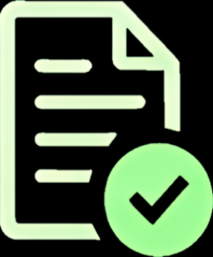
Three Workstreams to Accelerate
Framework, Tooling and Validation
LLOYDS
BANK
PwC is supporting targeted delivery, but MRO owns the direction, second-line risk view and oversight outcomes.
Workstream 1
Workstream 2
Workstream 3
Al System Risk
Management Framework
Automated Al Risk
Management Tooling for MRO
Independent Validation of
Priority Al Use Case
Establish AI Risk Policy Enabler and
operating model.
Develop tooling for AI model risk
classification, independent validation
and ongoing oversight
Execute full independent validation of
a high-risk GenAl / agentic Al use case.
Define proportionate end-to-end Al
lifecycle controls.
Assess documentation, architecture,
controls, developer testing and
monitoring.
Support triage workflow, testing, evidence
capture, dashboards and monitoring.
Clarify accountabilities across MRO, CCOR,
CDAO and thebusiness.
Outcome
Outcome
Outcome
Clearer expectations, evidence
requirements and decision routes.
Regulator- and audit-ready
evidence with reduced rework
and scalable second-line capability.
Reusable validation blueprint to
standardise and accelerate future
Al validations.
7

Slide 3















Operating Model, Risk Taxonomy
and Policy Enabler
LLOYDS
BANKING GROUP
The PwC artefacts help translate Al policy expectations into a practical, navigable governance journey.
Al Governance
Operating Model
AI Risk
Taxonomy
Al Risk Policy
Enabler
Provides a Group-wide approach for
identifying, routing and coordinating
Al risks across existing policies.
Sets out the end-to-end governance
process for AI use cases.
Maps Al-specific risk manifestations
into the existing enterprise risk
structure.
Defines what happens, when, who is
involved and how actions are performed.
Helps teams understand which policies
apply, which risk teams to engage, and
what evidence or approvals are required.
Uses existing L1 / L2 / L3 risks as
the baseline.
Introduces triage and governance
pathways based on inherent risk.
Clarifies that 1LoD owns Al use cases
end to end; 2LoD retains policy review
and challenge ownership within domains.
Identifies where additional clarity,
review or uplift may be required.
Together, these artefacts create the practical interpretation layer for way of working, routing and oversight.
8

Slide 4










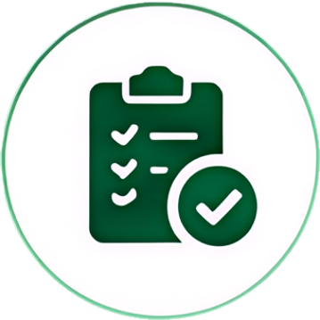

Clearer Escalation, Review and Approval Routes
LLOYDS
BANK
The target way of working separates delivery coordination from independent second-line oversight.
Group Risk Committee (GRC)
Final sign-off for Tier 1 use cases
and escalated cases.
Model Governance Committee (MGC)
Final sign-off for Tier 2 use cases and
escalated Tier 3-5 cases.
Al Control Tower (1LoD)
Al Risk Oversight Forum
(2LoD, run by MRO)
Data & Al Ethics Committee (1LoD)
Resolves delivery escalations and
blockers; tracks Al outcomes at
Group level.
Reviews use cases with ethical
dilemmas and has decision-
making power.
Centralised forum for reviewing
and triaging Al, GenAl and
agentic Al use cases.
Al Risk Triaging Forum (2LoD)
Triage AI use cases and ensures
relevant 2LoD teams are engaged.
Al Control Tower supports delivery coordination; the MRO-led Al Risk Oversight Forum provides second-line risk oversight and challenge.
9

Slide 5



















Risk-Managed Acceleration Through Clearer Governance
LLOYDS
BANKING
GROUP
The aim is not to slow Al delivery, but to enable safe, consistent and scalable Al adoption.
Expected outcomes
Immediate next steps
Simpler end-to-end Al governance
Finalise Al governance target-state narrative
Clearer ownership and decision rights
Progress Al Risk Policy Enabler, Risk Taxonomy
and Operating Model
Reduced duplication and rework
Consistent evidence and approval expectations
Continue PwC Workstream 2 tooling assessment
and integration
Proportionate validation based on risk, materiality
and autonomy
Execute priority Al use case validation
under Workstream 3
Stronger monitoring, incident capture and
revalidation triggers
Scalable second-line tooling and independent
validation capability
Prepare ongoing updates for Al Control Tower,
MGC and GRC as required
MRO is leading the evolution towards a joined-up, proportionate and evidence-based
Al risk oversight model that supports responsible Al adoption across the Group.
10

