Slide 1
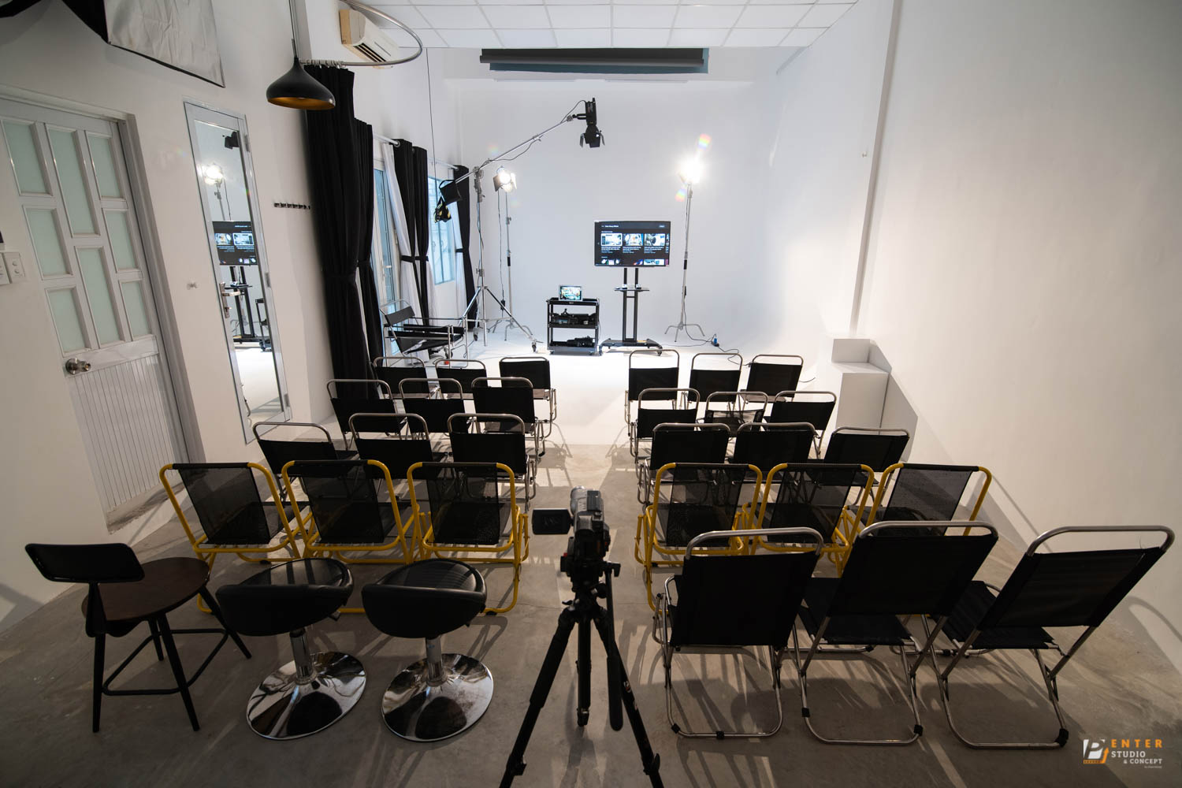
WORKSHOP
PRESENTATION SKILLS
Tusday March 6
9:00 AM - 11:00 AM
ENJOY NOW

