Slide 1

ANALOG PHOTO BOOTH FOR EVENTS
Photos your guests actually keep.
I bring an analog print booth to your event and run the whole night. Every guest walks out with a real photograph in their hand.
YOUR EVENT, HERE
Harbourfront · 11:48pm
futurenostalgia.ca
Festivals, hotels & events
01 / 06

Slide 2
WHY PRINTS
We don't remember files. We remember objects.
ADD A PHOTO
a guest holding their print
Your guests will shoot a hundred photos tonight and never open them again. The one they can hold, they keep for years. A print is a memory with a body.
02 / 06

Slide 3
HOW IT WORKS
I run the whole booth.
Your staff never touches any of it.
YOUR CORNER
I SHOOT IT
PRINTS ON THE SPOT
THEY KEEP IT
a few sq. ft. + power
camera + lighting, all mine
real film, about a minute
your event on the border
You give me a corner with power. I bring everything else and pack it all down at the end.
03 / 06

Slide 4
WHAT IT COSTS YOU
Nothing.
Your guests or a sponsor cover the prints. There are two ways to run it.
Per print
Sponsored
Guests pay for their own prints on the spot, the way they'd buy anything else at your event.
A sponsor covers a set number, so guests take them home free, with the sponsor's name on every print.
I'll help you pick the one that fits your event.
04 / 06

Slide 5
WHAT THEY TAKE HOME
A real print. Your event on the border.
YOUR EVENT
YOUR EVENT
Front row · 9:42pm
The line, all night
Two strangers, now friends
Last dance · 1:10am
Swap these for shots from your room, your crowd, your night.
05 / 06

Slide 6
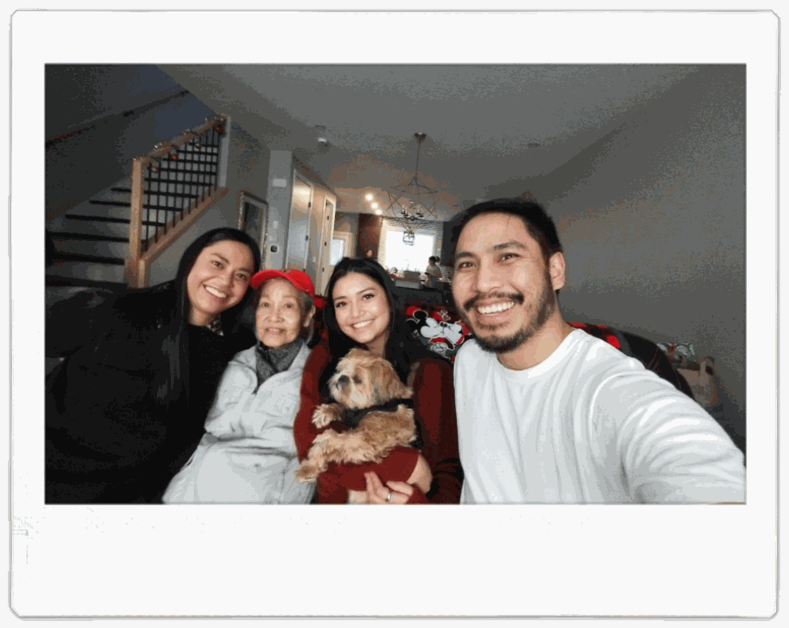
LET'S TALK
Give me a corner. I'll handle the rest. →
Tell me about your event and I'll come back within a day with dates and a price. No deposit to ask.
hello@futurenostalgia.ca
futurenostalgia.ca
@future.nostalgia
I'm Josh Gonzales. I started future.nostalgia for my own family, because the photos we keep are the ones we can hold. A share of every event goes to brain research — the science of why a photograph is worth keeping at all.
06 / 06

