Slide 1
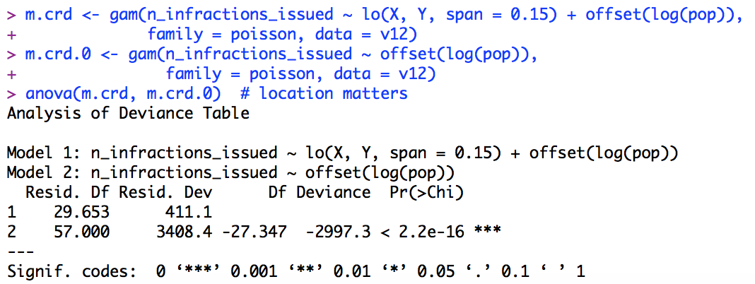
Non-parametric regression (Smoothing)
Our outcome is the count of violations issued for each county in a given year
# pop is the offset
Location matters
Notes:
Span is the proportion of data we used to fit each poisson regression model in GAM.
Overall, the GAM gives us the weighted average of the poisson models

Slide 2
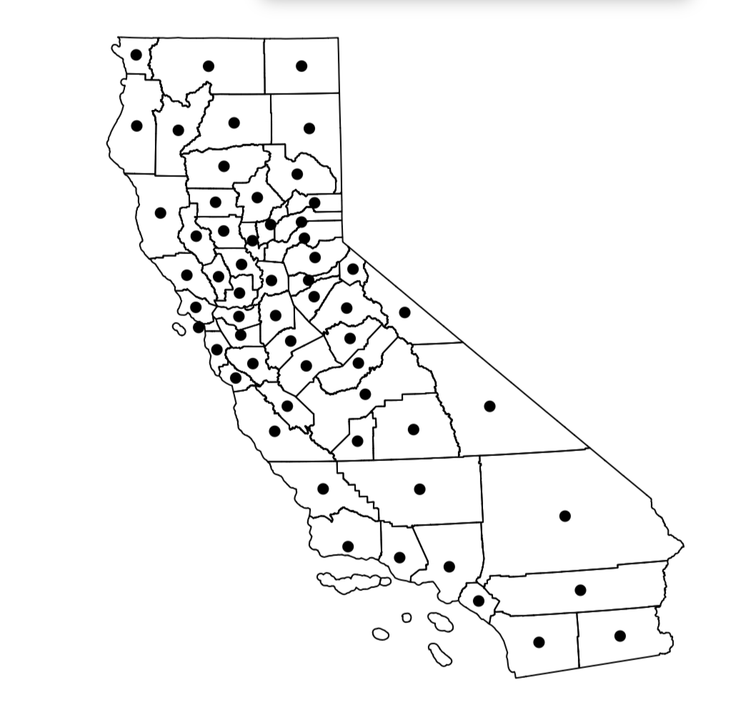
Notes:
This map shows the polygon of each county with their centroids (X, Y)
58 counties

Slide 3
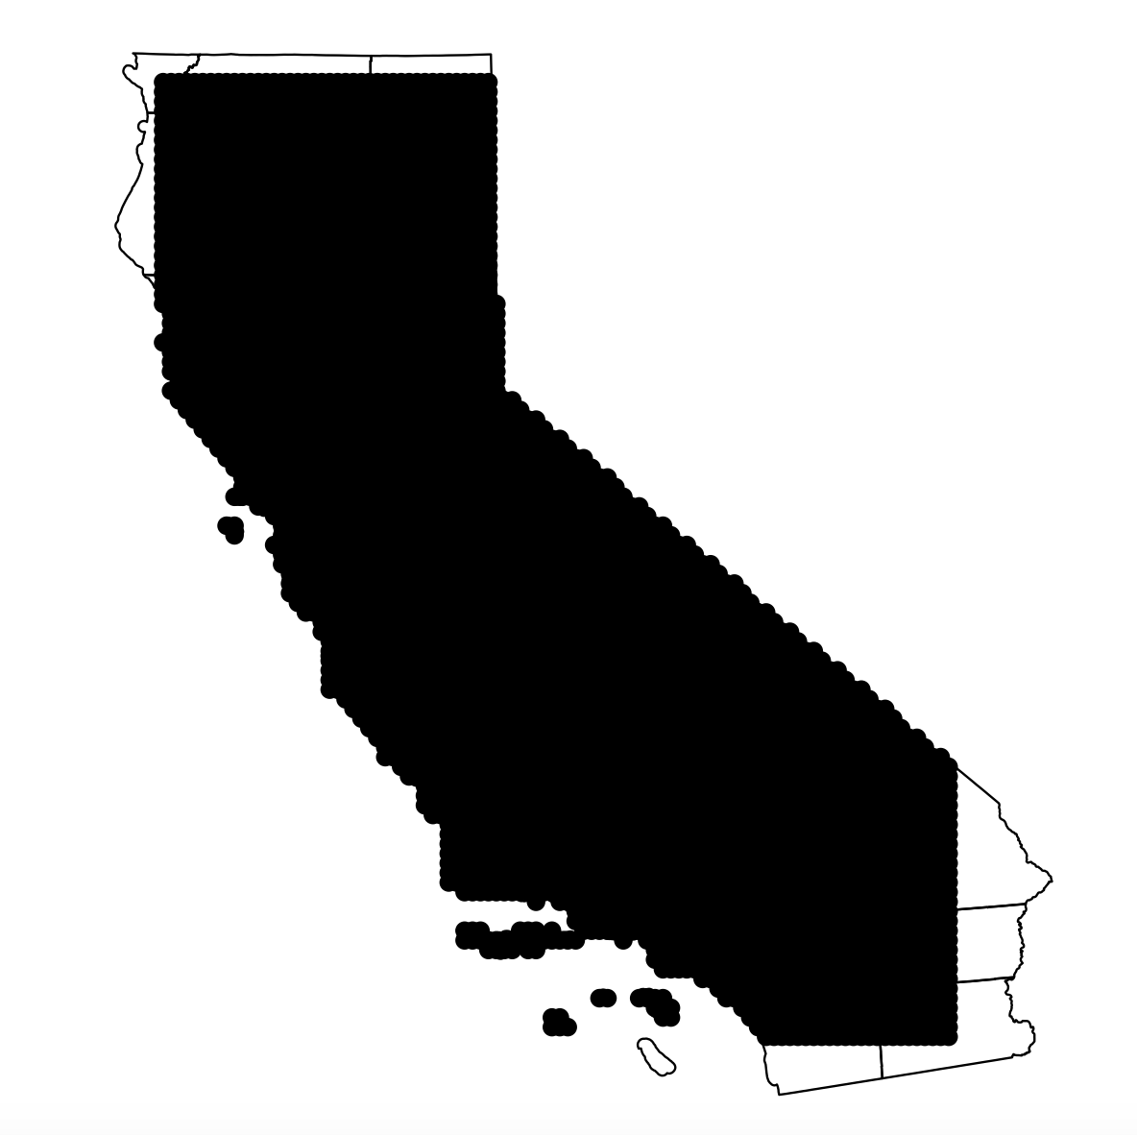
Notes:
Create the grid based on the centroid of each polygon(county)
5017 pairs of (X, Y), which covers most part of CA

Slide 4
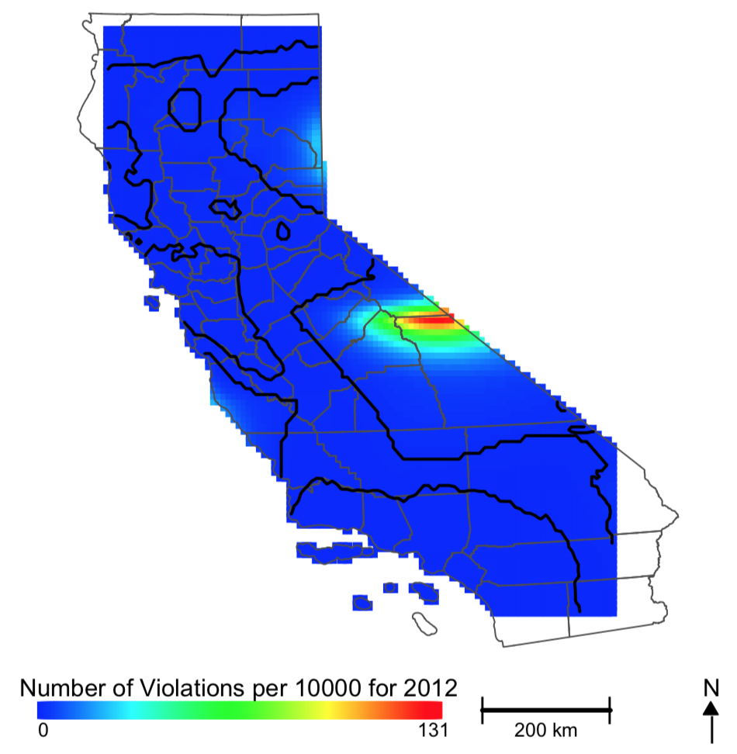
Notes:
Use the model we fit to predict the rate of violation (# violations / 10000 pop)
Red area shows high level

Slide 5
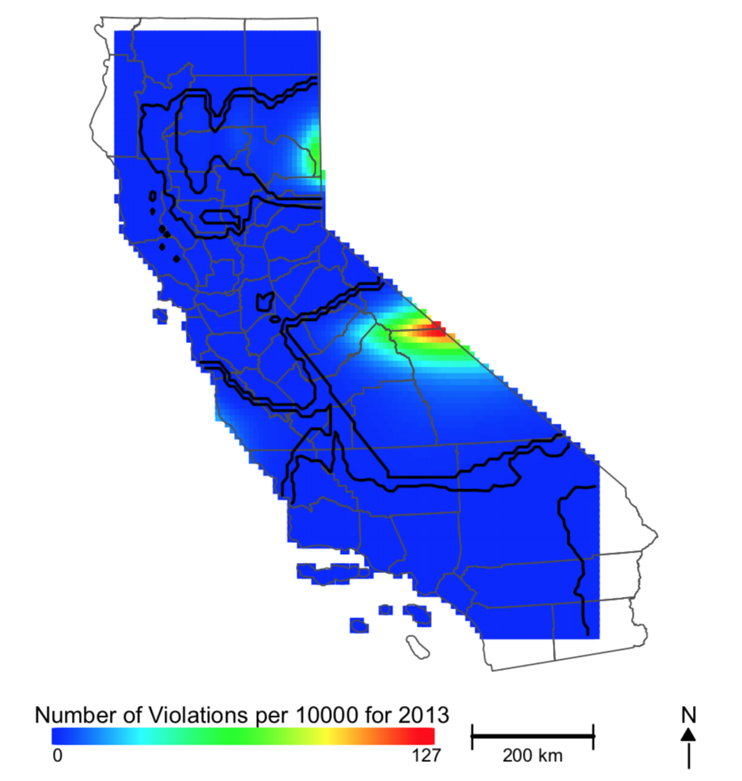

Slide 6


Slide 7
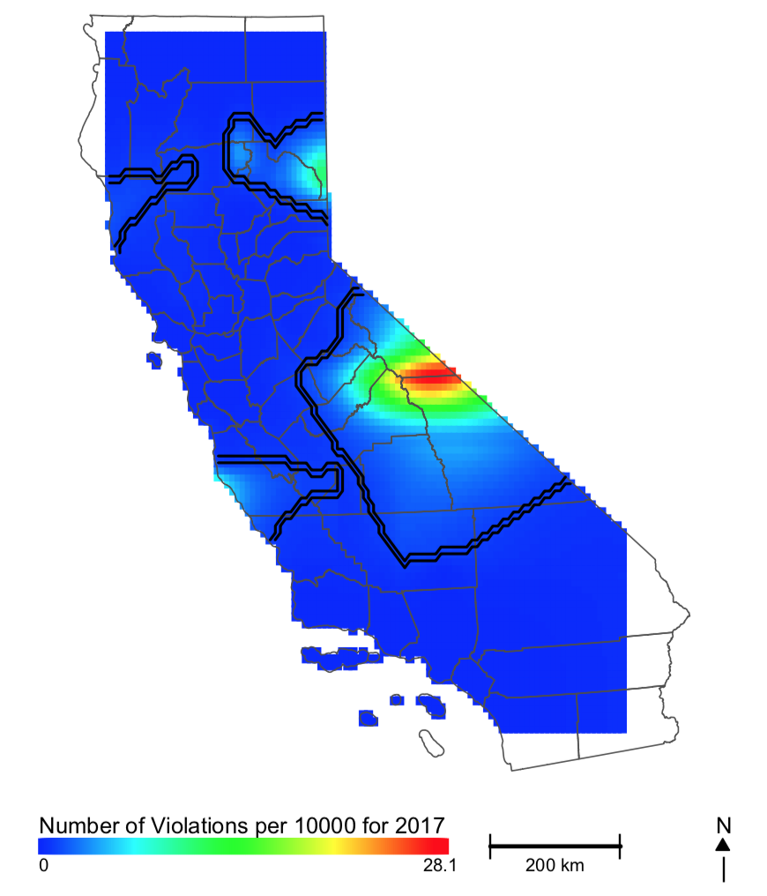

Slide 8
