Slide 1
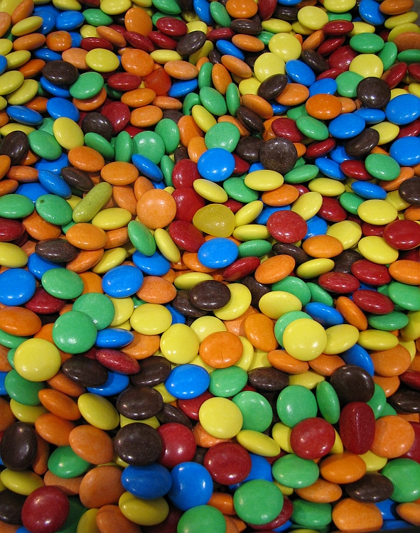
Deduplication in networks
Konstantin Manna
Aachen, 13.01.2013

Slide 2
Deduplication in Storage Systems
Unique Data + Pointers
Create Data
Deduplication
Look for Duplicates
Replace Duplicates with Pointers
Notes:
Companies create a lot of data; problem: they need to store the data + backups (dayly,weekly,.../incremental/diff/full)=>a lot more data needs to be stored => huge storage space needed =>deduplication fights this problem; data->fp(as normal)->... show offline deuplication process

Slide 3
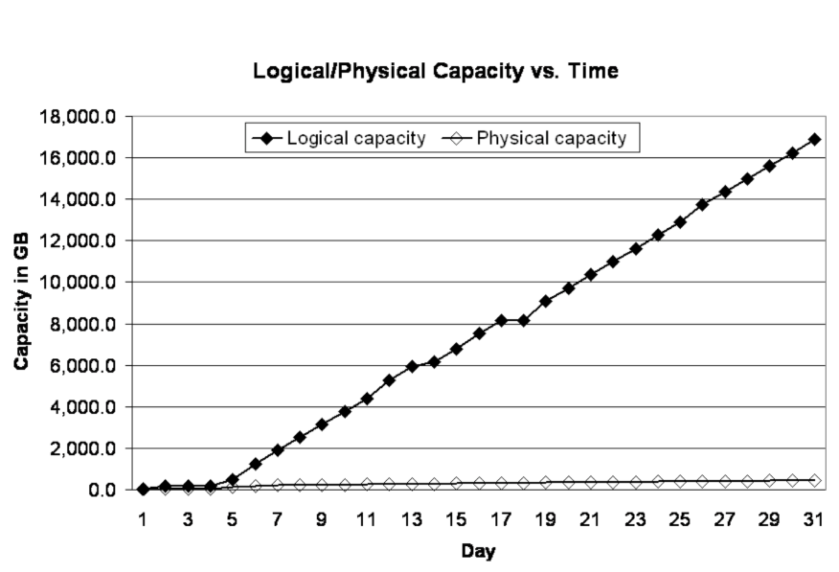
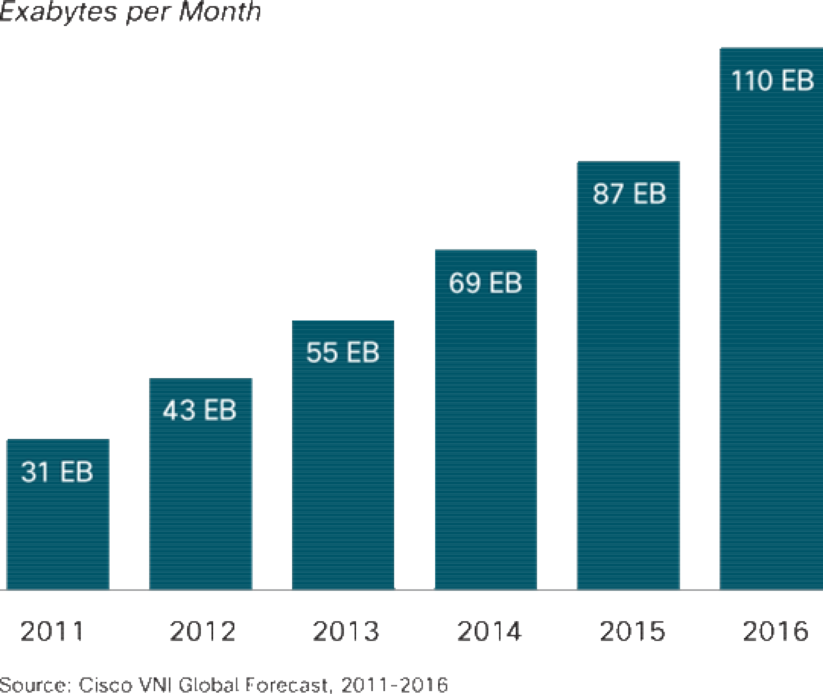
Interesting for networks
Good results for storage minimization
Similar Problem in Networks:
Traffic increases steadily
(Multimedia)
Deduplicatie the network traffic?
Notes:
Offline data deduplication for storage great results; we have a similar problem with network traffic; media(streaming...)=>a lot traffic=>offline doesnt work,need online(adapt)

Slide 4
Existing Solution for networks
File-optimization (JPEG, MPEG,...), compression, proxys do exist.
Another system like deduplication necessary?
Heavy load on line between A and B
→ Congestion, Packet loss, ...
Company A Company B
Notes:
But: already have systems that deal with this issue, like jpg,compression,proxys, why not enough?Bsp grafikunternehmen(picture)Still not enough(cuz slight changes/more data)=> deduplication(online)

Slide 5
Compression
Computational intense for routers
Suboptimal results
Company A Company B
Notes:
But: already have systems that deal with this issue, like jpg,compression,proxys, why not enough?Bsp grafikunternehmen(picture)Still not enough(cuz slight changes/more data)=> deduplication(online)

Slide 6
Proxy systems
Does not catch altered content
Company A Company B
Notes:
But: already have systems that deal with this issue, like jpg,compression,proxys, why not enough?Bsp grafikunternehmen(picture)Still not enough(cuz slight changes/more data)=> deduplication(online)

Slide 7


Deduplication Concept
Real life example
+
=
Notes:
But: already have systems that deal with this issue, like jpg,compression,proxys, why not enough?Bsp grafikunternehmen(picture)Still not enough(cuz slight changes/more data)=> deduplication(online)

Slide 8
Online Deduplication in networks
Load on line between A and B decreased
Company A Company B
Notes:
But: already have systems that deal with this issue, like jpg,compression,proxys, why not enough?Bsp grafikunternehmen(picture)Still not enough(cuz slight changes/more data)=> deduplication(online)

Slide 9
Deduplication in detail (sender)
Look for match in Database
Expand match ->
… 9c 6f 47 af 20 98 dd 43 ...
Client Data
… 9c 6f 47 af 20 98 dd 9f ...
Cache Data
Send
(*Ptr,len)
„9c“
Continue
Continue
Hash (rolling)
… 8a 9c 6f 47 af 20 98 dd 43 0a a8 85 d8 ...
Get Data
Notes:
Oral exapmle with two persons; then 4)deduplication process (picture)

Slide 10
Deduplication in detail (receiver)
Get Data from cache
…(*Ptr,len) ...
Get Data
Scan for Pointer to cache
(*Ptr,len) = „9c 6f 47 af 20 98 dd“
… 8a 9c 6f 47 af 20 98 dd ...
Send Data
Notes:
Oral exapmle with two persons; then 4)deduplication process (picture)

Slide 11
Cache insertion / Fingerprinting
How do Data + Hashes get into DB?
?
Inserting every Hash → simple, but not feasible → cache too big
… 9c 6f 47 af 20 98 dd 43 0a a8 85 d8 a9 4d ...
Increasing window size → fewer hashes → bad hit ratios
… 9c 6f 47 af 20 98 dd 43 0a a8 85 d8 a9 4d ...
Inserting every 2nd, 3rd,...,k-th Hash → static fingerprinting → bad hit ratios
… 9c 6f 47 af 20 98 dd 43 0a a8 85 d8 a9 4d ...
Insertion Algorithm: MODP/MAXP → guarantee matches of certain degree

Slide 12
MAXP
Original data
… 9c 6f 47 af 20 98 dd 43 ...
Hash every window
… 67
17
25
01 56 14 11 89 ...
(67 17 25 01)
Rolling Hash window
(17 25 01 56)
(25 01 56 14)
(01 56 14 11)(56 14 11 89)...
01,11,...
Adequate number of fingerprints
Robust vs. shifted data
Put fingerprints into cache

Slide 13
Measurement results

Slide 14

Conclusion
Redundancy = Problem
Advantages:
Higher transfer rates possible
Relief for congested connections
Possible gains in speed too
Disadvantages:
Additional memory needed on both sides (cache)
Additional computation (load) needed, especially sender
Transmission errors are critical (compact data)
Encryption of data is not beneficial (before deduplication)
Even better results: Combination of deduplication + Gzip + proxy

Slide 15
Middlebox vs Client centric
Middlebox
Client centric

