Slide 1
Robust Link Selection and Channel Assignment for Centrally Managed Wireless Mesh Networks
Bachelor Thesis
Konstantin Manna
Supervisors: Christoph Wollgarten, Jó Ágila Bitsch
16th October 2014

Slide 2

Short Reminder on the Problem
What's this about?
  Mesh-like Scenario with central entity
  Central entity manages nodes
  and creates initial network topology
What's the Problem?
  Poor Network Topology
  Poor Channel-Choice
  Link Failures Critical
  Only Manual Optimization

Slide 3
Goals and Restrictions for Solution
What's the Goal to Achieve?
  Increase Throughput ( Decrease Interference )
  Reduce End-to-End Link Failures
  Make better use of Ressources ( Radios / Channels )
  Keep Configurable
Restrictions to Work With:
  Centralized Solution ( No distributed approach )
  Static Scenario

Slide 4
Related Work
What about related work and why not use these?
- Many Distributed Approaches ( Not the Preferred Way )
- CLICA ( No Topology Restriction )
- INSTC ( Requires Homogenous Network )
- BFS-CA ( Wastes Ressources )
- CTA ( Uncontrolled Growth )
→ Feature Reuse

Slide 5
Our Solution
Composed of three Steps:
  Create a MST on overall Topology
  Add Redundant Links ( Survival Paths ) to MST
  Assign Channels to Link-Groups

Slide 6
Step 1: Create a MST
Modified DJP Algorithm:
  Start with Random Node
  Calculate Score for Links to New Nodes
  Add Edge with Highest Score to MST

Slide 7
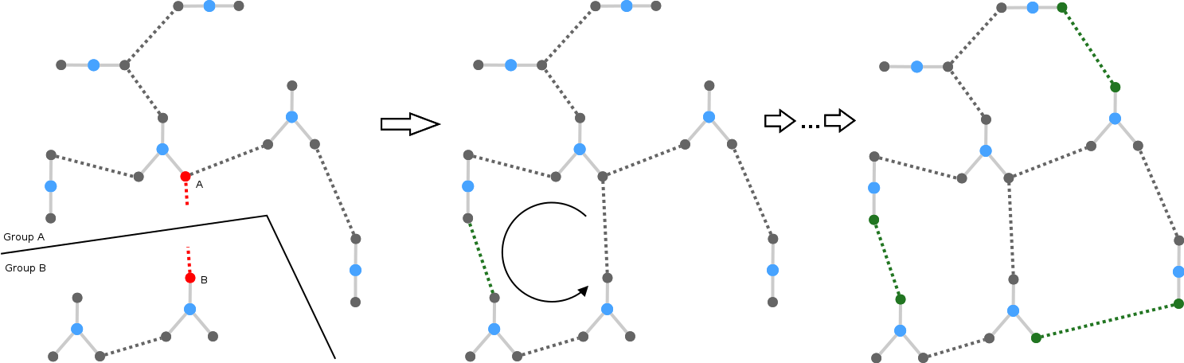
Step 2: Add Survival Paths
Iterative over all Edges in MST:
  Check for backup path
  If none exists, add highest scoring Edge,
  which reconnects the two groups

Slide 8
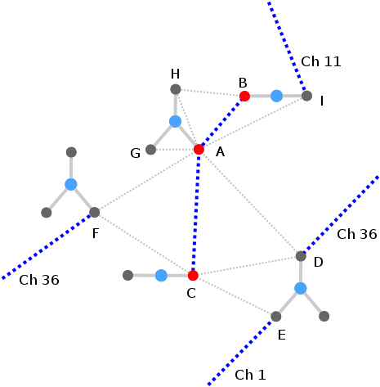
Step 3: Assign Channels to Links
Iterate over Link-Groups:
  Pick least interfering Channel
    Consider Internal & External

Slide 9
Evaluation Results
Testbed Results Suggest:
  Less Interference
  Fewer Network Disruptions
  More Throughput
Requirements met?
  Increased Throughput
  Reduced Link Failures
  Using Available Ressources
  Kept Configurable
  Centralized Environment
  ✔
  ✔
  ✔
  ✔
  ✔

Slide 10
Conclusion 1
Why is our solution better than related approaches?
  Heterogenous Environment ( Radios / Channels )
  Vendor neutral
  No MAC Changes
  Optional / Modular Design ( Survival Paths )
  Considers Foreign Sources of Interferences
  Easily Customizable ( Formula / Redundant links )
Future Work:
What's up next?
      Closer Integration into LCOS
      Further Optimizations
Open issues?
      Evaluation with Simulation
      Learning Algorithm ( Changing Link-Quality )
      Extensive Comparison to Related Work

Slide 11
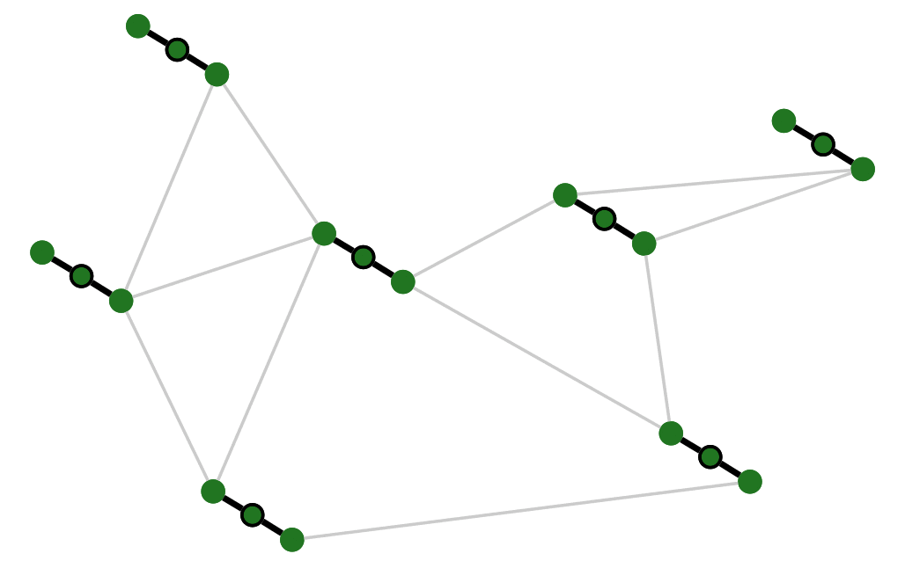
Conclusion 2
Personal Feedback:
  Overall Balanced Work-Package
  Each Phase ( Design / Implementation / Evaluation ) Finished on Time
  Collaboration with Supervisors and LANCOM Paramount
→ All Goals Achieved / Total Success
  ✔
Questions?

Slide 12
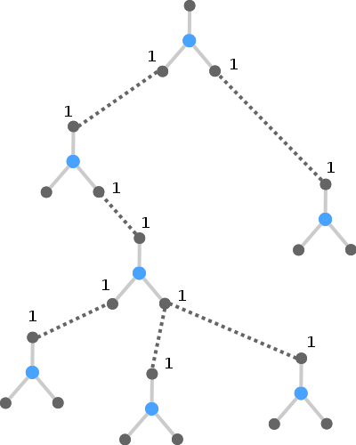
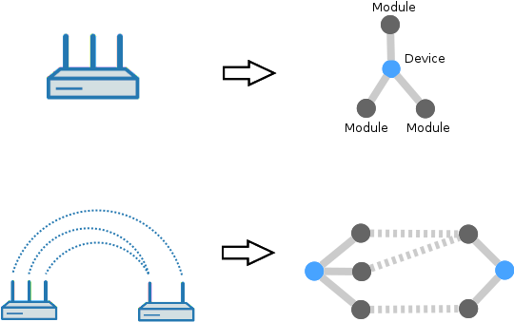
Mapping to Graph & AutoWDS Basic Topology

Slide 13
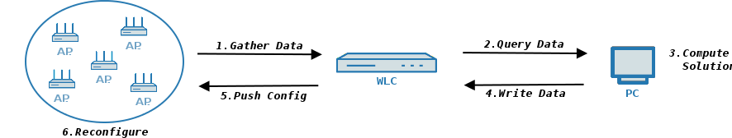
Configuration Flow

Slide 14
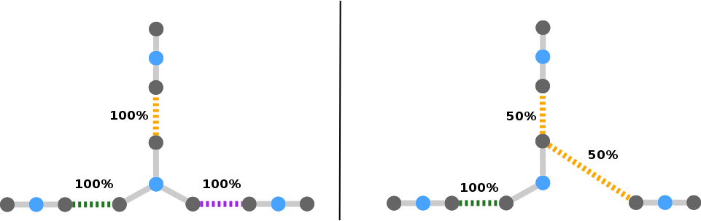
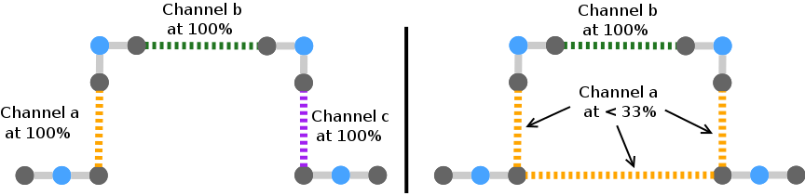
3 vs 2 Modules & Conflicting Additional Links

Slide 15
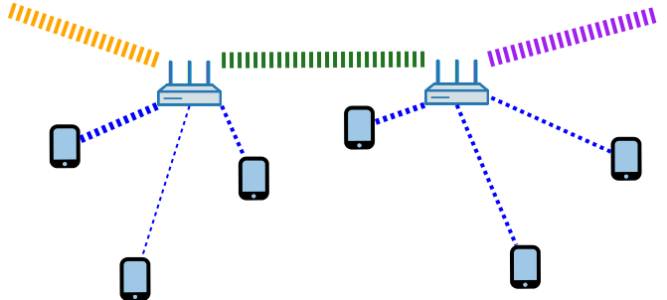
Modules to Spare

Slide 16
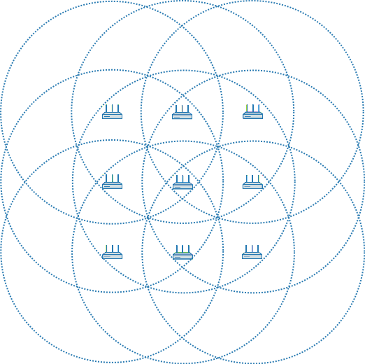
Python Example Step 1 and 2

Slide 17
Python Example MST and Survival MST

Slide 18
Python Example Channel Assigned MST + Survival MST

Slide 19
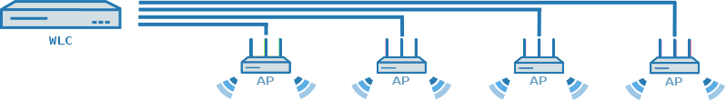
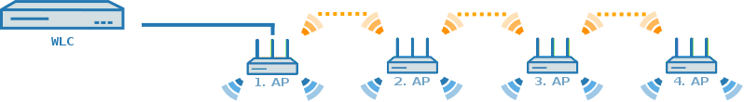
AutoWDS LAN & AutoWDS WLAN

Slide 20
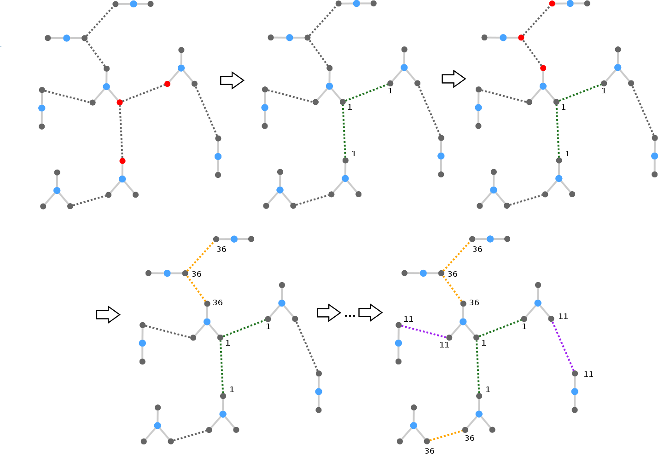
Channel Assignment

Slide 21
Channel Group

Slide 22
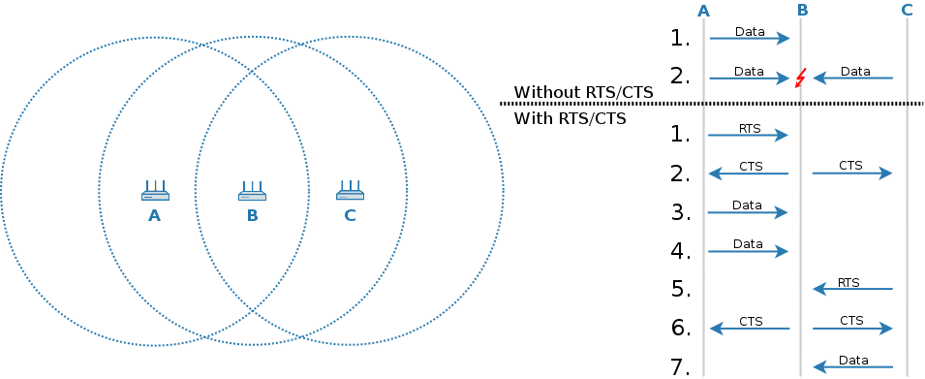
Hidden Station Problem Solution RTS/CTS

Slide 23
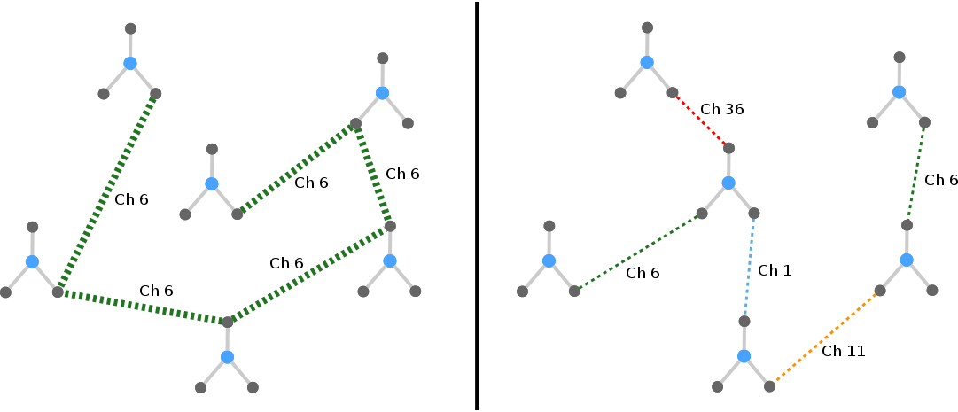
Impact of Connected-Count Value in MST-Formula

Slide 24
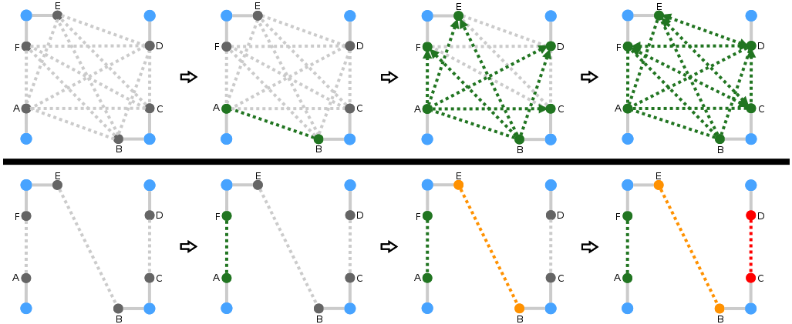
Network Topology: Dense vs Sparse

Slide 25
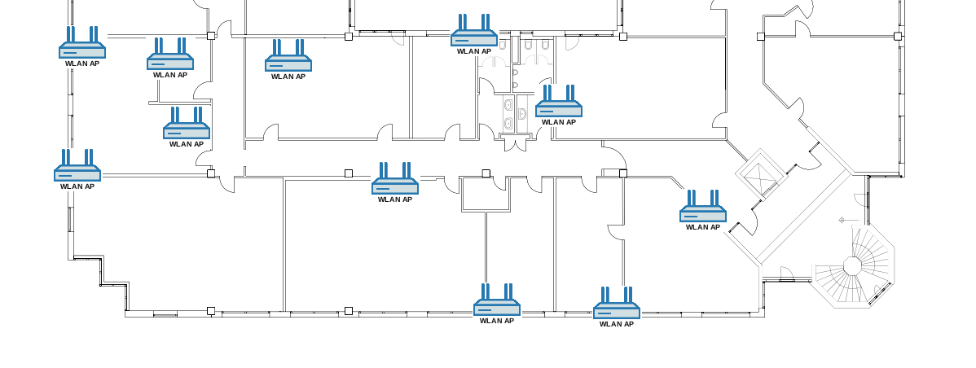
Testbed

Slide 26
Test Run Results: Error Rates

Slide 27
Finding Survival Paths

Slide 28
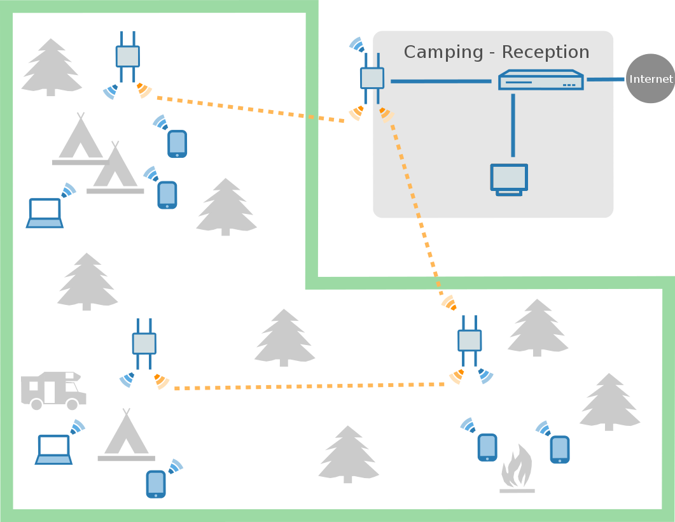
Example AutoWDS Deployment

Slide 29
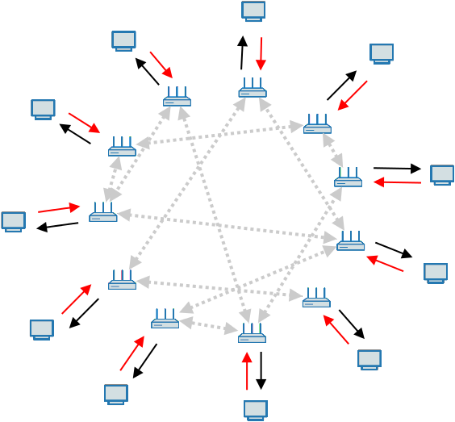
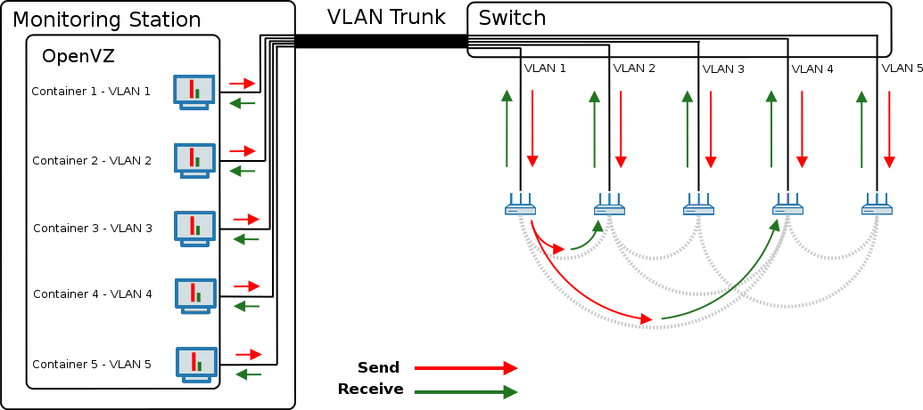
Testbed Setup

Slide 30
Network Topology: Before and After Optimization

