Slide 1
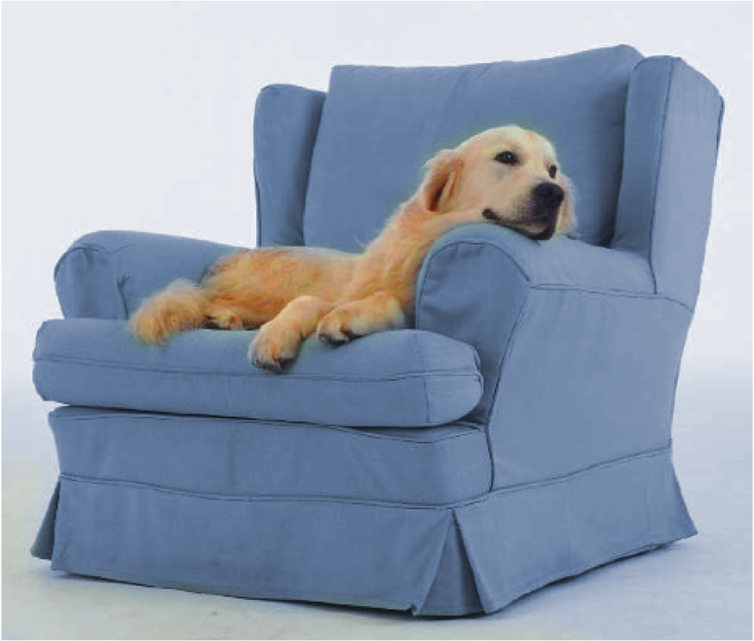
The Template
Slide Template by Tobias Heer
First Author, Co Authors
Please use the latest slide template.
Students: even if your supervisor gave you this file, ask if it really is the latest version!
Location / Event, March 2009

Slide 2
Title – Sky blue
You can copy the frame style with the brush tool.
An alternative title
Please use the latest slide template.
Students: even if your supervisor gave you this file, ask again for the latest version!
Location / Event, March 2009

Slide 3
The Template
Slide Template by Tobias Heer
First Author, Co Authors
This version contains the German version of the RWTH logo and should typically only be used for German talks!
Location / Event, March 2009

Slide 4
Title – Sky blue
You can copy the frame style with the brush tool.
An alternative title
This version contains the German version of the RWTH logo and should typically only be used for German talks!
Location / Event, March 2009

Slide 5
Note on Font Embedding
Why?
Large number of embedded font files
Good for a template: nobody can encounter ‘missing fonts’
Bad for you: annoying to work with
The Fix
Go to PowerPoint options, then Save options
Select Embed only the characters used in this presentation
This file is slow and huge!!!

Slide 6
Rules for DS Slides
Use only plain, un-animated slide transitions
Do not use special animation effects
Things should pop up „hard“
Things should not fly around, glitter, sparkle, beep, blink, etc.
Don‘t overload your slides with text
Use graphs and figures
Don‘t leave slides half empty – balance the content
Try to get a consistent look – re-use colors, shapes, etc.

Slide 7
Version History
V1: ????-??-?? Tobias Heer
V2: 2009-04-03 Tobias Heer
V3: 2009-10-20 Stefan Goetz
Fixed font inconsistencies
Higher-resolution logos
Consistent positions of graphic elements
More generic template texts
Notes on versions
V4: 2010-11-18 Stefan Goetz
Changed DS to ComSys logo and URLs
V5: 2011-06-14 Raimondas Sasnauskas
Changed the ComSys logo (logos/comsys/web/comsys-with-name-web.pdf)
Changed the headings font (Helvetica Neue) and it’s color (RGB: 0-66-144)
V6: 2012-01-27 Florian Schmidt
Added title page versions with English “RWTH Aachen University” logo

Slide 8

Shapes
Shape repository for presentations

Slide 9
Shapes
Shape repository for presentations

Slide 10
Colors and Shapes – Bevel
Bevel
Flat
Bevel
Flat
GSM
GSM
Bla
Bla
WiFi
WiFi
Blubb
Blubb
WiMax
WiMax
Bli
Bli
Blo
Blo
Gump
Gump

Slide 11
Arrow Styles

Slide 12
Your very important remark goes here
Your very important message goes here

Slide 13






Visio Devices

Slide 14
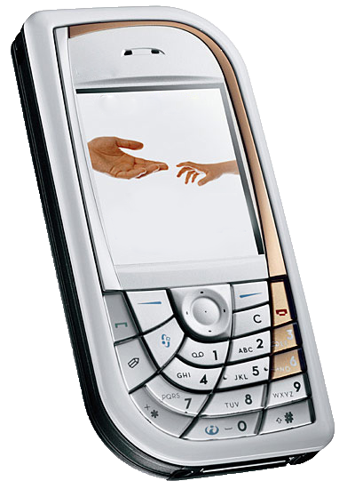
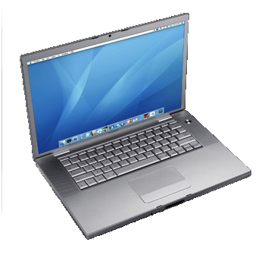
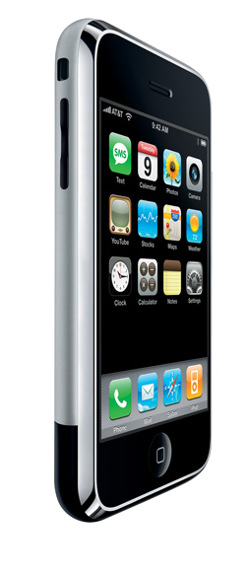
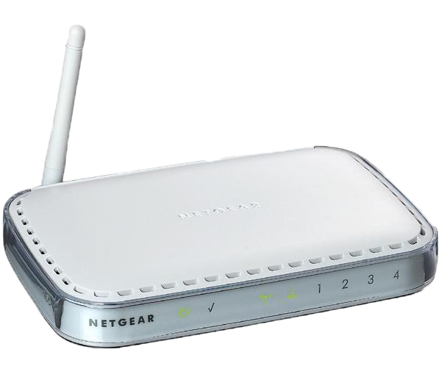
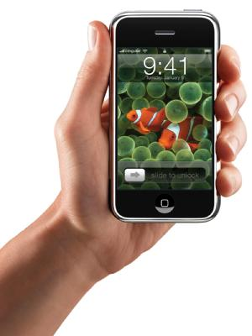
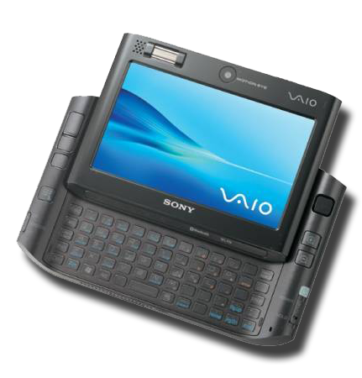
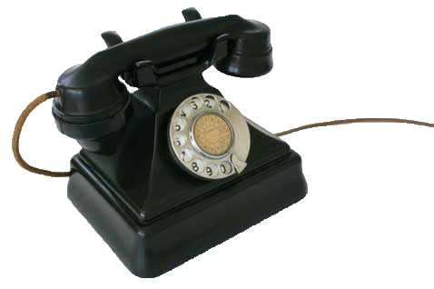
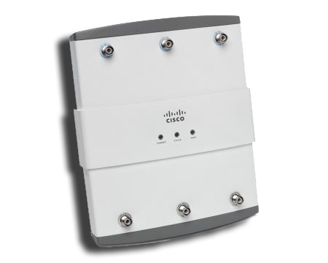
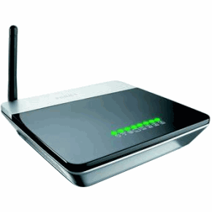
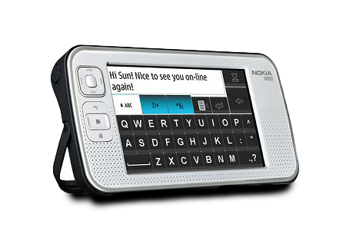
Devices

Slide 15




Misc

Slide 16





Logos

Slide 17
Integrity Protection - Delayed Key Disclosure
s
v
1.
m
M(h_{n-1}, m)
Key
2.
h_{n-1}
Temporal separation between 1. and 2.
Time synchronization / epochs (TESLA)
Interaction (Zero Common Knowledge, WIMP, Guy Fawkes)
Notes:
Animation + text mit klammer

Slide 18
Interactive Hash Chain Signatures in ALPHA
General hash-chain based signature model:
?
?
r₁
?
s
r₂
r₃
v
ALHPA model:
r₁
s
X
r₂
r₃
v
1. Path reservation
2. Verifier grants permission
3. Sender sends message m
X
X
X
Notes:
How can this work in multi-hop networks?
Ths is not useful.

