Slide 1
0
1
2
7
1
2
2
7
2
2
2
7
3
3
6
-
4
5
7
-
5
6
7
-
6
7
7
-
7
7
-
-
8
9
-
-
9
-
-
-

Slide 2
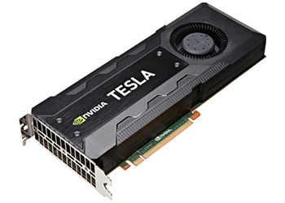










$$T_{0}$$
0
1
2
7
$$T_{1}$$
1
2
2
7
$$T_{2}$$
2
2
2
7
$$T_{3}$$
3
3
6
-
$$T_{4}$$
4
5
7
-
5
6
7
-
$$T_{5}$$
6
7
7
-
$$T_{6}$$
7
7
-
-
$$T_{7}$$
$$T_{8}$$
8
9
-
-
$$T_{9}$$
9
-
-
-

