Slide 1
Macro Benchmarking
Alexander Radchenko

Slide 2
Background
Game development for 15 years
System / 3d graphics programming and optimisation
Shipped 8 titles on various platforms
PS2, PS3, Xbox 360, Wii, iOS, Android, PC
1.5 years @ Optiver
Performance matters in both domains

Slide 3
Games
Soft realtime systems
Performance is important to certain extent
Normally run at 30 frames per second
Consistent load
Occasional spikes
Throughput is the king

Slide 4
Trading
Low latency request processing systems
Performance = Money
Most of the time system is doing nothing
Bursts
Latency is the king

Slide 5
Performance challenges in games
PC and mobiles
Fragmented HW
Game consoles
Fixed HW ☺
They are cheap for a reason ☹
Proprietary tools and devkits

Slide 6
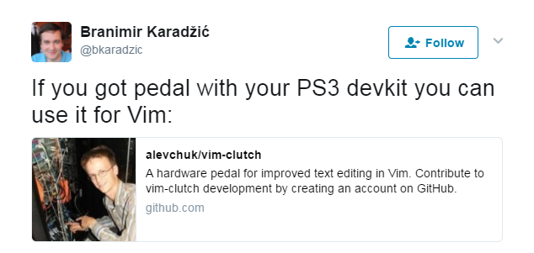
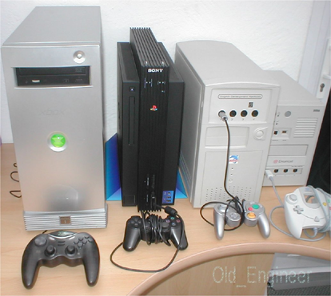
Performance challenges in games

Slide 7
Performance challenges in games
Game engine is being developed in parallel to the game itself
Performance “catch up”
Memory is a big concern
Memory budgets and tooling around it
Multiple weak CPUs

Slide 8

How games tackle performance
Reference game levels

Slide 9
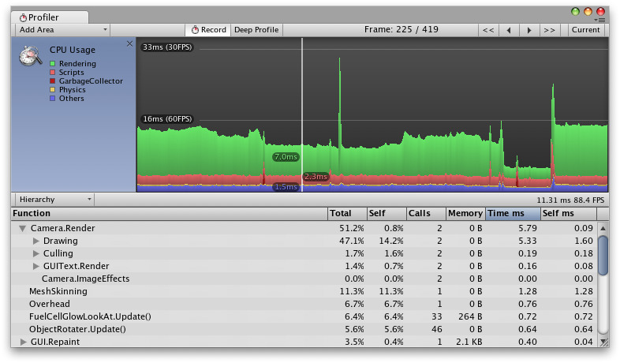
How games tackle performance
Custom profilers to analyze a whole session

Slide 10
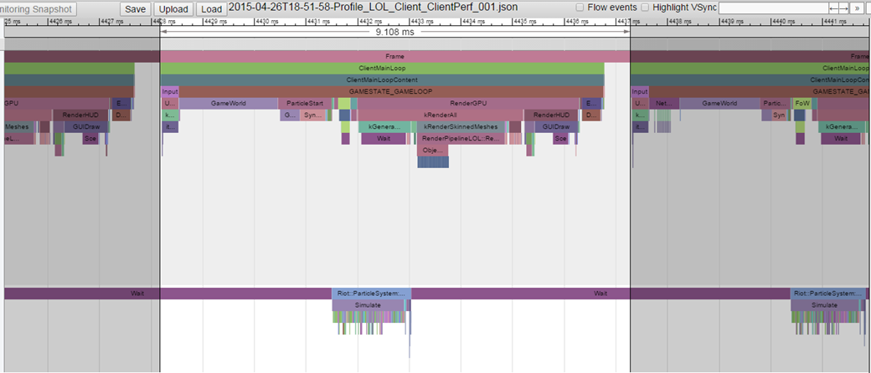
How games tackle performance
Custom profilers to analyze a single frame

Slide 11



How WoT tackled performance
World of Tanks
Online MMO shooter
Fragmented platform
Wide range of HW
Old laptops
High-end desktops
Everything in between

Slide 12
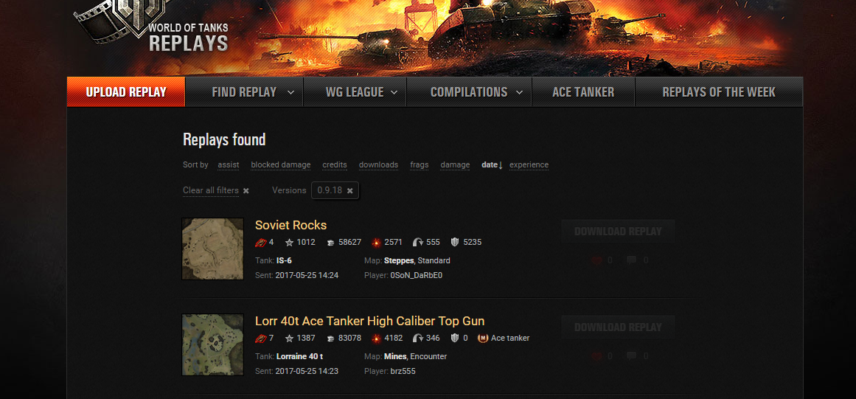
Replays
Recording incoming network traffic
Initially created to repro bugs
At some point released to the public

Slide 13
Replays
Useful tool for performance testing
Extremely useful as a bug repro tool
Compare different binaries or different content using the same replay
Very easy to use
In-house tools to drill down and identify problems

Slide 14
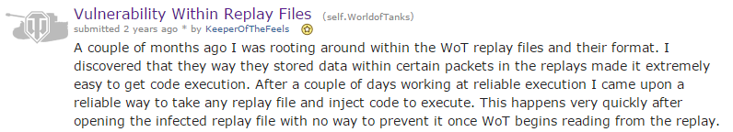
Replays: problems
Protocol upgrades
Game map changes may invalidate replay
Security

Slide 15
Regression testing
Categorize HW: low, medium, high, ultra
Run replays on a fixed set of HW
2s / 5s window averaged frame rate
QA won’t allow release with a performance drop outside of fixed threshold

Slide 16
Micro benchmarking
https://github.com/google/benchmark
Very easy to use
Single metric output
Highly recommend Chandler’s Carruth talk @ CppCon 2015 “Tuning C++…”

Slide 17
Macro benchmarking
TODo
Rehash content from wiki page
Make bunch of slides with perf analysis
Analyse clang vs gcc
Show how to move data to Jupiter

Slide 18
Overview
Won’t be talking about micro benchmarking
Perf, Vtune etc
Lots of materials available
Highly recommend Chandler’s Carruth talk @ CppCon 2015 “Tuning C++…”

Slide 19
HFT
Dedicated high end Linux HW
Speedlab environment to test performance
Lightweight tracing in speedlab and prod
Using time series DB to store captured data

Slide 20
Overview
Will talk about lightweight tracing
Understanding application performance
Visualising and recognising patterns

Slide 21
Low Latency Fizzbuzz
https://github.com/phejet/CppMeetupDemo
C++ server which reads input data
Outputs Fizz, Buzz, FizzBuzz or just a number
How to make it fast ?
Measure first !!!

Slide 22
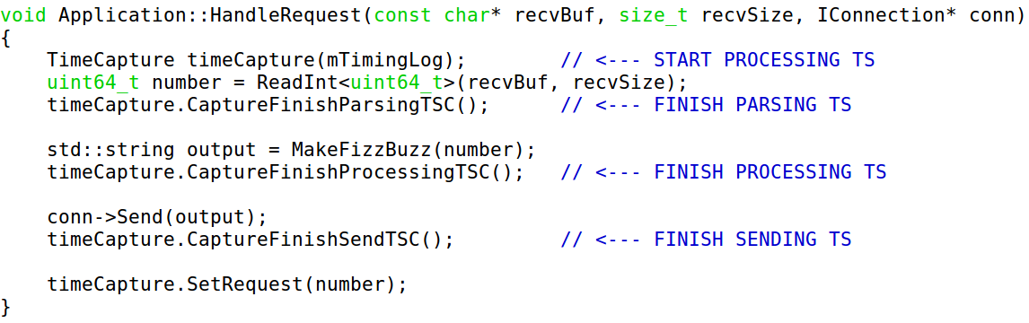
Request processing

Slide 23
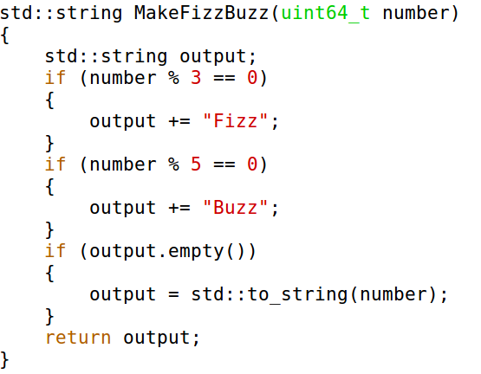
Fizzbuzz

Slide 24
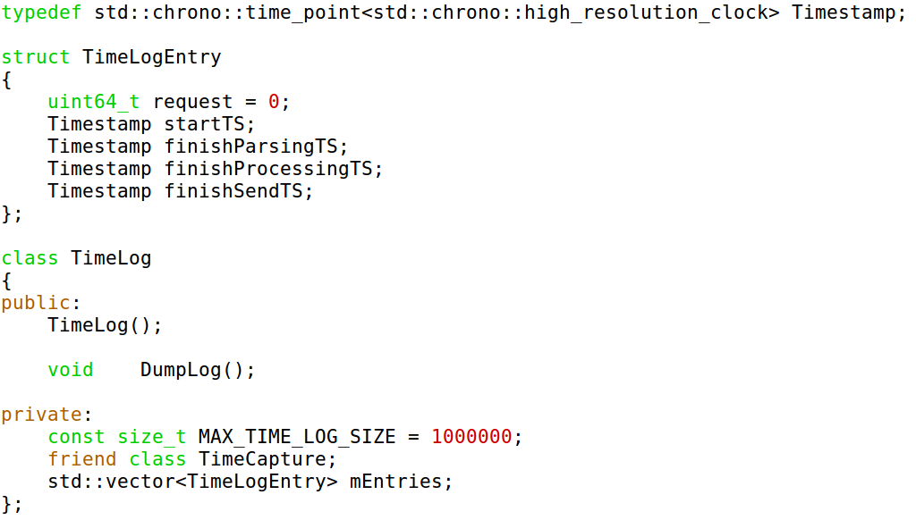
Timing

Slide 25
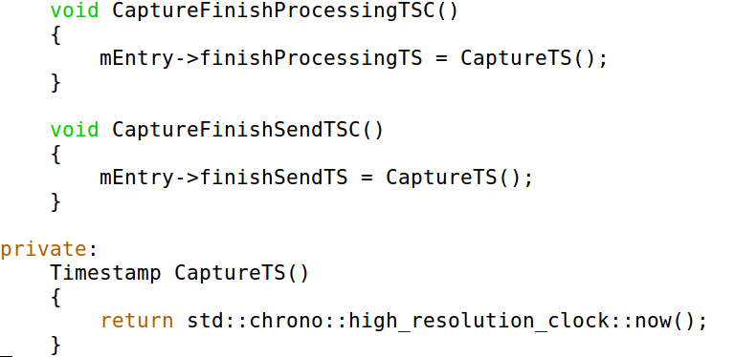
Timing

Slide 26
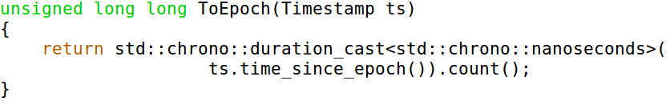
Using Epoch

Slide 27
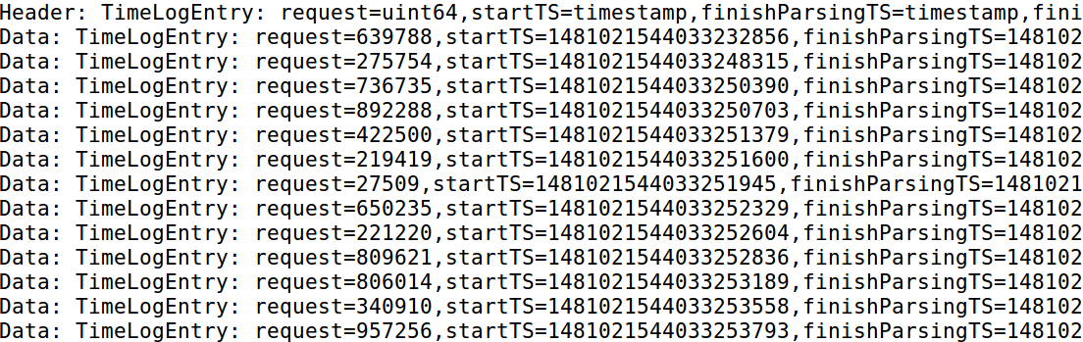
Timings output

Slide 28
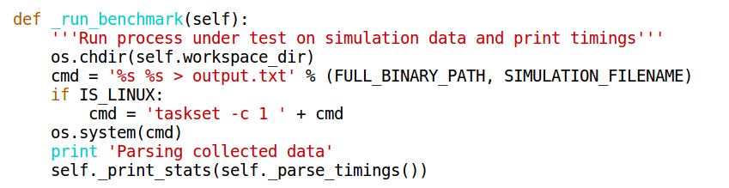
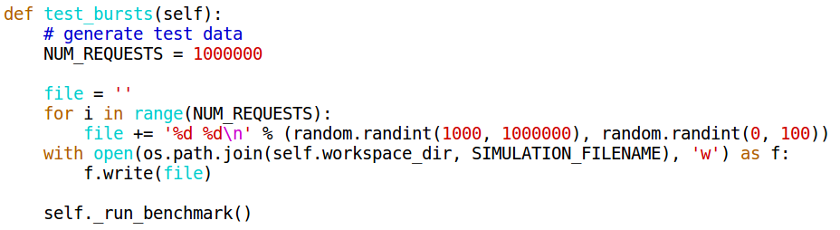
Macro benchmark

Slide 29
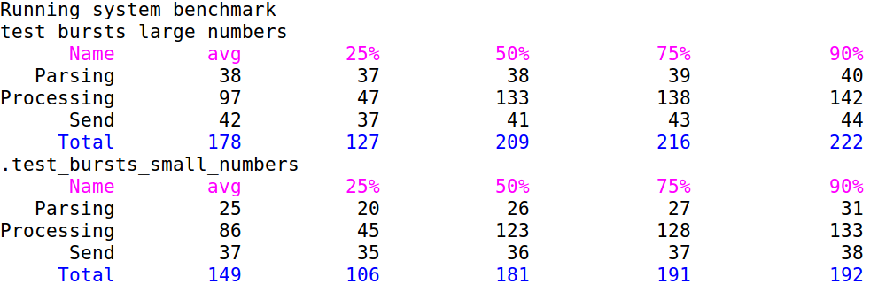
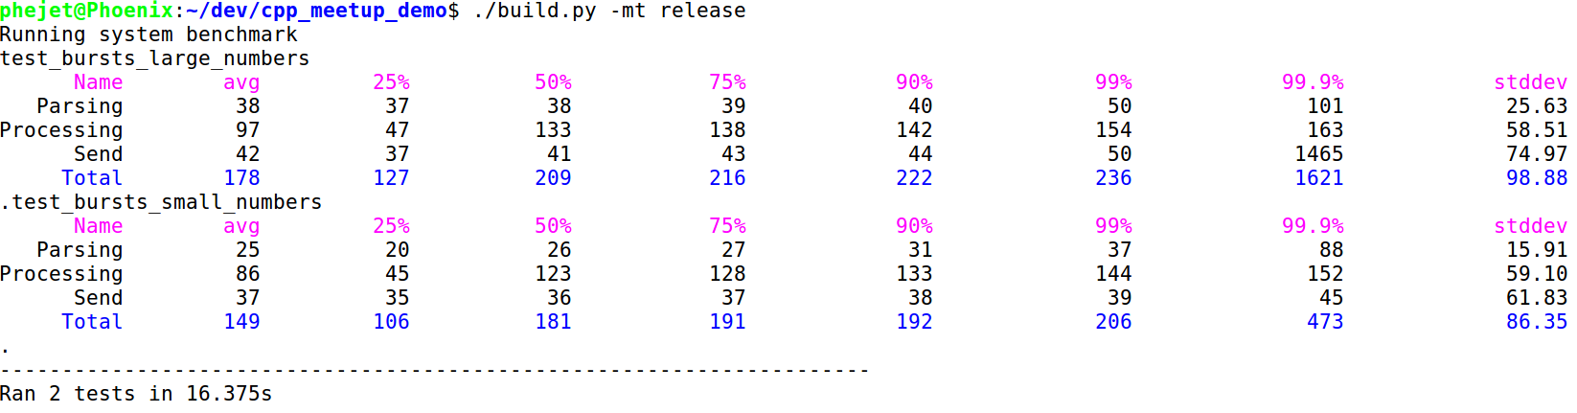
Quick feedback

Slide 30
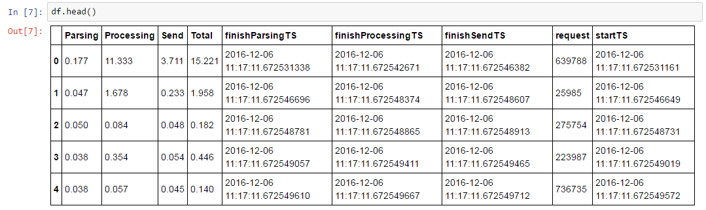
Jupiter notebook for in-depth analysis

Slide 31
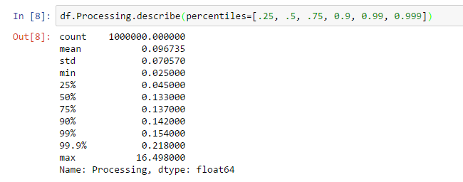
Jupiter notebook for in-depth analysis

Slide 32
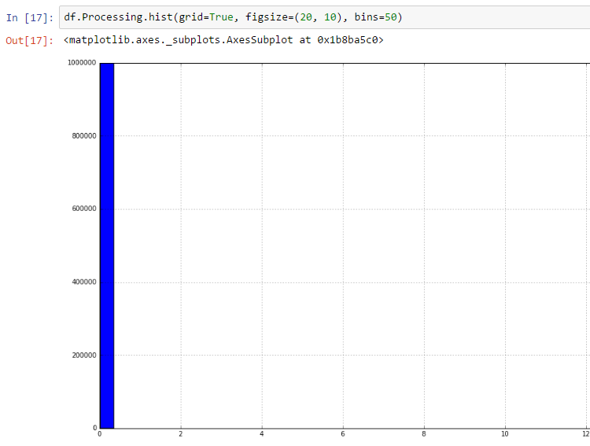
Jupiter notebook for in-depth analysis

Slide 33
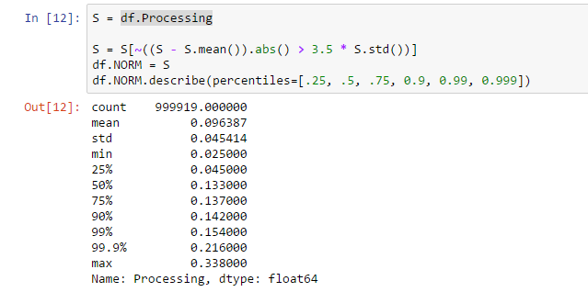
Jupiter notebook for in-depth analysis

Slide 34
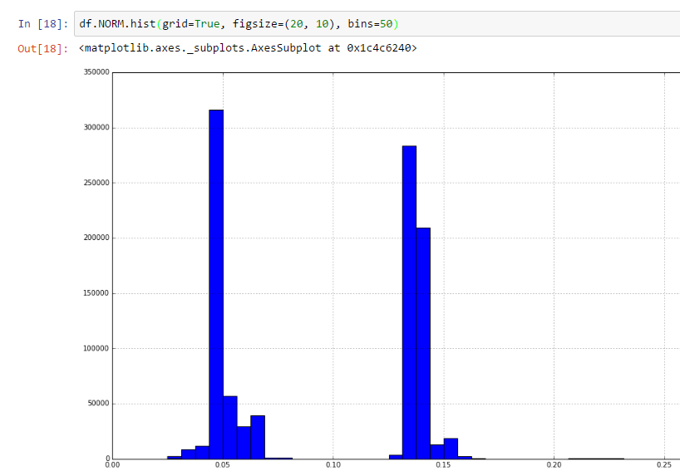
Jupiter notebook for in-depth analysis

Slide 35
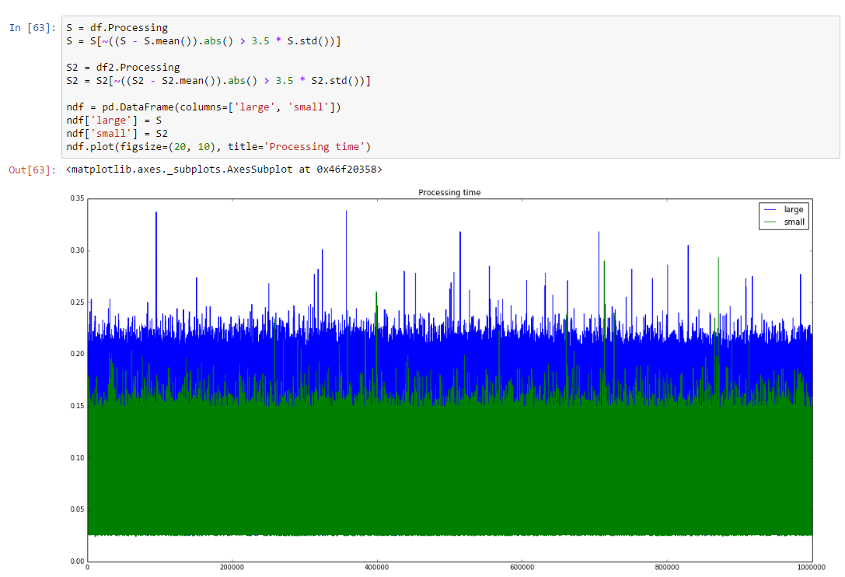
Jupiter notebook for in-depth analysis

Slide 36
Conclusion
Having a simple and reproducible way to measure performance is very important
Visualising performance data helps to understand it
Understanding is a necessary first step before optimisation

