Slide 1

Controlling Transient Lifetimes in Magnetic Nanoparticles
Matthew Phelps, Robert Camley, Karen Livesey
Department of Physics
University of Colorado Colorado Springs

Slide 2
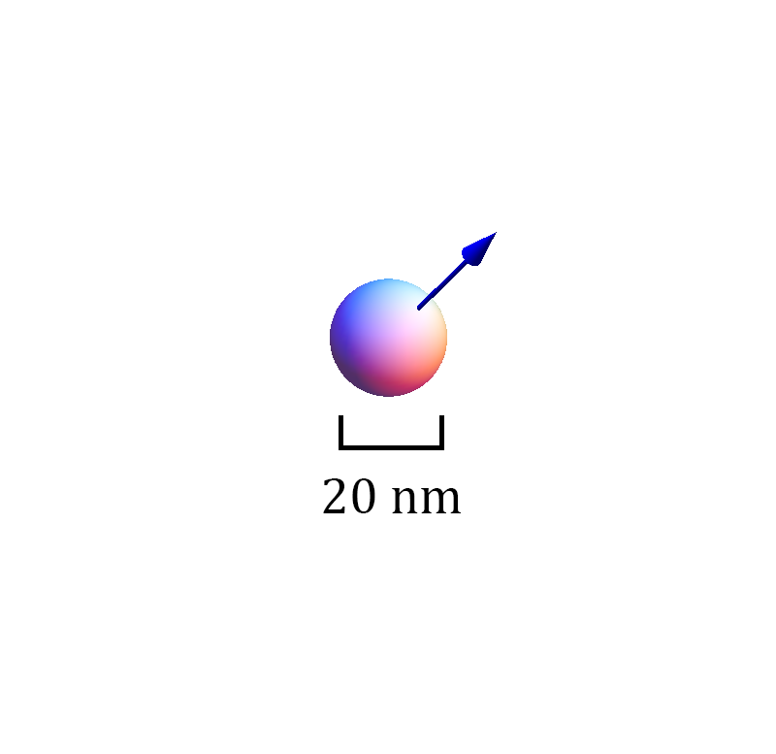
The Magnetic Nanoparticle

Slide 3
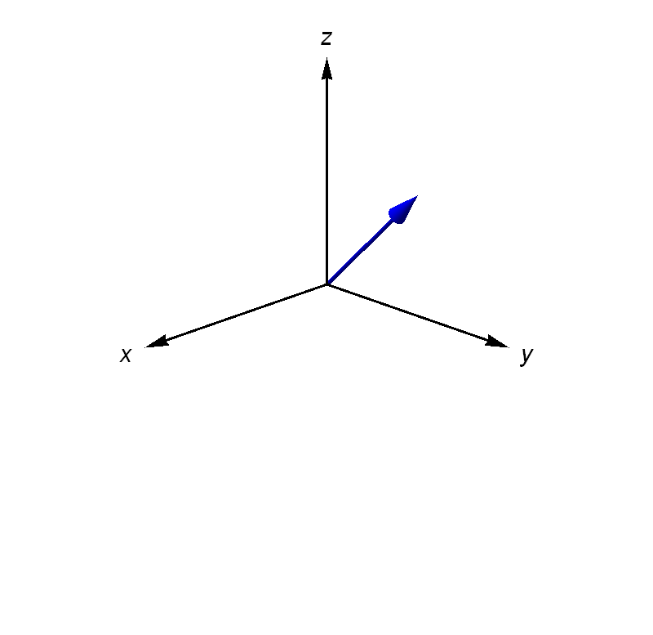
Magnetization Vector

Slide 4
Equations of Motion
(1)

Slide 5
Equations of Motion
(1)
magnetic torque
magnetic damping

Slide 6
Equations of Motion
(1)
magnetic torque
magnetic damping
Magnetic field H given by
(2)
static field
driving field

Slide 7
Equations of Motion
(1)
magnetic torque
magnetic damping
Magnetic field H given by
(2)
static field
driving field
Solved numerically by 2nd order Runge-Kutta Method
Equations of Motion

Slide 8
Magnetization Vector

Slide 9
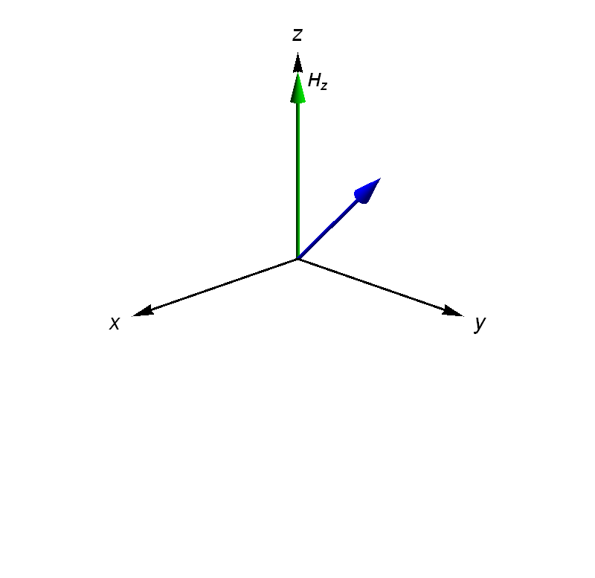
H_{z}=100 Oe

Slide 10
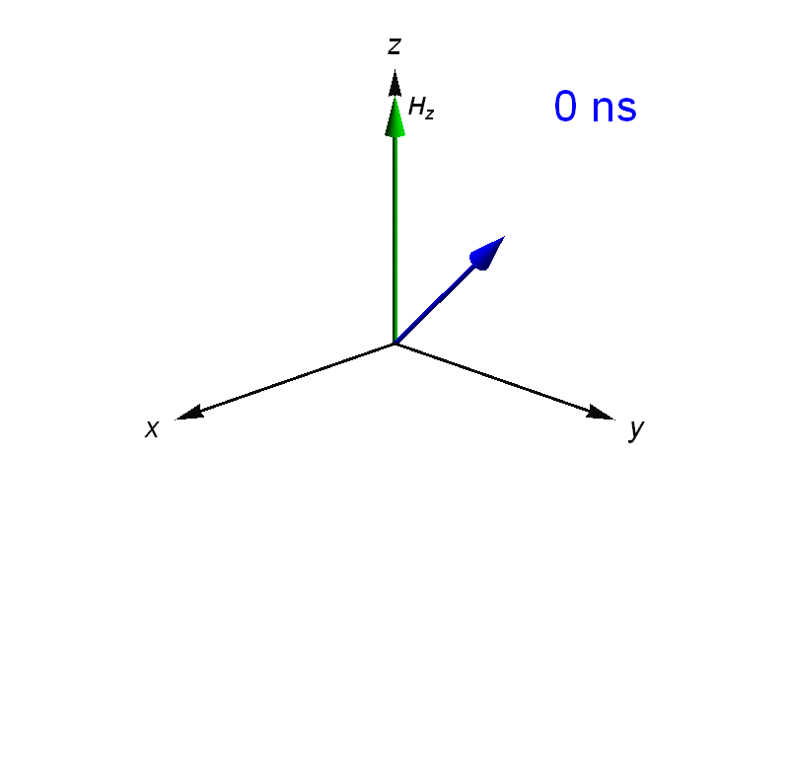
H_{z}=100 Oe

Slide 11
Motion of
Over Time

Slide 12
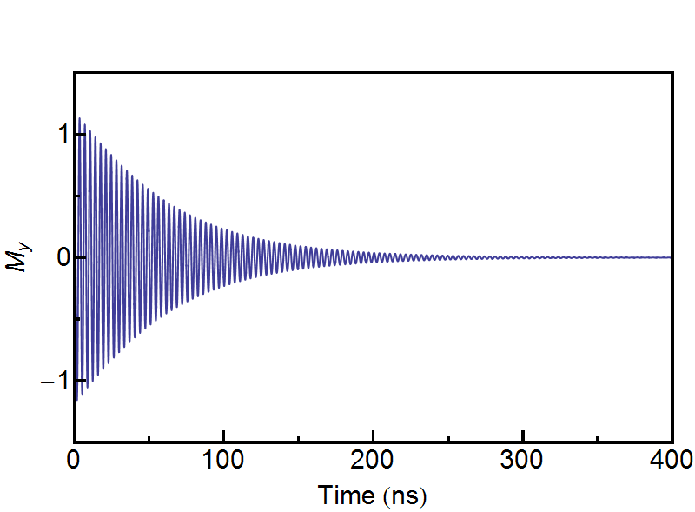
Motion of
Over Time

Slide 13
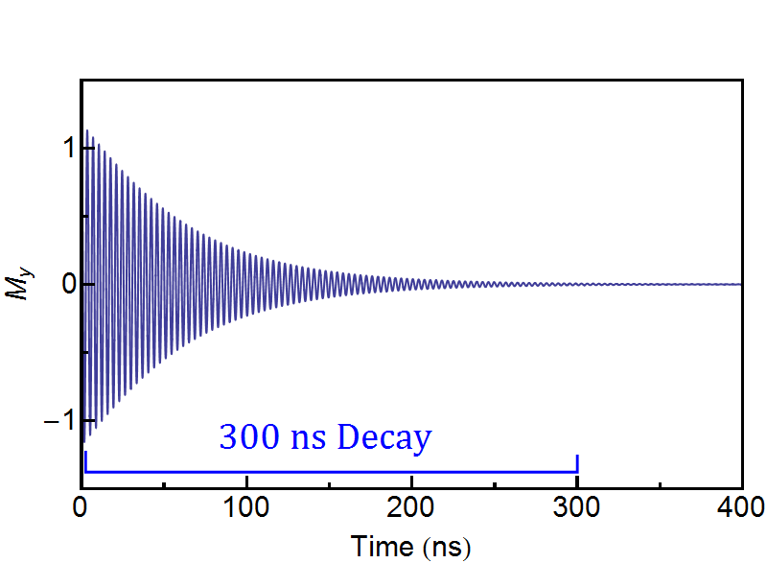
Motion of
Over Time

Slide 14
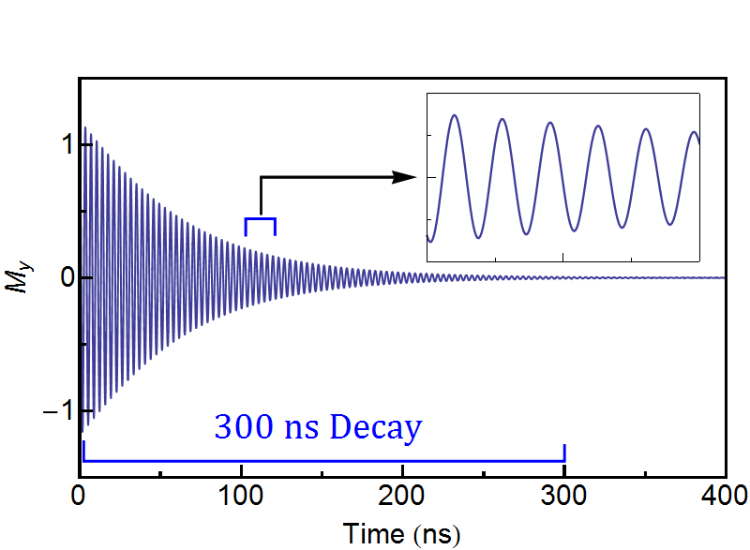
Motion of
Over Time

Slide 15
How do we analyze this motion?

Slide 16
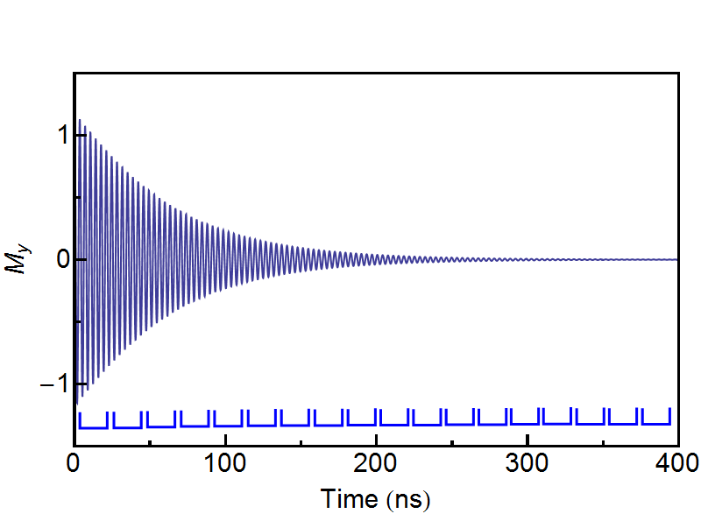
How do we analyze this motion?

Slide 17
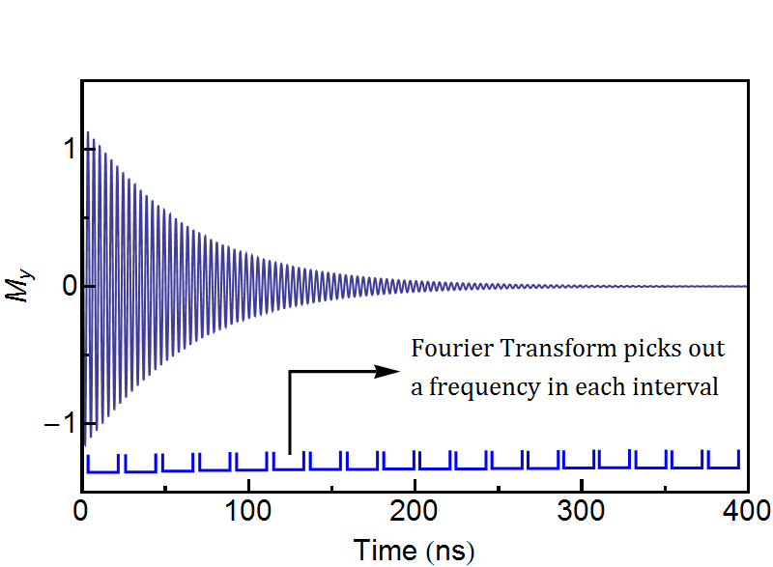
Apply Fourier Transform

Slide 18
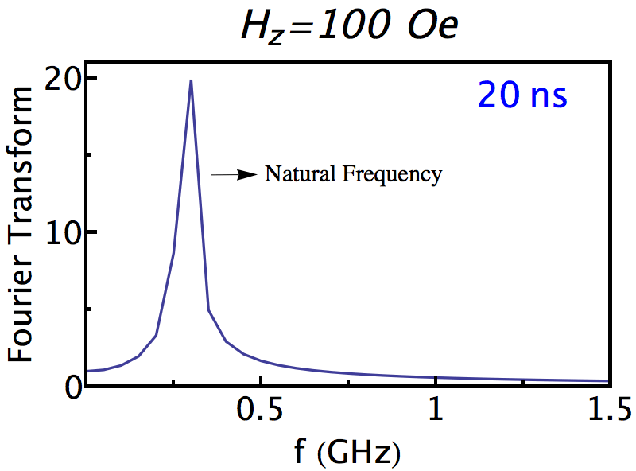

Slide 19


Slide 20
H_{z}=100 Oe
300 ns Decay Time
Natural Frequency Decayed
Lines up with H_{z}

Slide 21
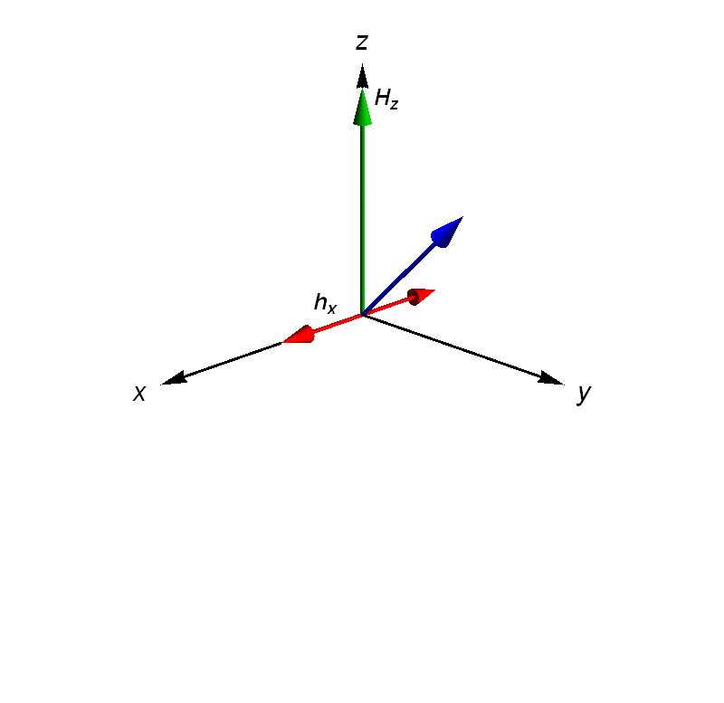
Lets add a driving field, h_{x}=100 Oe

Slide 22
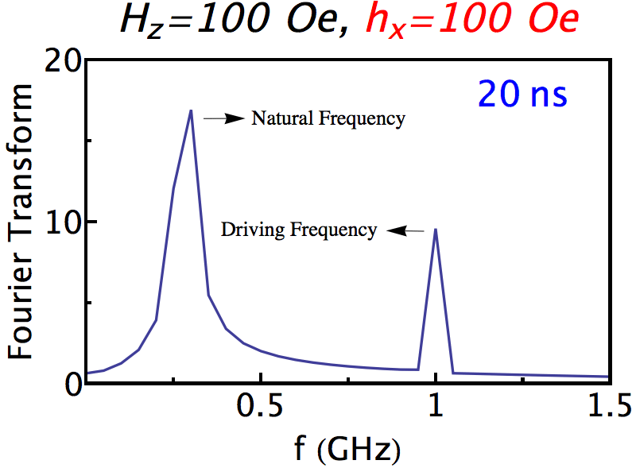

Slide 23


Slide 24
What if we change the strength of the driving field, h_{x}?

Slide 25
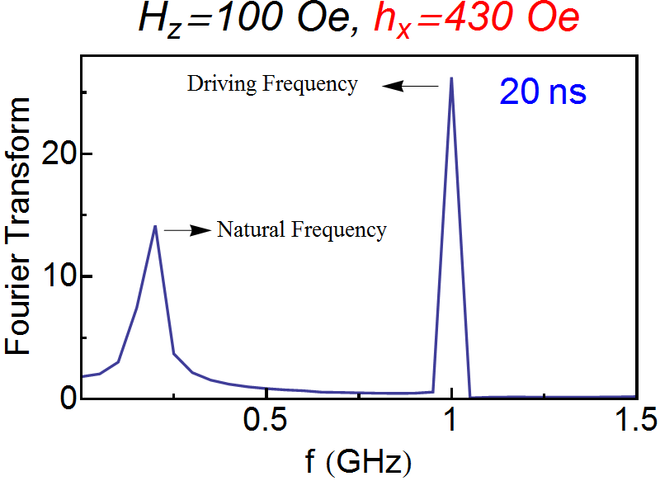

Slide 26


Slide 27
Where was the decay?
Lets plot the decay time of the natural frequency for different strengths of the driving field, hx

Slide 28
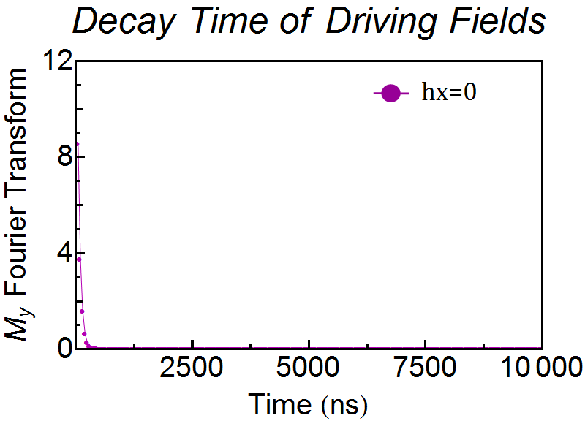

Slide 29
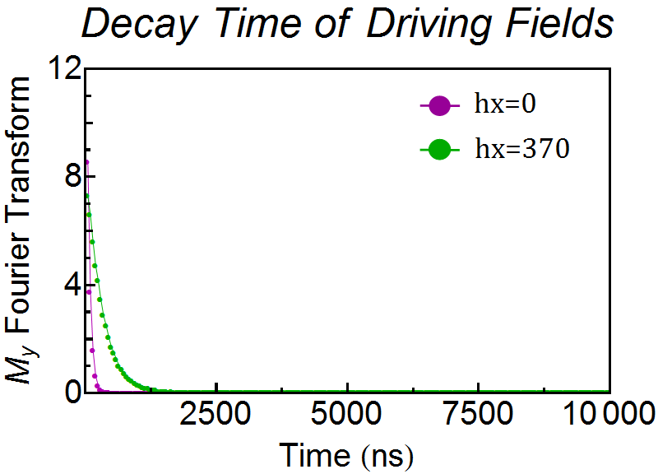

Slide 30
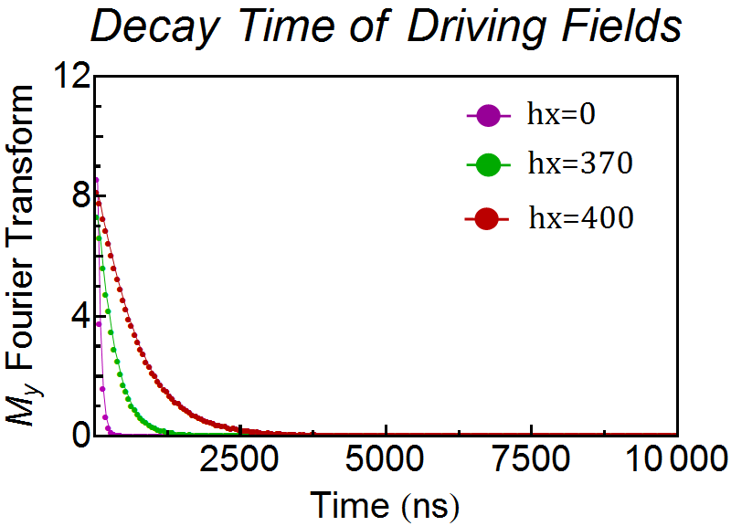

Slide 31
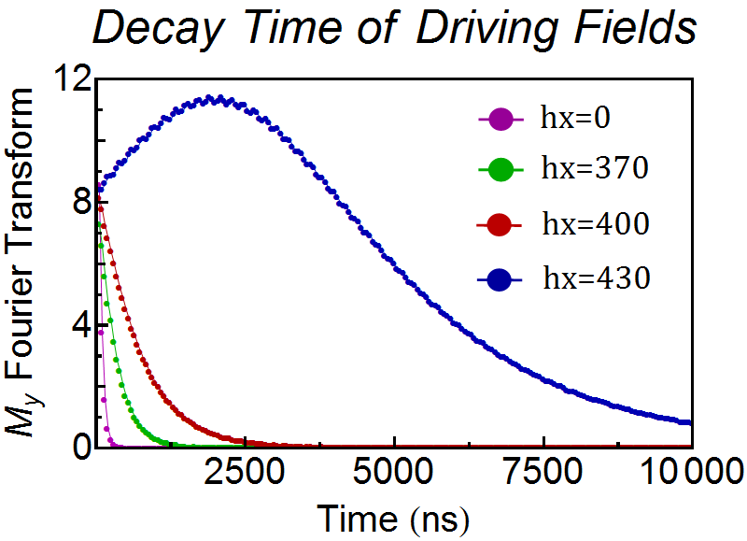

Slide 32
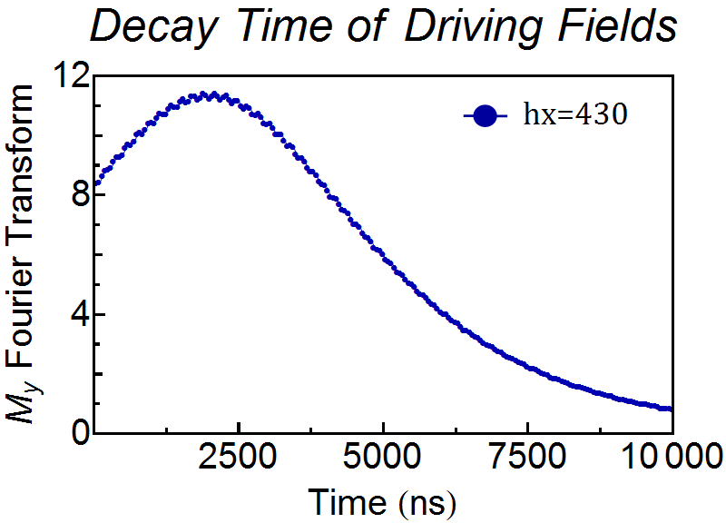

Slide 33
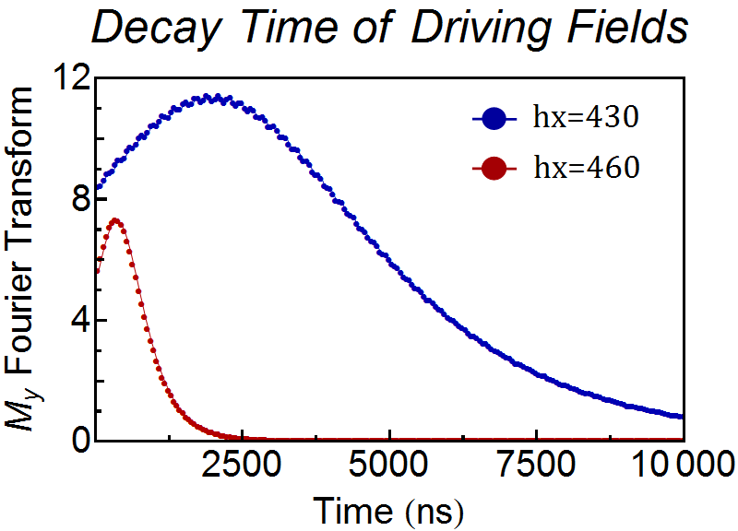

Slide 34
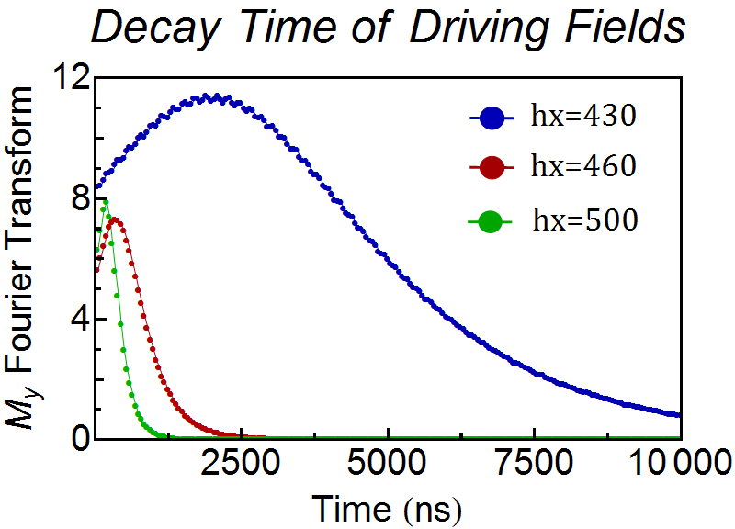

Slide 35
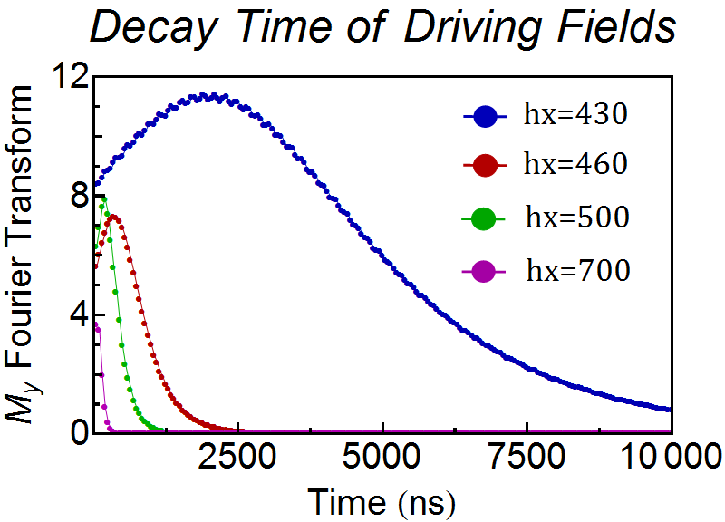

Slide 36
Overview
H_{z}=100 Oe, h_{x}=0 Oe
300 ns Decay

Slide 37
Overview
H_{z}=100 Oe, h_{x}=0 Oe
H_{z}=100 Oe, h_{x}=100 Oe
300 ns Decay
300 ns Decay

Slide 38
Overview
H_{z}=100 Oe, h_{x}=0 Oe
H_{z}=100 Oe, h_{x}=100 Oe
H_{z}=100 Oe, h_{x}=430 Oe
300 ns Decay
300 ns Decay
> 10,000 ns Decay

Slide 39
Overview
H_{z}=100 Oe, h_{x}=0 Oe
H_{z}=100 Oe, h_{x}=100 Oe
H_{z}=100 Oe, h_{x}=430 Oe
300 ns Decay
300 ns Decay
> 10,000 ns Decay
We can effectively control the decay time by choosing the strength of h_{x}!

Slide 40
Applications
Asdf
Adsf
Safd
Sadf
Safd

Slide 41
Acknowledgements
Supported by UCCS LAS Faculty Student Research Grant

