Slide 1
Lab 4 Centripetal Acceralation and Kepler’s Laws
2/16/18
Group Members:
Alpha
Beta
Gamma

Slide 2
Objectives
Explore circular orbits through centripetal acceleration and gravitational forces
Relation between period and radius of orbit
Generalize to elliptical orbits
Use Kepler’s laws to infer the mass of a black hole using observational data of SgrA*
Compare with mass of star and luminosity of orbit region
Calculate escape velocity for particular masses and radii

Slide 3
Theory

Slide 4
Circular Orbit
Using centripetal acceleration equation and the gravitational force equation, calculate the speed at which the Earth orbits the sun (assuming a circular orbit). State below. You may assume the following:
Try using Mathematica to do your calculations.

Slide 5
Circular Orbit
Using , derive the
proportionality relation between T and r. State below (you may simply type out the expression, such as
T^2 = …

Slide 6
Ellipses
Circular orbits are a special case of the more general elliptical orbit
Ellipses have a semi-major axis a, a semi-minor axis b, and two focal points
b
Focal Point
a

Slide 7
Elliptical Orbit
For the more general elliptical orbit, we may replace r by a, the semi major axis and M by (m+M). The relationship between period and semi-major axis now reads

Slide 8
Elliptical Orbit
Given the equation below, what form does it take when ?

Slide 9
Kepler’s Laws
Planets travel in elliptical orbits with the Sun at one of the two foci
A line joining a planet and the Sun sweeps out equal areas in equal time
The period squared is proportional to the semi-major axis cubed

Slide 10
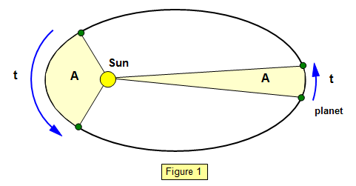
Kepler’s Second Law
The second law states: A line joining a planet and the Sun sweeps out equal areas in equal time.
This may be formulated as

Slide 11

Kepler’s Second Law
Given this picture, imagine we wanted to calculate the area swept out. We could approximate each area as a triangle (see fig. below)

Slide 12
Kepler’s Second Law
One triangle makes a much better approximation to the actual area than the other. Does the triangular approximation work better for shorter time intervals or longer time intervals? Why?

Slide 13
Kepler’s Second Law
If we know we can figure out what the
period of the elliptical orbit is. To see this, first let’s take the limit as becomes
differentially small, and then integrate
Under one full period it follow then that

Slide 14
Kepler’s Second Law
Since this constant is equal to
it then follows that
If we know and the area of the ellipse
then we can find the period

Slide 15
Kepler’s Second Law
The area of the ellipse is given as
Thus
You will need this result later.

Slide 16
Procedure
In the Mathematica notebook we have a collection of data that measured the orbital motion of a star traveling around a black hole.
Our task is to use this orbital data to determine what the mass of the black hole is.
How might we do this? Consider the equation below.
If we can determine a and T, then we will be able to solve for the total mass m+M
Go ahead and begin working on the Mathematica notebook at this time, to determine a and T.

Slide 17
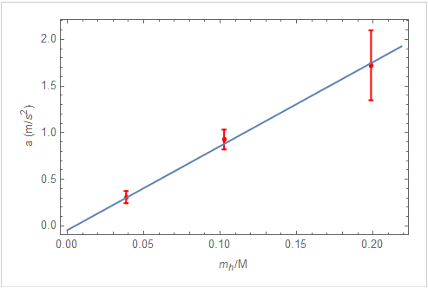
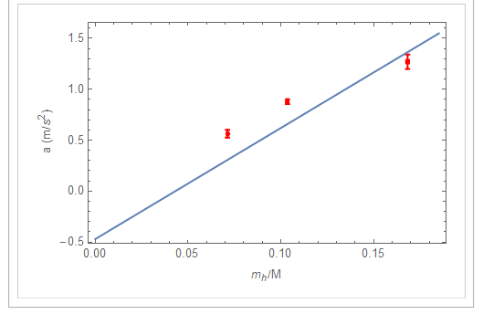
Fitting Data
Goal is to minimize the distance between each experimental data point and the fit function.
This may mean that not every data point touches the fit function.
Note the examples below from last lab
Good
Bad

Slide 18
Elliptical Fit
Paste a plot of your data and elliptical fit below

Slide 19
Elliptical Fit
Comment on the quality of the fit to your data.

Slide 20
dA/dt Fit
Paste the graph of dA/dt including the best fit line
Use the shape tool to encircle the points that represent good approximations to the area dA. Justify why these points make better approximations to the area than others.

Slide 22
Determining the Parameters
State the value of a found from the elliptical fit below:
State the value of dA/dt (with units) below from the slope m in Mathematica:

Slide 23
Determining the Parameters
Using a, b, and dA/dT, calculate the period, state below. In order to arrive at the correct units, we note that for our star in the Saggatarius one arcsec corresponds to 41 light days (the distance light would travel in 41 days). Be careful with units.

Slide 24
Calculating the Mass
Now that we have a and T, calculate the total mass M+m
Given the mass of the sun (stated earlier in PPT), calculate the number of ‘sunlike’ stars that would be contained in the total mass M+m
Stars have masses that range from 0.08 to 120 solar masses. Given this information, how does the mass of a typical star compare to the total mass M+m ? Are we then justified in taking M>>m ?

Slide 25
Calculating the Mass
We have determined the mass of the object of which the star is orbiting, but how do we know it is specifically a black hole? Maybe is just a cluster of stars? Turns out astronomers have determined that the amount of light coming from the ‘black hole’ area is significantly less than the amount of light in the surrounding the region. If the ‘black hole’ region were composed of a cluster of stars, the luminosity would have to be extremely large. Thus it is fair to assume that the mass that our star orbits and is gravitationally attracted to is due to a black hole.

Slide 26
Escape Velocity
The escape velocity is defined as the speed needed to escape the gravitational attraction of a planet (or any object, like a black hole)
It is defined as the velocity by which the kinetic energy is equal and opposite to the gravitational potential energy (sum cancels)
Given that the gravitational potential energy is
derive a formula that expresses the escape velocity as a function of G, M, and r.

Slide 27
Escape Velocity
Compute the escape velocity in (m/s) of the Earth using Earth’s mass and its radius (Google these quantities)

Slide 28
Escape Velocity
Now compute the escape velocity of the Earth if the Earth’s radius was only 0.5 cm

Slide 29
Escape Velocity
Compute the escape velocity of the Earth if the mass of the Earth was 2200 times the mass of the sun

Slide 30
Escape Velocity
Take your mass (or one of your partners) and compute the radius necessary such that the escape velocity is the speed of light c. This is the radius you would have to squeeze yourself down to transform yourself into a black hole!
Compare this to the radius of a typical atom

Slide 31
Conclusion
Summarize this lab. What was the objective? What did you find?

Slide 32
Upload the .ppt and .nb files to HuskyCT
You may think brighter stars must be closer, but this is not necessarily true.

Slide 33




Slide 34
Kepler’s Second Law
Given this picture, imagine we wanted to calculate the area swept out. We could approximate each area as a triangle (see fig. below)

Slide 35


Focal Point

