Slide 1
The Many Face of Microbial Communities
Thomas Albertine, Michael Phelps

Slide 2
The Problem
Microbiologists need a way to find differences and similarities between microbial samples
Current methods may not be very optimal
Humans are not meant to look at dozens of pie charts

Slide 3
Our Solution
New way of visualizing microbial communities
Easier to see patterns at a glance
Intuitive workflow
Potentially allow for new scientific discoveries

Slide 4
Standard Use Case
Scientist collects microbial samples
Puts data into file along with meta-data file
Runs FaceView software and loads files in loading interface
Select associations between speicies and feature
Manage groups in thumbnail interface
Analyzes faces in the analysis interface

Slide 5




Resources

Slide 6
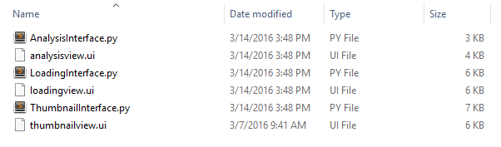
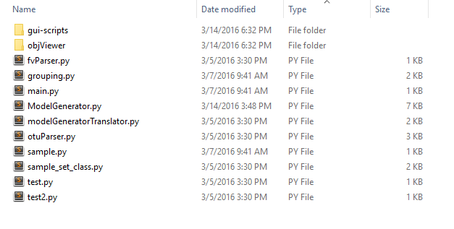
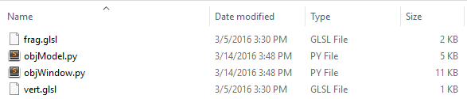
File Structure
./code/gui-scripts
./code
./code/objViewer

Slide 7
Challenges
Decypering the MakeHuman code
Using OpenGl in Python
Problems wih PyQt

Slide 8
User Study
5 OSU students of different backgrounds
Implemented suggestions for change
Fix a bug that prevented all selected models to be analyzed
Change highlighting colors in the thumbnail interface
Add ability to go back to previous views
Change names for model parameters

Slide 9
The End

