Slide 1
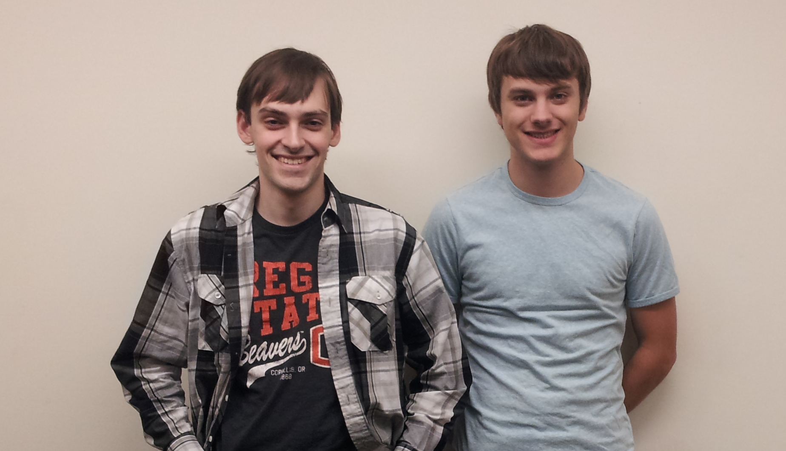


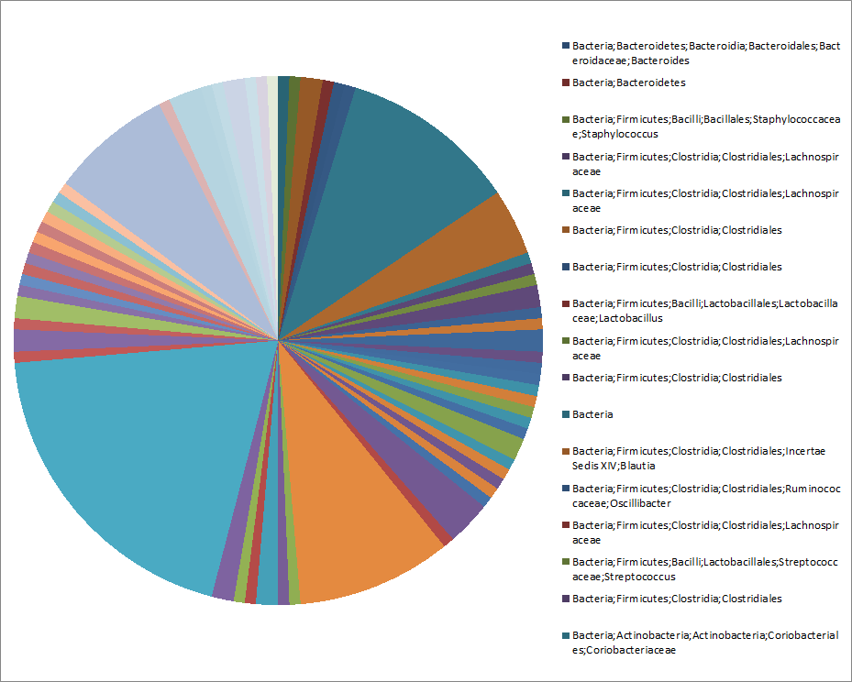
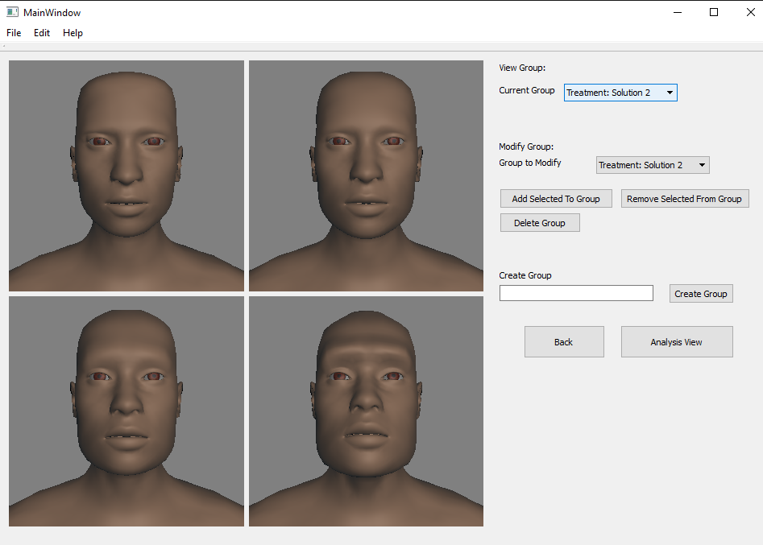


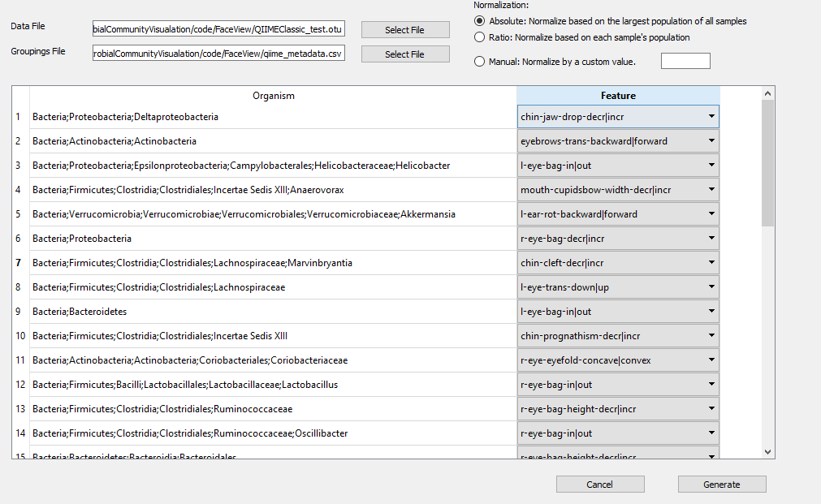
MICROBIAL FACIAL VISUALIZATIONS
Approach Taken
Using the open source software MakeHuman, we can generate various faces based on numerical parameters.
Load supported file formats (QIIME OTU)
Convert file format to parameters for MakeHuman API
Generate models as Wavefront .obj files
Present models to user using Qt UI framework
PROJECT TEAM #36
The Many Faces of Microbial Communities
Team Photo
Problem Description
Current visualization technologies for population data is unintuitive when attempting to find patterns between samples.
Makes scientists jobs more difficult
Bar charts and pie charts do not lend themselves to easy comparison for large data sets
Proposed Solution
The human brain has a special section just for recognizing faces
We can harness this by generating faces that represent sample data
This allows scientists to find patterns by recognizing them in facial features
This could potentially open up breakthroughs in microbiology
TEAM MEMBERS
Thomas Albertine
albertit@oregonstate.edu
Michael Phelps
phelpsmi@oregonstate.edu
PROJECT ADVISOR
Kevin McGrath
dmcgrath@oregonstate.edu
Nels Oscar
oscarn@oregonstate.edu
PROJECT SPONSOR
Dr. Jenna Lang
jennomics@gmail.com
Picture of Generated Models
Results and Recommendations
Our tool can read the data file, and create a visualization representative of that data.
That visualization is in the form of a face.
We recommend research into additional ways to visualize large, complex data sets like the population data we were provided.
Logos of software used in project
Technologies Used
MakeHuman (open source 3D model generation software)
Python 2.6 (general purpose programming language)
Qt (cross platform gui toolkit)
Wavefront .obj (geometry definition file format)
A bar chart of sample microbial data
Models generated from sample microbial data
Features
Additional features have been included to allow for easy use and optimal model generation.
Model generation parameterization
Sample grouping based on metadata
QIIME OTU format support
Rotate, pan, and zoom around models
Screenshot of configuration process
Selection and grouping tools for larger data sets

