Slide 1
The Many Face of Microbial Communities
Thomas Albertine, Michael Phelps

Slide 2
Our Purpose
New way of visualizing microbial communities
Easier to see patterns at a glance
Intuitive workflow
Potentially allow for new scientific discoveries

Slide 3



Resources

Slide 4
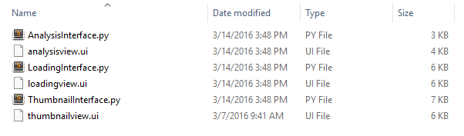
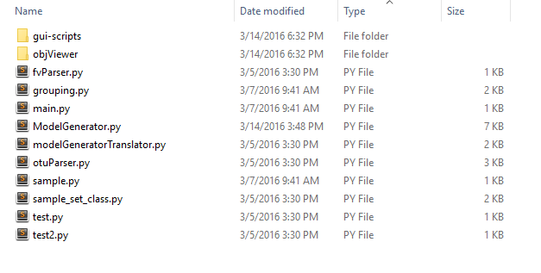
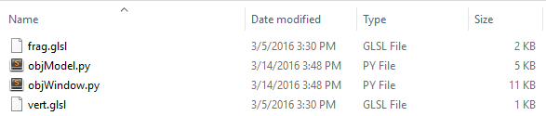
File Structure
./code/gui-scripts
./code
./code/objViewer

Slide 5
The End

