Slide 1
ILA SAW Figures
Edwin Arkel Rios

Slide 2
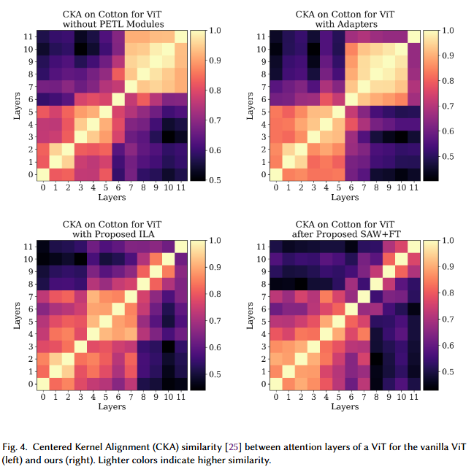
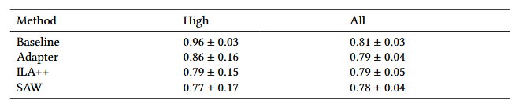
CKA
Original only included ViT (FZ) and Ours (ILA), added adapter to show the problem is pervasive even with PETL but how our method effectively solves the problem
Also, computed CKA across a "level" of features (1-4, 4-8, 8-12) to quantiatively express the CKA similarity issue

Slide 3
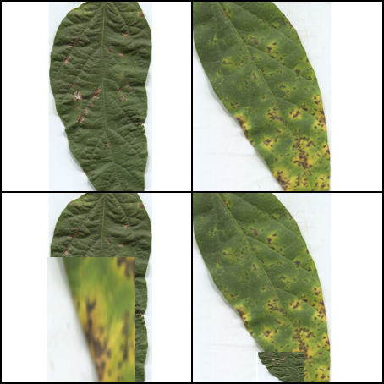

Slide 4
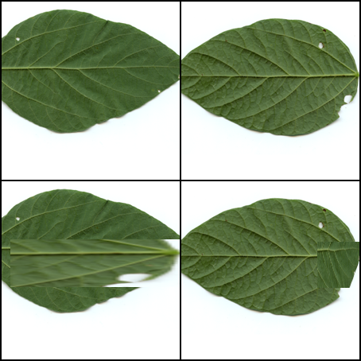

Slide 5
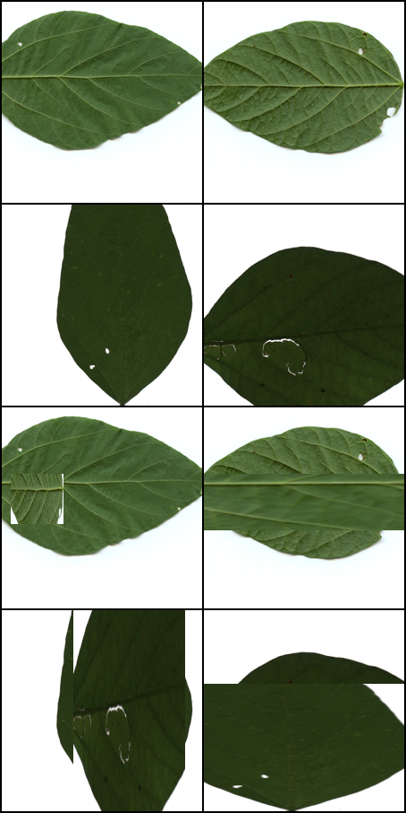

Slide 8





CLS
CLS
CLS
🔥
CLS
❄️
Notes:
soygene
GDC008-1-001_1_train.png
R6
yd064_R6_4_train.png
yd054, yd061, yd064 look very similar

Slide 9
Image A
Image B
Image A-B
Image B-A

Slide 10
Image A
Image B
Image A-B
Image B-A

Slide 11


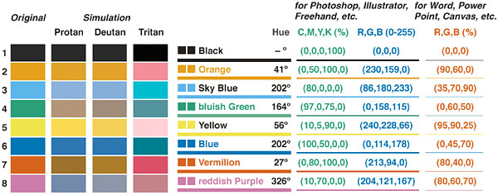
Legend:
Trainable 🔥
Frozen ❄️
Feature Extractor Backbone
Positives
Negatives
Feature Maps
Projector MLP
Representations
KD Loss
with ILA
Attention Maps

Slide 12
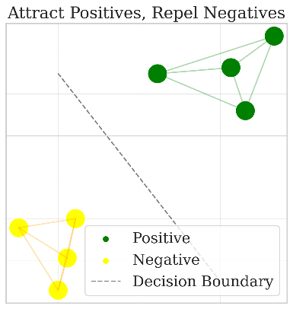
Self-Supervised Adaptation Warmup (SAW) with Dual-Attention-guided Mix Augmented SupCon (DAMAS)
Legend:
Trainable 🔥
Dual-Attention Rollout
Vision Transformer Stage 1
Vision Transformer Stage 1
Frozen ❄️
Down-Sampling ILA
Down-Sampling ILA
Positives
Attention Maps
Vision Transformer Stage 2
Vision Transformer Stage 2
Negatives
Down-Sampling ILA
Down-Sampling ILA
Vision Transformer Stage 3
Vision Transformer Stage 3
Output Features
Output Features
Global-Average Pooling
Global-Average Pooling
Projector MLP
Projector MLP
Representations
SupCon Loss
Representations
Notes:
Show the dual-attention

Slide 13
Self-Supervised Adaptation Warmup (SAW) with Dual-Attention-guided Mix Augmented SupCon (DAMAS)
Dual-Attention Rollout
Vision Transformer Stage 1
Vision Transformer Stage 1
Down-Sampling ILA
Down-Sampling ILA
Attention Maps
Vision Transformer Stage 2
Vision Transformer Stage 2
Down-Sampling ILA
Down-Sampling ILA
Vision Transformer Stage 3
Vision Transformer Stage 3
Output Features
Output Features
Global-Average Pooling
Global-Average Pooling
Projector MLP
Projector MLP
Representations
SupCon Loss
Representations
Legend:
Trainable 🔥
Frozen ❄️
Positives
Negatives
Notes:
Show the dual-attention

Slide 14
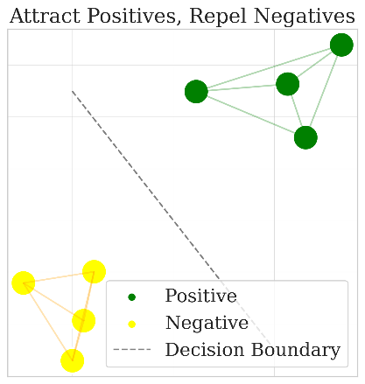









Self-Supervised Adaptation Warmup (SAW) with Dual-Attention Mix Augmented SupCon (DAMAS)
Vision Transformer with ILA during Fine-Tuning
ILA: Intermediate Layer Adapter
$$Z_{L}$$
$$H×W×3$$
SDS
Channel Downsampling
Dual-Attention Rollout
Embedding
Vision Transformer Stage 1
Vision Transformer Stage 1
CLS
Down-Sampling ILA
Down-Sampling ILA
2D Depthwise Convolution (DWC)
Residual Spatial Downsampling (RSDS): 2D DWC with Near One Initialization)
Attention Maps
$$N_{1}×D$$
Stage 1
Transformer Encoder $×L_{1}$
Vision Transformer Stage 2
Vision Transformer Stage 2
BatchNorm
Down-Sampling ILA
Down-Sampling ILA
Down-Sampling ILA
Nonlinear Activation
Vision Transformer Stage 3
Vision Transformer Stage 3
$$N_{2}×D$$
Stage 2
Transformer Encoder $×L_{2}$
Pointwise Convolution
Feature Maps
Feature Maps
Down-Sampling ILA
Channel Upsampling
Global-Average Pooling
Global-Average Pooling
$$N_{3}×D$$
Stage 3
Transformer Encoder $×L_{3}$
Projector MLP
Projector MLP
Classification Head
+
Representations
SupCon Loss
Representations
Ground-Truth Labels
Cross-Entropy Loss
Predictions
$${\hat{Z}}_{L}$$
Legend:
Trainable 🔥
Frozen ❄️
Positives
Negatives
Loss Function
Notes:
Show the dual-attention

Slide 15








Self-Supervised Adaptation Warmup (SAW) with Dual-Attention Mix Augmented SupCon (DAMAS)
ILA: Intermediate Layer Adapter
$$Z_{L}$$
$$H×W×3$$
SDS
Channel Downsampling
Dual-Attention Rollout
Embedding
Embedding
2D Depthwise Convolution (DWC)
Residual Spatial Downsampling (RSDS): 2D DWC with Near One Initialization)
$$N_{1}×D$$
Group 1
Transformer Encoder $×L_{1}$
Transformer Encoder $×L_{1}$
Attention Maps
Down-Sampling ILA
Down-Sampling ILA
BatchNorm
$$N_{2}×D$$
Group 2
Transformer Encoder $×L_{2}$
Transformer Encoder $×L_{2}$
Nonlinear Activation
Down-Sampling ILA
Down-Sampling ILA
Pointwise Convolution
$$N_{3}×D$$
Group 3
Transformer Encoder $×L_{3}$
Transformer Encoder $×L_{3}$
Channel Upsampling
Classification Head
Projection Head
Projection Head
+
Labels
Cross-Entropy
Predictions
Representations
SupCon
Representations
Fine-Tune Stage
SAW Stage
$${\hat{Z}}_{L}$$
Legend:
Trainable 🔥
Frozen ❄️
Positives
Negatives
Loss Function
Notes:
Show the dual-attention

Slide 16
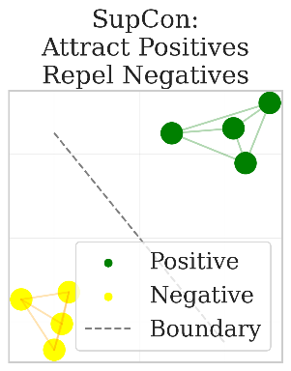




ViT with ILA and Self-Supervised Adaptation Warmup (SAW) with Dual-Attention Mix Augmented SupCon (DAMAS)
ILA: Intermediate Layer Adapter
$$Z_{L}$$
$$B×H×W×3$$
SDS
Channel Downsampling
Dual-Attention Rollout
Image Embedding
Image Embedding
2D Depthwise Convolution (DWC)
Residual Spatial Downsampling (RSDS): 2D DWC with Near One Initialization)
$${B×N}_{1}×D$$
Group 1
Transformer Encoder $×L_{1}$
Transformer Encoder $×L_{1}$
Attention Maps
Down-Sampling ILA
Down-Sampling ILA
BatchNorm
$${B×N}_{2}×D$$
Group 2
Transformer Encoder $×L_{2}$
Transformer Encoder $×L_{2}$
Nonlinear Activation
Down-Sampling ILA
Down-Sampling ILA
Pointwise Convolution
$${B×N}_{3}×D$$
Group 3
Transformer Encoder $×L_{3}$
Transformer Encoder $×L_{3}$
Channel Upsampling
Classification Head
Projection Head
Projection Head
+
Labels
Cross-Entropy
Predictions
Representations
SupCon
Representations
Fine-Tune Stage
SAW Stage
$${\hat{Z}}_{L}$$
Legend:
Trainable 🔥
Frozen ❄️
Positives
Negatives
Loss Function
Notes:
Show the dual-attention

Slide 17
ViT with ILA and Self-Supervised Adaptation Warmup (SAW) with Dual-Attention Mix Augmented SupCon (DAMAS)
ILA: Intermediate Layer Adapter
$$Z_{L}$$
$$B×H×W×3$$
SDS
Channel Downsampling
Dual-Attention Rollout
Image Embedding
Image Embedding
2D Depthwise Convolution (DWC)
Residual Spatial Downsampling (RSDS): 2D DWC with Near One Initialization)
$${B×N}_{1}×D$$
Group 1
Transformer Encoder $×L_{1}$
Transformer Encoder $×L_{1}$
Attention Maps
Down-Sampling ILA
Down-Sampling ILA
BatchNorm
$${B×N}_{2}×D$$
Group 2
Transformer Encoder $×L_{2}$
Transformer Encoder $×L_{2}$
Nonlinear Activation
Down-Sampling ILA
Down-Sampling ILA
Pointwise Convolution
$${B×N}_{3}×D$$
Group 3
Transformer Encoder $×L_{3}$
Transformer Encoder $×L_{3}$
Channel Upsampling
Classification Head
Projection Head
Projection Head
+
Labels
Cross-Entropy
Predictions
Representations
SupCon
Representations
Fine-Tune Stage
SAW Stage
$${\hat{Z}}_{L}$$
Legend:
Trainable 🔥
Frozen ❄️
Positives
Negatives
Loss Function
Notes:
Show the dual-attention

Slide 18

Vision Transformer with ILA
ILA: Intermediate Layer Adapter
$$Z_{L}$$
$$H×W×3$$
SDS
Channel Downsampling
Embedding
CLS
2D Depthwise Convolution (DWC)
Residual Spatial Downsampling (RSDS): 2D DWC with Near One Initialization)
$$N_{1}×D$$
Stage 1
Transformer Encoder $×L_{1}$
BatchNorm
Down-Sampling ILA
Nonlinear Activation
$$N_{2}×D$$
Stage 2
Transformer Encoder $×L_{2}$
Pointwise Convolution
Down-Sampling ILA
Channel Upsampling
$$N_{3}×D$$
Stage 3
Transformer Encoder $×L_{3}$
Classification Head
+
Predictions
Legend:
Trainable 🔥
Frozen ❄️
$${\hat{Z}}_{L}$$

Slide 19
Vision Transformer with ILA
Intermediate Layer Adapter
$$Z_{L}$$
SDS
Channel Downsampling
Embedding
CLS
2D Depthwise Convolution (DWC)
Residual Spatial Downsampling (RSDS): 2D DWC with Near One Initialization)
Transformer Encoder Group
BatchNorm
Intermediate Layer Adapter (ILA)
Nonlinear Activation
Transformer Encoder Group
Pointwise Convolution
Intermediate Layer Adapter (ILA)
Channel Upsampling
Transformer Encoder Group
Classification Head
+
Predictions
Legend:
Trainable 🔥
Frozen ❄️
$${\hat{Z}}_{L}$$

Slide 20
Vision Transformer with ILA
Intermediate Layer Adapter
$$Z_{L}$$
SDS
Channel Downsampling
Embedding
CLS
CLS
Transformer Encoder Group
2D Depthwise Convolution (DWC)
Residual Spatial Downsampling (RSDS): 2D DWC with Near One Initialization
Intermediate Layer Adapter (ILA)
CLS
CLS
BatchNorm
Transformer Encoder Group
Nonlinear Activation
Intermediate Layer Adapter (ILA)
Pointwise Convolution
CLS
Channel Upsampling
Transformer Encoder Group
Classification Head
+
Predictions
$${\hat{Z}}_{L}$$
Legend:
Trainable 🔥
Frozen ❄️

Slide 21
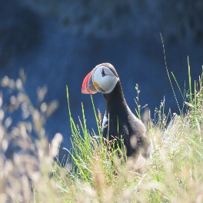
Trainable Feature Encoder 🔥
He a d🔥
Legend:
Traditional coarse recognition
Trainable 🔥
Frozen ❄️
Frozen Feature Encoder ❄️
He a d🔥
Linear classifier evaluation
Trainable Feature Encoder 🔥
Trainable Module🔥
He a d🔥
Traditional FGIR
Frozen Feature Encoder ❄️
Trainable Module🔥
He a d🔥
Parameter-Efficient FGIR
Notes:
https://www.flickr.com/photos/anjalorenz/50145521371/in/photolist-2jpbUsF-2m7MQWY-2m6cnjQ-2gPQAUV-rH3Trj-2gPPP9a-2gPQByF-2gPQChz-2n9jahs-2n9e6mC-2nHhmPF-2mwA4Ty-2j2kn4i-2mnYed4-2nhMcGy-2gPPPHM-2gBVk5p-LHoK5o-2mV4x6f-X3cQpT-S725Km-2p1Xut7-2nvapro-2nvcTax-2mbfoAj-2nhNnrd-263SDSN-2oBNxfH-2mb6rXj-2nFmqVS-2nujLBc-2nEyT2i-2nEtPae-2oMH6WE-2fkwRqV-2oDAno7-2oDCfve-2oBbofn-2mbdYr8-JZ7iDv-2gjkYnN-2gkPSE1-2mbdYrJ-2gdneS7-2mbbhnP-2oLsznh-vtdCz9-wnVewd-2nEyQ5G-dT12zz

