Slide 1
Progress Report 2025/04/20
Edwin Arkel Rios

Slide 2
Journal Possibilities
ACM TIST
Special Issue on Transformers
02/01 -> 03/01 -> April-June -> 07/01
ACM TOMM
Special Issue on Green Learning for Multimedia Computing
04/15 -> 10/15 -> 12/15 -> 01/15 (2026)
IJCV
Special Issue on Embedded Vision
01/31 -> 03/31 -> 04/30 -> 05/31
IEEE TSUSC (Sustainable Computing)
IEEE TCASAI (Circuits and Systems for Artificial Intelligence)
IEEE TCSVT (Circuits and Systems for Video Technology)
IEEE TETCI (Emerging Topics in Computational Intelligence)
IEEE TAI (Artificial Intelligence)
IEEE TNNLS (Neural Networks and Learning Systems)
IEEE TIP (Image Processing)
IEEE TMM (Multimedia)
Notes:
https://dl.acm.org/pb-assets/static_journal_pages/tist/pdf/ACM-TIST-CFP-SI-Transformers-1733429756037.pdf
• Efficient training and deployment of large-scale transformer models • Fine-tuning strategies for pre-trained transformer models
Submission, first round, revision, final decision
https://dl.acm.org/pb-assets/static_journal_pages/tomm/pdf/ACM-TOMM_SI-GreenLearning-CFP-Final-1733865451843.pdf
Submission, first round, revision, final decision
Compact networks • Lightweight models • Energy-efficient training strategies • Energy-efficient inference approaches
https://link.springer.com/journal/11263/updates/27709722
Lightweight and efficient computer vision algorithms for embedded systems
Submission, first round, revision, final decision
TSUSC
Cost Efficient Sensor Positions Determination For HumanActivity Recognition. 2022. 10 pages. 1 ½ introduction, ½ related work, 1 ½ method, ½ methodology, 5 results, 1/2 reference, 1/2 authors AStudy on the Energy Sustainability of Early Exit Networks for Human Activity Recognition. 2024. 14 pages. 1 ½ introduction, 1 related work, 1 ½ background, 2 methodology, 7 results, ½ reference, ½ authors
TCASAI
6 months ago
Expanded versions of conference publications may be submitted
SearchQ: Search-Based Fine-Grained Quantization for Data-Free Model Compression. 9 pages: 1 introduction, 1 background/related work and motivation, 3 method, 3 methodology and results, 1 reference, 1 authors
An Artificial-Intelligence-based SLAM Processor with Scene-adaptive Sampling and Hybrid NeRF Model Training Acceleration. 2024. 13 pages: 2 introduction, 1 motivation, 5 method, 3 methodology and results, 1 references, 1 authors
TETCI
Parameter-Efficient Transfer Learning for Medical Visual Question Answering. 2023. 11 pages: 2 introduction, 1 related work, 2 method, 1 methodology, 4 results, 1 references, 1 authors
Detail Reinforcement Diffusion Model: Augmentation Fine-Grained Visual Categorization in Few-Shot Conditions. 11 pages: 1 introduction, 1 related work, 3 method, 4 results, 1 reference, 1 authors
PETformer: Long-term Time Series Forecasting via Placeholder-enhanced Transformer
TAI
Bi-LSTM Sequence Modeling for On-The-Fly Fine-Grained Sketch-Based Image Retrieval. 2022. 8 pages: 1 introduction, 1 related work, 1 method, 1 methodology, 3 results, 1 references
Fine-Grained Food Classification Methods on the UEC FOOD-100 Database. 2021. 6 pages: 1 introduction, 1 related work, 1 methods, 1 dataset, 1 methodology and experiments, 1 references
Lightweight Parallel Convolutional Neural Networkwith SVM classifier for Satellite Imagery Classification. 2024. 12 pages: 2 introduction, 1 related work, 5 method, 3 results, 1 references
TNNLS
Penalizing the Hard Example But Not Too Much: A Strong Baseline for Fine-Grained Visual Classification
TETC Transactions on Emerging Topics in Computing
MTFC: A Multi-GPU Training Framework for Cube-CNN-Based Hyperspectral Image Classification

Slide 3
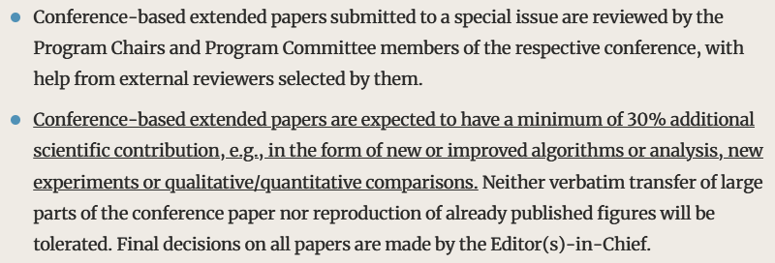
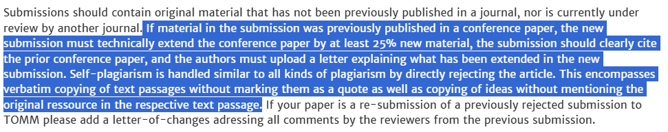
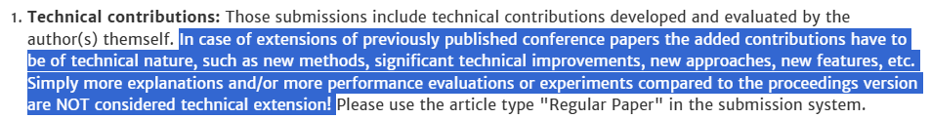
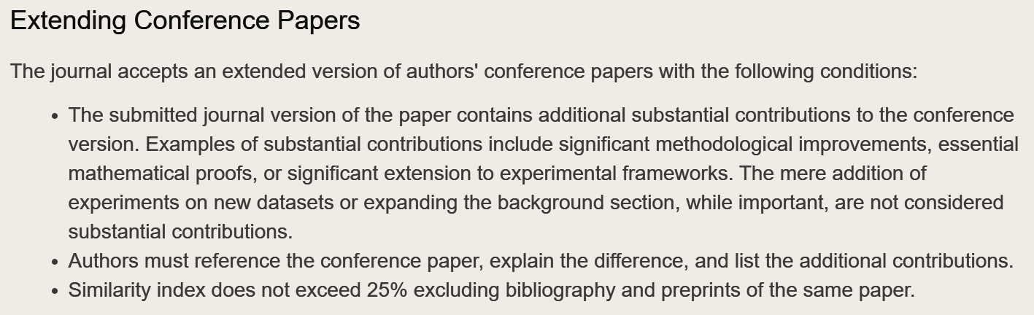
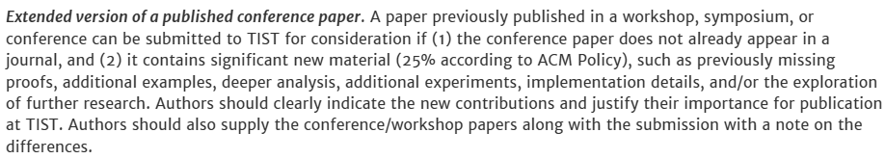
Conference Extensions
Cover letter with detailed description of differences
Rewrite everything (specially introduction, related work)
Remake figures (avoid copyright)
Extend method (loss, etc)
Additional experiments/ablations/metrics
IJCV, TETC, TAI, TOMM, TIST
Cover letter: https://arxiv.org/html/2309.04023v2
Notes:
https://link.springer.com/journal/11263/updates/17308948
https://www.computer.org/csdl/journal/ec/write-for-us/15071
https://cis.ieee.org/publications/ieee-transactions-on-artificial-intelligence/information-for-authors-tai
https://dl.acm.org/journal/tomm/author-guidelines
https://dl.acm.org/journal/tist/author-guidelines
50% extra content

Slide 4
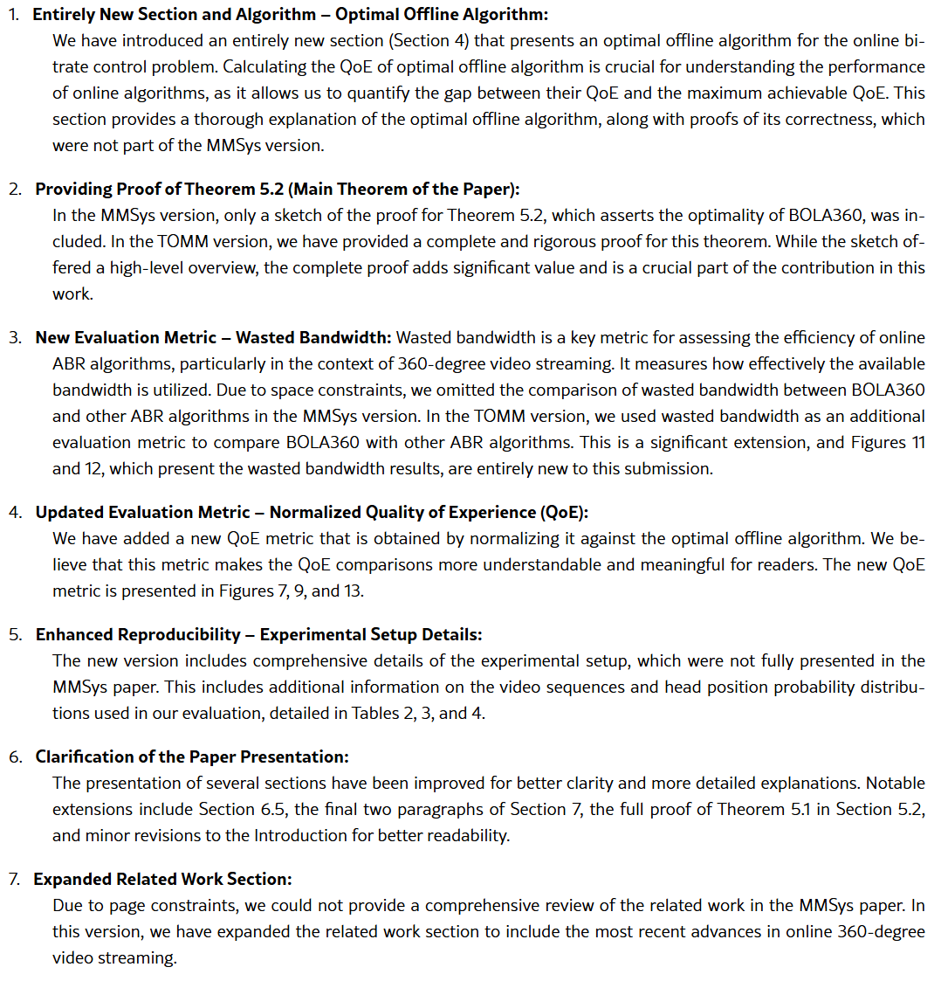
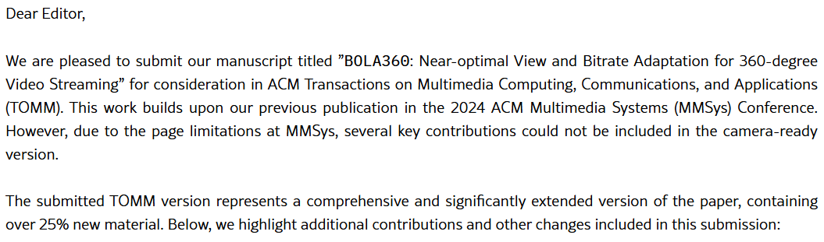

Journal Extension Cover Letter

Slide 5
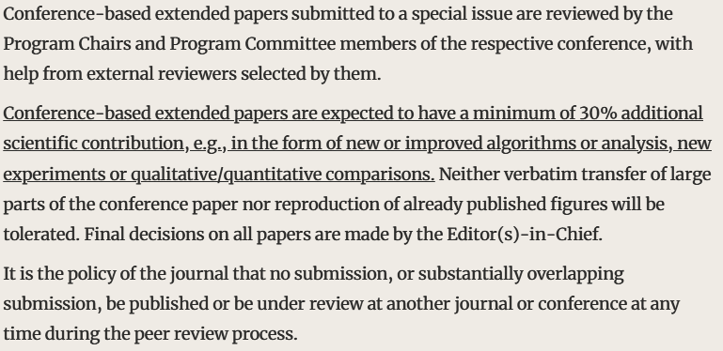
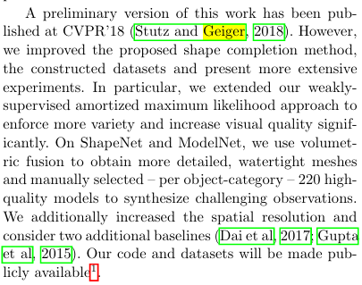
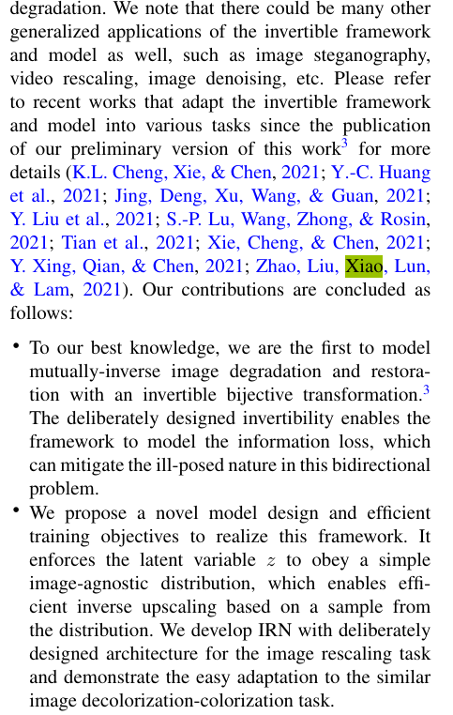
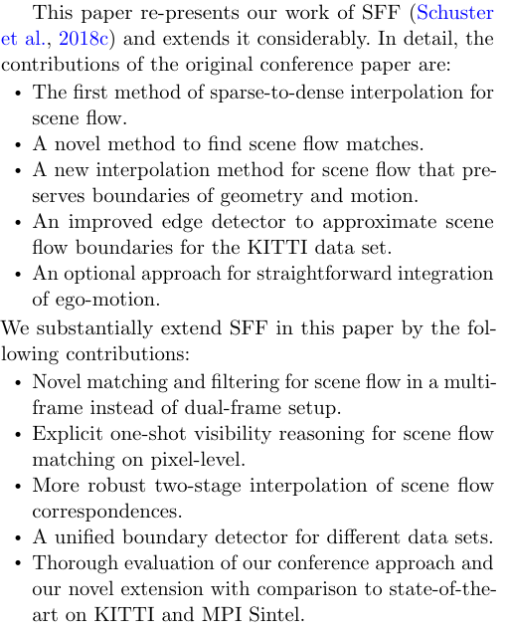
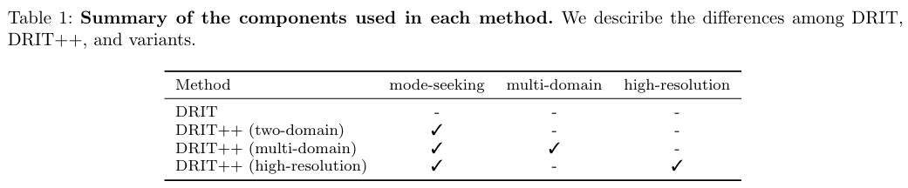
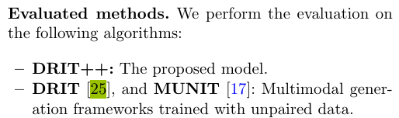
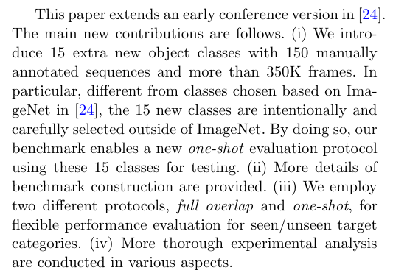
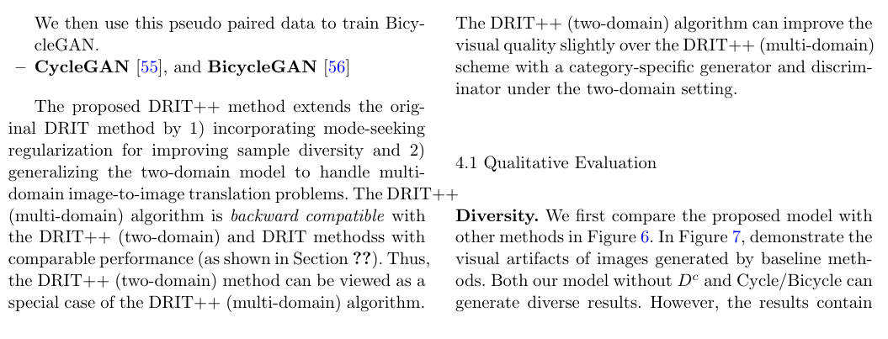
Conference Paper Extension IJCV
Top journal (IF) but B-tier according to NYCU
Call for Papers: Special Issue on Embedded Vision https://link.springer.com/journal/11263/updates/27709722
Notes:
Learning 3D Shape Completion under Weak Supervision
LaSOT: A High-quality Large-scale Single Object Tracking Benchmark
Invertible Rescaling Network and Its Extensions
DRIT++: Diverse Image-to-Image Translation via Disentangled Representations
SceneFlowFields++: Multi-frame Matching, Visibility Prediction, and Robust Interpolation for Scene Flow Estimation

Slide 6
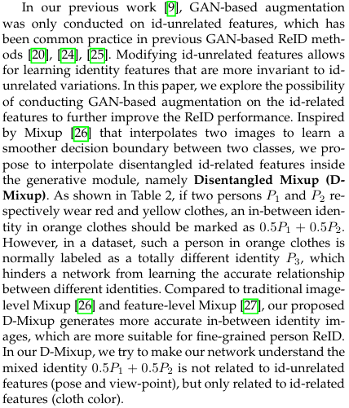
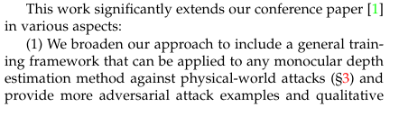
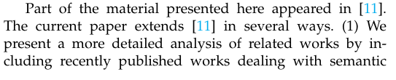
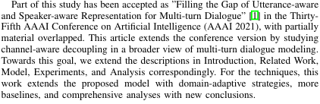
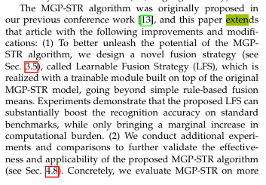
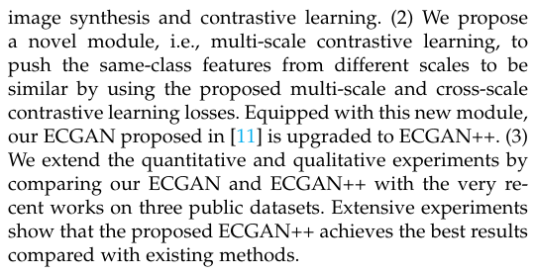
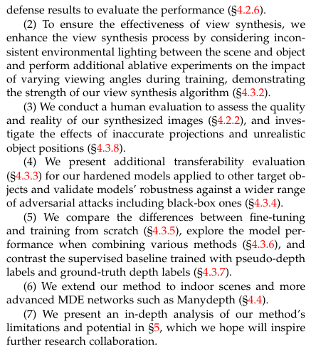
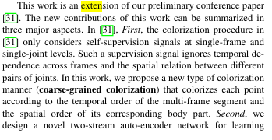
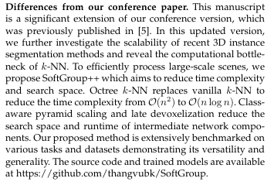
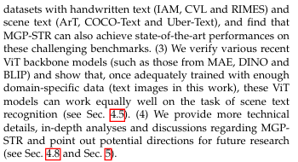
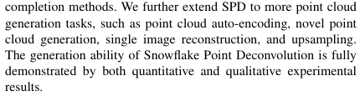
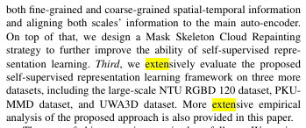
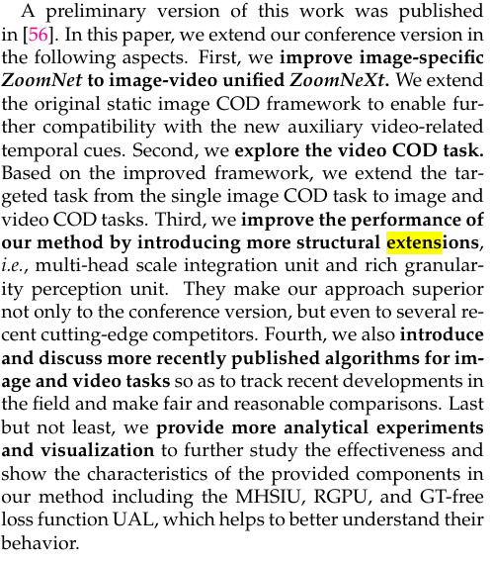
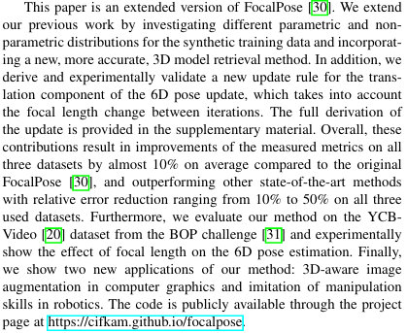
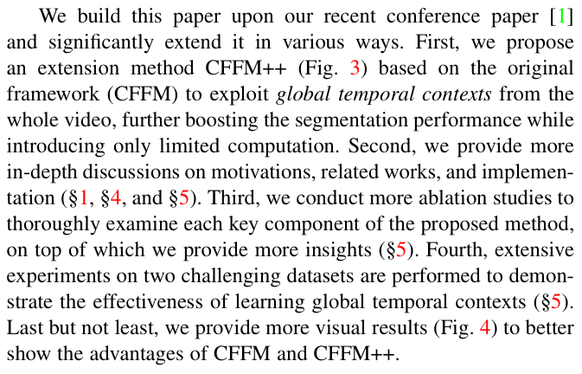
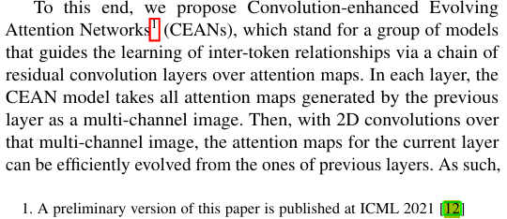
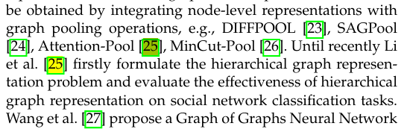
Other Conference Extension Examples
Notes:
TPAMI extension arxiv
IJCV extension arxiv
Channel-aware Decoupling Network for Multi-turn Dialogue Comprehension. TNNLS 23.
Filling the Gap of Utterance-aware and Speaker-aware Representation for Multi-turn Dialogue. AAAI 21.
Self-Supervised 3D Action Representation Learning with Skeleton Cloud Colorization. TPAMI 23.
Skeleton Cloud Colorization for Unsupervised 3D Action Representation Learning. ICCV 21.
Multi-Granularity Prediction with Learnable Fusion for Scene Text Recognition. TPAMI 23.
Multi-Granularity Prediction for Scene Text Recognition. ECCV 22.
Semi-Supervised Hierarchical Graph Classification. TPAMI 22.
Semi-Supervised Graph Classification: A Hierarchical Graph Perspective. WWW 19.
Self-supervised Adversarial Training of Monocular Depth Estimation against Physical-World Attacks. TPAMI 24.
Adversarial Training of Self-supervised Monocular Depth Estimation against Physical-World Attacks. ICLR 23.
Learning Local and Global Temporal Contexts for Video Semantic Segmentation. TPAMI 22.
Coarse-to-fine feature mining for video semantic segmentation. CVPR 22
Edge Guided GANs with Multi-Scale Contrastive Learning for Semantic Image Synthesis. TPAMI 23.
Edge Guided GANs with Contrastive Learning for Semantic Image Synthesis. arXiv 20 / ICLR 23.
Scalable SoftGroup for 3D Instance Segmentation on Point Clouds. TPAMI 23.
SoftGroup for 3D Instance Segmentation on Point Clouds. CVPR 22.
Convolution-enhanced Evolving Attention Networks. TPAMI 23.
Evolving Attention with Residual Convolutions. ICML 21.
FocalPose++: Focal Length and Object Pose Estimation via Render and Compare. TPAMI 24.
Focal Length and Object Pose Estimation via Render and Compare. CVPR 22.
Learning Invariance from Generated Variance for Unsupervised Person Re-identification. TPAMI 23.
Joint Generative and Contrastive Learning for Unsupervised Person Re-identification. CVPR 21.
Snowflake Point Deconvolution for Point Cloud Completion and Generation with Skip-Transformer. TPAMI 22.
SnowflakeNet: Point Cloud Completion by Snowflake Point Deconvolution with Skip-Transformer. ICCV 21.
ZoomNeXt: A Unified Collaborative Pyramid Network for Camouflaged Object Detection. TPAMI 24.
Zoom In and Out: A Mixed-scale Triplet Network for Camouflaged Object Detection. CVPR 22.

