Slide 2
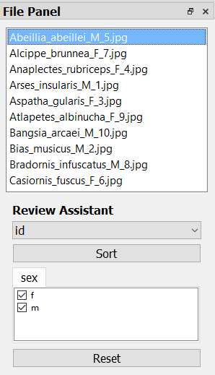
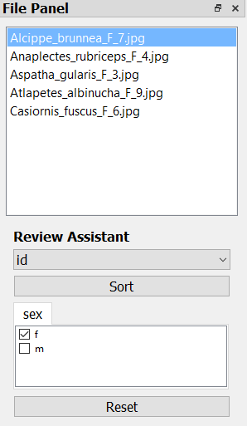
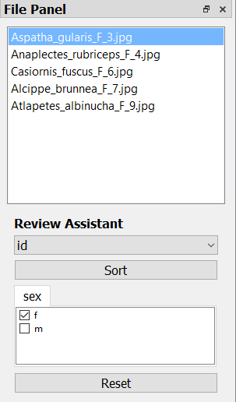

Slide 3
Other AI models
PhenoLabel
Place labels
PhenoTrain
Train & apply AIs
PhenoLabel
Review predictions
Downstream
Analysis
Not many images

