Slide 1



Regression and Classification in Metabolomics
Andrés Castillo, Andrés Bernal
September 2025

Slide 2
Outline
Motivation: the “too-good-to-be-true” BMI model (39 PCs) — train vs test
Dataset & Tasks: plasma 1H NMR (ROI filtered),
Regression (BMI) & Classification (COVID vs No COVID)
Preprocessing: ROI (exclude water), scale/center, PCA from train only, train/test split
Regression (BMI): linear → multiple → polynomial; metrics (R², MSE); the overfit mirage
Fixing Regression: choose #PCs via CV/test RMSE (3–10 PCs); brief note on ridge/lasso/PLS
Interpretation: back-project PC coefficients → weights over ppm (biochemical regions)
Classification (COVID): logistic, decision tree, kNN; evaluation (confusion matrix, F1, ROC/PR);
Results & Lessons: what generalized, what didn’t; pitfalls & best practices

Slide 3
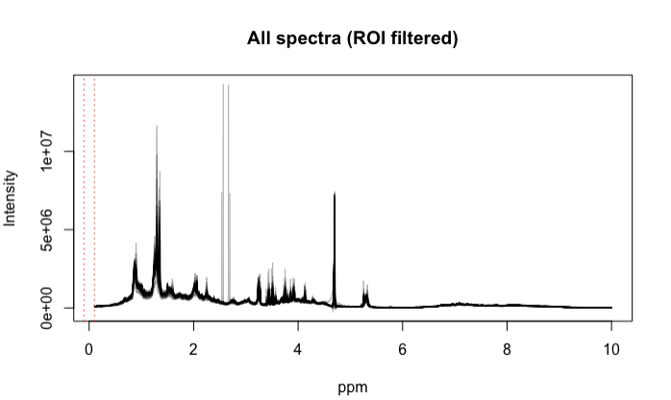
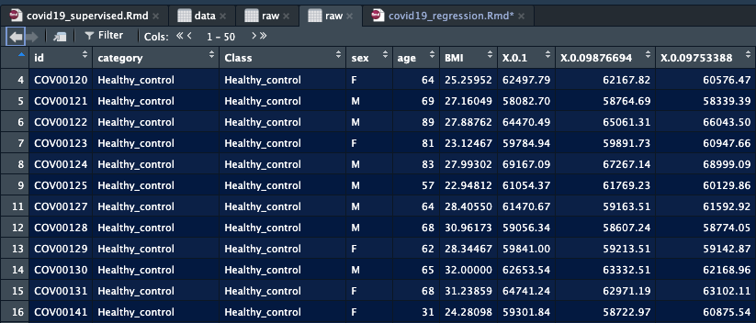
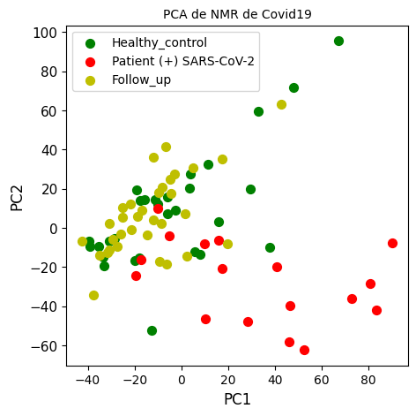
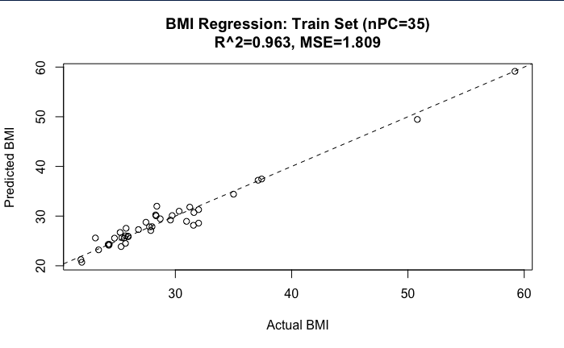
What We’ll Do
Notes:
“This session is about learning regression and classification in a way that sticks. For clarity, we’ll lean on a dataset you’ve seen: COVID-19 plasma 1H NMR.”
“Quick reminder: it includes 1D and CPMG spectra, plus infection status, age, and sex, spanning non-hospitalized post-COVID participants, hospitalized acute cases, and healthy controls.”
“We’ll use a simple BMI regression as a teaching example, not because this dataset was built for BMI, but because it perfectly shows why validation matters: a model can look amazing on the training set and still fail on new data.”
“By the end, you should feel confident slotting supervised ML into your pipelines, while staying skeptical. Most results are average; when they look too good, that’s usually a sign to double-check your analysis.”

Slide 4
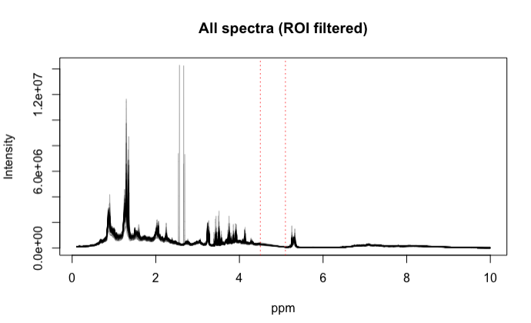
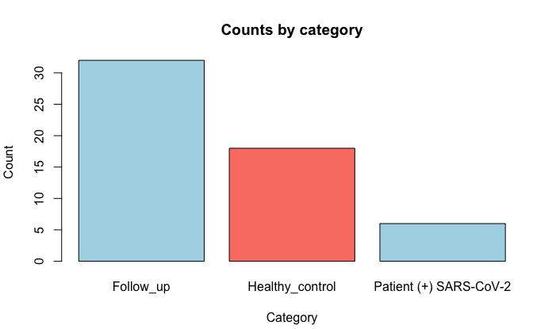
The Dataset
Participants span acute, post-COVID (recovery), and healthy controls
Metadata: infection status, age, sex (BMI used here only as a teaching proxy)
For today: map labels to COVID vs No COVID (recovery + healthy)
COVID-19 recovery cohort (Holmes et al., 2021): plasma 1D & CPMG ¹H NMR
Practical notes: ROI filtering (e.g., remove water 4.5–5.1 ppm), scale/center, PCA on train only
Notes:
“This dataset gives us two spectral flavors: 1D (macromolecules + small molecules) and CPMG, which suppresses macromolecules to highlight small molecules.”
“Participants include acute COVID cases, recovery (post-COVID), and healthy controls. We’ll collapse labels to a simple COVID vs No COVID for classification.”
“Although the dataset wasn’t designed for BMI prediction, we’ll use BMI as a didactic regression target to illustrate why validation matters, because it produces a great-looking overfit mirage on train.”
“Preprocessing choices matter: we’ll exclude water and any obvious artifact regions (ROI), scale/center, and perform PCA on the training set only; the test set is projected with predict() to avoid leakage.”
“Keep the bigger lesson in mind: today’s goal is to practice a clean pipeline that you can reuse, regardless of endpoint.”

Slide 5
The plan(Workflow)
Step 1: Preprocess spectra (ROI filtering, scaling, PCA on train only)
1
Step 2: Split dataset → Train vs Test (no peeking!)
2
Step 3: Build models
Regression: predict BMI
Classification: predict COVID vs No COVID
3
Step 4: Evaluate performance (R², RMSE; Confusion Matrix, F1)
4
Step 5: Interpret results in ppm space
5
Notes:
Here’s the workflow we’ll follow together.”
“We start with preprocessing: filter out water, scale and center, and reduce dimensions with PCA, but only on the training set.”
“We then split the dataset into train and test. This is crucial, without a test set, we can’t know if the model generalizes.”
“On the modeling side, we’ll do regression for BMI and classification for COVID status.”
“We’ll evaluate using metrics appropriate for each task(R² and RMSE for regression; confusion matrix, accuracy, and F1 for classification.)”
“Finally, we’ll interpret the models, projecting results back into ppm space to see which regions of the spectrum carry signal.

Slide 6
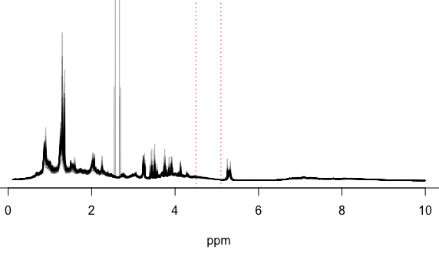
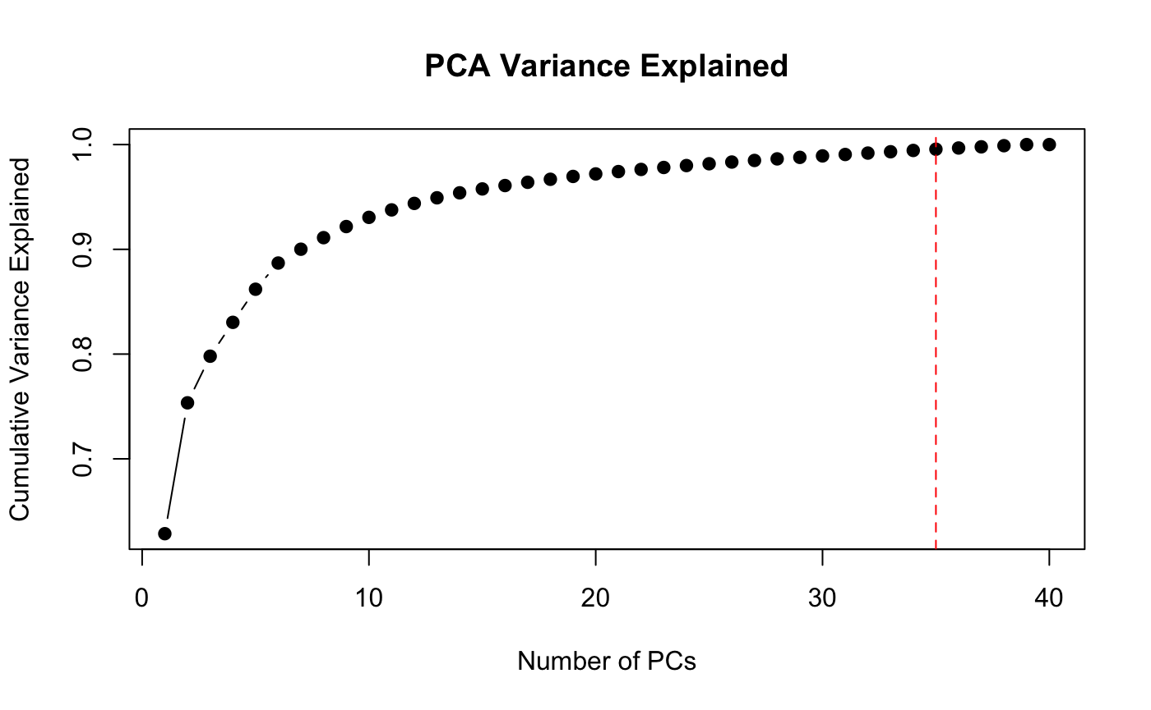
PCA Refresher
Too many variables: 8,000+ points per spectrum
PCA = compression: projects spectra into fewer orthogonal components
PCs capture variance: PC1 = largest, PC2 = second-largest, etc.
Not guaranteed to capture relevance for BMI or COVID
We’ll choose the number of PCs based on model performance, not only the variance explained
[PC1, PC2, PC3, PC4, … PC10]
Notes:
“Each NMR spectrum has thousands of points. Feeding them all into regression would be impossible and unstable.”
“Principal Component Analysis, or PCA, compresses those points into a smaller set of orthogonal variables, principal components.”
“PC1 captures the direction of maximum variance, PC2 the next, and so on. This is great for data reduction.”
“But variance ≠ relevance. The first PCs might describe the largest trends, but they don’t necessarily predict BMI or COVID.”
“That’s why we’ll decide the number of PCs to keep based on how the model performs, not just on how much variance is explained.”

Slide 7
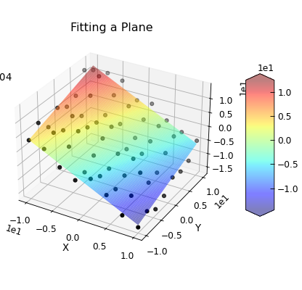
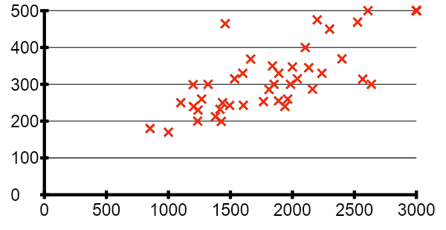
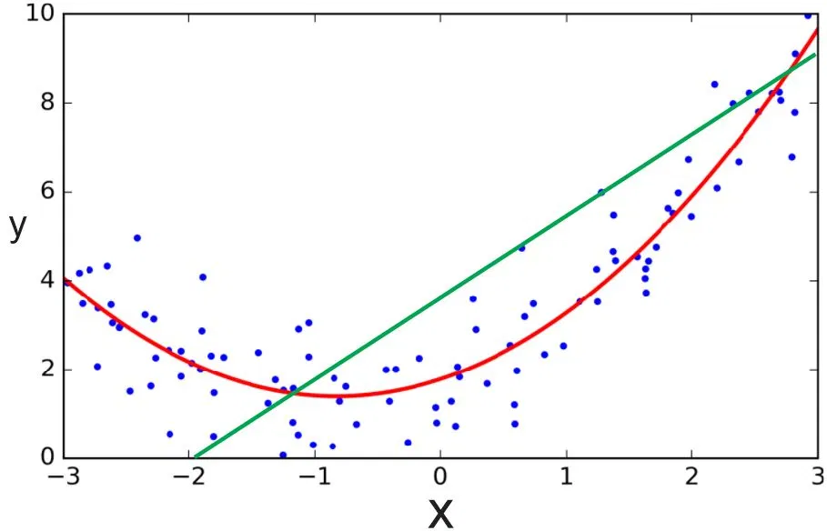

Regression Basics
Regression = predict a number (here, BMI)
Start simple:
Linear regression: one predictor, straight line
Multiple regression: several predictors (PCs)
Polynomial regression: add curvature if needed
Evaluate fit: R² (variance explained), RMSE (error size)
A good line on training is not good pattern
$$\hat{y}$$
x
Notes:
“Regression is our tool for predicting a numeric outcome. In this dataset, we’ll use BMI, not because it’s biologically central here, but because it makes a clear teaching case.”
“We’ll start with the simplest idea: fit a straight line between one predictor and BMI. Then we extend to multiple predictors, like PC1 + PC2 + … PCk.”
“Polynomial regression adds curvature when relationships aren’t strictly linear.”
“To evaluate fit, we’ll use R², which tells us how much variance we explain, and RMSE, which tells us the average error size.”
“But here’s the catch: just because the regression line looks good on the training data doesn’t mean it will generalize. That’s the trap we’re about to explore.

Slide 8
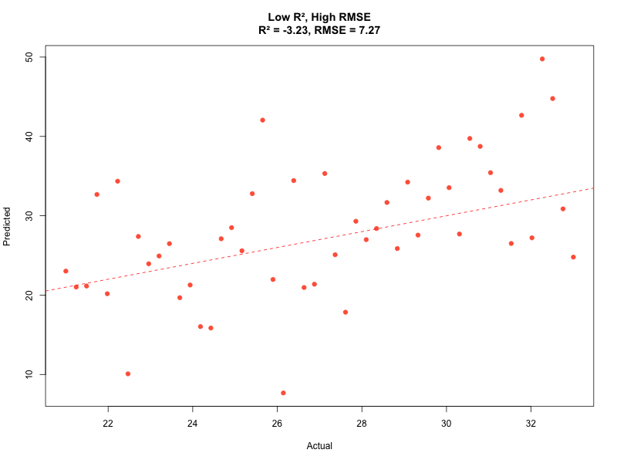
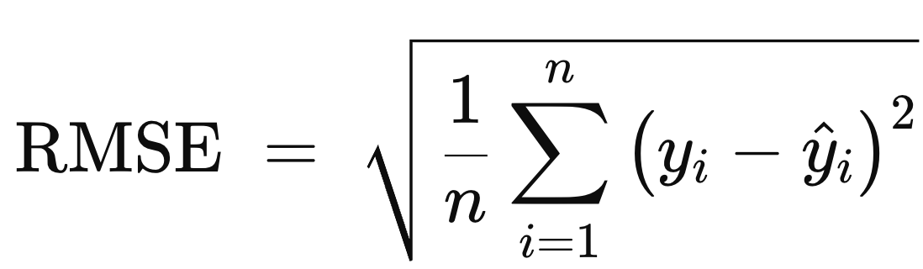
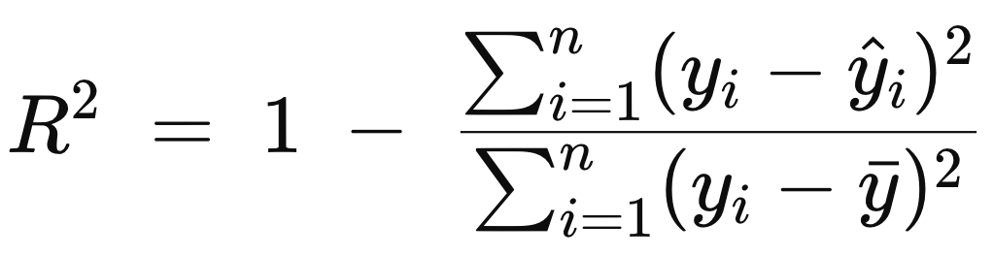
Evaluating Regression Performance
RMSE:
Lower is better; same units as
outcome (BMI here)
R² (coefficient of determination):
Fraction of variance in the outcome explained by the model
R² = 1 → perfect fit;
R² = 0 → no better than mean
Notes:
“Once we fit a regression, how do we know if it’s any good?”
“R² tells us what fraction of the variance in BMI is explained by our predictors. An R² of 1 means perfect predictions; an R² of 0 means we did no better than guessing the average.”
“RMSE tells us, in the units of BMI, how far off our predictions are on average. A smaller RMSE means more accurate predictions.”
“But the key message: these numbers are only meaningful if we compute them on a test set. On training data, they can look fantastic even when the model won’t generalize.”

Slide 9
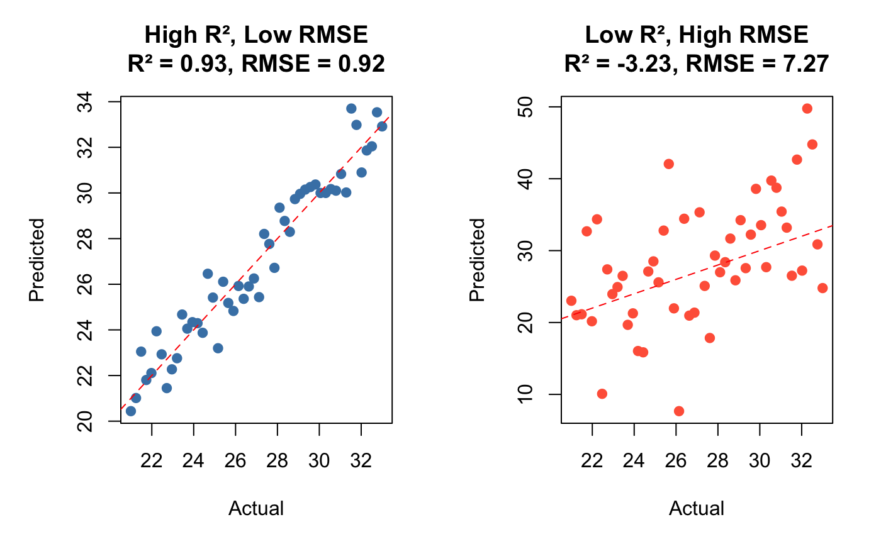
Evaluating Regression Performance

Slide 10
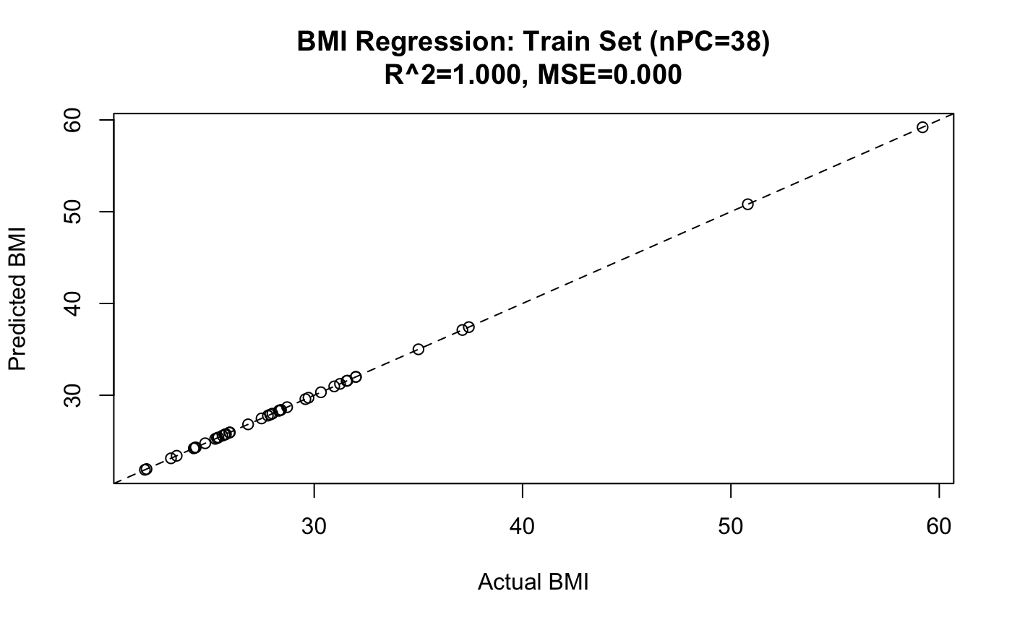
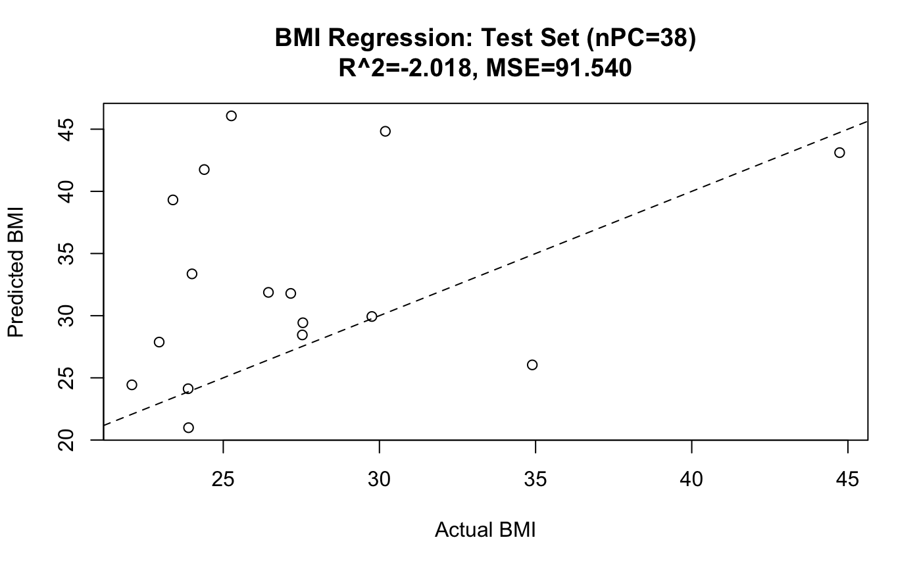
The Overfitting Mirage (38 PCs)
Model with 38 PCs (almost as many predictors as samples)
Train set: R² ≈ 1.0, RMSE ≈ 0 → looks perfect
Test set: predictions collapse → poor generalization
Overfitting: model memorizes noise instead of learning signal
Lesson: don’t trust training performance alone
Notes:
“Here’s the trap: with 39 PCs we can fit BMI almost perfectly on the training set. R² is essentially 1, RMSE is tiny, it looks fantastic.”
“But on the test set, the illusion breaks. Predictions scatter, performance drops. This is a textbook case of overfitting, the model is capturing noise, not meaningful signal.”
“Notice that we used almost as many predictors as samples. With so few degrees of freedom left, the coefficients can ‘explain’ the training data but have no stability.”
“The big message: don’t be seduced by a beautiful train fit. Always check the test set. If the test plot looks this bad, it means the model hasn’t learned anything generalizable.”

Slide 11
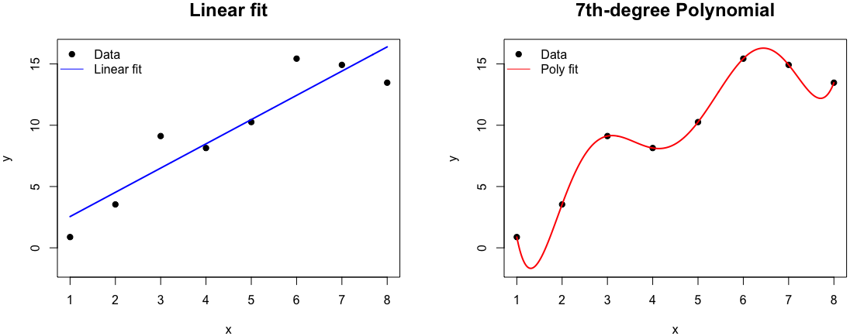
Why the Mirage Happens
Too many predictors (PCs) → model can memorize noise
Training error goes down, but the variance of predictions explodes
Classic bias–variance trade-off:
Few PCs → high bias, underfit
Too many PCs → high variance, overfit
Notes:
“Why does the mirage happen? With so many PCs, the regression can fit almost every wiggle in the training data, including random noise.”
“That gives us very low training error, but the cost is high variance: the model becomes unstable, and predictions on new data jump around.”
“This is the bias–variance trade-off: too simple and you underfit, too complex and you overfit. Somewhere in the middle lies the sweet spot.”
“Our job is to find that sweet spot, and the only way is by evaluating on data the model hasn’t seen.”

Slide 12
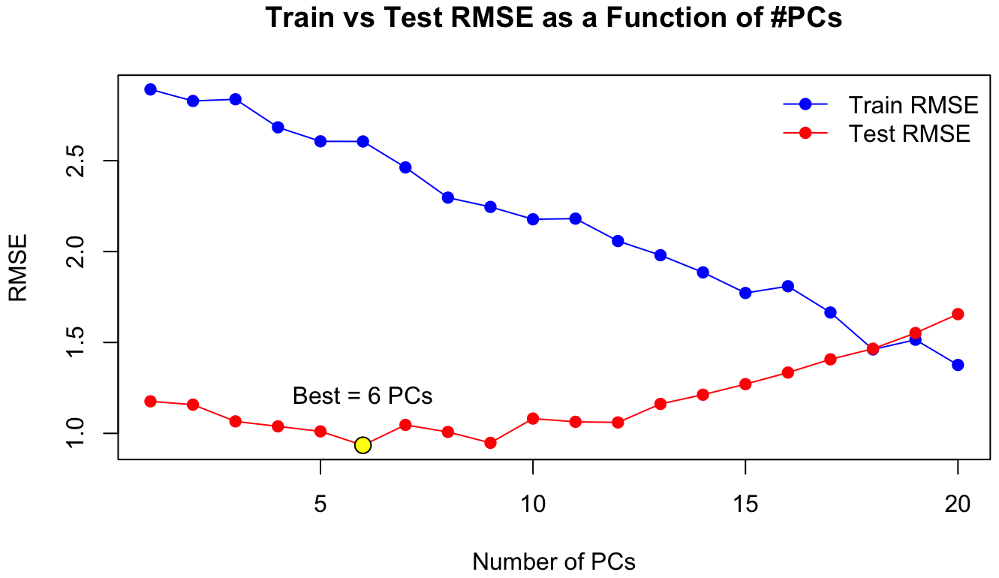
Fixing Regression (Choosing the Right Complexity)
Don’t use “as many PCs as possible” → overfitting trap
Find the sweet spot: enough PCs to capture signal, not noise
Strategies:
Use Train/Test split or Cross-Validation
Compare metrics (RMSE, R²) across PC counts
Keep models as simple as possible that still generalize
Notes:
“So how do we fix the overfitting problem? The key is not to keep every PC, but to pick the number that balances bias and variance.”
“We can try a range of PC counts, say 3 to 15, and evaluate on the test set or using cross-validation.”
“This gives us a curve of Test RMSE versus number of PCs. Somewhere in the middle, the RMSE is lowest, that’s our sweet spot.”
“Notice that while training error always goes down as we add more PCs, test error tells the truth. That’s why evaluation is essential.”
“The rule of thumb: keep models as simple as you can, as long as they still generalize.”

Slide 13
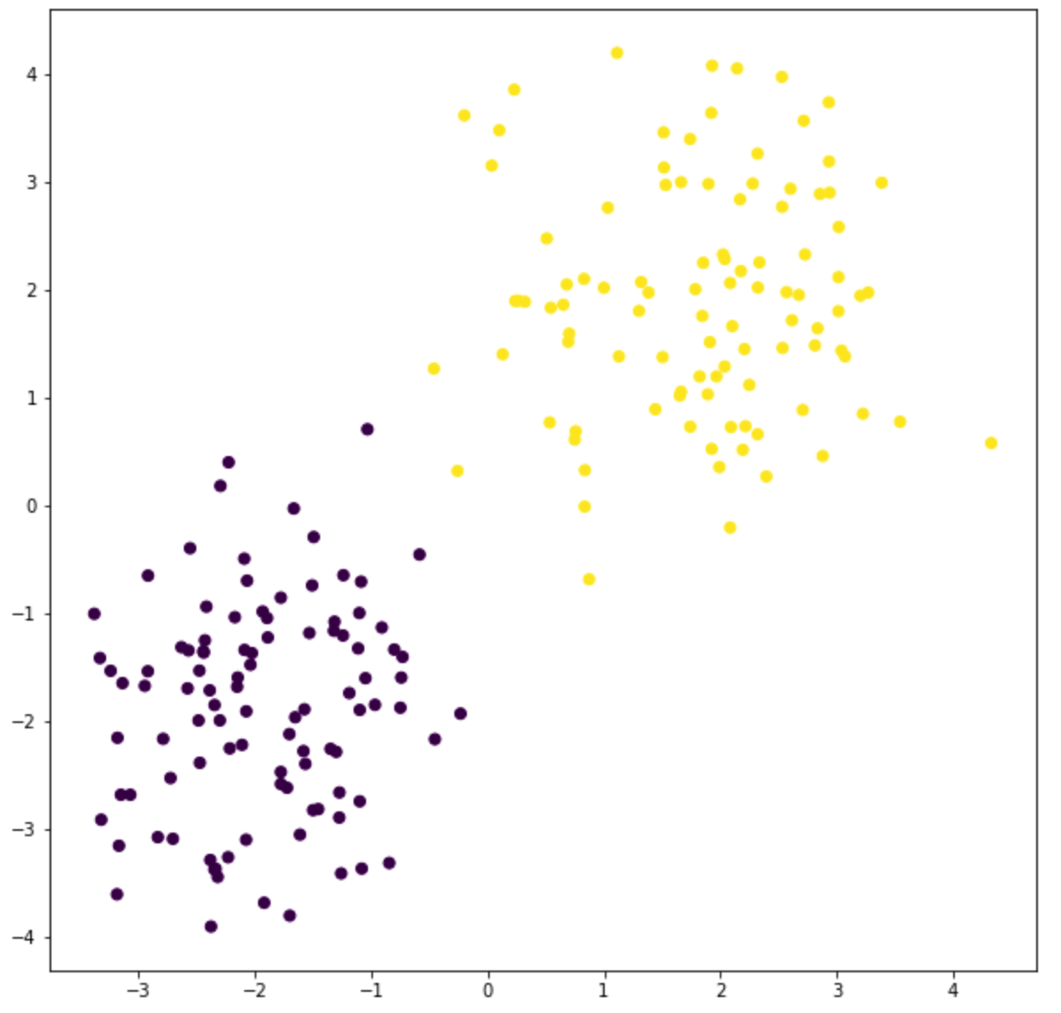
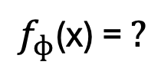
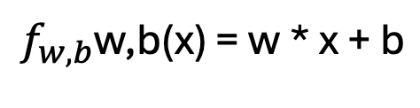

From Regression to Classification
$$\hat{y}$$
$$f_{w,b}\text{w}\text{,}\text{b}\text{(}\text{x}\text{) = }\text{w}\text{ ∗ }\text{x}\text{ + }\text{b}$$
$$f_{ɸ}\text{(}\text{x}\text{) = }?$$
Output is a real number
Output is a category
Notes:
“So far, we’ve focused on regression, predicting BMI as a number. But what if our outcome is categorical, like COVID vs No COVID?”
“We can take the same linear model and add a sigmoid function. This turns any number into a probability between 0 and 1.”
“If the probability is above a threshold, say 0.5, we call it COVID; otherwise, No COVID.”
“This is the idea behind logistic regression, arguably the simplest and most interpretable classifier.”
“From here, we’ll also introduce two other families of classifiers, decision trees and k-nearest neighbors, so you can compare how different approaches behave.”

Slide 14
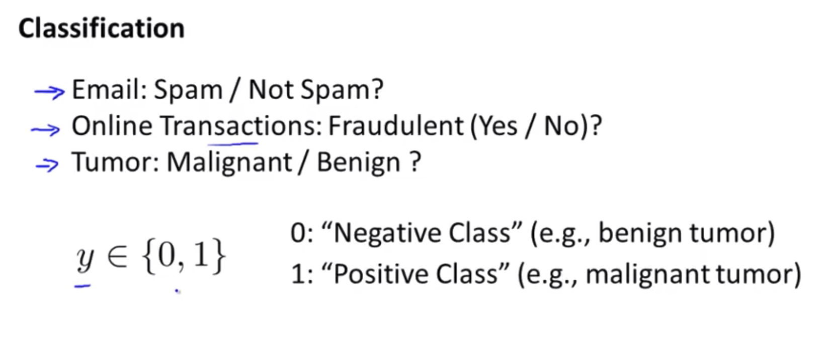
Notes:
“So far, we’ve focused on regression, predicting BMI as a number. But what if our outcome is categorical, like COVID vs No COVID?”
“We can take the same linear model and add a sigmoid function. This turns any number into a probability between 0 and 1.”
“If the probability is above a threshold, say 0.5, we call it COVID; otherwise, No COVID.”
“This is the idea behind logistic regression, arguably the simplest and most interpretable classifier.”
“From here, we’ll also introduce two other families of classifiers, decision trees and k-nearest neighbors, so you can compare how different approaches behave.”

Slide 15

Binary Classification
x0 | x1 | y(label)
-2 | -1.5 | 0
-1 | -2 | 0
-0.7 | -4 | 0
1 | 2 | 1
2.2 | 3.5 | 1
0.6 | 1.7 | 1
Centroides
1
0
-0.3 | -2.5 | ?
A new sample: Should be purple or yellow?

Slide 16
Binary Classification
x0 | x1 | y(label)
-2 | -1.5 | 0
-1 | -2 | 0
-0.7 | -4 | 0
1 | 2 | 1
2.2 | 3.5 | 1
0.6 | 1.7 | 1
1
x1
y
0
x0
-0.3 | -2.5 | ?

Slide 17
Binary Classification
0
y
1
x0 | x1 | y(label)
-2 | -1.5 | 0
-1 | -2 | 0
-0.7 | -4 | 0
1 | 2 | 1
2.2 | 3.5 | 1
0.6 | 1.7 | 1
x1
x1
-0.3 | -2.5 | ?

Slide 18
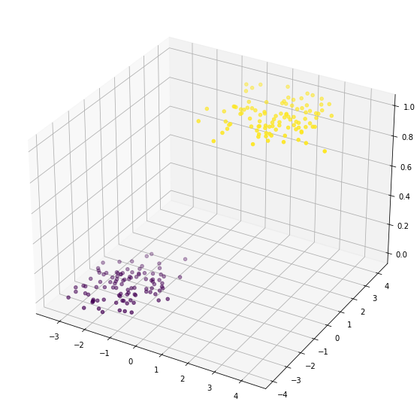
Binary classification
f_{W,b}(x0, x1) >= 0.5
x0 | x1 | y(label)
-2 | -1.5 | 0
-1 | -2 | 0
-0.7 | -4 | 0
1 | 2 | 1
2.2 | 3.5 | 1
0.6 | 1.7 | 1
w0 = mx0
w1 = mx1
w = [w0, w1]
f_{W,b}(x0, x1) = w[0]x0 + w[1]x1 + b
-0.3 | -2.5 | ?

Slide 19
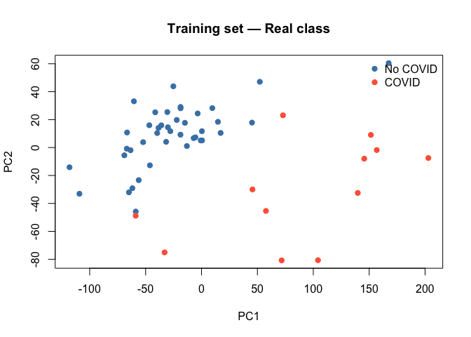
Covid19 vs No Covid19 classification

Slide 20
Classification evaluation
On each classification
Pred
x
 | COVID | No COVID
COVID | TP | FN
No COVID | FP | TN
x
Truth
Pred
 | COVID | No COVID
COVID | 10 | 3
No COVID | 0 | 41
x
Truth

Slide 21
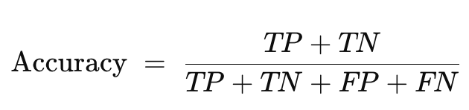
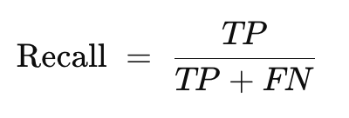
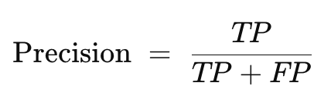
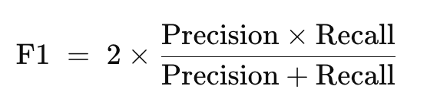
Classification evaluation
On each classification
Pred
 | COVID | No COVID
COVID | TP | FN
No COVID | FP | TN
x
Truth
x
x

Slide 22
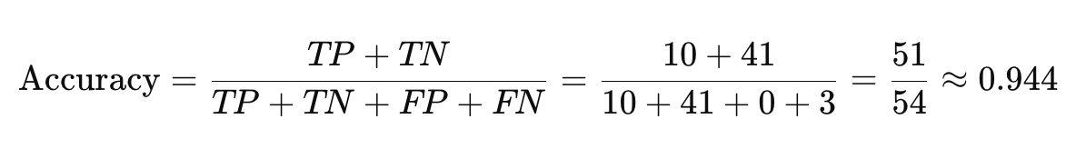
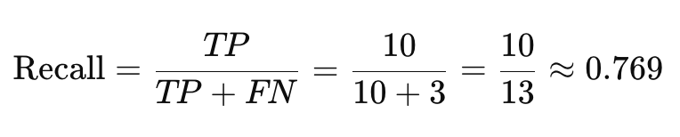
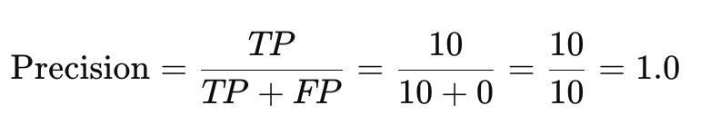
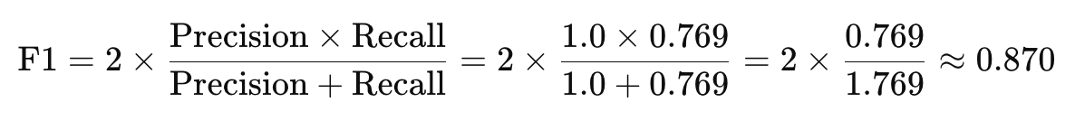
Classification evaluation on training set
Pred
 | COVID | No COVID
COVID | 10 | 3
No COVID | 0 | 41
Truth

Slide 23
Classification evaluation on test set
Pred
 | COVID | No COVID
COVID | 10 | 3
No COVID | 0 | 41
Truth

Slide 24
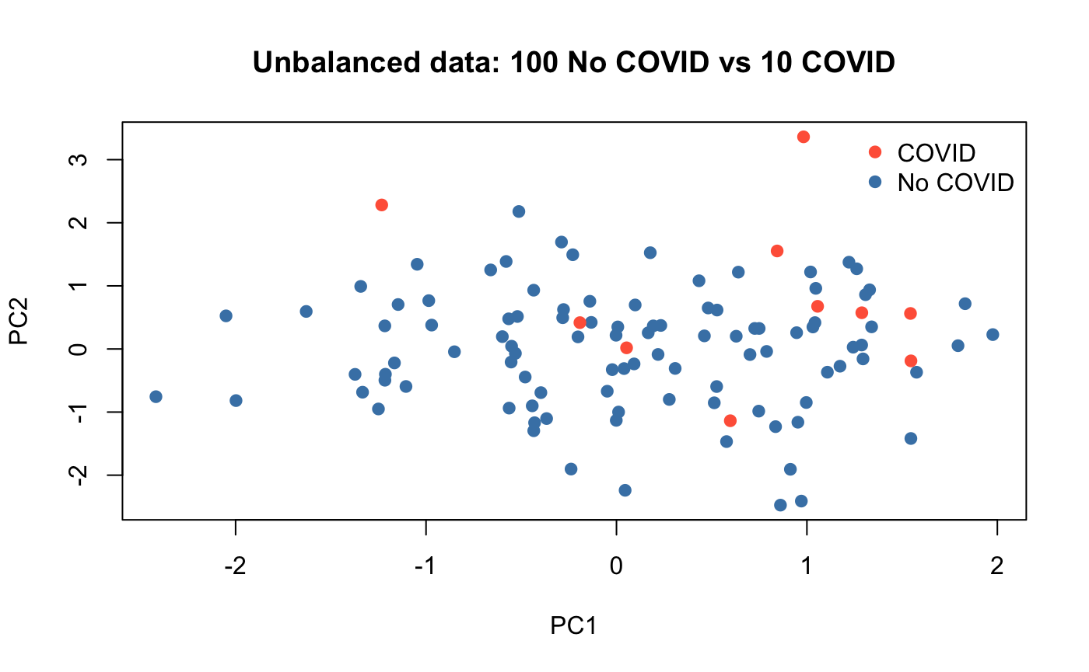
Unbalanced data
COVID
Pred
 | COVID | No COVID
COVID | 10 | 3
No COVID | 0 | 41
Truth
No COVID

Slide 25
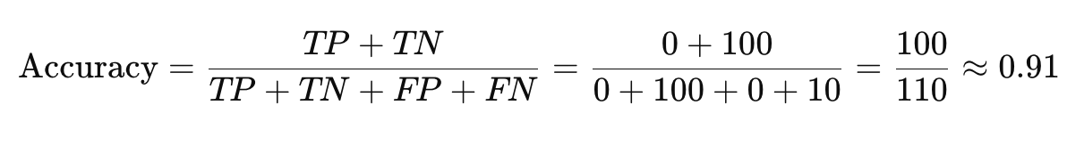
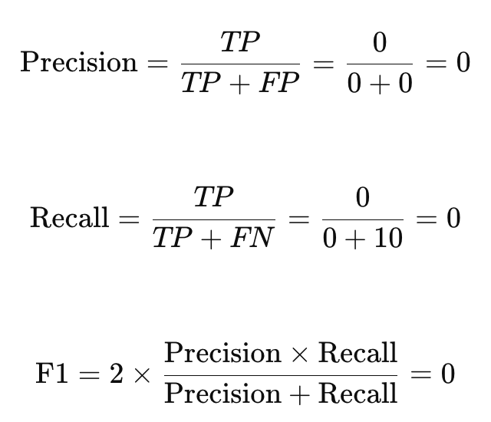
Unbalanced data
Pred
 | COVID | No COVID
COVID | 0 | 10
No COVID | 0 | 90
Truth

Slide 26
Logistic Regression
Extension of linear regression for yes/no outcomes
Adds a sigmoid function to squeeze predictions into [0,1]
Output = probability of “COVID” (positive class)
Decision rule: if p ≥ 0.5 → COVID, else No COVID
Coefficients can be interpreted (direction and strength of association)
1
x1
y
0.5
0
x0
Notes:
“Logistic regression takes the idea of a straight line and then squashes it into probabilities between 0 and 1.”
“It’s popular in biology because coefficients are interpretable — they tell us which PCs or features increase or decrease the odds of COVID.”
“But it can only learn linear boundaries unless we engineer features.”

Slide 27
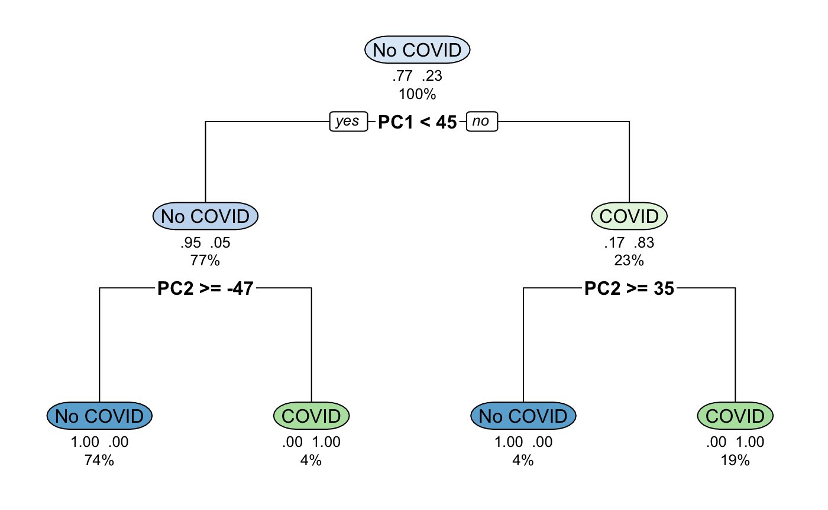
Decision Trees
Model as a series of yes/no questions
Splits the data recursively into groups with similar labels
Very interpretable: easy to trace predictions
Can overfit if grown too deep → pruning or ensembles (random forests) help

Slide 28
k-Nearest Neighbors (kNN)
Prediction based on similarity to neighbors
Look at the k closest points in PC space
Majority vote → predicted class
K = 3
Notes:
“kNN doesn’t fit a line or a tree, it just looks around the neighborhood.”
“If most of your nearest neighbors are COVID, you’re predicted as COVID.”
“It’s very intuitive, but sensitive to noisy data and class imbalance.”

Slide 29
Comparing Classifiers
Method | Strengths | Weaknesses
Logistic Regression | Interpretable, fast, good baseline | Only linear boundaries
Decision Trees | Easy to visualize, handles nonlinearity | Overfits if deep, unstable splits
kNN | Simple, flexible, nonlinear | Sensitive to scaling & imbalance
Notes:
“Each method has its niche: Logistic regression is interpretable and a strong baseline, trees are intuitive and capture nonlinearities, while kNN is flexible but needs careful scaling and balance.”
“There’s no single ‘best’ method. The right choice depends on your data, the question, and whether interpretability or raw predictive power is more important.”
“In practice, it’s common to try several models and compare them side by side, just as we’ll do in the workshop.”

