Slide 1

Exploring vegetation phenology at continental scales: linking temperature-based indices and land surface phenological metrics
Romulo Goncalves
Alliance Project with ITC – University of Twente
Notes:
Here we present a novel exploratory analysis where we link temperature-based phenological indices and land surface phenological metrics. This analysis, illustrated with two multi-decadal and high-spatial resolution phenological products for continental USA, focuses on identifying phenological regions and on mapping the coherence between phenological products.
Phenology studies the timing of recurring plant and animal biological phases, their causes, and their interrelations[1]. This seasonal timing varies from place to place and from year to year because it is strongly inﬂuenced by environmental conditions. Understanding this variability is critical to quantify the impact of climate change on our planet.

Slide 2
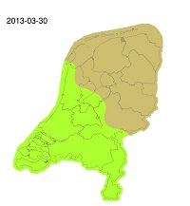
Phenology
“Phenology is the science that studies recurring biological events such as leaﬁng and blooming as well as their variations in space and time”.
Understanding this Phenological variability is critical to quantify the impact of climate change on the global biogeochemical cycles.
e.g. changes in the carbon and water cycles
To manage natural resources
e.g. timing of animal migration
Food production
e.g. timing of agricultural activities
Public health
e.g. timing of hay fever

Slide 3
Exploratory analysis
Two of the most important sources of spatiotemporal phenological data:
Phenological models based on weather-and/or location related factors
Land surface phenological metrics derived from Earth observation sensors

Slide 4
Phenological models
The Extended Spring indices(SIx):
a suite of models that transform daily temperatures into consistent phenological metrics [2].
predict the dates of ﬁrst leaf and of ﬁrst bloom for three key indicator species.
long-term (1980 to 2015) and high spatial resolution (1km) version of the Leaf and Bloom indices
[2] Mark D. Schwartz and others., “Spring onset variations and trends in the continental united states: past and regional assessment using temperature-based indices,”
Int. J. Climatol., 2013.
Notes:
More precisely, these models predict the dates of ﬁrst leaf and of ﬁrst bloom for three key indicator species.
These phenological dates can be used to track spring onset at continental scales. In this work, we use a new long-term (1980 to 2015) and high spatial resolution (1km) version of the Leaf and Bloom indices, which was recently generated for the conterminous US by adapting the SI-x models to a cloud computing environment [3].

Slide 5
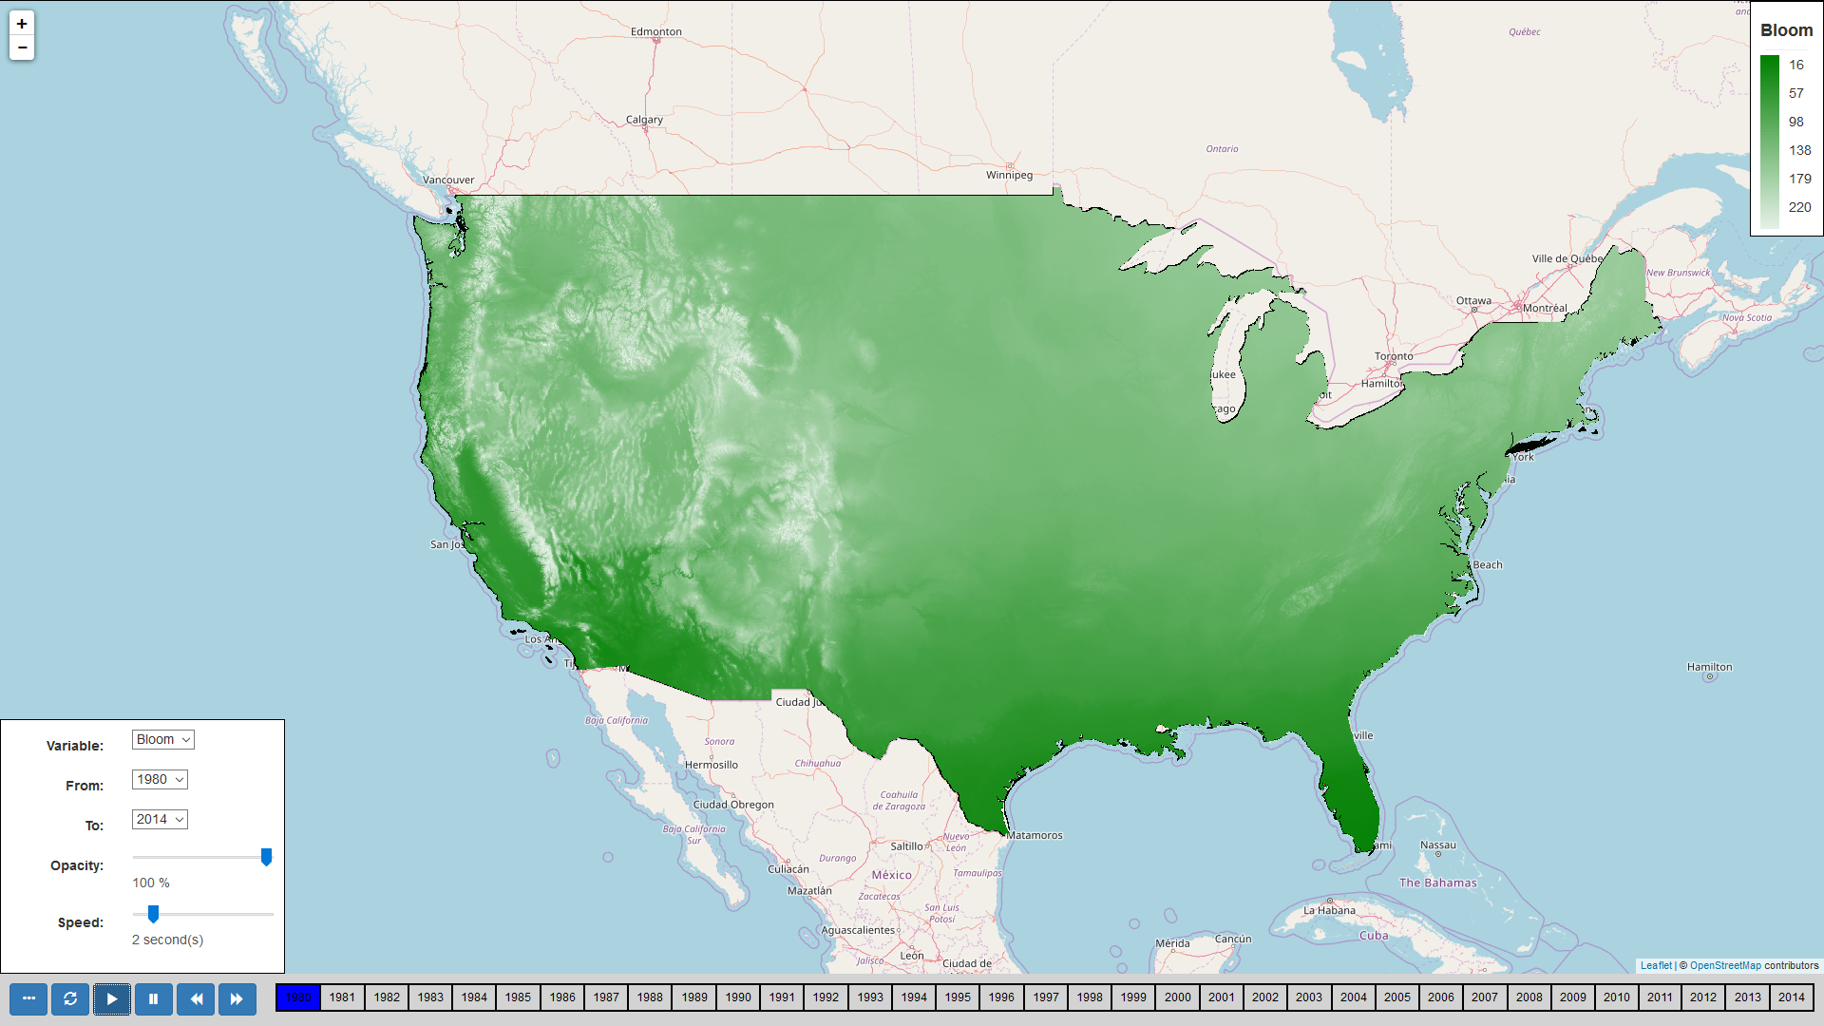
Green-wave
[3] Emma Izquierdo-Verdiguier, Raul Zurita-Milla, et al., “Using cloud computing to study trends and patterns in the extended spring indices,”
Third International Conference on Phenology, 2015.

Slide 6
Land surface phenology
Time series of remotely sensed data can be used to derive various land surface phenological metrics.
Start of Season (SOS)
Indicates the beginning of photosynthetic activity in plants.
Time series of the Advanced Very High Resolution Radiometer (AVHRR) sensor.
The spatial resolution of this product matches that of the SI-x but it is only available for the period 1989 - 2014.

Slide 7
Enable-Science
Identify regions with similar phenology
Notes:
Using these two phenological products and our computational platform, we ﬁrst identify regions with similar phenology (Section 2). Then, we study the correlation between the phenological products (Section 3) and, ﬁnally, we summarize our ﬁndings and present follow up activities (Section 4).

Slide 8
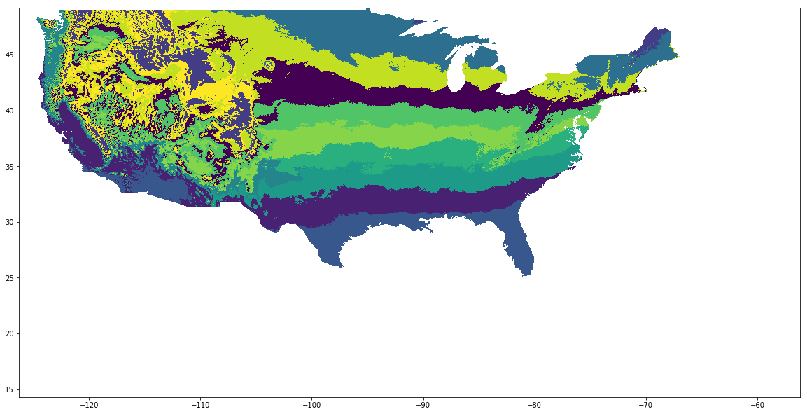
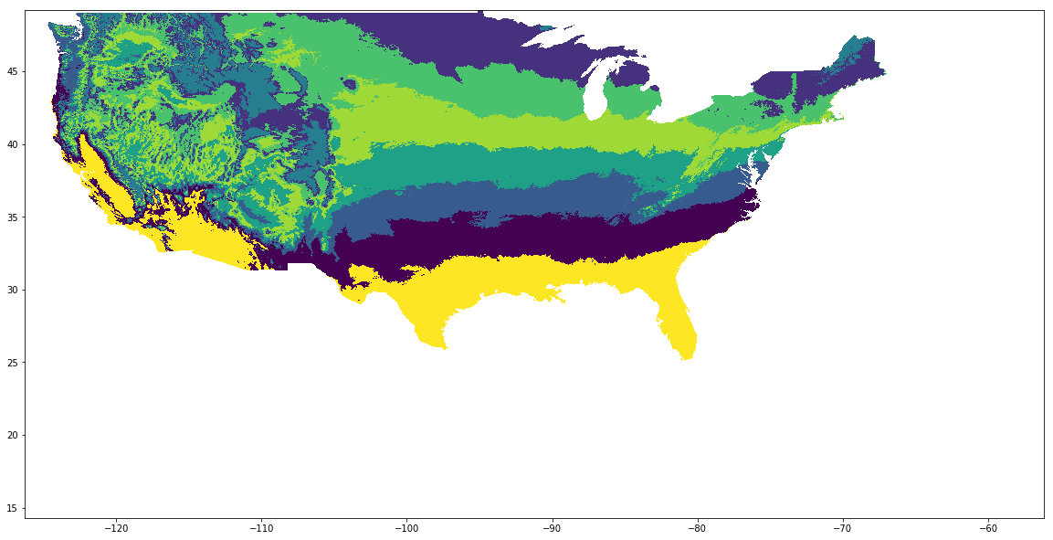
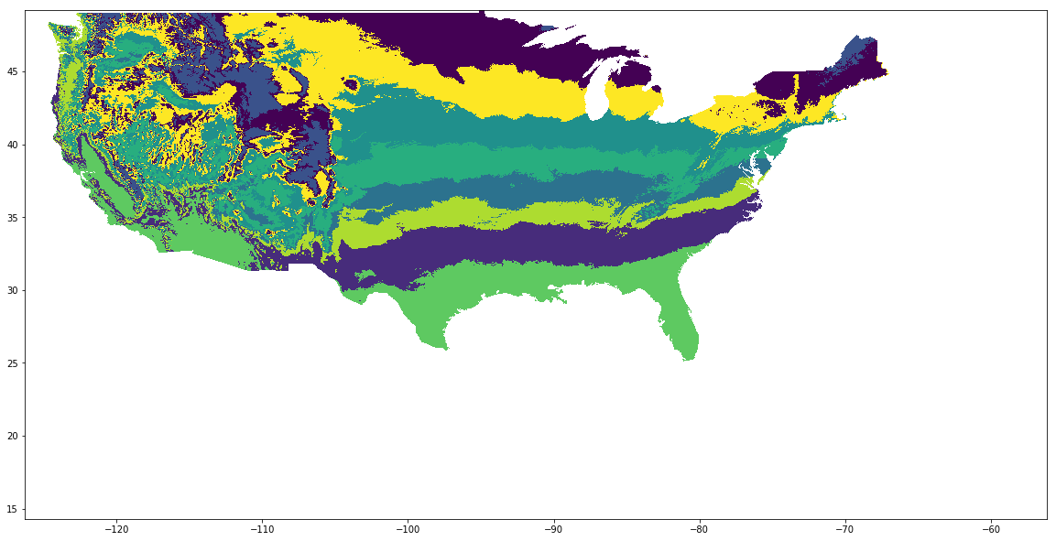
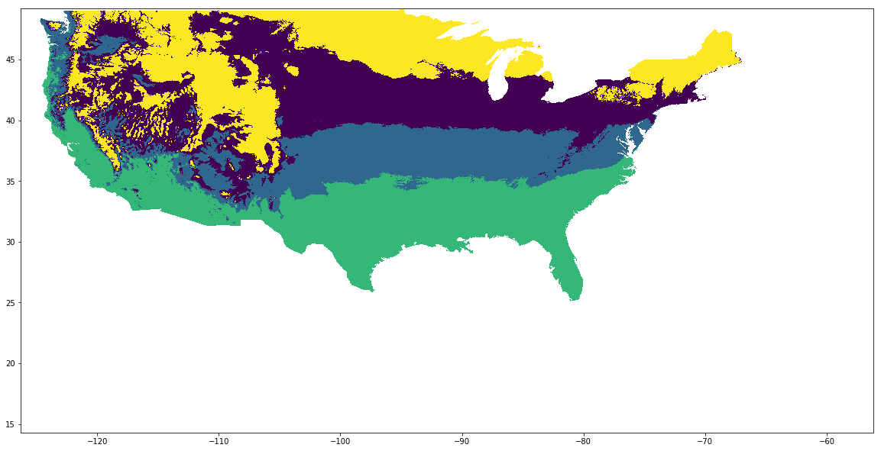
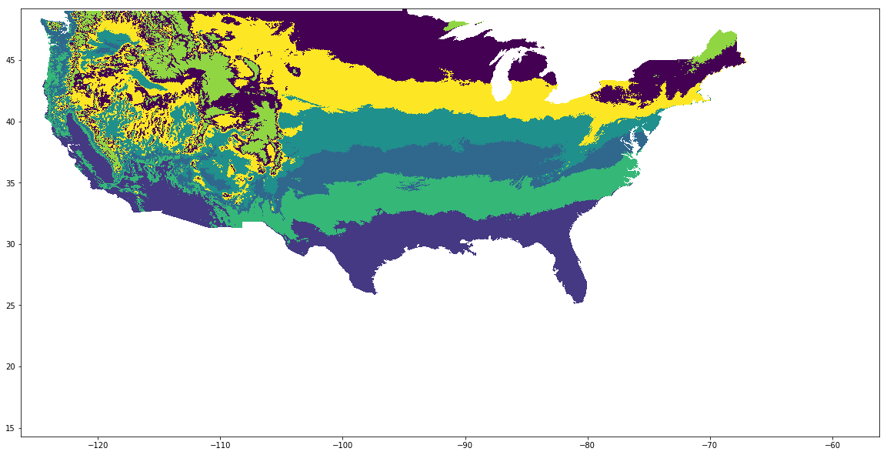
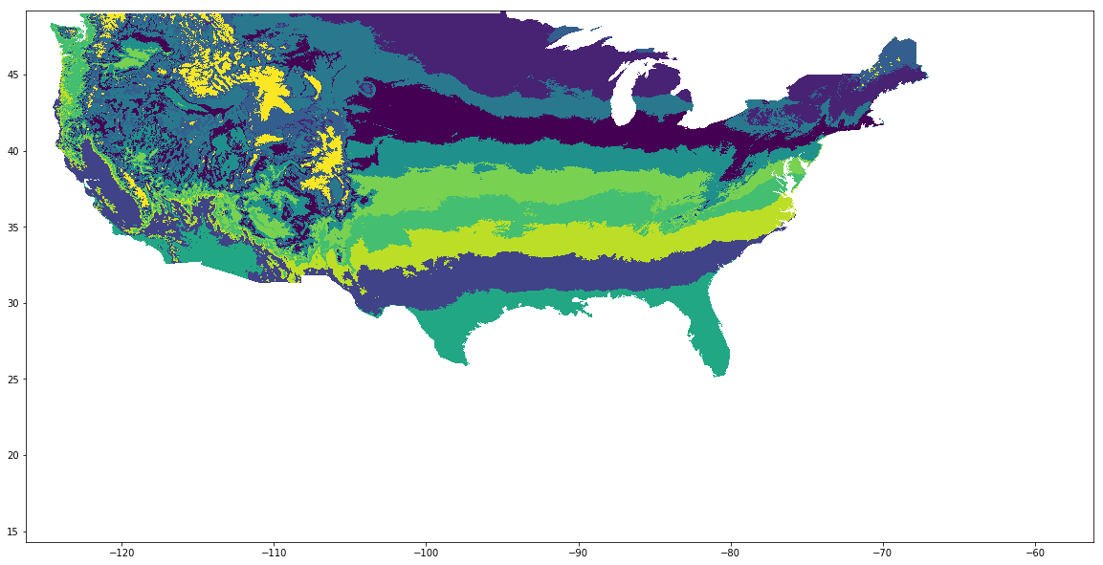
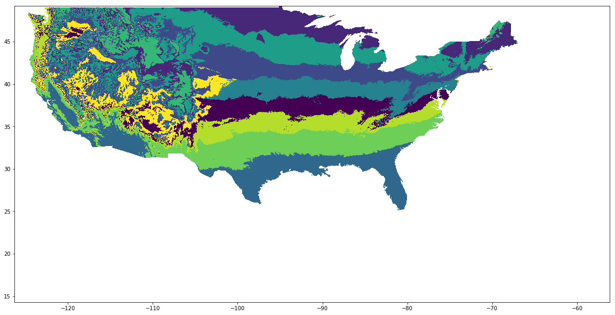
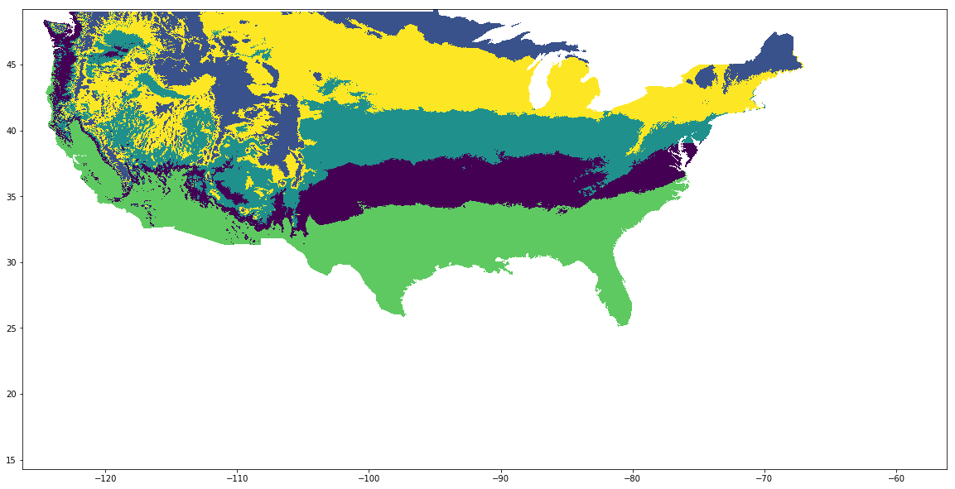
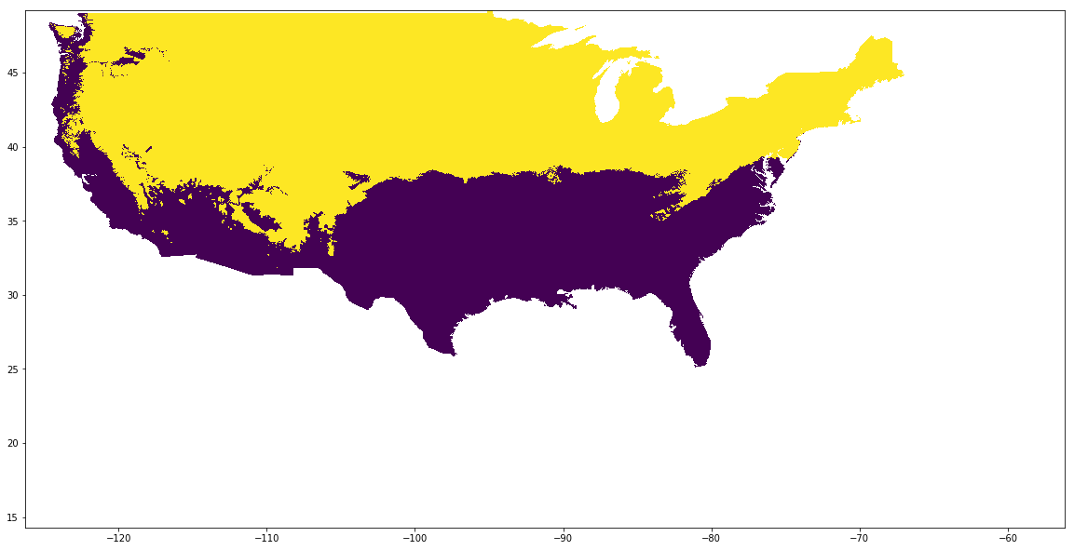
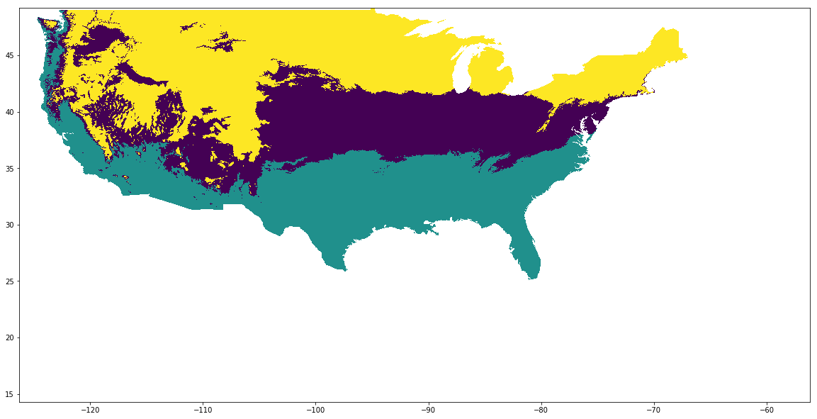
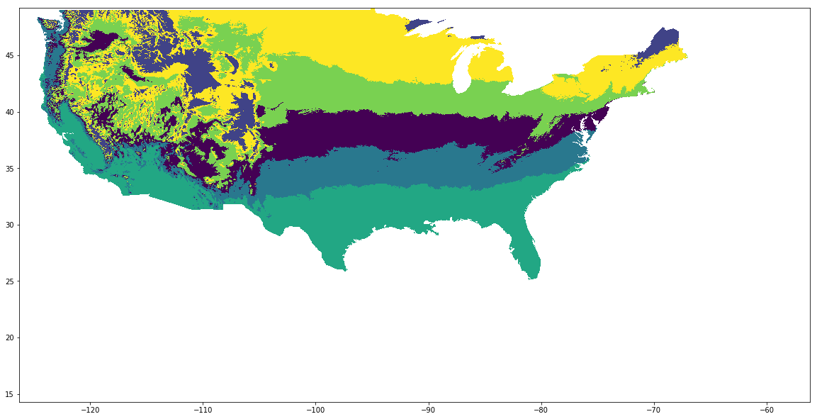
Identify regions with similar phenology

Slide 9
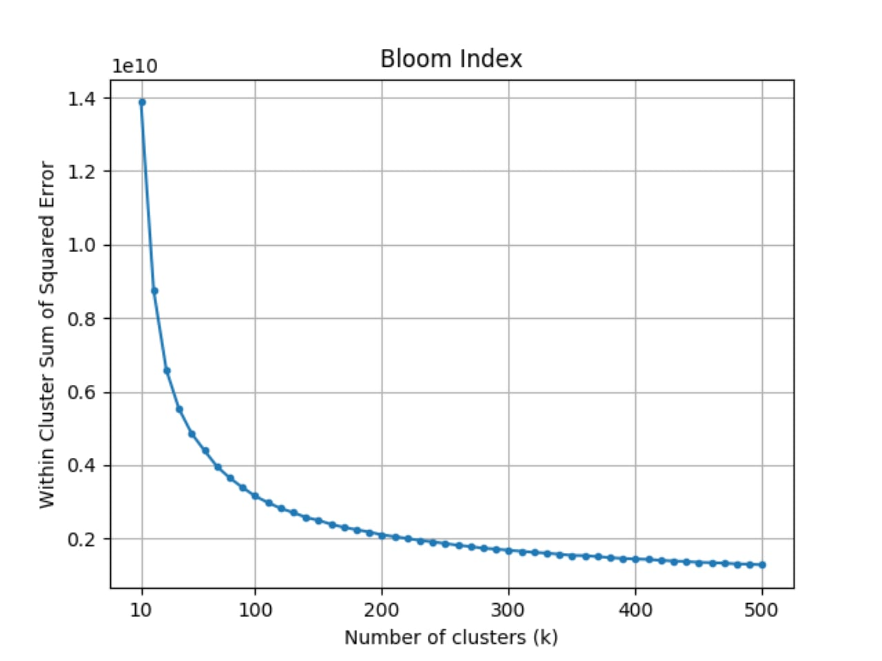
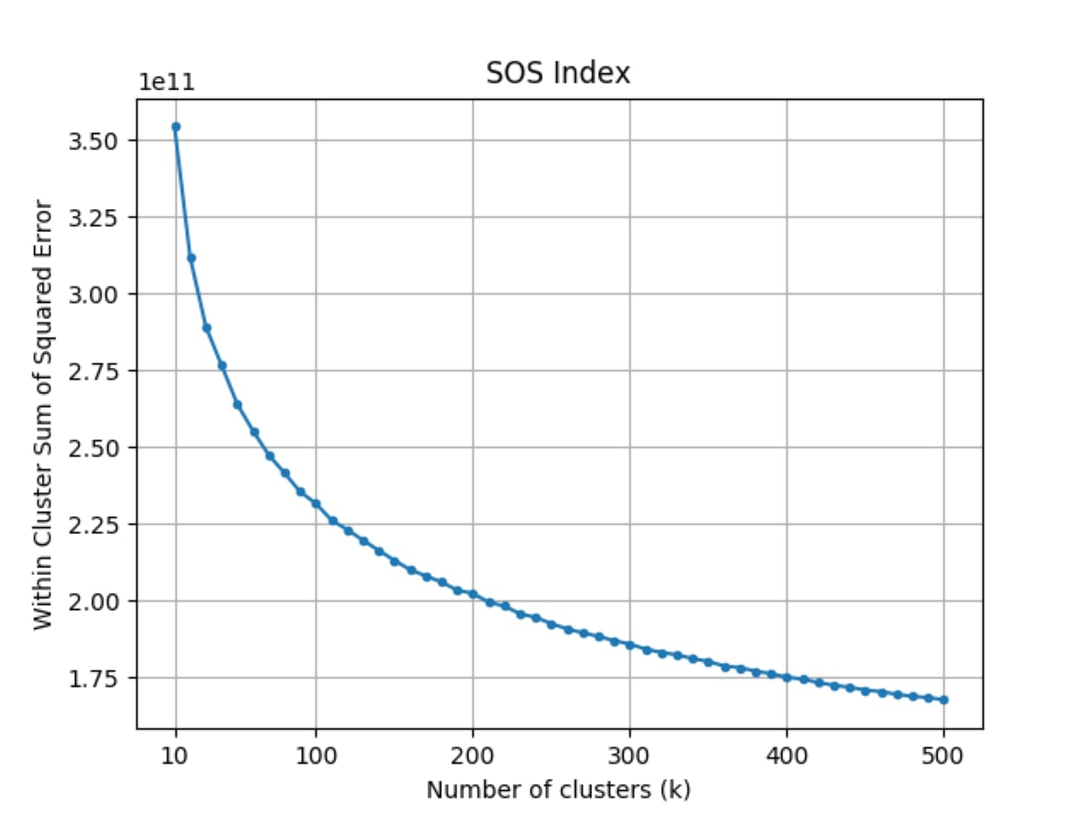
Kmeans-Clustering
Within cluster sum of squared Errors vs the number of clusters for the Bloom indices and the SOS metric
Notes:
Clustering is a popular exploratory data analysis method that allows analysts to study their datasets at a higher level of abstraction. Here we K-means to identify regions with similar phenology (i.e. phenoregions)
The three phenological products were clustered into k groups(with k values ranging from 10 to 500 in steps of 10) and the optimal k value was identiﬁed by the ”elbow” of the Within Cluster Sum of Squared Error (WCSSE) graph.

Slide 10
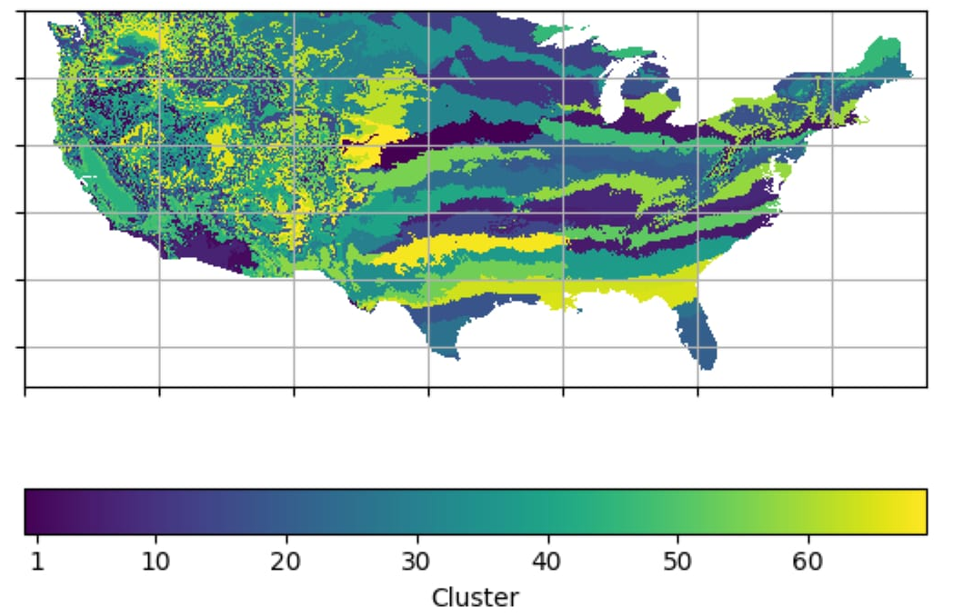
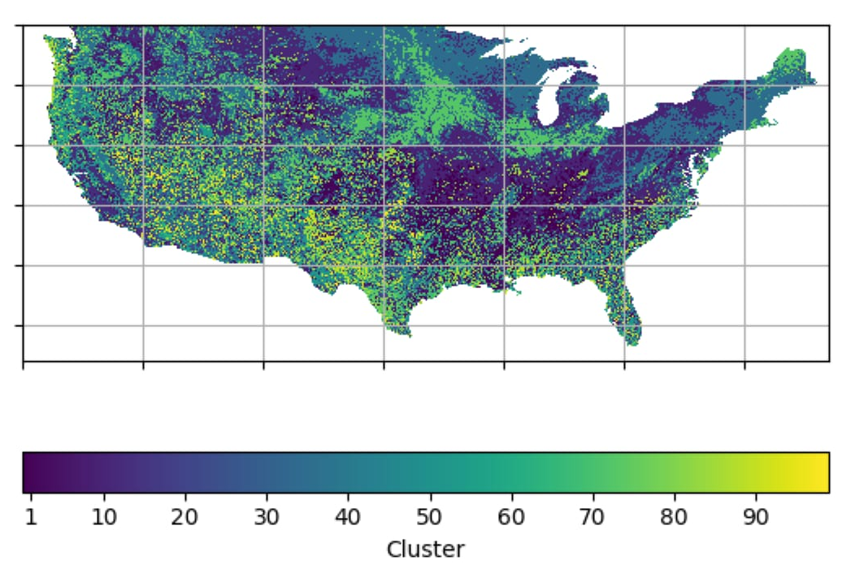
Kmeans-Clustering
Clustering maps for the Bloom indices (k=70) and the SOS metric (k=100)
Notes:
Figure 1 shows the WCSSE plots and the clustering results. The optimal number of phenoregions is 70 for the Leaf and Bloom indices and 100 for the SOS metric.
This indicates that land cover phenological variability is larger than the one caused by temperature differences.
However, the phenological regions derived from the spring indices have a much stronger spatial coherence, especially on the East Small scale differences in elevation and land cover lead to much more scattered phenoregions in the American West.

Slide 11
Enable-Science
Identify regions with similar phenology
Study the correlation between the phenological products
Notes:
The ecological meaning of land surface phenological metrics is not fully clear yet [4]. To shed light on this, we performed a spatiotemporal correlation analysis between the Leaf and Bloom indices and the SOS metric.

Slide 12
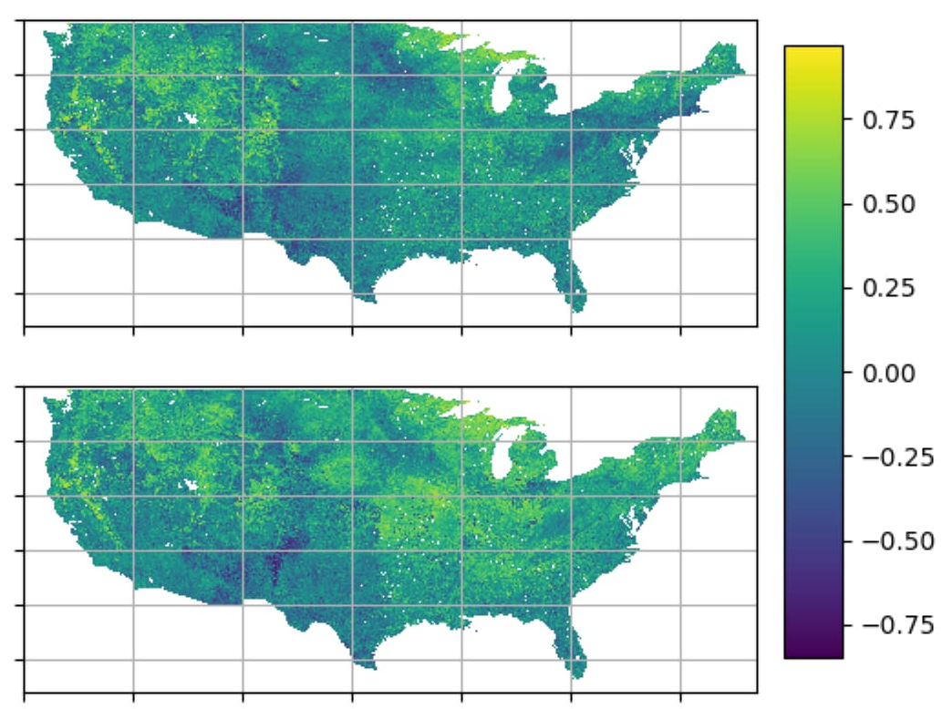
Correlation between the phenological products
the Leaf index and SOS
the Bloom index and SOS
Notes:
Figure 2 shows that large areas exhibit moderate to high positive correlations. This conﬁrms that temperature is, indeed, one of the main drivers of phenological development.
Our analysis also shows that the Leaf index is, in general, less correlated with the SOS than the Bloom index. This could indicate that satellites cannot detect the very early leaf onset, and that a certain amount of leaves (vegetation activity) is needed before spring can be seen from space.
Interestingly, ﬁgure 2 also shows areas with moderate to high negative correlation. These areas correspond to locations where phenology seems to be driven by other environmental factors (e.g. water) and to areas where the SOS happens in the second half of the year.

Slide 13
Enhance-Science
Identify regions with similar phenology
Study the correlation between the phenological products
Co-clustering
Principal component analysis
Notes:
the SVD helps to analyze/understand the covariablity of (gridded) time series. In our case, we want to see if the temperature based indices (extended spring indices) are "correlated" with satellite phenology
we have shown that temperature-based indices are both positively and negatively correlated with the AVHRR SOS metric. Further analysis is needed to better understand the complementary and synergistic value of these two phenological products.
Future work will deal with the integration of the millions of ground phenological observations collected by citizen scientists as well as with the analysis of very high spatial resolution phenological metrics from the Sentinel missions

Slide 14
Follow us at
High spatial resolution phenological modelling at continental scales: https://github.com/phenology
Infra-structure
hsr-phenological-modelling
Notes:
ESA cloudtoolbox

Slide 15



Questions?
Image from: http://aboutinterviews.com/5-questions-to-not-ask-in-a-job-interview/

