Slide 1

High spatial resolution phenological modelling at continental scales - Infra-structure
Romulo Goncalves
Alliance Project with ITC – University of Twente

Slide 2
Phenology
Phenology studies the timing of recurring plant and animal biological phases, their causes, and their interrelations. This seasonal timing varies from year to year and from place to place because it is strongly influenced by weather and climatic variability.
Understanding this Phenological variability is critical to quantify the impact of climate change on the global biogeochemical cycles.
e.g. changes in the carbon and water cycles
To manage natural resources
e.g. timing of animal migration
Food production
e.g. timing of agricultural activities
Public health
e.g. timing of hay fever

Slide 3
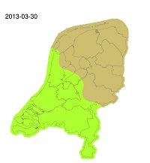
Green-wave
http://geoserver.itc.nl/greenwave/
It’s spring time! Or isn’t it ?
https://www.itc.nl/Pub/News-overview/2016/in2016-march/Its-spring-time!-Or-isnt-it.html

Slide 4








Technology

Slide 5
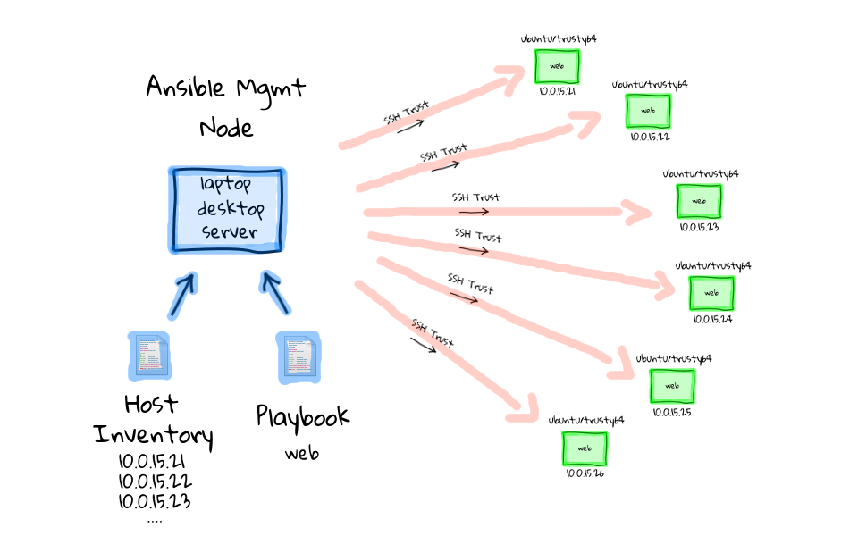




Infra-structure

Slide 6
Follow us at
All the action is happening:
https://github.com/nlesc-sherlock/emma
Phenology organization at GitHub:
https://github.com/phenology
https://github.com/phenology/infrastructure

Slide 7

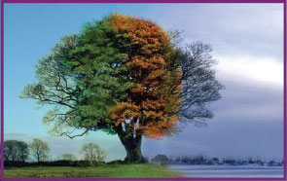

Questions?
Image from: http://aboutinterviews.com/5-questions-to-not-ask-in-a-job-interview/

