Slide 1

Presentation On Negative Effect of video games
Teacher name = sir wajid

Slide 2
“Group Members”
Hamza Khan “Introduction” “38”
Hammad Ahmed Khan “Main Body” “36”
Hafiz Jawad Akhtar “Main Body” “34”
Abdul Haseeb “Recommendation & conclusion” “04”

Slide 3
Introduction
What is video game?
Video game is made for fun and entertainment. But in our report we will discus it negative effect on children and people. Video game is invented in 1970 by Nintendo.
Negative effect of game ?
Academic Performance
Online game (spend money and time)
Video Game addiction
EFFECTS OF VIDEO GAMES ON HEALTH
Violent Video Games

Slide 4
Graphical representation Type of game people like

Slide 5

The Effects of Video Game Play On Academic Performance
Video game effect on Academic performance.
Distract their focus from study.
Don’t pay total attention on topic
and lecture in class.
Don’t sleep proper due to it
exam could not do well

Slide 6

Online game (spend money and time)
Online video game effect.
Spending money .
Spending a lots of times.
Electrical energy use.
Greediness of money (game digital currency)

Slide 7

Video Game addiction Effect
Video game addiction.
Video game became gambling.
Mental Disorders
Video game addiction like drugs

Slide 8

EFFECTS OF VIDEO GAMES ON HEALTH
Video game effect on heath and body.
Effect on thinking
Effect on eyes.
Effect on brain.(headaches)
Physical weakness

Slide 9

Violent Video Games
Negative effect of violent video Games.
Banded video games are not for children
it developed the mind to a wrong way.
Unwanted material and bloodiness seen
by child.(blood scene etc.)
Criminal thinking
Attempt subside. (blue whale game)

Slide 10
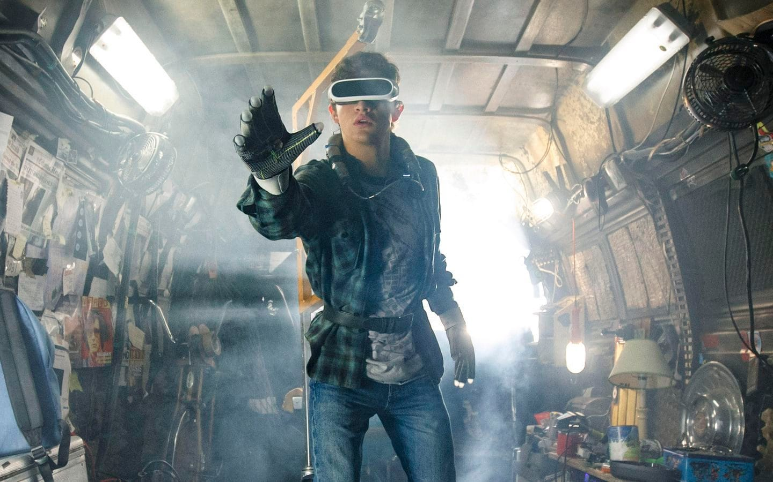
Can confuse reality and fantasy
The technology is so developed that in virtualization the virtual game forgot us what we are and where are we in 3d virtual game we confuses in reality and fantasy because of we are living in reality but we imagine it in fantasy because of it many incident are happen and people forgot what they are.

