Slide 1
OBD : technical overview
Chris Mungall
Notes:
NCORB
s/core4/core1

Slide 2
Outline
The annotation lifecycle
OBD Model and modeling requirements
Current OBD architecture
Discussion

Slide 3
The need for OBD
The value of any kind of data is greatly enhanced when it exists in a form that allows it to be integrated with other data
Current knowledge encoded using ontologies are fragmented across multiple databases, multiple schemas
OBD provides a common means of accessing and querying across these annotations

Slide 4
OBD - What is it?
  General purpose biomedical knowledgebase
    Repository of biomedical annotations
    Ontology-based queries and analysis
    Annotations from multiple sources can be compared through use of ontologies and ontology mappings
  Current primary use
    Genotype-phenotype associations for DBPs
  Future uses
    Annotation of information entities
      Documents, datasets, records, images
    Annotation of any biomedical entity using bio-ontologies

Slide 5
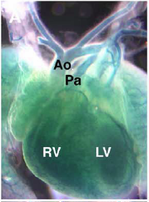
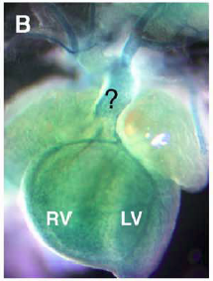
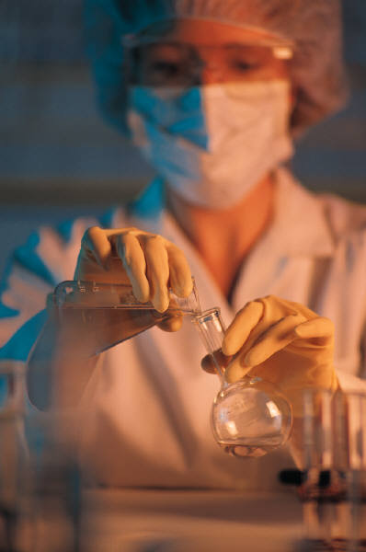
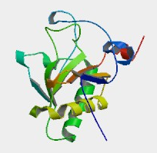
The annotation lifecycle
Absence
of aorta
Lab
db
investigator
read
Dev Biol 2005 Jul 15;283(2):357-72
observation
publish/
create
“Sonic hedgehog is required for cardiac outflow tract
and neural crest cell development”
Information entity
bio-entity
Experiment/
investigation
communicate
X
Direct
annotation
query/
meta-analysis
Agent+tools
(human/computer)
Community/expert
Shh⁻
Absence
Of aorta
annotation
Shh
bio-entity
Shh⁺
Heart
development
Computational representation
Notes:
Simplified: needs modified for high-throughput of course
Hypothesis generation and testing

Slide 6
What is an annotation?
OBD has a very inclusive definition of annotation
  An attributed statement positing some relation(s) between entities
  Typically accompanied by associations to evidence-oriented entities and metadata
Examples:
Shh participates_in heart development
p53 implicated_in cancer
p53 has_function DNA repair
PMID:1234 mentions melanoma
http://… depicts (lesion that located_in CA4)
Abc[-] influences blood pressure
Trial3456 has_inclusion_criteria (age that < 65)
Shh⁺
Participates
in
Heart
development

Slide 7
OBD and annotations
represents
subj
relation
obj
annotation
Absence
of aorta
investigator
read
Dev Biol 2005 Jul 15;283(2):357-72
observation
publish/
create
“Sonic hedgehog is required for cardiac outflow tract
and neural crest cell development”
Information entity
bio-entity
Experiment/
investigation
communicate
X
Direct
annotation
query/
meta-analysis
annotation
Agent
(human/computer)
Community/expert
Shh⁻
influences
Absence
Of aorta
local db
local db
submit/
consume
local db
Shh
bio-entity
Shh⁺
Heart
development
Participates
in
Multiple schemas
Computational representation
Notes:
Simplified: needs modified for high-throughput of course
Hypothesis generation and testing

Slide 8
Flexibility of OBD
Most ontology-based bio-curation focuses on stating associations between bio-entities and types as represented in ontologies
  Where bio-entities can be types or instances
    Genes, proteins, genotypes, cells, organisms, strains
OBD can also accommodate ‘tagging’ annotations
  E.g. Ontrez, term extraction from literature
  Associations between information entities and ontology terms
    E.g. documents, document parts, datasets, images

Slide 9
Ontrez in OBD
representation
subj
relation
obj
annotation
Absence
of aorta
investigator
PMID:1234
Read/
search
Dev Biol 2005 Jul 15;283(2):357-72
observation
publish/
Create/
“Sonic hedgehog is required for cardiac
outflow tract and neural crest cell development”
Information entity
bio-entity
extraction
Experiment/
investigation
communicate
X
Direct
annotation
query/
meta-analysis
annotation
Agent
(computer)
Community/expert
Cardiac
outflow
tract
describes
PMID:1234
abstract
Shh
bio-entity
Shh
describes
PMID:1234
abstract
Computational representation
Notes:
No explicit representation of association, other than co-annotation

Slide 10
OBD model: Requirements
Generic
  We can’t define a rigid schema for all of biomedicine
  Let the domain ontologies do the modeling of the domain
Expressive
  Use cases vary from simple ‘tagging’ to complex descriptions of biological phenomena
Formal semantics
  Amenable to logical reasoning
  FOL and/or OWL1.1
Standards-compatible
  Integratable with semantic web

Slide 11
OBD Model: overview
Graph-based: nodes and links
  Nodes: Classes, instances, relations
  Links: Relation instances
    Connect subject and object via relation plus additional properties
  Annotations: Posited links with attribution / evidence
Equivalent expressivity as RDF and OWL
  Links aka axioms and facts in OWL
  Attributed links:
    Named graphs
    Reification
    N-ary relation pattern
Supports construction of complex descriptions through graph model

Slide 12
Modeling requirement: descriptions
Descriptions are class expressions composed using multiple classes
  Genus and differentia
  Post-composed at annotation time
    Examples (in owl manchester syntax*):
      _{GO}Dendrite_spine that part_of _{CL}Golgi_cell
      _{PATO}Decreased_length that inheres_in (_{GO}Dendrite_spine that part_of _{CL}Golgi_cell)
  Ontologies can also contain these class expressions
    Pre-composed logical definitions
The ability to represent and reason over these descriptions is a key OBD requirement
* Existential quantifier omitted

Slide 13
Reasoning over descriptions
Query requirement
  Queries for annotations to “CNS neuron cell projection”
  Should return:
    Annotations to: _{GO}Dendrite_spine that part_of _{CL}Golgi_cell
Computational Requirements
  Entailments
    EL++ or greater
  OWL constructs
    intersectionOf
    equivalentClass
      Representing Phenotypes in OWL (OWLED 2007)

Slide 14
Example of
Annotation in OBD
Post-composition of complex anatomical entity descriptions
Post-composition of phenotype classes (PATO EQ formalism)
key

Slide 15
OBD Architecture
Two stacks
Semantic web stack
  First iteration
  Built using Sesame triplestore + OWLIM
  Limited developer resources
  Future iterations: Science-commons Virtuoso
OBD-SQL stack
  Current focus
  Traditional enterprise architecture
  Plugs into Semantic Web stack via D2RQ

Slide 16
OBD Architecture:
Two stacks

Slide 17
OBD-SQL Stack
Alpha version of API implemented
  Test clients access via SOAP
  Phenote current accesses via org.obo model & JDBC
Wraps org.obo model and OBD schema
  Share relational abstraction layer
  Org.obo wraps OWLAPI
Phenote currently connects via JDBC connectivity in org.obo

Slide 18
OBDAPI examples
node = getNodeById(“OMIM:601653”)
nodes = getNodesBySearch(“p53*”)
Sources = getSourceNodes()
nodes = getNodesBySource(“OMIM”)
nodes = getNodesByQuery(queryExpr)
graph = getAnnotationGraphAroundNode(“PATO:0001050”, true)
graph = getAnnotationGraphAroundNode(classExpr, true)
annots = getAnnotationStatementsForAnnotatedEntity(“Entrez:2138”)
stats = getSummaryStatistics()
stats = getCoAnnotatedNodes(“CL:1234567”)
stats = getEnrichedClasses(entityNodeList,Distribution.HYPERGEOMETRIC)

Slide 19
Objects sent over the wire
RESTful: OBD-XML
  rnc on sourceforge
SOAP: obd.model objects
  Core classes:
    Graph
    Node
      (instance nodes, class nodes, relation nodes)
    Statements
      LiteralStatement
      LinkStatement
  Payload can be requested ‘frame-style’ or ‘axiom-style’

Slide 20
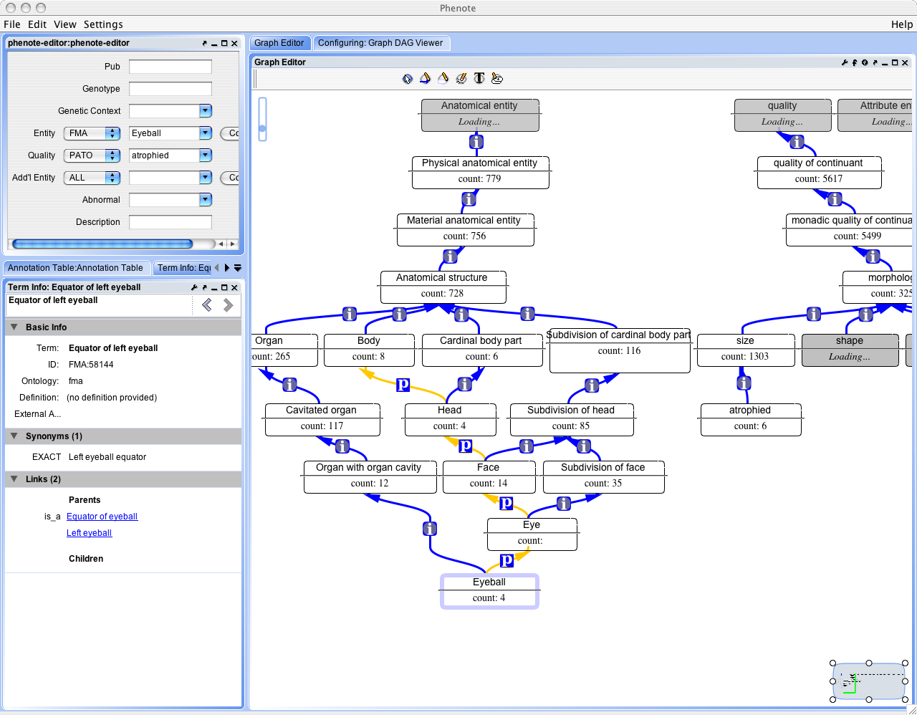
Phenote components as OBD clients
Currently
Implemented

Slide 21
Genome browser mashup
Sensory neuron
Vulva
Uterine muscle
locomotion
oviposition
Under
Development
(Holmes lab)

Slide 22
OBD Mediator Architecture
OBDAPI can act as client to other OBDAPIs
Mediator node distributes queries to source nodes

Slide 23
OBD-SQL Database
Generic minimal table model
Makes heavy use of views for core capabilities
  E.g.
    analyzing information content of classes based on annotation
  Views can be materialized for speed
Deductive closure of classes (named and class expressions) pre-computed
  Not a blind transitive closure
  Subset of OWL-DL semantics (EL++)
http://www.bioontology.org/wiki/index.php/OBD:OBD-SQL-Schema

Slide 24
OBD Dataflow

Slide 25
Analysis requirements
The value of any kind of data is greatly enhanced when it exists in a form that allows it to be integrated with other data
OBD must have capabilities for using to ontologies to query and analyze data effectively
Example:
  Classes in common between similar entities
  E.g. Gene homology and phenotype

Slide 26
Phenotype
Homology of anatomical structure
Sequence
homology

Slide 27
Visualisation and display of annotations
Annotation comparison
  Within species
    Combining annotatin sources
  Across species
    Translational research
OBD web-based interface
prototype

Slide 28
Discussion: Integration
How should OBD be integrated with BioPortal?
Use case:
  User queries for Sonic hedgehog on BioPortal
  What happens?
    What APIs are called?
    What components in the persistence layer are used?

Slide 29
OBDAPI in BioPortal: two choices
Choice 1: Two separate APIs
  Ontology API
  Annotation API
Choice 2: Unified API
  Use same API for search, implementing same behaviour
  Same submission services
  Same query model

Slide 30
Some requirements for unified API
Expressive model
  Logical expressivity on a par with OWL-DL
  Rich terminological and lifecycle model on a par with OBOF
Rich query model and capabilities
  Logical entailment for both named classes and class expressions
  Simple facades to express common queries
  Expressive queries for more complex cases
  Compiles to SQL & SPARQL

Slide 31
OBD Roadmap
Jan 2008
  Package OBD website
  OBD core API released
  Local-OBD installer
Mar 2008
  Port wrappers and import/export pipeline to java
  Prototype RoR BioPortal integration
  RESTful layer over API
May 2008
  SPARQL wrapper
  Integrate with Science Commons triplestore
  Dynamic wrappers for other data sources
  Analysis service layer released
  Pluggable reasoner framework
Sep 2008
  Integration with BIRN mediator

Slide 33
end

Slide 36
Requirements breakout

Slide 37
 | OBD | Ontrez
Model | assertions | tagging
Analogy | Database/knowledgebase | Search engine; flickr; index
Statements about | Any bio or info entity; Genetic entities; individuals; trials; … | Document and dataset elements
Canonical example | P53 protein variant gives rise to cancer | Document mentions p53 Document mentions cancer
Granularity | high | low
Accuracy | Function of expertise | Function of concept recgnition engine
Content generation | Human - expert/community Automated | Automated (text matching); Can be regenerated
Use | Search; finding annotations for entity of interest; finding similar entities; analysis; complex queries | Finding documents and datasets; input to curation?
Size | Curated: 100s to millions Automated: ? | 500gb?
Risk | Scalability Not enough assertions to have utility. - Ability to reason/query over large knowledgebase. Truth maintenance? | - Scalability - Variation in precision/accuracy across domains (biology vs clinical)

Slide 38
Ontrez annotation/tagging can be modeled by OBD annotation model

Slide 39
Share same API, model
Separate underlying databases, API collects results

Slide 40
Capability requirement | OBD | Ontrez
Content maintenance
Annotation tracking and mapping | Yes | no
Use of cross-ontology links | Yes (query expansion and in query) | Yes (‘semantic query expansion’)
Boolean queries | yes | yes
Composite descriptions | Yes | ? - perhaps in future
Search on annotated entities | Yes | ?
Reasoning; detecting contradictions | Yes | ?; no
Detailed provenance | Yes | ?
Modeling element metadata | no | yes
Distribution and local installation | yes | Parking lot
Content submission pipeline | yes | ?

Slide 41
Requirements for other resources | OBD | Ontrez
Ontology text definitions | yes | no
Distribution and local installation | yes | disagreement

Slide 42
Capabilities
Today
  Get annotations for ‘Shh’
    (synonym for “sonic hedgehog gene”)
    NCI Thesaurus axioms (BioPortal)

Slide 43
Use case
What happens when a user queries on Shh?
Sources:
  Ontologies
    Ncithesaurus
  Annotations
  Tagging
    Returns documents, datasets

