Slide 1
The NCBO Open Biomedical Ontology Database (OBD)
Chris Mungall
Notes:
The NCBO Open Biomedical Ontology Database (OBD) is a flexible
information system for querying and managing ontology-based
annotations across a wide variety of biological, clinical and
biomedical domains.
Currently, most biomedical annotations are stored in database silos
that are difficult to cross-query. Even in those situations where
ontologies are used to integrate data, database search and query
capabilities often do not take into account the semantics of
ontologies, yielding incomplete results.
OBD provides a framework and common high-level API for accessing
annotations derived from multiple sources, using ontologies to reveal
the implicit links buried in data.
In this talk I describe the OBD architecture, together with the use of
OBD within the context of the NCBO phenotype Driving Biological
Projects. Here, curators from the DBP institutions used the NCBO
Phenote tool to create human genotype-phenotype annotations using OMIM
as source. These phenotypes are modeled with expressive
post-coordinated constructs using a variety of ontologies, such as
PATO and the FMA. The annotations are housed in OBD where they can be
queried alongside model organism annotations, in which phenotypes may
be modeled using other ontologies. I present some solutions to the
challenge brought by homology at both gene and anatomical structure
levels.

Slide 2
Outline
Introduction
  Annotations
  The need for a database of ontological annotations
OBD Overview
Example of use
  NCBO phenotype annotations
  Using homology for translational medicine
OBD Implementation
  Migration to Jena/RDF
  Modeling annotations in RDF

Slide 3
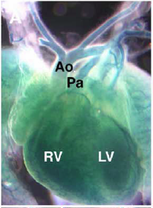
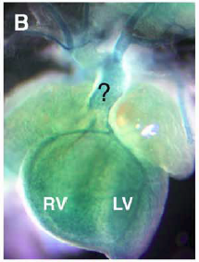

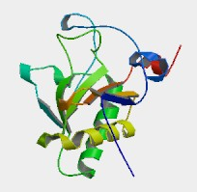
The annotation lifecycle
Absence
of aorta
Lab
db
investigator
read
Dev Biol 2005 Jul 15;283(2):357-72
observation
publish/
create
“Sonic hedgehog is required for cardiac outflow tract
and neural crest cell development”
Information entity
bio-entity
Experiment/
investigation
communicate
X
Direct
annotation
query/
meta-analysis
Agent+tools
(human/computer)
Community/expert
Shh⁻
Absence
Of aorta
annotation
Shh
bio-entity
Shh⁺
Heart
development
Computational representation
Notes:
Simplified: needs modified for high-throughput of course
Hypothesis generation and testing

Slide 4
What is an annotation?
OBD has a very inclusive definition of annotation
  An attributed statement positing some relation(s) between entities
  Typically accompanied by associations to evidence-oriented entities and metadata
Examples:
Shh participates_in heart development
p53 implicated_in cancer
p53 has_function DNA repair
PMID:1234 mentions melanoma
http://… depicts (lesion that located_in CA4)
Abc[-] influences blood pressure
Trial3456 has_inclusion_criteria (age that < 65)
Shh⁺
Participates
in
Heart
development

Slide 5
OBD and annotations
represents
subj
relation
obj
annotation
Absence
of aorta
investigator
read
Dev Biol 2005 Jul 15;283(2):357-72
observation
publish/
create
“Sonic hedgehog is required for cardiac outflow tract
and neural crest cell development”
Information entity
bio-entity
Experiment/
investigation
communicate
X
Direct
annotation
query/
meta-analysis
annotation
Agent
(human/computer)
Community/expert
Shh⁻
influences
Absence
Of aorta
local db
local db
submit/
consume
local db
Shh
bio-entity
Shh⁺
Heart
development
Participates
in
Multiple schemas
Computational representation
Notes:
Simplified: needs modified for high-throughput of course
Hypothesis generation and testing

Slide 6
Utility of annotations
Search
  Locating data and knowledge
Organizing and formalizing knowledge
Analysis
  Data mining
  Revealing implicit connections in data

Slide 7
Problems with existing databases
Lack of annotations
    Annotations are not curated in the first place
      NLP is hard
      Difficult to access, e.g. supplementary data
Lack of semantics
    Annotations don’t use ontologies
      E.g. free-text or ad-hoc terminologies
Locked in silos
    Closed or restricted databases
    No API or web services
    Cross-querying must be done manually
    API doesn’t use ontology semantics
      E.g. no way to search for mesenchyme-derived cell lines
    APIs not composable
Notes:
OBD helps with some of these

Slide 8
What does OBD provide?
UI, API, query layer and web-services for ontology-based annotations
Aggregation of annotations from multiple sources
Query and analysis capabilities
    E.g. Given a disease/phenotype class, retrieve
      Genes, genotypes, investigations
      Similar entities based on annotation profile
    Given a biological entity or piece of data, retrieve
      All annotations
Annotation management capabilities
  Maintain annotations in the context of ontology lifecycles

Slide 9
OBD
Architecture
overview
semweb
app
Java
app
any
app
OBD REST Layer
SPARQL
(via D2RQ)
OBD Java API
April 2008
Jena API
OBO API
OBD
SQL
RDF
triplestore
.obo
.owl

Slide 10
How is OBD queried?
Presentation layer
  Prototype
    http://spade.lbl.gov:8080/OBDUI
  To be integrated into BioPortal
RESTful requests
  Everything has a URL
  Everything available as
    OWL, JSON, text, OBDXML
Java APIs: OBDAPI & Jena
  Query objects
SPARQL
  Low-level RDF queries
For most users
Remote clients;
AJAX Mashups;
Non-java clients
Java clients
Semweb clients

Slide 11
OBD in NCBO: Phenotype Annotation
Genotype + Environment = Phenotype
Phenotypes are of broad interest to basic science and healthcare
  BIRN (R01): multiscale phenotype imaging
  NCBO DBPs:
    Annotation of human clinical phenotypes (OMIM)
    Comparison with model organism phenotypes
Components:
  Phenote
  Ontologies
  Genotype-Phenotype formalism
  OBD
Notes:
Also mention Das group.
Stress OBD is generic

Slide 12
Modeling phenotypes:
Named classes are not enough
Some ontologies pre-coordinate complex phenotype descriptions
  E.g. mammalian phenotype
Alternative is to post-coordinate at annotation time
  More flexibility
  Use PATO as base
  Class expressions
    OWL intersectionOf constructs
    ‘cross-products’
  ‘EQ’ information model
Can be nested arbitrarily deeply
General principle extending beyond phenotypes
MP:0001072
abnormal vestibulocochlear
nerve morphology
inheres_in
PATO:decreased
thickness
FMA:cochlear
nerve

Slide 13
NCBITaxon:9606
Homo sapiens
PATO:morphology
NCBI_Gene:EYA1
PATO:thickness
FMA:cranial
nerve
inheres_in
PATO:decreased
thickness
FMA:vestibulocochlear
nerve
OMIM:601653.nn
EYA1 variant
SO:gene
FMA:cochlear
nerve
PMID:1415348
SO:genotype

Slide 14
NCBITaxon:9606
Homo sapiens
DO:brancio-oto-renal
syndrome
GAD
PATO:morphology
NCBI_Gene:EYA1
PATO:thickness
FMA:cranial
nerve
inheres_in
PATO:decreased
thickness
FMA:vestibulocochlear
nerve
OMIM:601653.?
EYA1 variant
SO:gene
FMA:cochlear
nerve
FMA:cochlear
nerve
PMID:1415348
SO:genotype
inheres_in
PATO:hypoplastc
PMID:657583
FMA:kidney

Slide 15
http://{urlbase}/html/nodes/OMIM:601653
inheres_in
PATO:underdeveloped
OMIM:601653.?
EYA1 variant
FMA:Cochlear
nerve
PMID:1415348

Slide 16
http://{urlbase}/view/nodes/OMIM:601653
inheres_in
PATO:increased width
OMIM:601653.?
EYA1 variant
FMA:Vestibular
aqueduct
PMID:8533848

Slide 17
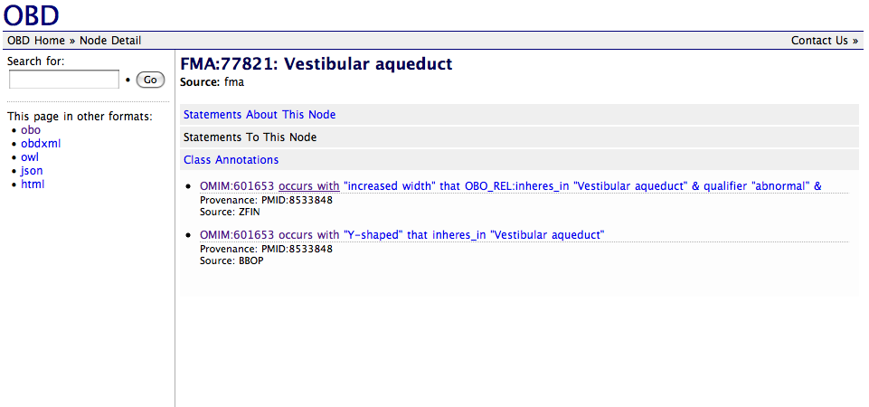
All annotations for an ontology class
http://{urlbase}/html/nodes/FMA:77821

Slide 18
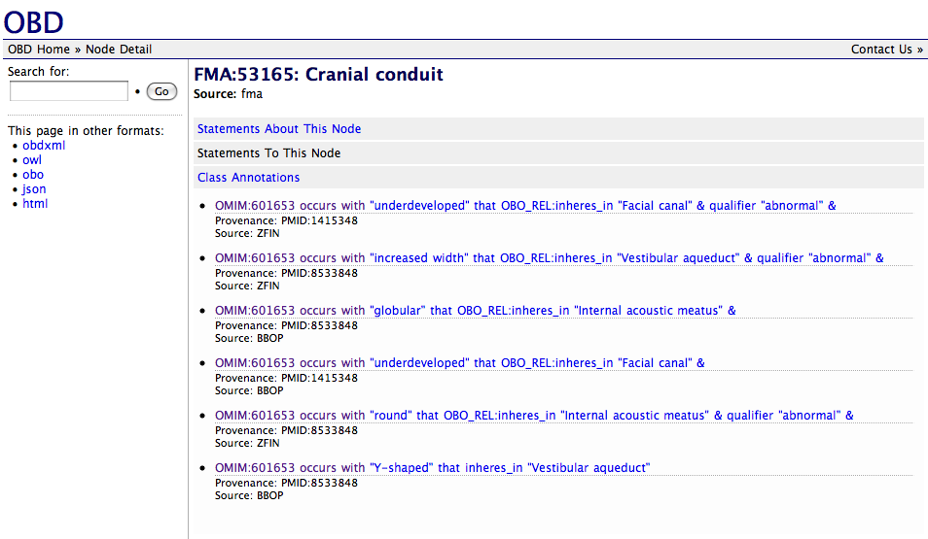
Inclusion of deductive closure
http://{urlbase}/html/nodes/FMA:53165

Slide 19
http://{urlbase}/owl/nodes/OMIM:601653/statements/all

Slide 20
http://{urlbase}/view/nodes/OMIM:601653
http://{urlbase}/html/nodes/OMIM:601653/sim

Slide 21
Aggregating annotations in OBD
Method
  Combine annotations from multiple sources
    NCBO, MODs, OMIM, GAD
  Use ontologies to integrate and aggregate information
Aggregating annotations adds value
  But requires comprehensive ontology content
    Logical definitions of classes
  Homology relations
    Gene level and ontology level
  Advanced querying and reasoning

Slide 22
Homology annotations/mappings

Slide 23
Homology annotations/mappings

Slide 24
MGI:EYA1
MGI
MP:abnormal vestibulocochlear
nerve morphology
MGI:nnn
eya1 variant nn
NCBITax:
Mouse
Homologene:
EYA1
NCBITax:
Human
NCBI_Gene:EYA1
NCBO
inheres_in
PATO:decreased
thickness
FMA:cochlear
nerve
OMIM:601653.nn
EYA1 variant
FMA:cochlear
nerve
ZFIN:eya1
ZFIN
inheres_in
PATO:decreased
thickness
ZFIN:geno-nnn
Eya1 variant nn
NCBITax:
Zebrafish
ZFA:cranial
nerve VIII

Slide 25
MGI:EYA1
MGI
MP:abnormal vestibulocochlear
nerve morphology
MGI:nnn
eya1 variant nn
=
NCBO
NCBITax:
Mouse
Homologene:
EYA1
inheres_in
PATO:morphology
NCBITax:
Human
MA:vestibulocochlear
VIII nerve
NCBI_Gene:EYA1
NCBO
inheres_in
PATO:decreased
thickness
FMA:cochlear
nerve
OMIM:601653.nn
EYA1 variant
FMA:cochlear
nerve
ZFIN:eya1
ZFIN
inheres_in
PATO:decreased
thickness
ZFIN:geno-nnn
Eya1 variant nn
NCBITax:
Zebrafish
ZFA:cranial
nerve VIII

Slide 26
MGI:EYA1
MGI
MP:abnormal vestibulocochlear
nerve morphology
MGI:nnn
eya1 variant nn
=
NCBITax:
Mouse
Homologene:
EYA1
inheres_in
PATO:morphology
NCBITax:
Human
MA:vestibulocochlear
VIII nerve
NCBI_Gene:EYA1
NCBO
inheres_in
PATO:decreased
thickness
FMA:vestibulocochlear
nerve
FMA:cochlear
nerve
OMIM:601653.nn
EYA1 variant
FMA:cochlear
nerve
ZFIN:eya1
ZFIN
inheres_in
PATO:decreased
thickness
ZFIN:geno-nnn
Eya1 variant nn
NCBITax:
Zebrafish
ZFA:cranial
nerve VIII

Slide 27
MGI:EYA1
MGI
MP:abnormal vestibulocochlear
nerve morphology
MGI:nnn
eya1 variant nn
=
NCBITax:
Mouse
Homologene:
EYA1
inheres_in
PATO:morphology
NCBITax:
Human
MA:vestibulocochlear
VIII nerve
NCBI_Gene:EYA1
NCBO
inheres_in
PATO:decreased
thickness
FMA:vestibulocochlear
nerve
FMA:cochlear
nerve
OMIM:601653.nn
EYA1 variant
FMA:cochlear
nerve
ZFIN:eya1
ZFIN
inheres_in
PATO:decreased
thickness
ZFIN:geno-nnn
Eya1 variant nn
homology
annotations
NCBITax:
Zebrafish
ZFA:cranial
nerve VIII
Notes:
Hypothesis: find missing information

Slide 28
MGI:EYA1
MGI
MP:abnormal vestibulocochlear
nerve morphology
MGI:PAX2
MGI:nnn
eya1 variant nn
=
NCBITax:
Mouse
Homologene:
EYA1
inheres_in
PATO:morphology
NCBITax:
Human
MA:vestibulocochlear
VIII nerve
NCBI_Gene:EYA1
NCBO
inheres_in
PATO:decreased
thickness
FMA:vestibulocochlear
nerve
FMA:cochlear
nerve
OMIM:601653.nn
EYA1 variant
FMA:cochlear
nerve
ZFIN:eya1
ZFIN
inheres_in
PATO:decreased
thickness
ZFIN:geno-nnn
Eya1 variant nn
homology
annotations
NCBITax:
Zebrafish
ZFA:cranial
nerve VIII
Notes:
Other target genes

Slide 29
Querying for annotations by homology mappings

Slide 30
Phenotype Homology Matrix

Slide 31
Results summary
Current OBD-phenotype kb size:
  333k annotations
    96% to named classes (pre-coordinated)
  3143 class expressions (post-coordinated classes)
Value
  Aggregating annotations and using ontologies can reveal implicit links in data
  Same methodology can apply to other annotation types
Plans
  Aggregate more annotations
  Analyze annotations with DBPs

Slide 32
OBD Architecture and evolution
History
Technical requirements
  Complex composite descriptions in OWL
  Reasoning over descriptions
  Modeling annotations in RDF
Jena implementation

Slide 33
OBD API evolution
History
  2006: Sesame triplestore
    SeRQL queries
    BigOWLIM
  2006-2007: OBDSQL + java API
    Custom SQL graphstore
    Forward chaining entailment
    OWLAPI bridge
    SPARQL via D2RQ
  2007-: Jena + triplestores
    OBDAPI wraps Jena
    Integration across NCBO, R01s, external groups

Slide 34
OBD Annotation formalism
Structure of annotation
    Annotation = Su Pr Ob context? qualifier* property*
  Generic
  Triple-like
Object
Subject
Relation
PMID:1234567
mentions
DO:brancio-oto-renal disease
property
evidence
mgrep

Slide 35
OBD Annotation formalism
Structure of annotation
    Annotation = Su Pr Ob context? qualifier* property*
  Generic
  Triple-like
  Nodes can be named entities or expressions
Object
Subject
Relation
inheres_in
PATO:decreased
thickness
OMIM:601653.nn
EYA1 variant
influences
FMA:cochlear
nerve
property
posits
PMID:1415348

Slide 36
Complex composed descriptions modeled naturally in OWL
OWL
layered as RDF:
[a owl:Class ;
owl:intersectionOf (
PATO:0000592 ,
[a owl:Restriction ;
owl:onProperty ro:inheres_in ;
owl:allValuesFrom FMA:53431
]
)
]
inheres_in
PATO:decreased
thickness
FMA:cochlear
nerve
OWL can be layered on RDF
leverage RDF APIs and SPARQL
But this is very low level
OWL APIs and query languages are better

Slide 37
OWL entailment required for annotation classes
RDFS entailment
not enough for post-
composed classes.
Some (small) fragment
Of OWL is required
inheres_in
PATO:morphology
FMA:nerve
Reasoner
Without reasoning
Over composed classes
Queries will be incomplete
inheres_in
PATO:decreased
thickness
FMA:cochlear
nerve

Slide 38
Annotations in RDF
An annotation is just an RDF triple, right?
Object
Subject
Relation
inheres_in
PATO:decreased
thickness
OMIM:601653.nn
EYA1 variant
influences
FMA:cochlear
nerve
property
posits
PMID:1415348

Slide 39
Annotations in RDF
An annotation is just an RDF triple, right?
Unfortunately, it’s more complicated..
  OWL-DL compatibility
  Reification vs named graphs
Object
Subject
Relation
inheres_in
PATO:decreased
thickness
OMIM:601653.nn
EYA1 variant
influences
FMA:cochlear
nerve
property
posits
PMID:1415348

Slide 40
Summary of annotation encoding patterns
Notes:
Based on HCLS etc

Slide 41
So many modeling options, which to choose?
Multiple modeling options
The best one is a function of multiple factors, including time
  Choosing one and sticking with it may not work
Impact of changes in RDF modeling strategy
  Non-trivial applications will break
  An intermediate layer can shield applications from changes

Slide 42
OBDAPI as intermediate layer on top of RDF API
OBDAPI:
  java
    getAnnotationStatementsForNode(‘CL:0000148’)
  REST
    http://{urlbase}/owl/nodes/CL:0000148/annotations
Notes:
Tbox-in-ABox

Slide 43
OBDAPI as intermediate layer on top of RDF API
OBDAPI:
  java
    getAnnotationStatementsForNode(‘CL:0000148’)
  REST
    http://{urlbase}/owl/nodes/CL:0000148/annotations
SPARQL:
CONSTRUCT
{ ?su ?rel ?ob .
?stmt rdf:subject ?su .
?stmt rdf:object ?ob .
?stmt rdf:predicate ?rel .
?stmt ?stmtRel ?stmtOb
}
FROM obd:asserted
FROM NAMED obd:entailed
WHERE
{
GRAPH obd:asserted
{
?su ?rel ?ob .
?stmt rdf:subject ?su .
?stmt rdf:object ?ob .
?stmt rdf:predicate ?rel .
OPTIONAL { ?stmt ?stmtRel ?stmtOb }
} .
GRAPH obd:entailed
{ ?ob ?relPrime cl:CL_0000148
}
}
Notes:
Tbox-in-ABox

Slide 44
OBDAPI as intermediate layer on top of RDF API
OBDAPI:
  java
    getAnnotationStatementsForNode(‘CL:0000148’)
  REST
    http://{urlbase}/owl/nodes/CL:0000148/annotations
SPARQL:
CONSTRUCT
{ ?su ?rel ?ob .
?stmt rdf:subject ?su .
?stmt rdf:object ?ob .
?stmt rdf:predicate ?rel .
?stmt ?stmtRel ?stmtOb
}
FROM obd:asserted
FROM NAMED obd:entailed
WHERE
{
GRAPH obd:asserted
{
?su ?rel ?ob .
?stmt rdf:subject ?su .
?stmt rdf:object ?ob .
?stmt rdf:predicate ?rel .
OPTIONAL { ?stmt ?stmtRel ?stmtOb }
} .
GRAPH obd:entailed
{ ?ob rdfs:subClassOf ?restr .
?restr a owl:Restriction .
?restr onProperty ?relPrime
?restr someValuesFrom cl:CL_0000148
}
}
Notes:
RDF-OWL pattern

Slide 45
OBDAPI as intermediate layer on top of RDF API
OBDAPI:
  java
    getAnnotationStatementsForNode(‘CL:0000148’)
  REST
    http://{urlbase}/owl/nodes/CL:0000148/annotations
SPARQL:
CONSTRUCT
{ ?su ?rel ?ob .
?stmt rdf:subject ?su .
?stmt rdf:object ?ob .
?stmt rdf:predicate ?rel .
?stmt ?stmtRel ?stmtOb
}
FROM obd:asserted
FROM NAMED obd:entailed
WHERE
{
GRAPH obd:asserted
{
?su ?rel ?obInst .
?obInst a ?ob
?stmt rdf:subject ?su .
?stmt rdf:object ?obInst .
?stmt rdf:predicate ?rel .
OPTIONAL { ?stmt ?stmtRel ?stmtOb }
} .
GRAPH obd:entailed
{ ?ob rdfs:subClassOf ?restr .
?restr a owl:Restriction .
?restr onProperty ?relPrime
?restr someValuesFrom cl:CL_0000148
}
}

Slide 46
OBDAPI Query Objects
OBDAPI:
  java
    // all entities annotated to some part of the hippocampus
    // and involved in parkinsonian disorders
    bq = new BooleanQueryTerm(Operator.AND);
    bq.addQueryTerm(new LinkQueryTerm(partOf,‘FMA:62493’));
    bq.addQueryTerm(‘DOID:3753’); // parkinsonian disorders
    getNodesByQueryTerm(new AnnotationQueryTerm(bq));
  REST
    not yet exposed at REST level

Slide 47
OBDAPI Query Objects
OBDAPI:
  java
    // all entities annotated to some part of the hippocampus
    // and involved in parkinsonian disorders
    bq = new BooleanQueryTerm(Operator.AND);
    bq.addQueryTerm(new LinkQueryTerm(partOf,‘FMA:62493’));
    bq.addQueryTerm(‘DOID:3753’); // parkinsonian disorders
    getNodesByQueryTerm(new AnnotationQueryTerm(bq));
  REST
    not yet exposed at REST level
SPARQL:
SELECT
{ ?n }
WHERE
{
?stmt1 rdf:subject ?n .
?stmt2 rdf:subject ?n .
?stmt1 rdf:subject ?p1 .
?p1 rdfs:subClassOf ?pr1 .
?pr1 a owl:Restriction .
?pr1 someValuesFrom ?hcp .
?hcp rdfs:subClassOf ?r .
?r a owl:Restriction .
?r onProperty ro:part of .
?r someValuesFrom FMA:62493 .
?stmt2 rdf:subject ?p2 .
?p2 rdfs:subClassOf DOID:3753
}

Slide 48
Current approach
Use OBD API as intermediate layer
Translate API calls and queries to Jena/SPARQL
Applications have choice of which layer to target

Slide 49
Forthcoming features
BioPortal presentation layer integration
OBR (aka Ontrez) backend integration
Analysis capabilities
  Class enrichment
  Semantic similarity
  Rule mining
Annotation management
  Submission pipeline
  Annotation mapping across ontology versions

Slide 50
Summary
OBD provide a means to aggregate and query annotations
  Simple yet expressive
  Uses ontology semantics
  Inter-ontology links are invaluable
Semantic web technology can provide a unifying layer
  But an intermediate layer is still required

Slide 51
end

Slide 52
Acknowledgments

Slide 54
Summary of modeling options
Ignore the OWL-full problem
Model statement but not meaning
‘Abox’ trick
  Treat classes as individuals
Anonymous individuals
  Works well for [I,C]
  Semantically weaker
Use OWL Axioms [C,C]
  Current OBD approach
Use OWL Descriptions [C,C]
  Cf neurocommons/HCLS approach
  Complex
Notes:
Not mutually exclusive

Slide 55
OWL Approaches [C,C]
Use OWL Axioms
  E.g.
    GenotypeX SubClassOf
      [ a owl:Restriction ;
      owl:onProperty ro:influences ;
      owl:someValuesFrom phenoY ]
Use OWL Descriptions
  E.g.
    IntersectionOf(GenoX, restriction(ro:influences,some(phenoY)))
    Neurocommons names this class
      then states that some instance of this exists
Caveats:
  RDF APIs and SPARQL are too low level to work with these effectively
    SPARQL-DL
  Triplestores will have incomplete semantics

Slide 56
Statement properties
Provenance evidence etc
Approaches
  Reification?
  Named graphs?
  N-ary relations?
  OWL1.1 annotation axioms?
    RDF representation not setteled
  Neurocommons pattern
    Triple between evidence instance and owl description

Slide 57
RDF triplestores
Scalability
  Difficult to determine
  High risk
  Most benchmarks are for semantic web use cases
Expressivity
  Most have RDFS semantics
  Extensions (BigOWLIM) are experimental

Slide 58
RDFS issues: all-some relations
Problem: ontology relations
  Non-subclass axioms involve OWL Descriptions
  E.g.
    Heart_ventricle subClassOf [ a owl:Restriction ; onProperty part_of ; someValuesFrom Heart ]
  Transitivity invisible to RDFS
  Queries will be woefully incomplete
Solution: ‘Abox trick’
  Make direct triples <Heart_ventricle part_of Heart>
  Employed by neurocommons, Uwash/SIG
  Problems:
    Unclear semantics, OWL-Full, less expressivity

Slide 59
RDFS Issues: expressivity
OWL Descriptions are required for all serious use cases
  E.g. post-coordinated descriptions
Ontologies are increasingly using intersectionOf descriptions + equivalentClass axioms

Slide 60
Why is this not an issue for others?
Semantic web use cases focus on small simple ontologies (e.g. FOAF) and large simple ABoxes

Slide 61
Annotations in RDF: simple triple approach
Pattern: all annotation statements as triples
  <?su ?rel ?ob>
  E.g.
    Img:123 depicts do:breast_neoplasm [I,C]
    genotypeABC influences phenotypeXYZ [C,C]
Open questions
  Metadata: reification or named graphs?
Advantages:
  Lightweight
  Maximum leverage from SPARQL and RDF tools
Disadvantages:
  Not OWL-DL compatible
Notes:
Violates DL if relation is objectProeprty and class is in TBox

Slide 63
MGI:EYA1
MGI
MP:abnormal vestibulocochlear
nerve morphology
MGI:nnn
eya1 variant nn
NCBITax:
Mouse
Homologene:
EYA1
NCBITax:
Human
NCBI_Gene:EYA1
NCBO
inheres_in
PATO:decreased
thickness
FMA:cochlear
nerve
OMIM:601653.nn
EYA1 variant
FMA:cochlear
nerve
ZFIN:eya1
ZFIN
inheres_in
PATO:decreased
thickness
ZFIN:geno-nnn
Eya1 variant nn
NCBITax:
Zebrafish
ZFA:cranial
nerve VIII

Slide 64
MGI:EYA1
MGI
MP:abnormal vestibulocochlear
nerve morphology
MGI:nnn
eya1 variant nn
=
NCBO
NCBITax:
Mouse
Homologene:
EYA1
inheres_in
PATO:morphology
NCBITax:
Human
MA:vestibulocochlear
VIII nerve
NCBI_Gene:EYA1
NCBO
inheres_in
PATO:decreased
thickness
FMA:cochlear
nerve
OMIM:601653.nn
EYA1 variant
FMA:cochlear
nerve
ZFIN:eya1
ZFIN
inheres_in
PATO:decreased
thickness
ZFIN:geno-nnn
Eya1 variant nn
NCBITax:
Zebrafish
ZFA:cranial
nerve VIII

Slide 65
MGI:EYA1
MGI
MP:abnormal vestibulocochlear
nerve morphology
MGI:nnn
eya1 variant nn
=
NCBITax:
Mouse
Homologene:
EYA1
inheres_in
PATO:morphology
NCBITax:
Human
MA:vestibulocochlear
VIII nerve
NCBI_Gene:EYA1
NCBO
inheres_in
PATO:decreased
thickness
FMA:vestibulocochlear
nerve
FMA:cochlear
nerve
OMIM:601653.nn
EYA1 variant
FMA:cochlear
nerve
ZFIN:eya1
ZFIN
inheres_in
PATO:decreased
thickness
ZFIN:geno-nnn
Eya1 variant nn
NCBITax:
Zebrafish
ZFA:cranial
nerve VIII

Slide 66
MGI:EYA1
MGI
MP:abnormal vestibulocochlear
nerve morphology
MGI:nnn
eya1 variant nn
=
NCBITax:
Mouse
Homologene:
EYA1
inheres_in
PATO:morphology
NCBITax:
Human
MA:vestibulocochlear
VIII nerve
NCBI_Gene:EYA1
NCBO
inheres_in
PATO:decreased
thickness
FMA:vestibulocochlear
nerve
FMA:cochlear
nerve
OMIM:601653.nn
EYA1 variant
FMA:cochlear
nerve
ZFIN:eya1
ZFIN
inheres_in
PATO:decreased
thickness
ZFIN:geno-nnn
Eya1 variant nn
homology
annotations
NCBITax:
Zebrafish
ZFA:cranial
nerve VIII
Notes:
Hypothesis: find missing information

Slide 67
MGI:EYA1
MGI
MP:abnormal vestibulocochlear
nerve morphology
MGI:PAX2
MGI:nnn
eya1 variant nn
=
NCBITax:
Mouse
Homologene:
EYA1
inheres_in
PATO:morphology
NCBITax:
Human
MA:vestibulocochlear
VIII nerve
NCBI_Gene:EYA1
NCBO
inheres_in
PATO:decreased
thickness
FMA:vestibulocochlear
nerve
FMA:cochlear
nerve
OMIM:601653.nn
EYA1 variant
FMA:cochlear
nerve
ZFIN:eya1
ZFIN
inheres_in
PATO:decreased
thickness
ZFIN:geno-nnn
Eya1 variant nn
homology
annotations
NCBITax:
Zebrafish
ZFA:cranial
nerve VIII
Notes:
Other target genes

Slide 68
semweb
app
Java
app
any
app
OBD REST Layer
D2RQ
OBD Java API
April 2008
Jena API
OBO API
OBD
SQL
RDF
triplestore
.obo
.owl

