Slide 1
Phylo-pheno

Slide 2
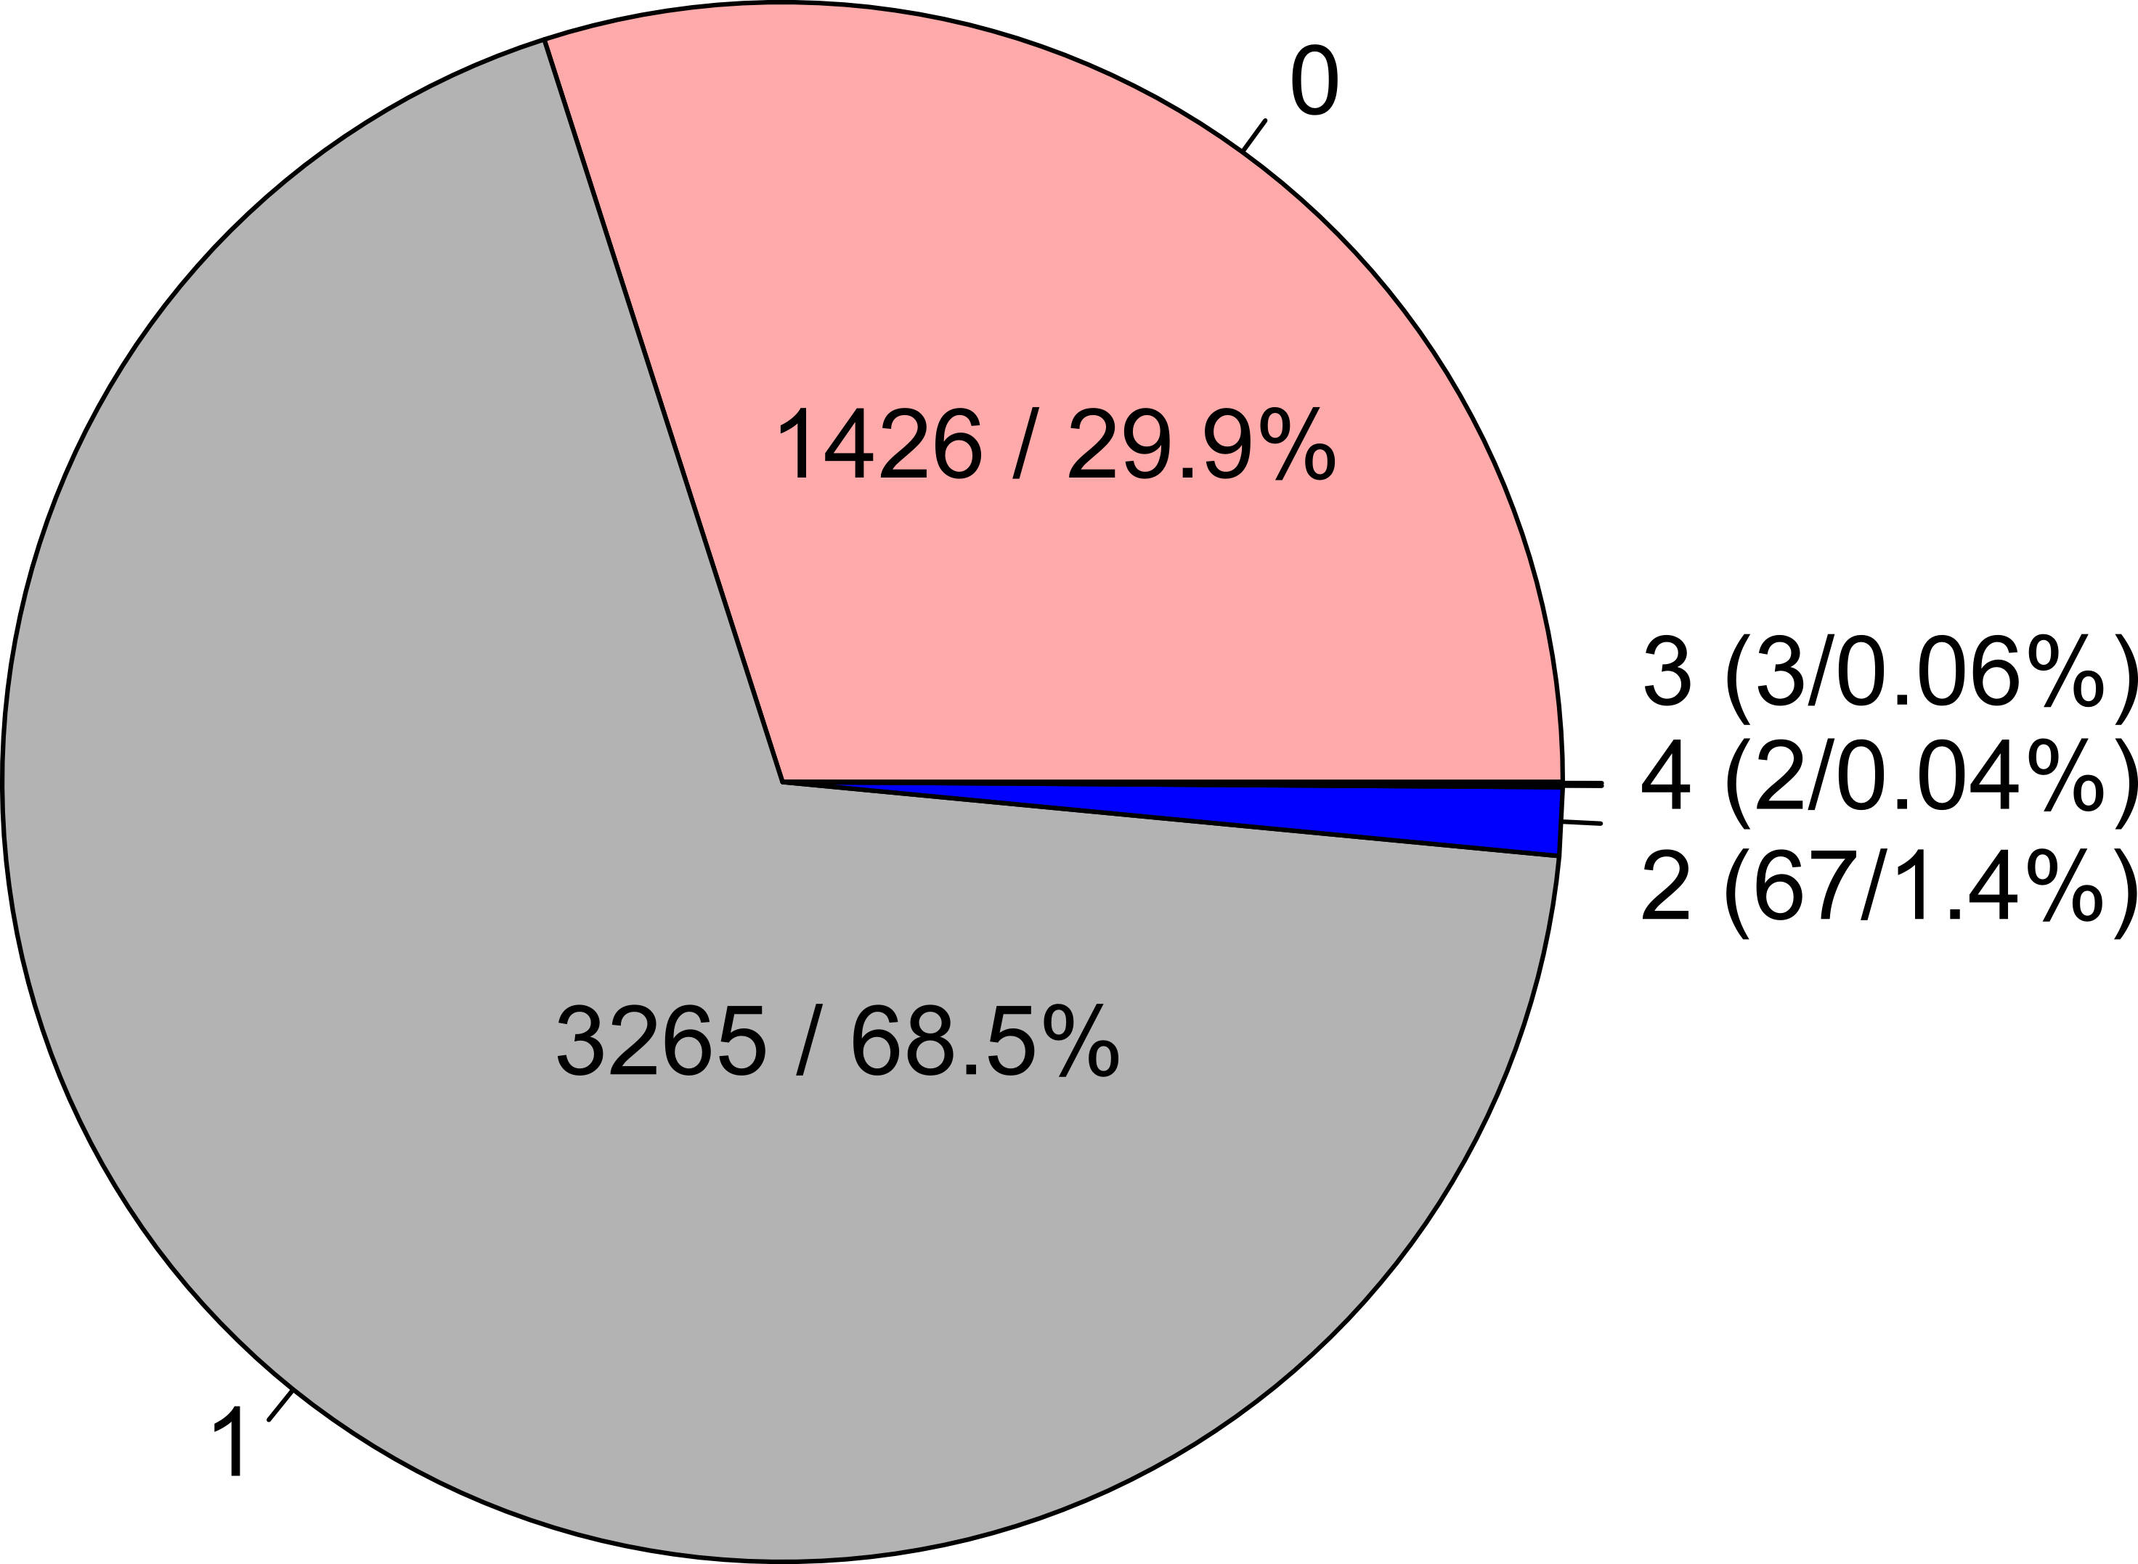
Proportion of number of OTT-VTO matches
Total: 4763
OTT – Open Tree Taxonomy
VTO – Vertebrate Taxonomy Ontology

Slide 3
OTT-VTO taxon match mapped
on catfish (Siluriformes) OpenTree synthetic phylogeny
# OTT to VTO
match
0
1
2
3
OTT – Open Tree Taxonomy
VTO – Vertebrate Taxonomy Ontology
4

Slide 4
Final reconciliation
NCBI matched | 43,249
TNRS exact matches | 51,440
TNRS synonyms | 3108
missing | 9087

Slide 5
Multiple VTO mappings to a single Open Tree ID

Slide 6
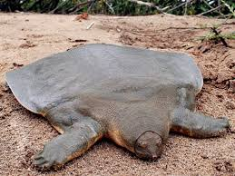
Trionychidae
Cretalamna
Amyda radula
Plastomenus communis
Plastomenus lachrymalis
Amyda cariosa
Plastomenus corrugatus
Trionychidae
Plastomenus leptomitus
Plastomenus fractus
Amyda menenri

