Slide 1
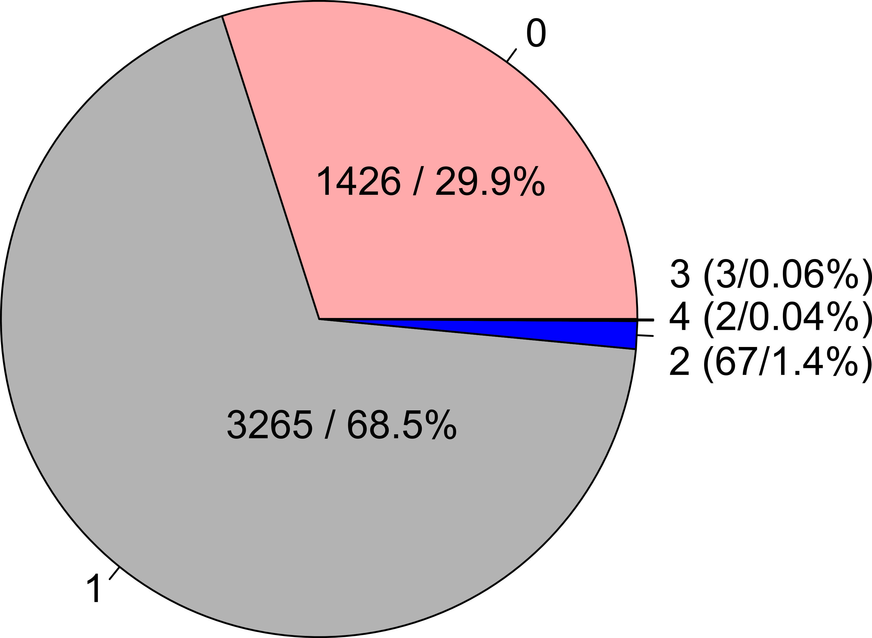
Proportion of number of OTT-VTO matches
Total: 4763
OTT – Open Tree Taxonomy
VTO – Vertebrate Taxonomy Ontology

Slide 2
OTT-VTO taxon match mapped
on catfish (Siluriformes) OpenTree synthetic phylogeny
# OTT to VTO
match
0
1
2
3
OTT – Open Tree Taxonomy
VTO – Vertebrate Taxonomy Ontology
4

