Slide 1
Names, Ranks, Clades, and Taxonomy Ontologies
Peter E. Midford
University of Kansas
Phenoscape Project

Slide 2
Overview
What’s in a taxonomy ontology?
Examples
What (ontologically) are species?
What (ontologically) are higher taxa?
What (ontologically) are taxonomic ranks?
Bridging the gap with phylogenetics

Slide 3
What’s in a taxonomy ontology?
Terms
  Taxa
  Ranks
Relations
  Taxa -> Taxa
  Taxa -> Rank
  Rank -> Rank
Species
Genus
Su 19063
Danio rerio
Danio
Notes:
Diagram is schematic of relations in a taxonomy ontology - this will appear in later slides to indicate what relations are appropriate for particular choices in representing species and taxa as individuals or classes.

Slide 4
Other things in taxonomy ontologies
Synonyms
Database cross references
Other properties (e.g., extinct)

Slide 5
Examples
Name | Project | Format | Taxon Model
Teleost Taxonomy ontology | Phenoscape | OBO | Traditional (has_rank)
NCBI taxonomy | OBO Foundary | OBO | Traditional (has_rank)
Granene taxonomy | Granene | OBO | Traditional (OBO subsets)
Ethan | Spire | OWL | Traditional

Slide 6
Teleost Taxonomy Ontology
The TTO contains 36,060 terms,
  30,385 are species
  5045 are genera
  542 are families.
~38,000 taxonomic synonyms
  mostly at the species level
  a few at the genus level
Current rank ontology has 8 terms
  A proposed, separate ontology of ranks contains 31 terms.
Notes:
Contents here

Slide 7
Taxonomic_rank
is_a
is_a
is_a
is_a
is_a
Species
Genus
Family
Order
Class
has_rank
has_rank
has_rank
has_rank
has_rank
Danio rerio
is_a
Danio
is_a
Cyprinidae
is_a
Cypriniformes
is_a
Actinopterygii
Notes:
Structure diagram - current working TTO

Slide 8
Building Taxonomy Ontologies
Commonly generated from outside source
  TTO generated from Catalog of Fish
  NCBI taxonomy ontology generated from dump of NCBI

Slide 9
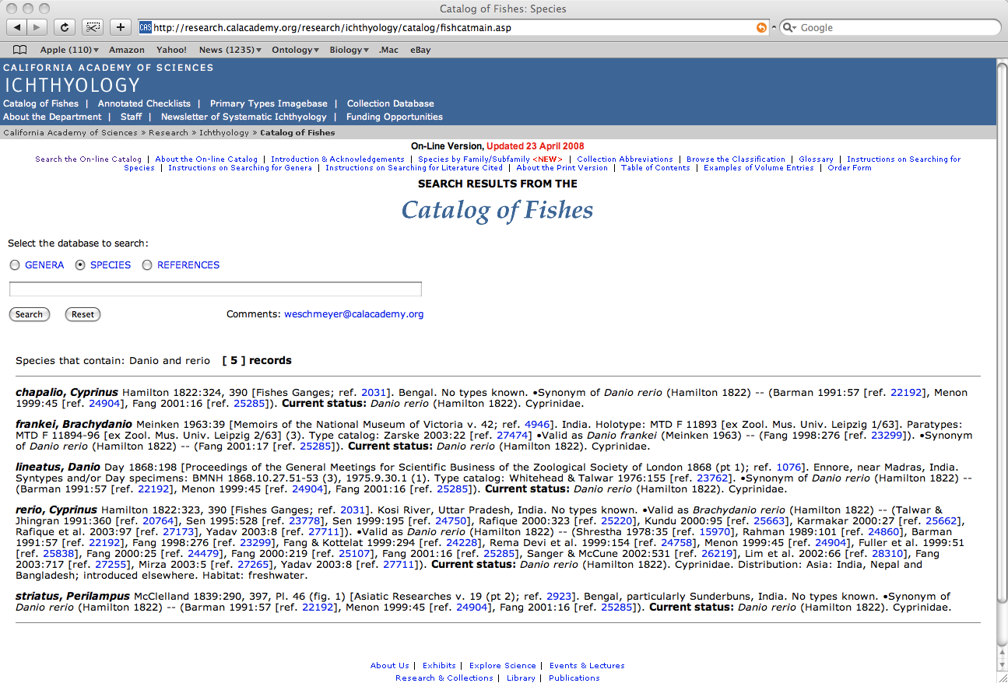
Notes:
Shows name history for Catalog of Fish search.

Slide 10
TTO workflow
Catalog of
Fishes
TTO Update
TTO
update
Area specialists
revision
Manual commit
TTO term
request
tracker
Teleost-discuss
Mail list
Curators
TTO administrator
Notes:
Changes to TTO come from update to the catalog of fishes, invited revisions of high levels (I.e., families) by area experts and requests from curators encountering names that aren’t in TTO.

Slide 11
Why a taxonomy ontology?
Annotate phenotypes to species
  Annotate to higher taxa (only for homologies)
  Might use higher level taxa as query terms
This requires, minimally, a controlled vocabulary of taxa
With 30,000+ taxa, some sort of structure is desirable

Slide 12
Why not use a Phylogeny?
Reality unknown (almost certainly reticulated)
Phylogeny - an inference product
Taxonomy - a product of human judgment/peer review
Taxonomy should reflect phylogeny, but not every phylogeny gets to ‘ground’ a taxonomy

Slide 13
What (Ontologically) are Species?

Slide 14
What are Species
Traditional view - Species are classes
Recent view - species are individuals (particulars)
Both - species are metaclasses

Slide 15
Species as classes
Classes are sets of individuals, defined by shared properties
Paradigmatic example:
  gold atom - an atom that contains 79 protons
Classes don’t go extinct
Species
?
Genus
‘has_rank’
‘has_rank’
Su 19063
Danio rerio
Danio
instance_of
is_a

Slide 16
Species as individuals
Occurs in a bounded region of space or time
Individuals are not necessarily compact or continuously connected
  Every organism in a species has a reproductive association with another organism in the (its parent(s)).
Species split and go extinct
Problem due to transitivity of part_of (my stomach part_of Homo sapiens), (Ghislen 2007)
Species
Genus
Su 19063
Danio rerio
Danio
part_of

Slide 17
Species as both
Metaclass
  A class containing classes as its members (not subclasses)
Allows a species to have behave as individual and as a class
  Captures spatial/temporal bounds and connectivity, but also type definitions
  But if we take phylogenetic taxonomy serious, type definitions are secondary and potentially misleading
Species
Genus
instance_of
SU 19063
instance_of
Danio rerio
is_a
Danio
Notes:
Suggested in email by Alan Ruttenberg.

Slide 18
Higher taxa as classes
Traditional view if species are classes
Higher taxa as classes of individual species is counter intuitive and runs into similar issues
?
Species
Genus
‘has_rank’
‘has_rank’
SU 19063
Danio rerio
Danio
instance_of
is_a
Notes:
Higher classes might be something other than individuals or classes, but, for modeling, there aren’t many alternatives available in OBO or other DL ontology languages - though both seem to have some notions of a set defined by extension (listing members).

Slide 19
Higher taxa as individuals
Aren’t evolutionary units in the same way species are
However, higher taxa are bounded, like species, and inherit some characters ‘up’ from their species (e.g., extinction, range) - suggestive of part_of relation
So, argument for individuality isn’t as strong as it was for species, but what is the alternative?
Species
Genus
SU 19063
part_of
Danio rerio
Danio
part_of

Slide 20
What are Ranks?

Slide 21
Ordering Ranks
Names of ranks are traditional, but give little or no indication of absolute size of taxa
All systems of taxonomic rank are ordered
What relation to use for ordering will depend on nature of taxa

Slide 22
Ranks as metadata
Ranks are individuals
Ordering is then an arbitrary (partial) ordering relation
Works well with taxa as classes
Species
subrank_of
Genus
has_rank
has_rank
SU 19063
Danio rerio
Danio
instance_of
is_a

Slide 23
Rank as a class of taxa
Works with taxa as individuals
Opens the possibility of using an established ordering (part_of)
Species
Genus
instance_of
instance_of
SU 19063
part_of
Danio rerio
part_of
Danio

Slide 24
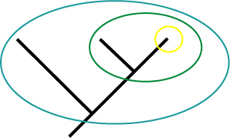
Taxa as clades
Species
part_of
Genus
part_of
Family
A species contains fewer lineages and covers less time than
its containing genus - is this sufficient for part_of

Slide 25
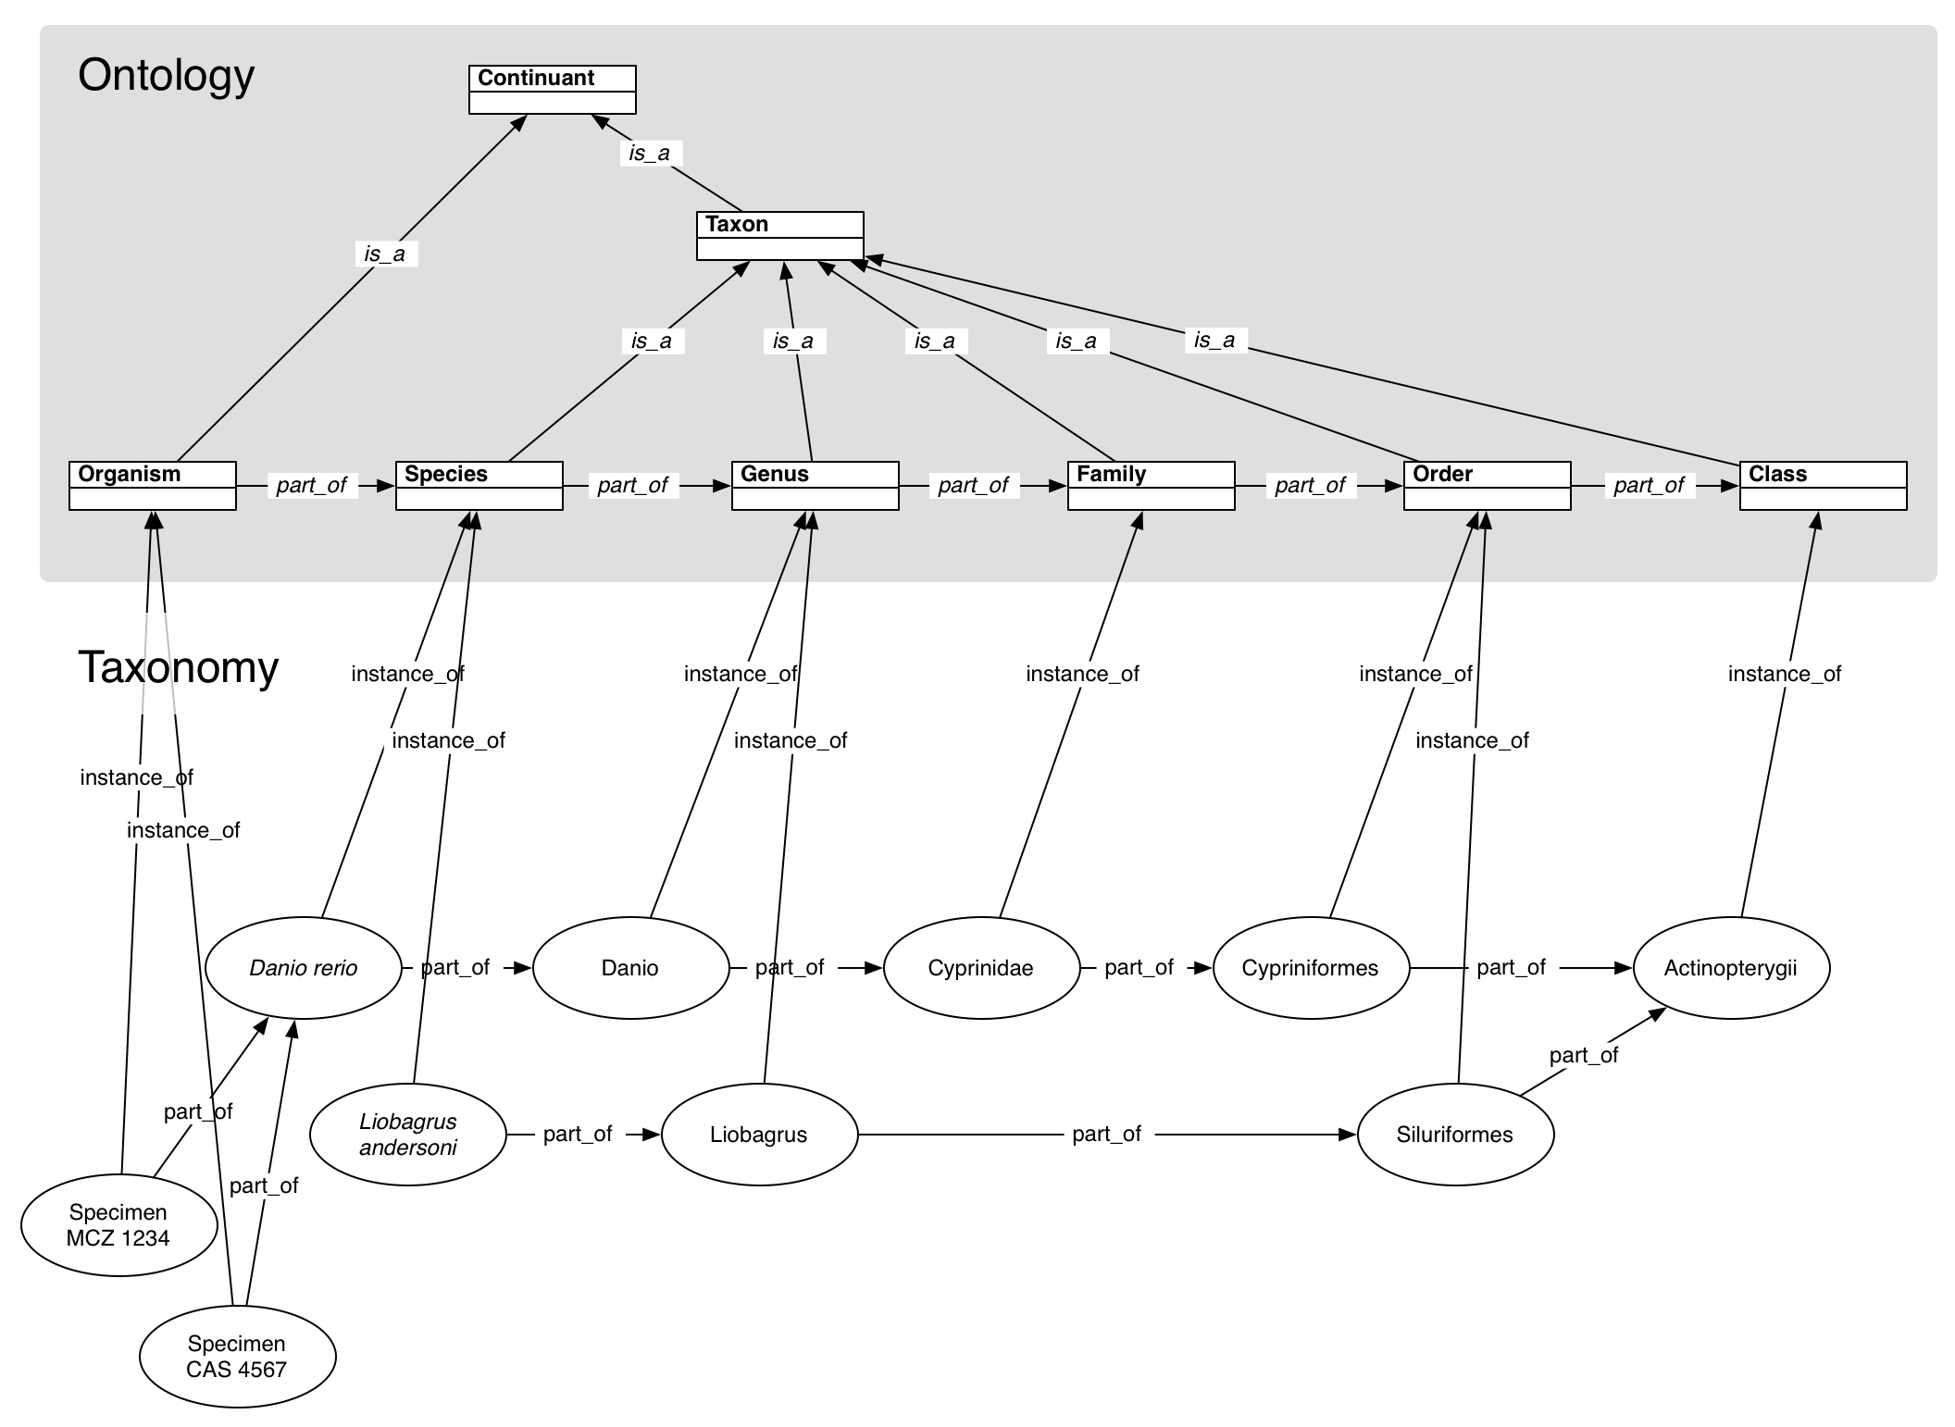
Jim Balhoff

Slide 26
Thank you
Chris Mungall
Jim Balhoff
Barry Smith
Michael Ashburner
Alan Ruttenberg
Todd Vision
And other Phenoscape collaborators
NSF for funding (DBI 0641025)

